Slide 1
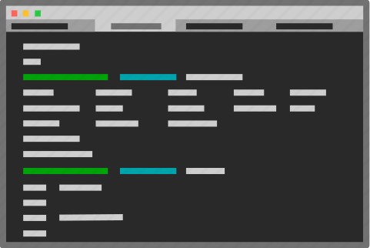
> P1 PRESENTATION
> Harish Kandaswamy - https://github.com/BigData2025-Rev/Harish-Project1
> January 2025
> Revature Inc.

Slide 2

> Project Requirements
> A CLI Python application that models a store, with data stored in a backend database
> Must be able to create, read, update, and delete from a database
> Must have at least 3 different tables/collections
> Must have a login feature as well as user/admin roles
> Must have logging of events

Slide 3

> The Computer Store
> A computer parts store that sells parts of various types such as CPUs, GPUs, and motherboards
> Keeps track of user info and saves order history for future access
> Users can filter parts by type for an easier shopping experience
> Admin users can modify users’ order history, modify store inventory, and edit users’ admin privileges

Slide 4



> Tech Stack
> Python 3
> colorama
> pymongo
> logging
> MongoDB
> git (+ GitHub)

Slide 5
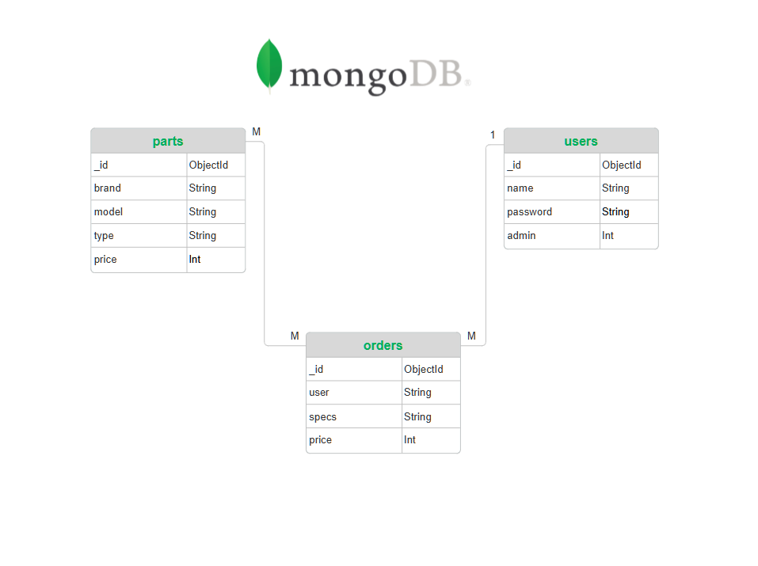
> Entity Relationship Diagram

Slide 6
> Demo

