Slide 1

P1 Presentation
Tin Ngo – https://github.com/BigData2025-Rev/tinngo-project1

Slide 2
P1 – Library
A library that allow users to browse a list of books, then they can borrow and return books
Also allow users to write reviews for books or read others reviews
Admin users can add more books, remove reviews or grant other users admin access

Slide 3
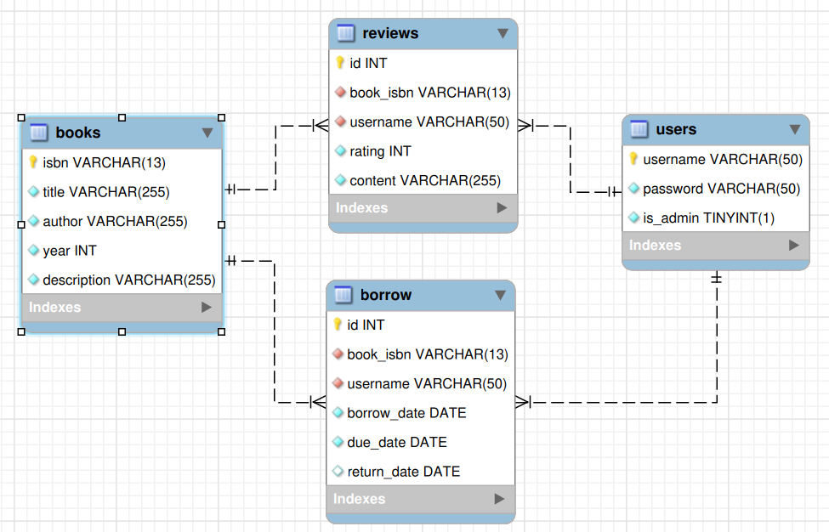
Database Schema

Slide 4
Tech Stack
Python 3
MySQL/MongoDB
Git (version control)

Slide 5

Demo

