Slide 1

Go To Market(G2M) Case Study
G2M insight for Cab Investment firm
Monisha Shree SenthilNathan
LISUM32
25-April-2024

Slide 2
Background –G2M(cab industry) case study
Problem Statement:
XYZ (US-based private firm) is considering an investment in the growing US cab industry. With multiple key players present, XYZ seeks data-driven insights to identify the company with the strongest potential for return on investment (ROI).
Cab Companies:
Yellow Cab
Pink Cab
Objective:
Analyse provided datasets on two cab companies to understand their customer demographics, pricing strategies, profitability, and overall market performance. Leverage these insights to recommend the most promising company for XYZ's investment, considering their G2M strategy.
Workflow:
Data Collection and Understanding
Exploratory Data Analysis (EDA)
Insights Generation
Hypothesis
Recommendations

Slide 3
Data Collection and Understanding
Cab Data:
Transaction ID: A unique identifier assigned to each transaction
Date of Travel: The date on which the cab service was availed by the customer
Company: Indicates the cab company associated with the transaction
City: Specifies the city in which the cab service was utilized
KM Travelled: Represents the distance covered during the cab ride
Price Charged: Denotes the amount charged to the customer for availing the cab service
Cost of Trip: Indicates the operational cost incurred by the cab companies for facilitating the trip
Cab_Data.csv
Customer_ID.csv
Transaction_ID.csv
City.csv
USholiday.csv
25 Features( including 3 derived features)
Timeframe of the data: 2016-01-31 to 2018-12-31
Assumptions:
Profit of rides are calculated keeping other factors constant and only
Price_Charged and Cost_of_Trip features used to calculate profit.
Final cab data
City Data
City: Refers to the name of the city where the cab service is provided.
Population: Indicates the total population of the city where the cab service operates.
Users: Represents the number of users or customers availing cab services in the respective city.
Holiday Data
Date: This field represents the date of the holiday
Holiday: the name or description of the holiday being observed.
WeekDay: This field indicates the day of the week on which the holiday falls.
Month: This field represents the month in which the holiday occurred
Day: This field represents the day of the month on which the holiday occurred.
Year: This field represents the year in which the holiday occurred.
Customer Data
Customer ID: This is a unique identifier assigned to each customer using the cab service.
Gender: Indicates the gender of the customer availing the cab service.
Age: Represents the age of the customer availing the cab service.
Income (USD/Month): Indicates the monthly income of the customer in USD.
Transaction data
Transaction ID: This is a unique identifier assigned to each transaction.
Customer ID: This is a unique identifier assigned to each customer using the cab service.
Payment_Mode: Indicates the mode of payment used for the transaction, such as cash or credit/debit card.

Slide 4

EXPLORATORY DATA ANALYSIS

Slide 5
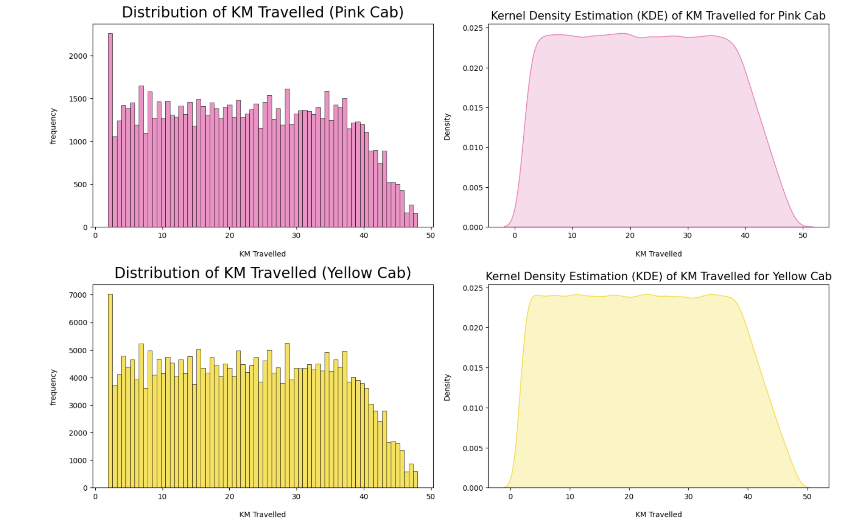
Profit Analysis
Distribution of KM travelled
Both Pink and Yellow Cab rides Kilometer are in the range of approximately 2 to 50 KM.

Slide 6
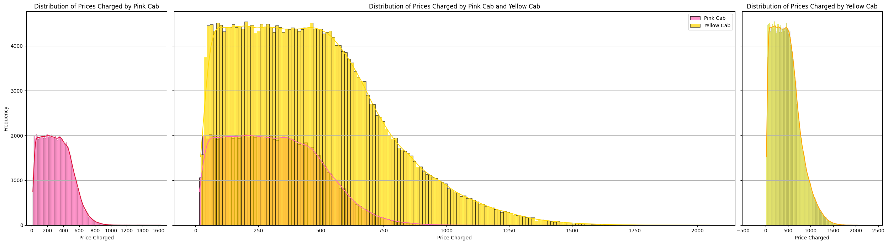
Profit Analysis
Distribution Price vs Distance
0s
min_price = np.min(PinkCab_df['Price_Charged'])
max_price = np.max(PinkCab_df['Price_Charged'])
mode_price = PinkCab_df['Price_Charged'].mode()[0] # Mode may return multiple values, so we select the first one
# Print the results
print("Minimum price charged by Pink Cab:", min_price)
print("Maximum price charged by Pink Cab:", max_price)
print("Most common price charged by Pink Cab:", mode_price)
min_price_y = np.min(YellowCab_df['Price_Charged'])
max_price_y = np.max(YellowCab_df['Price_Charged'])
mode_price_y = YellowCab_df['Price_Charged'].mode()[0] # Mode may return multiple values, so we select the first one
# Print the results
print("Minimum price charged by Yellow Cab:", min_price_y)
print("Maximum price charged by Yellow Cab:", max_price_y)
print("Most common price charged by Yellow Cab:", mode_price_y)
output
Minimum price charged by Pink Cab: 15.6 Maximum price charged by Pink Cab: 1623.48 Most common price charged by Pink Cab: 204.21
Company | Min Price Charged | Max Price Charged | Common Price charged
Pink Cab | $15.6 | $1623.48 | $204.21
Yellow Cab | $20.73 | $2048.03 | $191.27
Both the company’s distribution are right skewed indicating the presence of outliers on the higher end of the price spectrum. These outliers could be due to various factors such as long-distance rides, surge pricing during peak hours or events, or additional charges for specific services.

Slide 7

Insights Generation

Slide 8
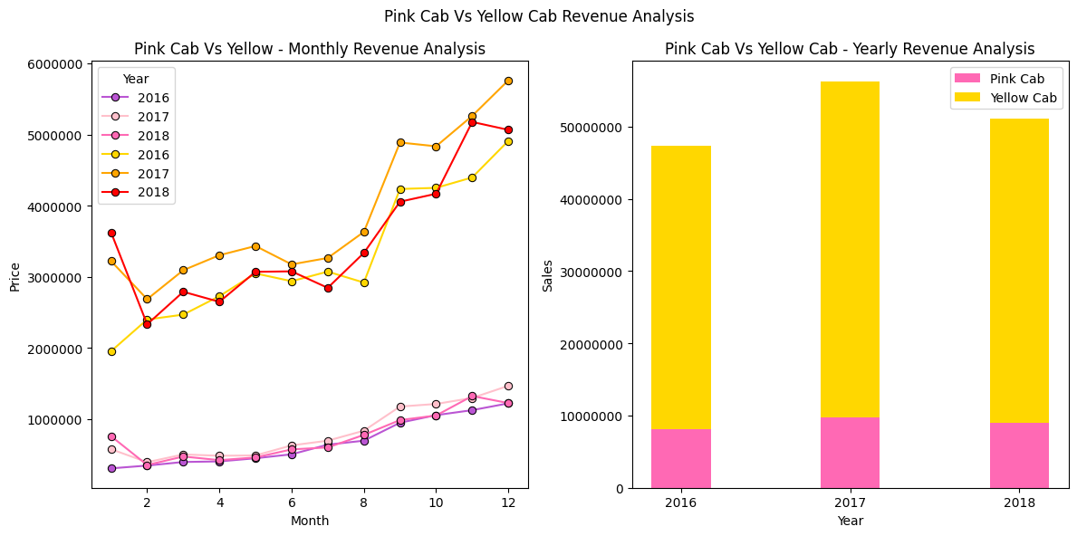
Overall Revenue Analysis
Yellow Cab's annual revenue significantly exceeds Pink Cab's revenue for each year shown (2016, 2017, 2018).
The proportion of Pink Cab's revenue to Yellow Cab's revenue is relatively small each year.
Overall, Yellow Cab appears to be the more dominant player in terms of revenue generation for the time periods represented in the graphs. Additionally, there seems to be seasonality in the cab business, with end-of-year peaks likely due to holidays and potentially more travel activity.

Slide 9
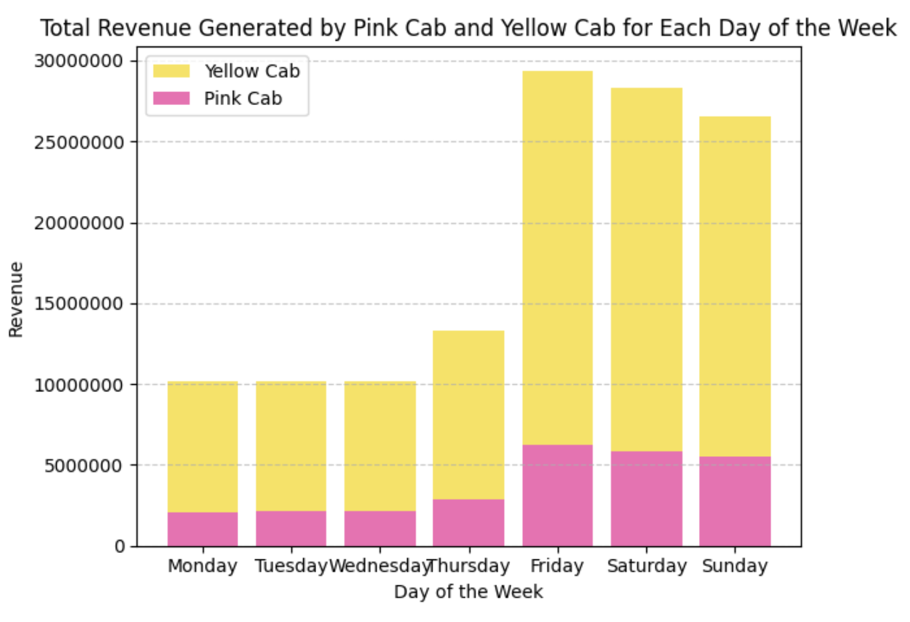
Weekday and Weekend Revenue Analysis
Pink Cab the average revenue surges from approximately 303.18 during weekdays to about 321.25 during weekends, representing a percentage difference of approximately 5.96%
Weekend Revenue Comparison
Both Pink Cab and Yellow Cab demonstrate a significant increase in revenue during weekends compared to weekdays.
Yellow Cab experiences a notable increase in average revenue during weekends, rising from approximately 447.84 during weekdays to about 472.26 during weekends. This corresponds to a percentage difference of approximately 5.45%
The data analysis shows the significance of weekends as a prime revenue-generating period for both Pink Cab and Yellow Cab, highlighting the importance of strategic planning and operational excellence to optimize revenue performance during leisure periods

Slide 10
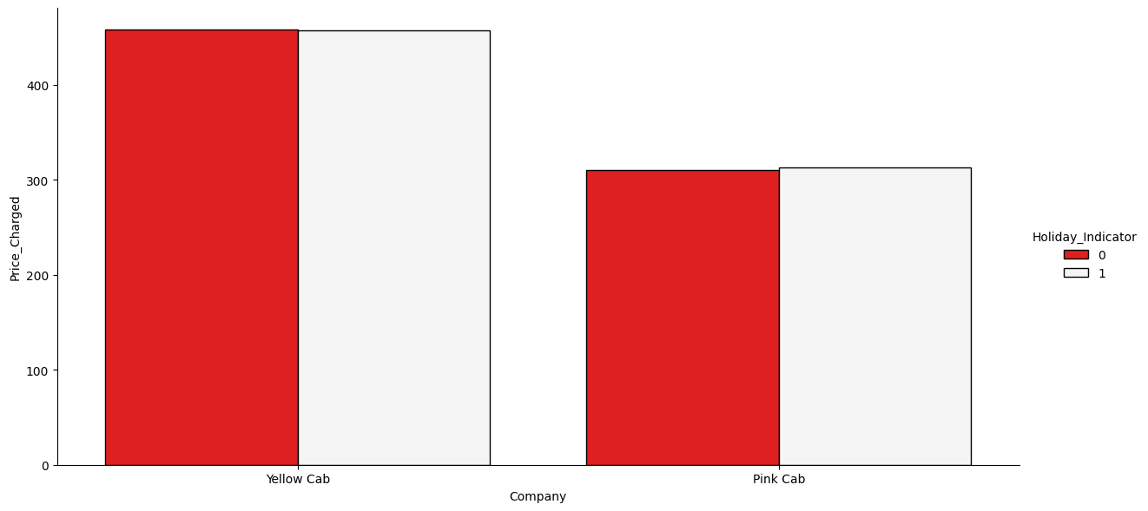
Weekday and Weekend Revenue Analysis
Pink Cab experiences a notable increase in revenue during holiday periods compared to non-holiday periods. Pink Cab's average revenue rises, and this corresponds to a percentage difference of approximately 0.98%, signifying a slight improvement in revenue during holidays.
Yellow Cab's revenue demonstrates a marginal decrease during holiday periods in comparison to non-holiday periods. This translates to a percentage difference of approximately -0.19%, indicating a slight decline in revenue for Yellow Cab during holidays.
These findings suggest that Pink Cab experiences a positive revenue impact during holiday periods, while Yellow Cab sees a minor reduction in revenue during the same periods.

Slide 11
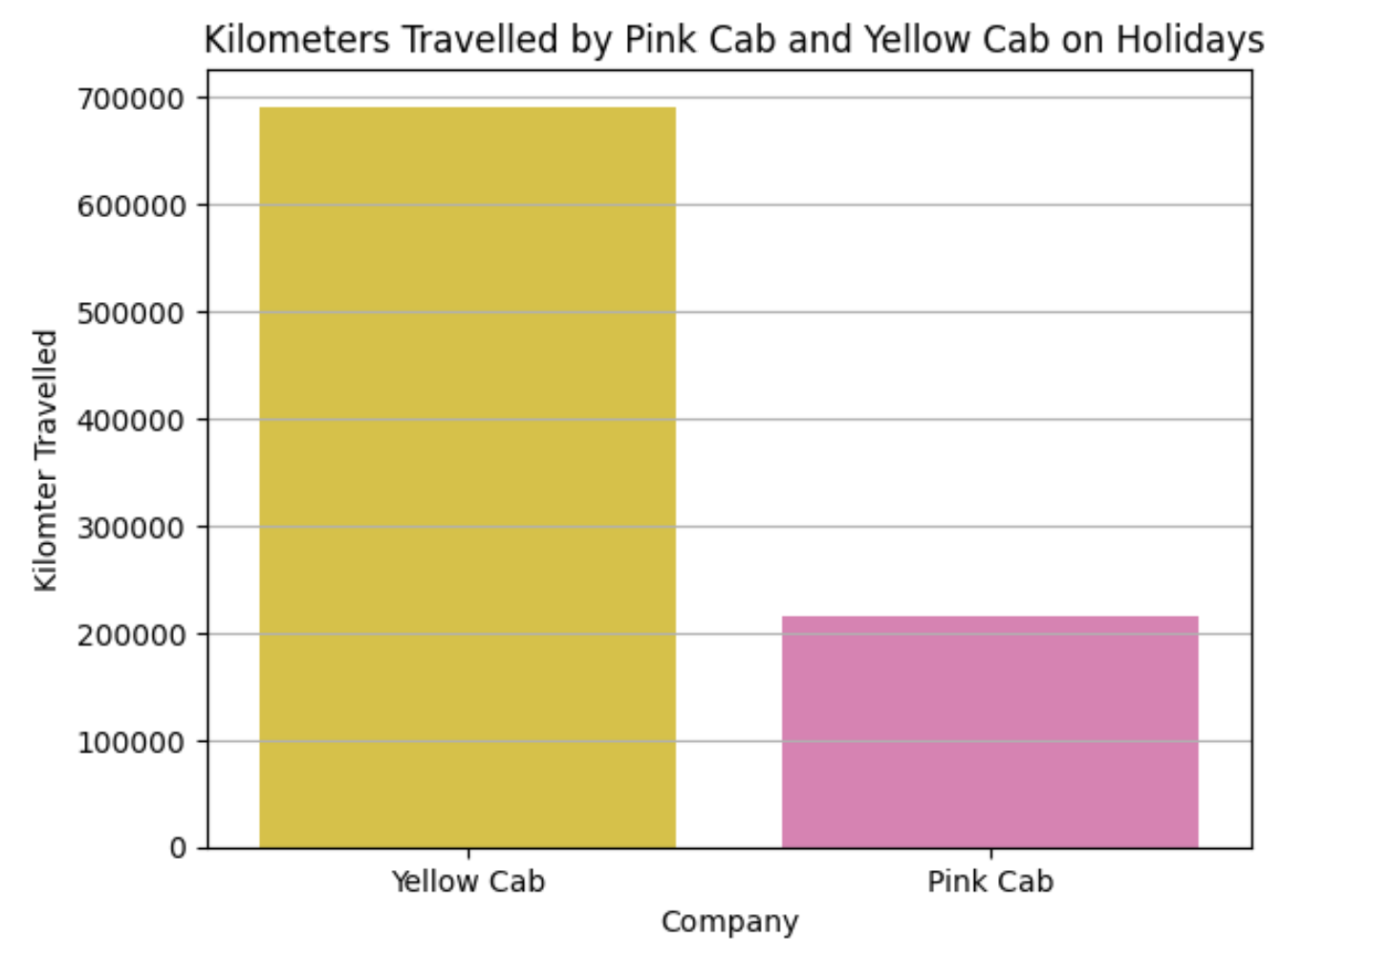
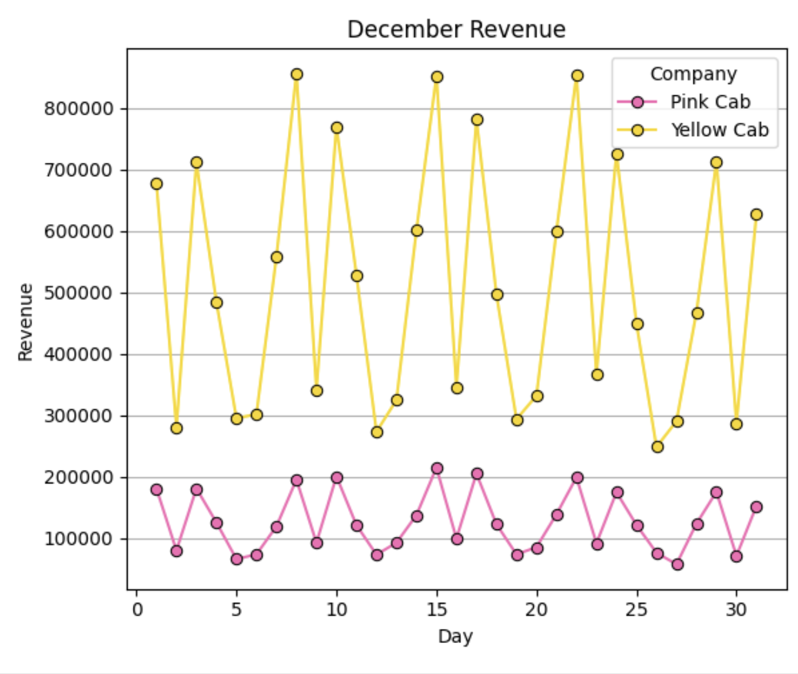
Impact of US Holidays on Distance Travelled and Revenue
For Pink Cab, there is a slight decrease in the average distance travelled during holiday periods. The average distance decreases approximately around 0.25%.
Conversely, Yellow Cab shows a slight increase in the average distance travelled during holiday periods compared to non-holiday periods. The average distance travelled has increased approximately 0.04%.
The analysis reveals that December stands out as the top revenue-generating month for both Pink Cab and Yellow Cab. This observation aligns with broader seasonal trends, as December typically witnesses heightened consumer activity and increased travel demand associated with holiday festivities.

Slide 12
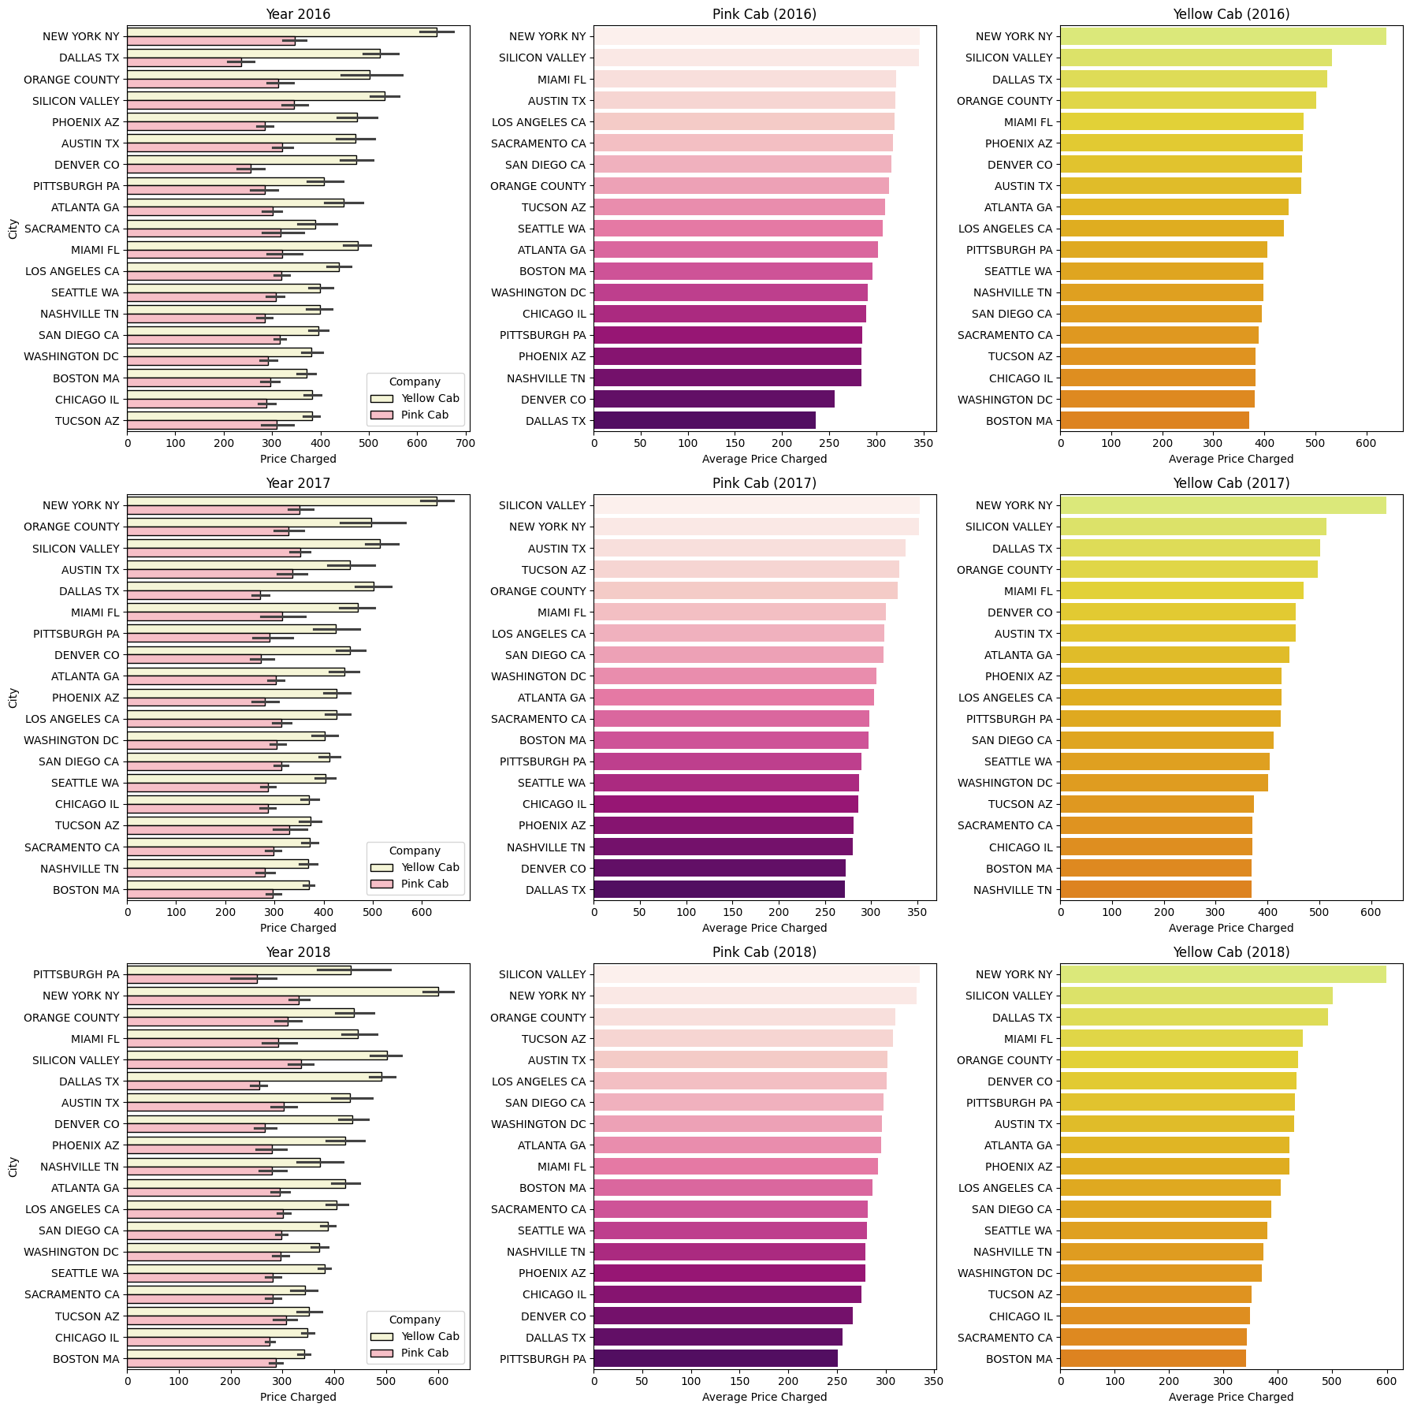
Analysis of Revenue generated in each City
Upon examining revenue data, it becomes evident that Yellow Cab has consistently generated higher revenue overall compared to Pink Cab.
In specific instances, Pink Cab achieved its highest revenue in New York during the year 2016. However, in subsequent years, namely 2017 and 2018, Silicon Valley emerged as the leading revenue-generating city for Pink Cab. Notably, there were variations in the third-ranking city each year, with Miami, Austin, and Orange County occupying the position in 2016, 2017, and 2018, respectively.
Conversely, Yellow Cab maintained its revenue dominance in New York across all three years. Additionally, Silicon Valley and Dallas consistently secured the second and third positions, respectively, in revenue generation for Yellow Cab throughout the same period.

Slide 13
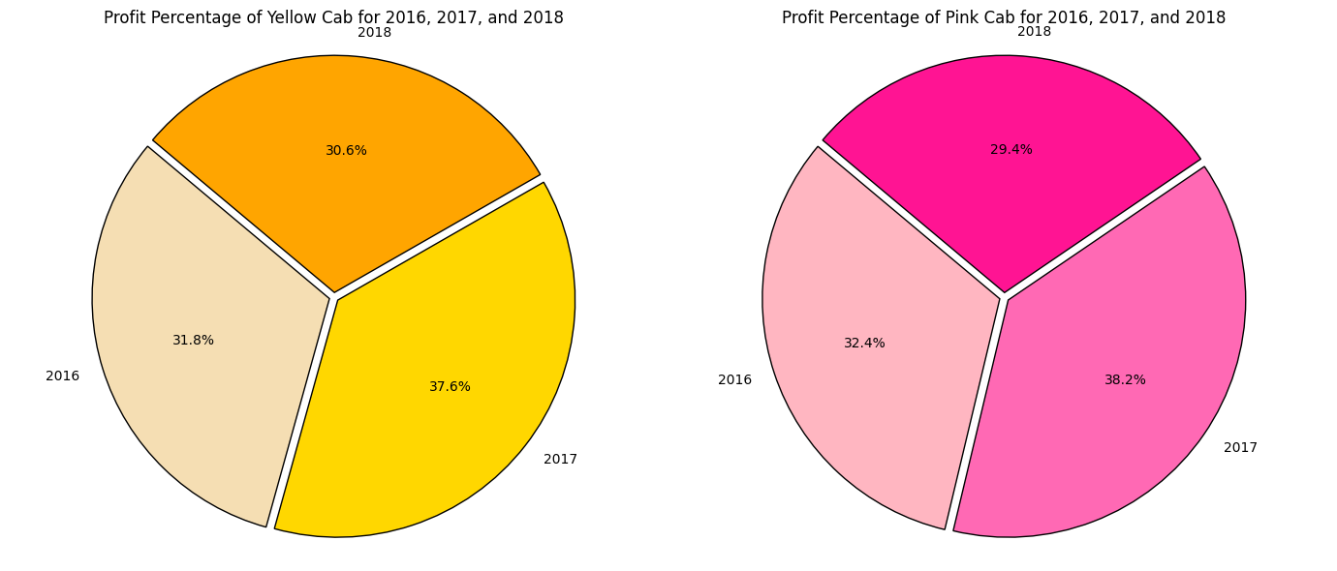
Analysis of Revenue generated in each City
The analysis of profitability trends over a three-year period reveals that Pink Cab exhibited a consistent growth trajectory in profitability from 2016 to 2017, followed by a slight decline in 2018.
Conversely, Yellow Cab demonstrated robust profitability throughout the same period. Despite fluctuations, both companies maintained relatively stable profit margins. These findings shows that Yellow Cab has sustained profitability and market dominance compared to Pink Cab.

Slide 14
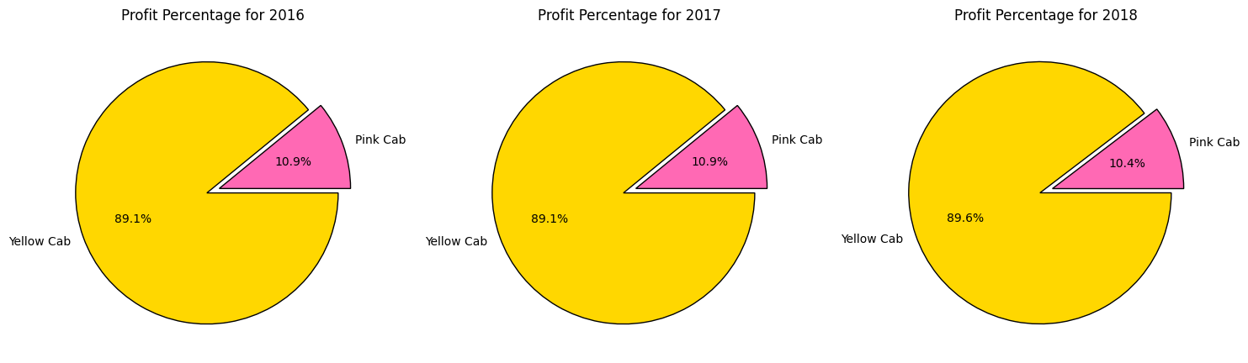
Analysis of Revenue generated in each City
While Yellow Cab maintains a significantly higher average profit due to its larger revenue base, Pink Cab exhibits a more consistent profit margin around 10.3% to 10.9%. Pink Cab operates with a potentially leaner cost but they extract a larger portion of their revenue as profit despite a lower overall income.

Slide 15
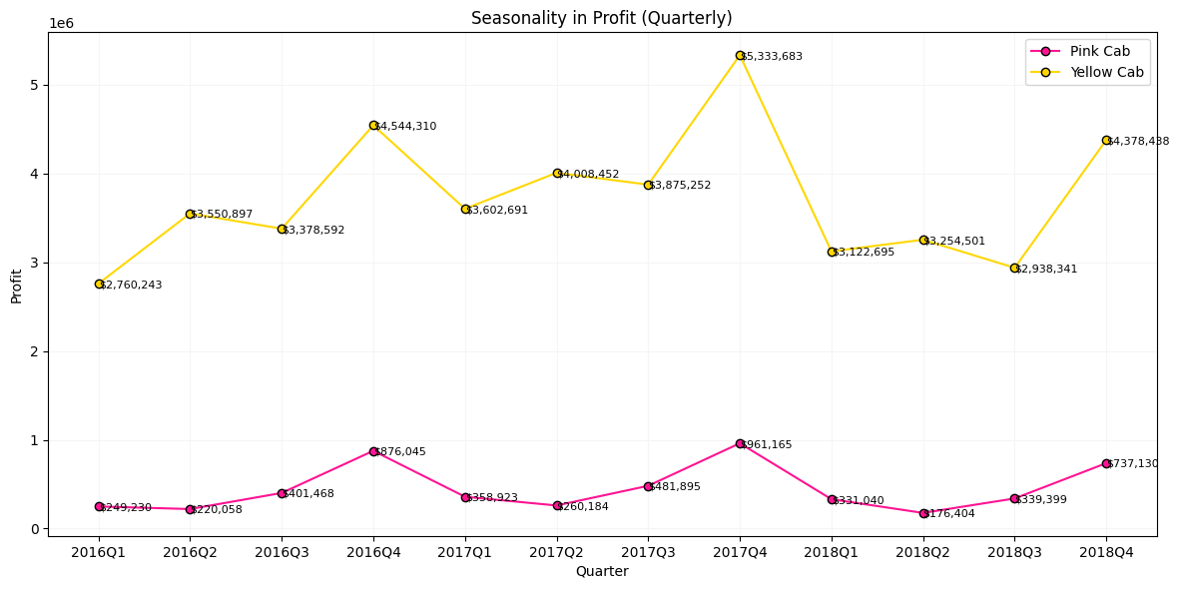
Analysis of Quarterly Profit
The analysis of quarterly profit data highlights the financial performance of Pink Cab and Yellow Cab services from 2016 to 2018. While Yellow Cab maintains its position as the market leader with higher profitability, Pink Cab faces challenges in achieving comparable levels of financial success.

Slide 16
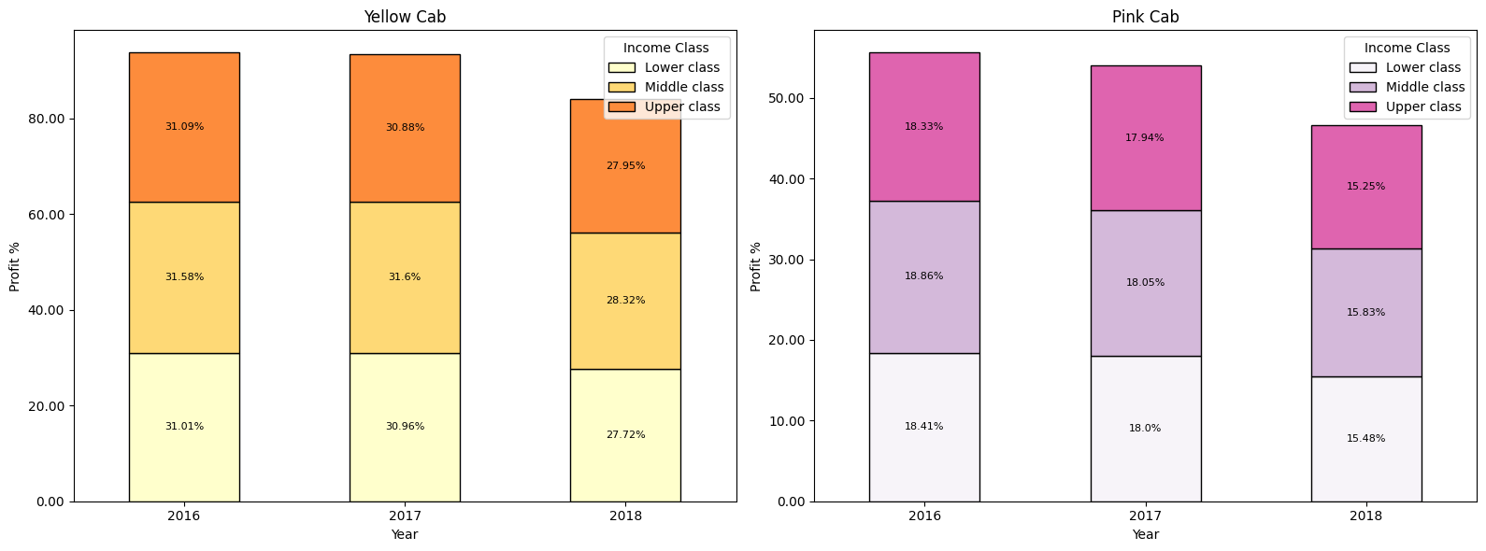
Profitability Across Income Classes
Yellow Cab has a larger customer base and/or charges higher prices than Pink Cab. It is also seen that both companies earn the most revenue from customers in the upper income class.

Slide 17
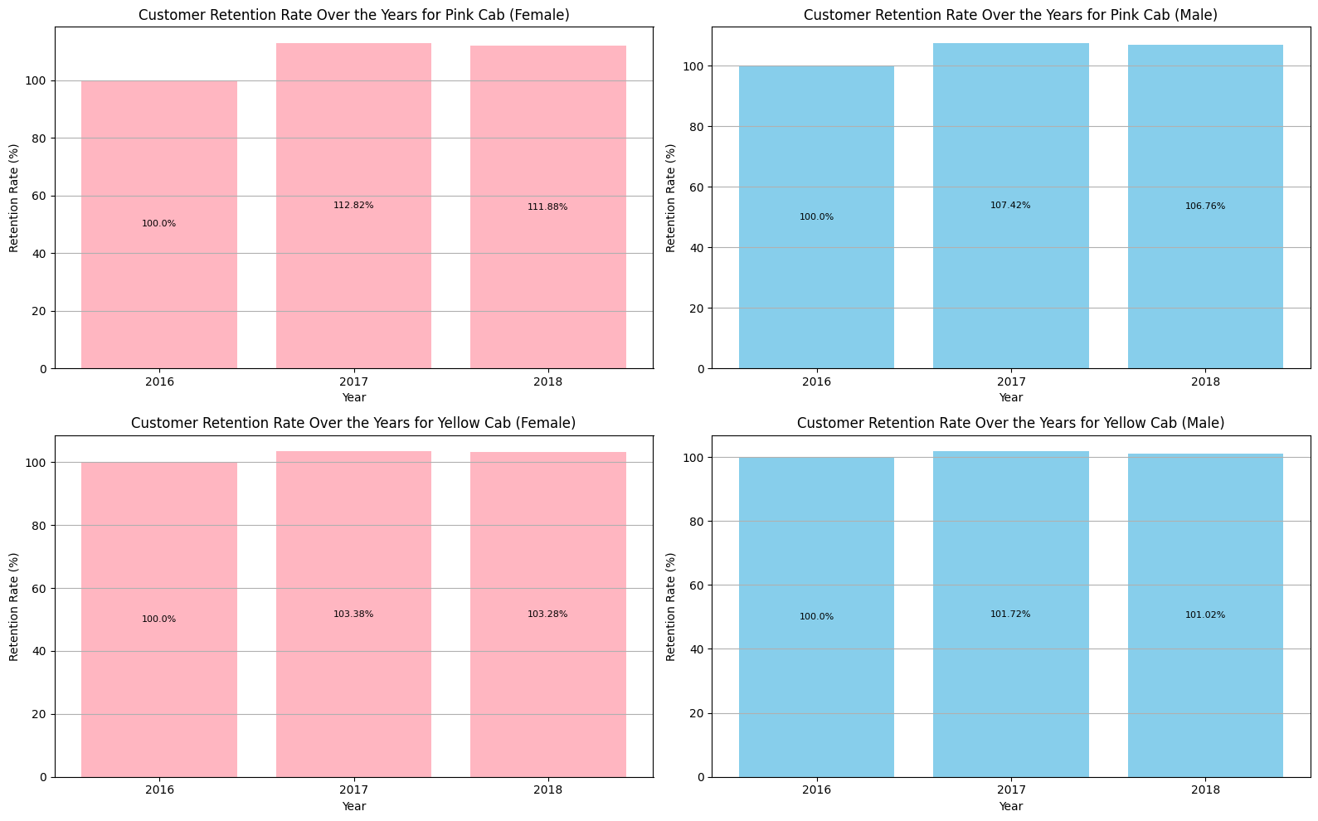
Customer Retention
Surprisingly, Pink Cab has reattained its customers (at least 10 rides over 3 years) in both genders when compared to Yellow Cab

Slide 18

Hypothesis

Slide 19
Hypothesis
there is a significant impact of KM_Travelled and Profit are related.
Hypothesis 1: Company with Maximum Cab Users
H0: There is a significant difference in the average price charged between Pink Cab and Yellow Cab.
H1: There is no significant difference in the average price charged between Pink Cab and Yellow Cab.
Hypothesis 2: Effect of Holidays on Cab Usage
H0: There is a significant difference in cab usage between holidays and non-holidays.")
H1: There is no significant difference in cab usage between holidays and non-holidays.")
Hypothesis 3: Seasonality in Cab Usage
H0: There is a significant difference in cab usage across different seasons.")
H1: : There is no significant difference in cab usage across different seasons.")
Hypothesis 4: Impact of Payment Mode on Cab Usage
H0: There is a significant association between payment mode and cab usage.")
H1: There is no significant association between payment mode and cab usage.")
Hypothesis 5: Impact of City Population on Cab Usage
H0: There is a significant impact of city population on cab usage.
H1: There is no significant impact of city population on cab usage.
Hypothesis 6: Impact of Distance Travelled on Profit
H0: there is a significant impact of KM_Travelled and Profit are related.")
H1: there is no significant impact ofKM_Travelled and Profit are related.")
Hypothesis 7: Profit is proportional to increase in customers
H0: There is a significant relationship between the number of customers and profit margins
H1: There is no significant relationship between the number of customers and profit margins
There is a significant difference in the average price charged between Pink Cab and Yellow Cab.
There is no significant difference in cab usage between holidays and non-holidays.
There is a significant difference in cab usage across different seasons
There is a significant association between payment mode and cab usage
There is a significant impact of city population on cab usage.
There is a significant impact of KM_Travelled and Profit are related.
There is a significant relationship between the number of customers and profit margins.

Slide 20

Recommendations

Slide 21
Recommendations
We have analyzed both the cab companies on following points
Revenue and Profit
Higher Revenue: Yellow Cab consistently generates significantly higher overall revenue than Pink Cab.
Stronger Profitability: Yellow Cab demonstrates robust and stable profitability throughout the period analyzed. While Pink Cab's profit margin is more consistent, its overall profit is lower due to lower revenue.
Market Dominance: Yellow Cab maintains a dominant position in the market across most cities and years analyzed.
Customer Base
Larger Customer Base: Yellow Cab likely has a larger customer base, suggesting a wider market reach.
Holiday Performance
Minimal Impact: Yellow Cab experiences only a slight decrease in revenue during holidays, suggesting better resilience during market fluctuations.
Weekend Performance: Both companies see a similar increase in revenue during weekends, but Yellow Cab's higher base revenue translates to a larger absolute increase.
Retention Rate
Pink Cab Advantage: While Pink Cab shows a higher customer retention rate for high-value customers (those who take at least 10 rides in 3 years), this needs to be considered in the context of its overall smaller customer base.

Slide 22
Recommendations
However, there are some considerations for Pink Cab:
Profit Margin: Pink Cab maintains a consistent profit margin, suggesting efficient cost management.
Holiday Strategy: Pink Cab seems to have a strategy that maintains or even increases revenue during holidays despite shorter travel distances, possibly due to surge pricing or targeted promotions.
Overall Investment Recommendation:
Considering the factors above, Yellow Cab appears to be the more attractive investment opportunity due to its dominant market position, higher revenue and profitability, and larger customer base. However, it's important to conduct further research to understand:

Slide 23
Thank You

