Slide 1
Real-time disaster response
Team: USC/SDSU

Slide 2
What we have done
Build text message to get internet information without internet access
Map navigation
Google search
Post tweet to twitter
All done by SMS, not cellular data or wifi

Slide 3
How it works
Put the SMS receive and send on the cloud
Extract the information from text message
Send the API request from cloud computing
return with the API result

Slide 4
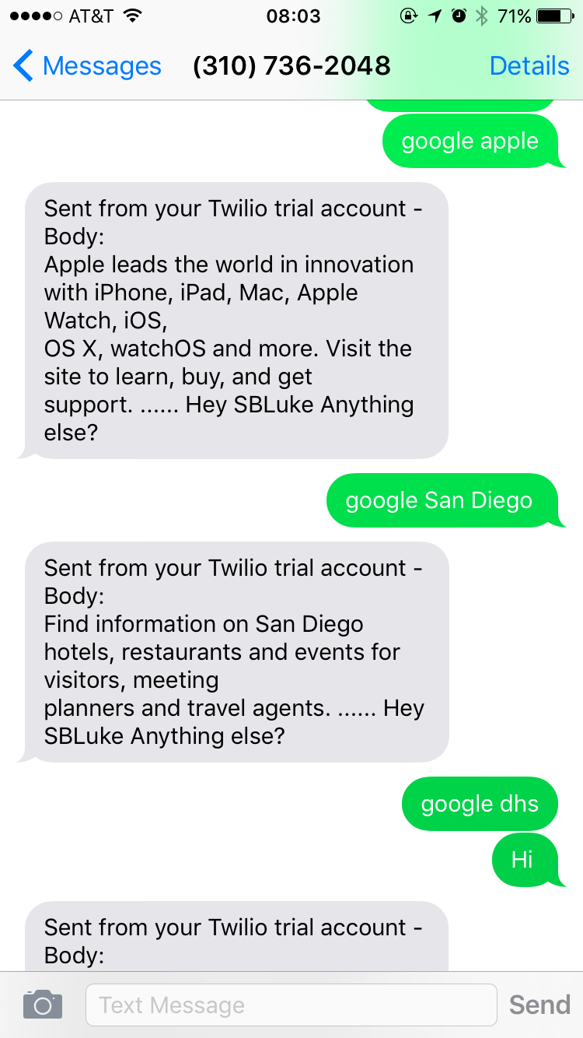
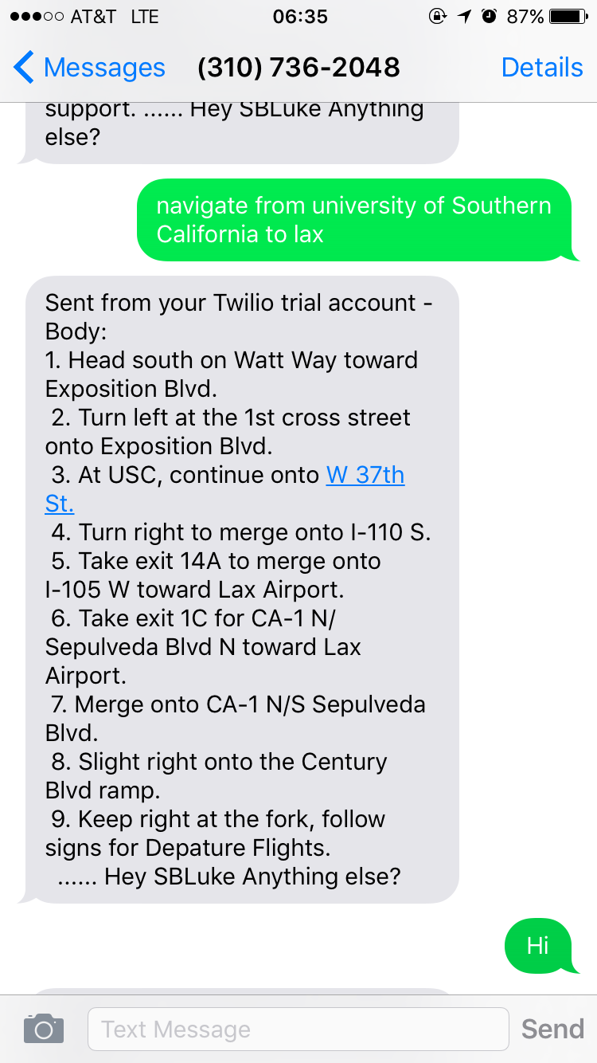
Google search
Map Navigation

Slide 5
What’s important and next
Of course, disaster response when NO network
Collecting real-time live data for rescue and resource coordinate

Slide 6
What’s important and next
Everyone’s SMS is unlimited
Dummy Phone -> Smart Phone
Smart Phone -> without cellular data
Build iOS App, UI interface, Transmit with Message, No cellular data

Slide 7
Thank you!
–Kai Lu

