Slide 1
Improving the Sharp App
Maternity Care Experience for South San Diego Patients
Team HealthCom
SDSU Hackathon 2024

Slide 2
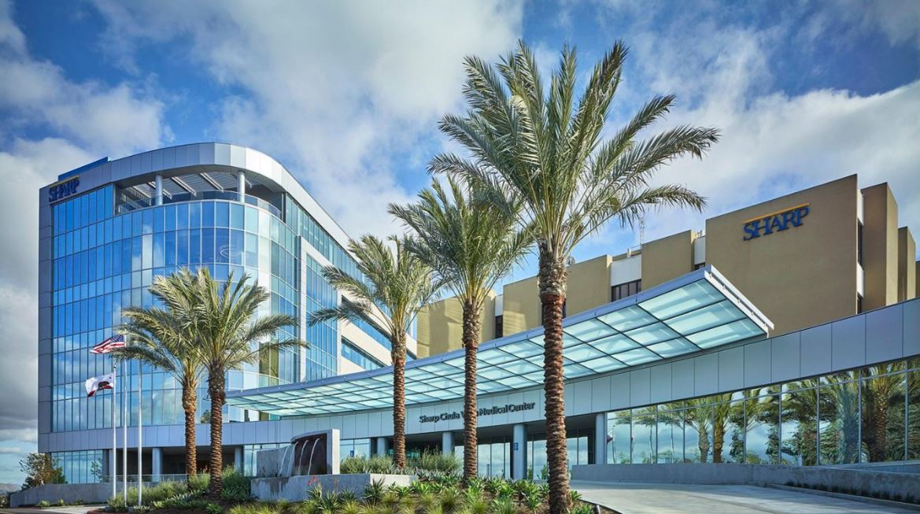
Notes:
Four months ago, Scripps Chula Vista closed their Maternity ward, making the Sharp Chula Vista Center for Women & Newborns the only hospital with a maternity ward in South San Diego county. This means more patients in South San Diego are seeking maternity services at Sharp. Before the closure of scripps, 150 babies were delivered here per month. Just 2 months after the Scripps closure they doubled to 300 deliveries.
The majority of South San Diego residents identify as Hispanic or Latino
Sharp has the opportunity to set an example across the state on how to improve access to maternity care

Slide 3

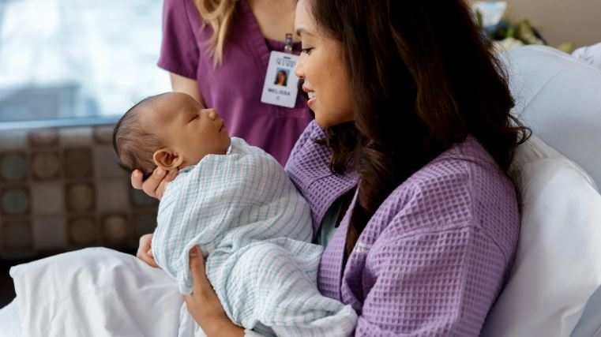
Notes:
PROBLEM: Sharp is now caring for Scripps CV patients who planned their care at Scripps and community clinic patients who may be new to Sharp
Although new providers have been hired to meet the demand in maternity care services, new patients need assistance with accessing maternity services
After researching this topic and speaking to a community clinic doctor in South San Diego, we propose new functionalities to improve the Sharp apps maternity service information to be informative and accessible to new patients, in particular community clinic patients, who are less familiar with maternity care and experience disparities in accessing care
https://www.figma.com/proto/Qcdf028GiLCWpbaUWNReDH/Maternity-App-(Copy)?node-id=2-4&t=hhpOOUEHLDzWFqHu-1
Sharp HealthCare is the only major healthcare provider dedicated to delivering high-quality medical services across all communities, regardless of location or socioeconomic status.
It’s our responsibility to ensure access to services is equitable for all communities. Our solution to meet the increase in new patients seeking maternity services allows for
The Sharp Experience values transforming the healthcare experience for our entire community, creating an advanced personal care experience for the San Diego community.

Slide 4
Future Directions
Interviews with pregnant patients to know what features they would like to be included in the Sharp app
Including people from different cultural backgrounds
Interviews with Sharp and community clinic doctors to ask what reminders they would like patients to receive
E.g. when and how to order a breast pump
Creating a Spanish version of the Sharp app
Notes:
https://www.figma.com/proto/Qcdf028GiLCWpbaUWNReDH/Maternity-App-(Copy)?node-id=0-1&t=k0ViTTwxNKMs2JI5-1

Slide 5
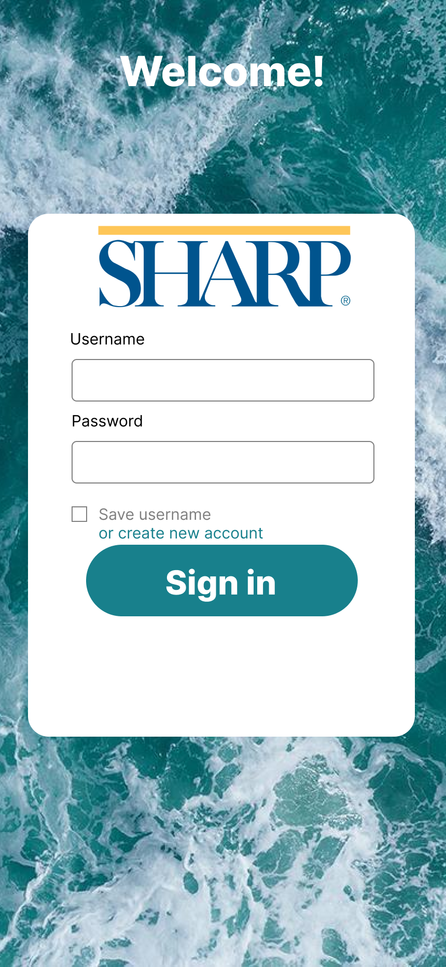

Slide 6
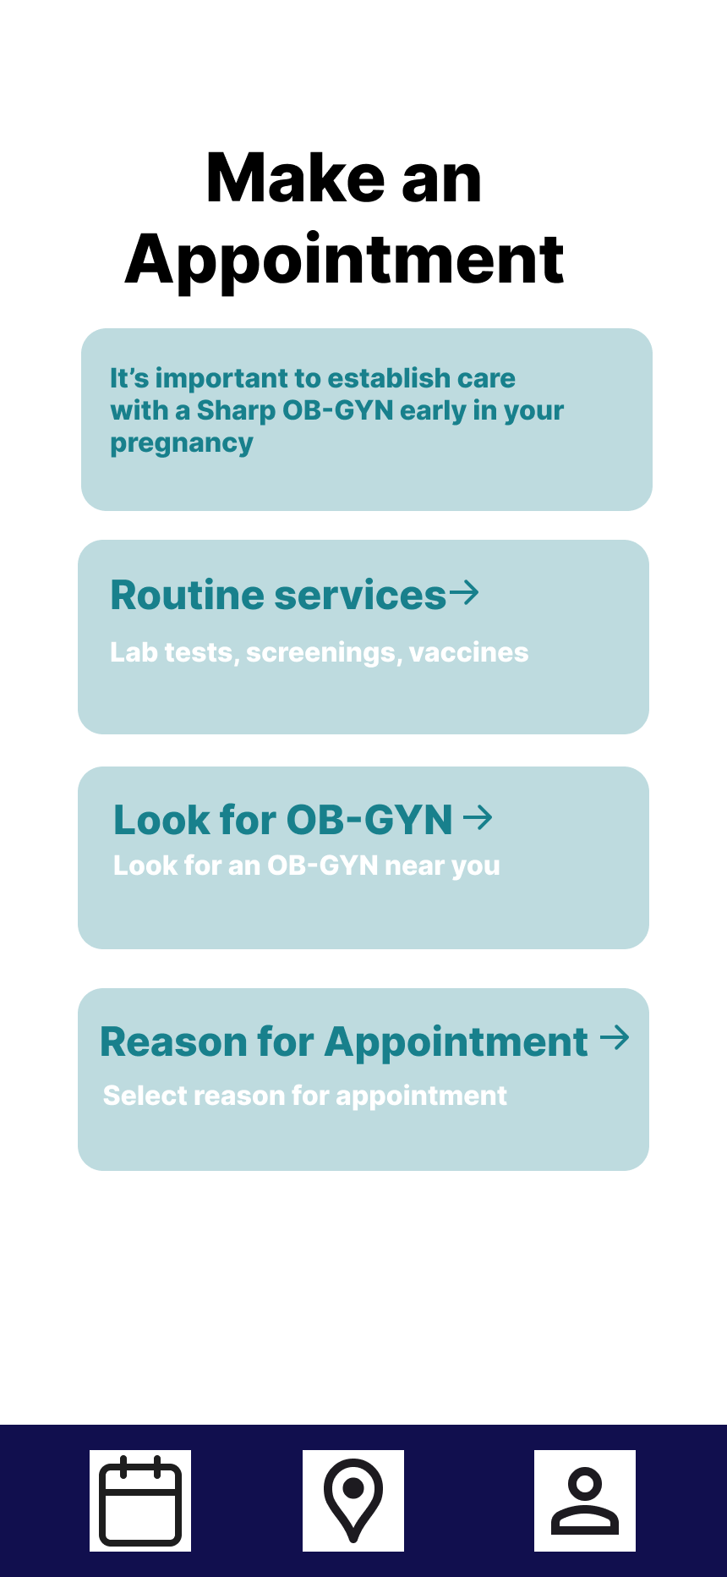

Slide 7
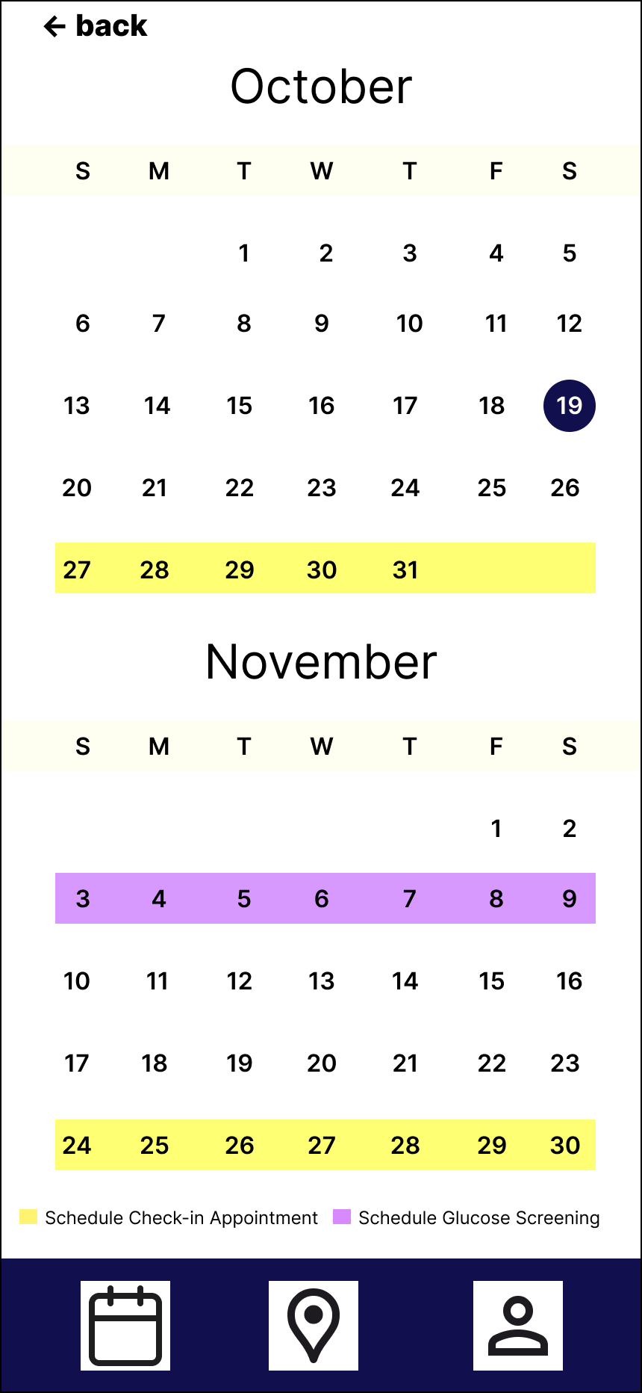

Slide 8
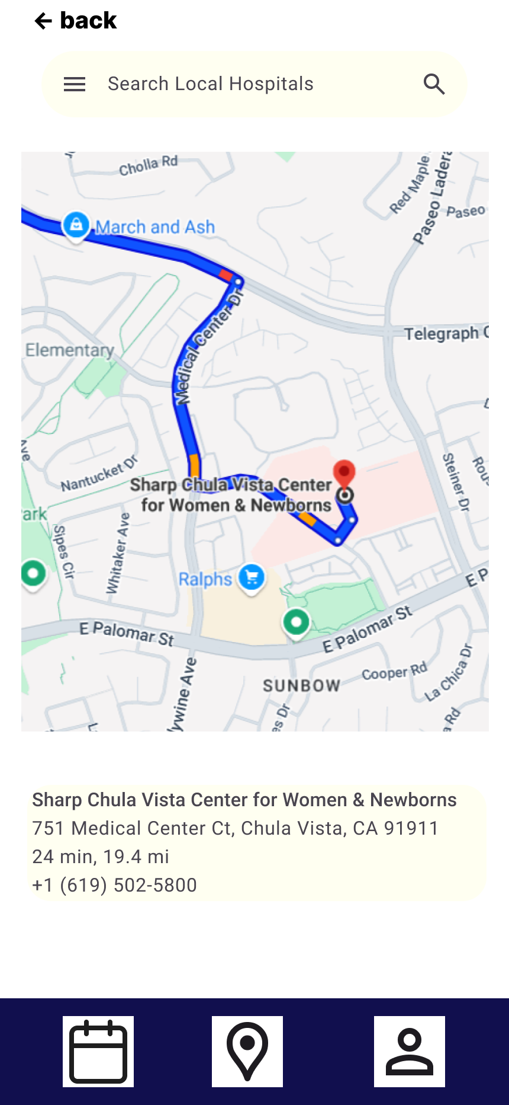

Slide 9
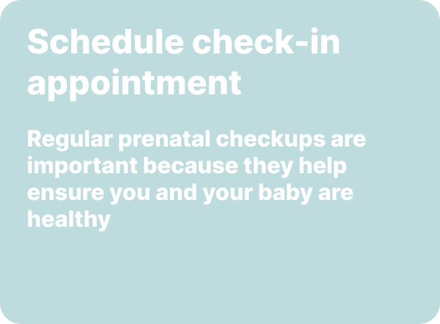

Slide 10


Slide 11
