Slide 1
CS-101
Team: Team CS 101

Slide 2
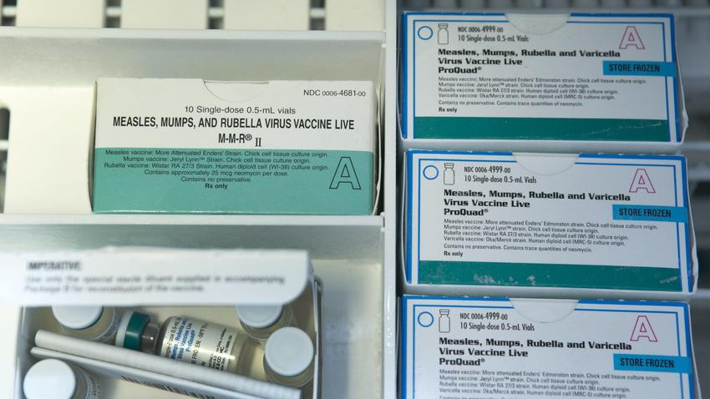
Introduction
Each Autumn all schools in California are required to report student compliance with California School Immunization Laws
California health and Safety Code Sections 120335-120375
Anti-Vaccination Movement
Religious beliefs
Misinformation (autism)
Political beliefs
Outbreaks can be fatal

Slide 3

Collecting Data
Extracted Data from multiple sources (2010-2016)
Department of Public Health
Shots for school
California Health and Human Services

Slide 4
Findings
Segmented:
Religious
Income
Income of 85k and above account for approximately 46% of low Vaccination rates
Political
Place on the extreme sides of the political spectrum “liberalism” or “conservative”
Institutions (Private/Charter vs Public)
Private/Charter Account for than half of exemption rates below 2.5% (level of concern)
Location:
Many are located north side of San Diego county
Vaccinations Rate Improving:
The percentage of fully vaccinated kindergartners entering the state's schools in 2015-2016 was the highest in a decade: 92.9%, up from 90.4% last year

Slide 5
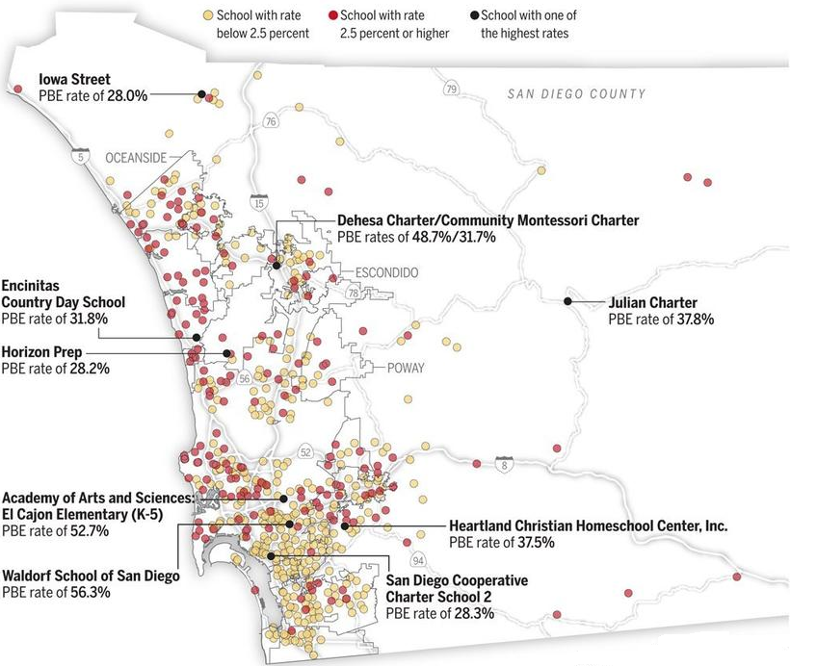
Religious
Personal Belief Exemption (PBE)
Concentrated along coast
SD cities:
El Cajon Elementary (52.7%)
Waldorf School of San Diego (56.3%)
Julian Charter (31.8%)

Slide 6
Website as a Tool
Provides statistical evidence with reliable source
Provides anti-government alternatives
Educational Tool

Slide 7

Passed Legislation
California’s New law SB 277
Kicks off in July 1st
Prevents loophole: “Personal belief exemption”
school enrollment is dependent on vaccination

Slide 8
Recommendations
Tax wealthy
Similar to individual employee mandate from Affordable Care Act
Short Term
Education
Very successful with fight against smoking and STDS
Could be applicable in a generation
Long term solution

Slide 9
References
https://www.cdph.ca.gov/programs/immunize/pages/immunizationlevels.aspx
http://www.shotsforschool.org/7th-grade/reporting-data/
http://www.latimes.com/opinion/editorials/la-ed-0202-vaccination-rates-20160201-story.html
http://www.sandiegouniontribune.com/news/health/sdut-vaccination-exemptions-private-charter-schools-2015feb07-htmlstory.html

