Slide 1
AKSO
Team 113 Big Data Geeks
Members: Kai Li, Lin Wen, Shuan He
Xi Huang, Yangyan Zhou
Yu-Tseng Chou

Slide 2
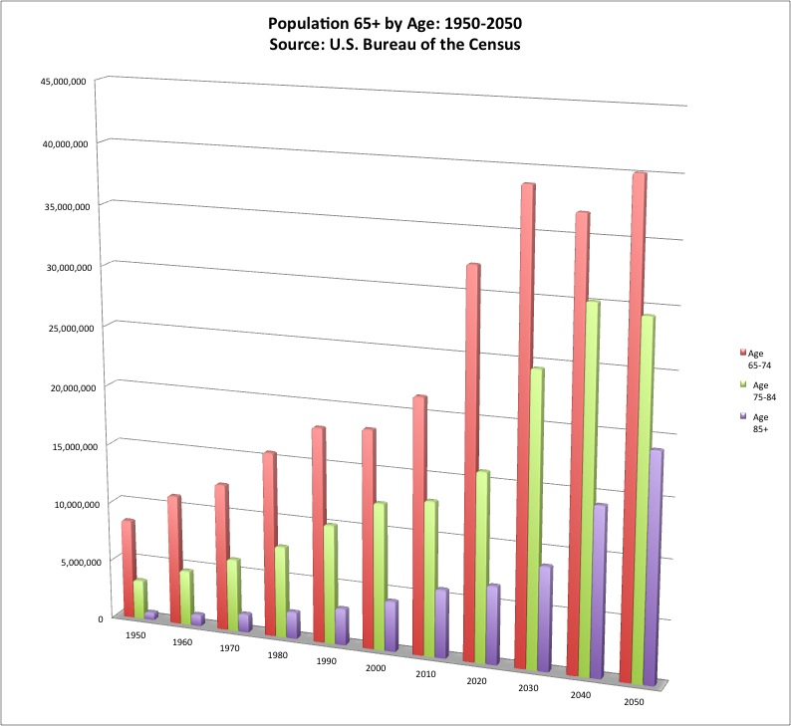
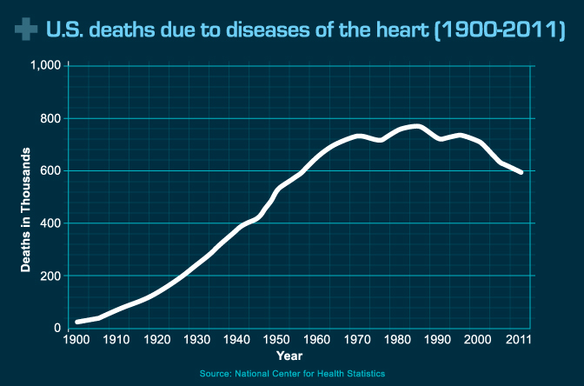
Problem Statement
Increasing population of elderlies who prefer to live independently in the U.S.
Heart disease is the leading cause of death for both men and women.
New way of heart attack prevention or emergency assistance is strongly in needed.
Notes:
In 2010, an estimated 524 million people were aged 65 or older—8 percent of the world’s population. By 2050, this number is expected to nearly triple to about 1.5 billion, representing 16 percent of the world’s population.
They are exposed to high risks of heart disease, stroke and falls.
Specifically we want to focus on current or potential heart disease patients
risk score
more and more older people,
Older people want live independently.
So the new technologies to change the way of medical diagnose or medicine treatment are strongly needed

Slide 3
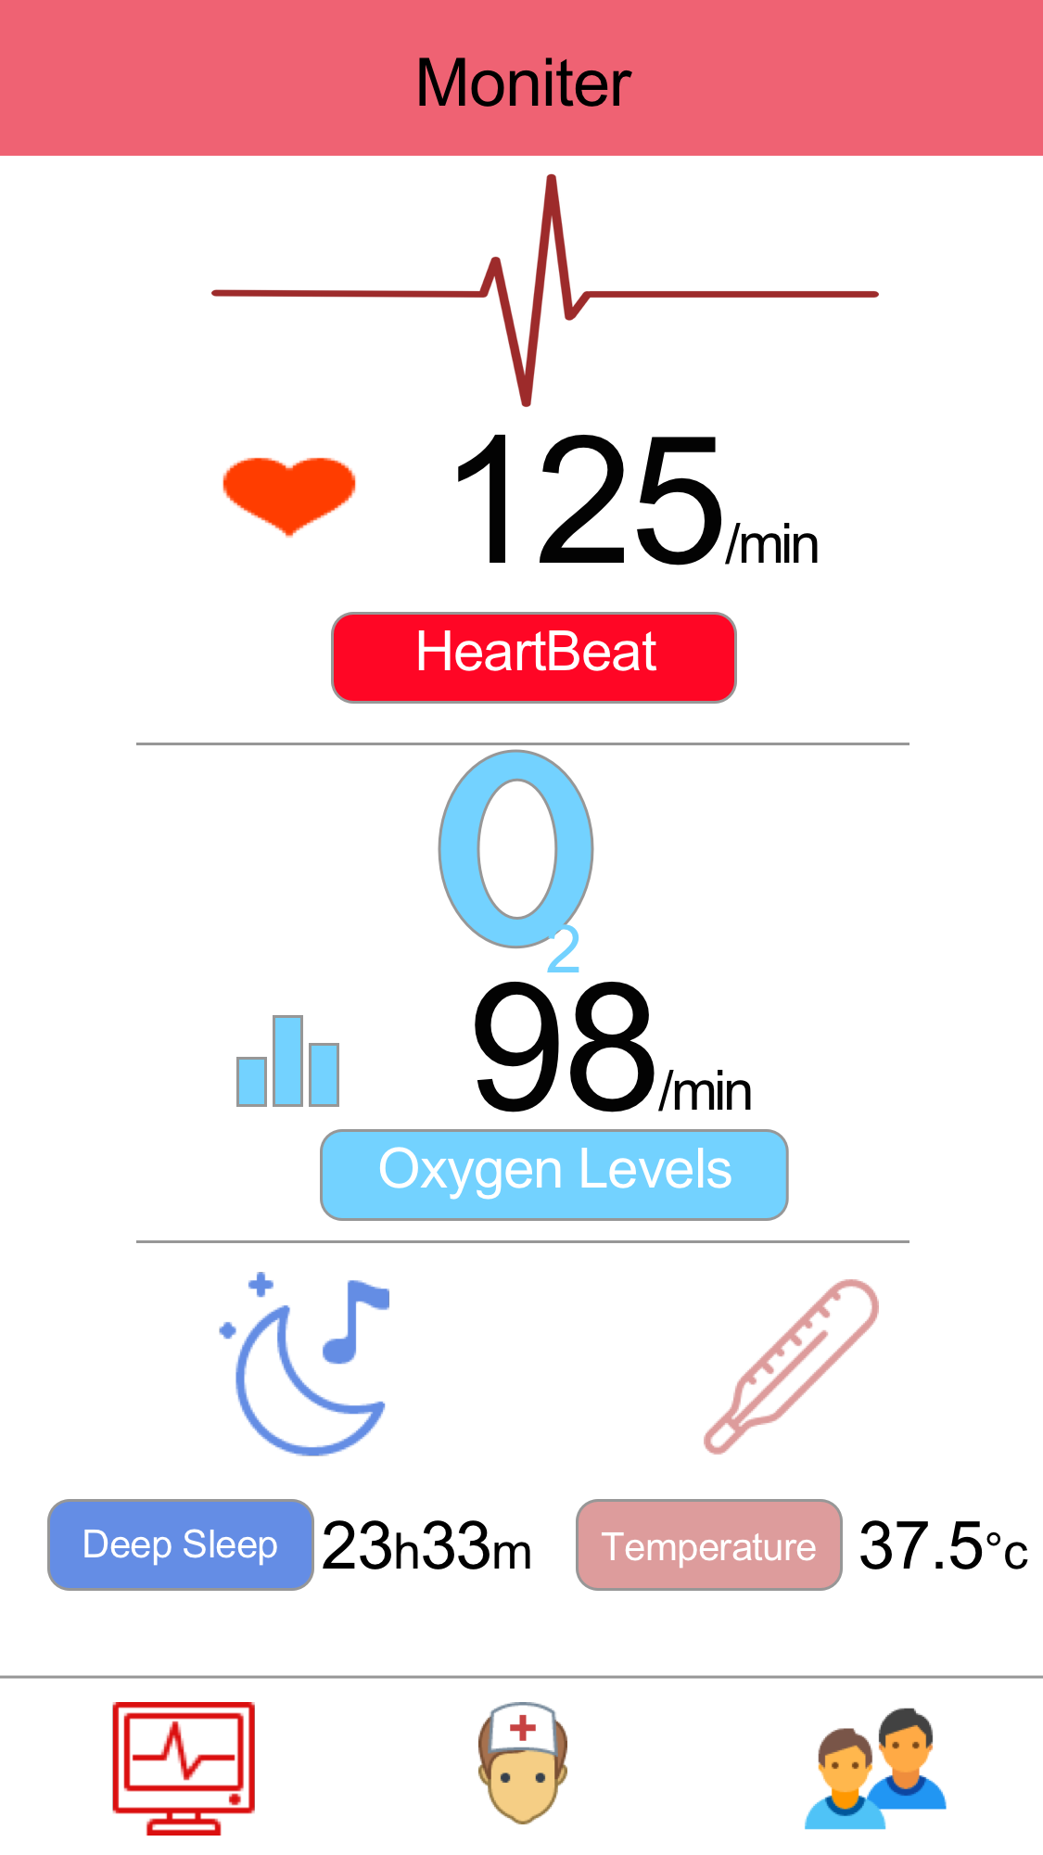
Design/Solution
We are proposing a precision medicine based solution: AKSO
SaaS (Software As A Service) System.
Heart disease risk assessment using a machine learning model on health records
Emergency detection and assistance using an individualized machine learning model
Notes:
Long-Term Risk Calculation
that allows the users to calculate their risk scores based on health records
Real-Time Monitor

Slide 4
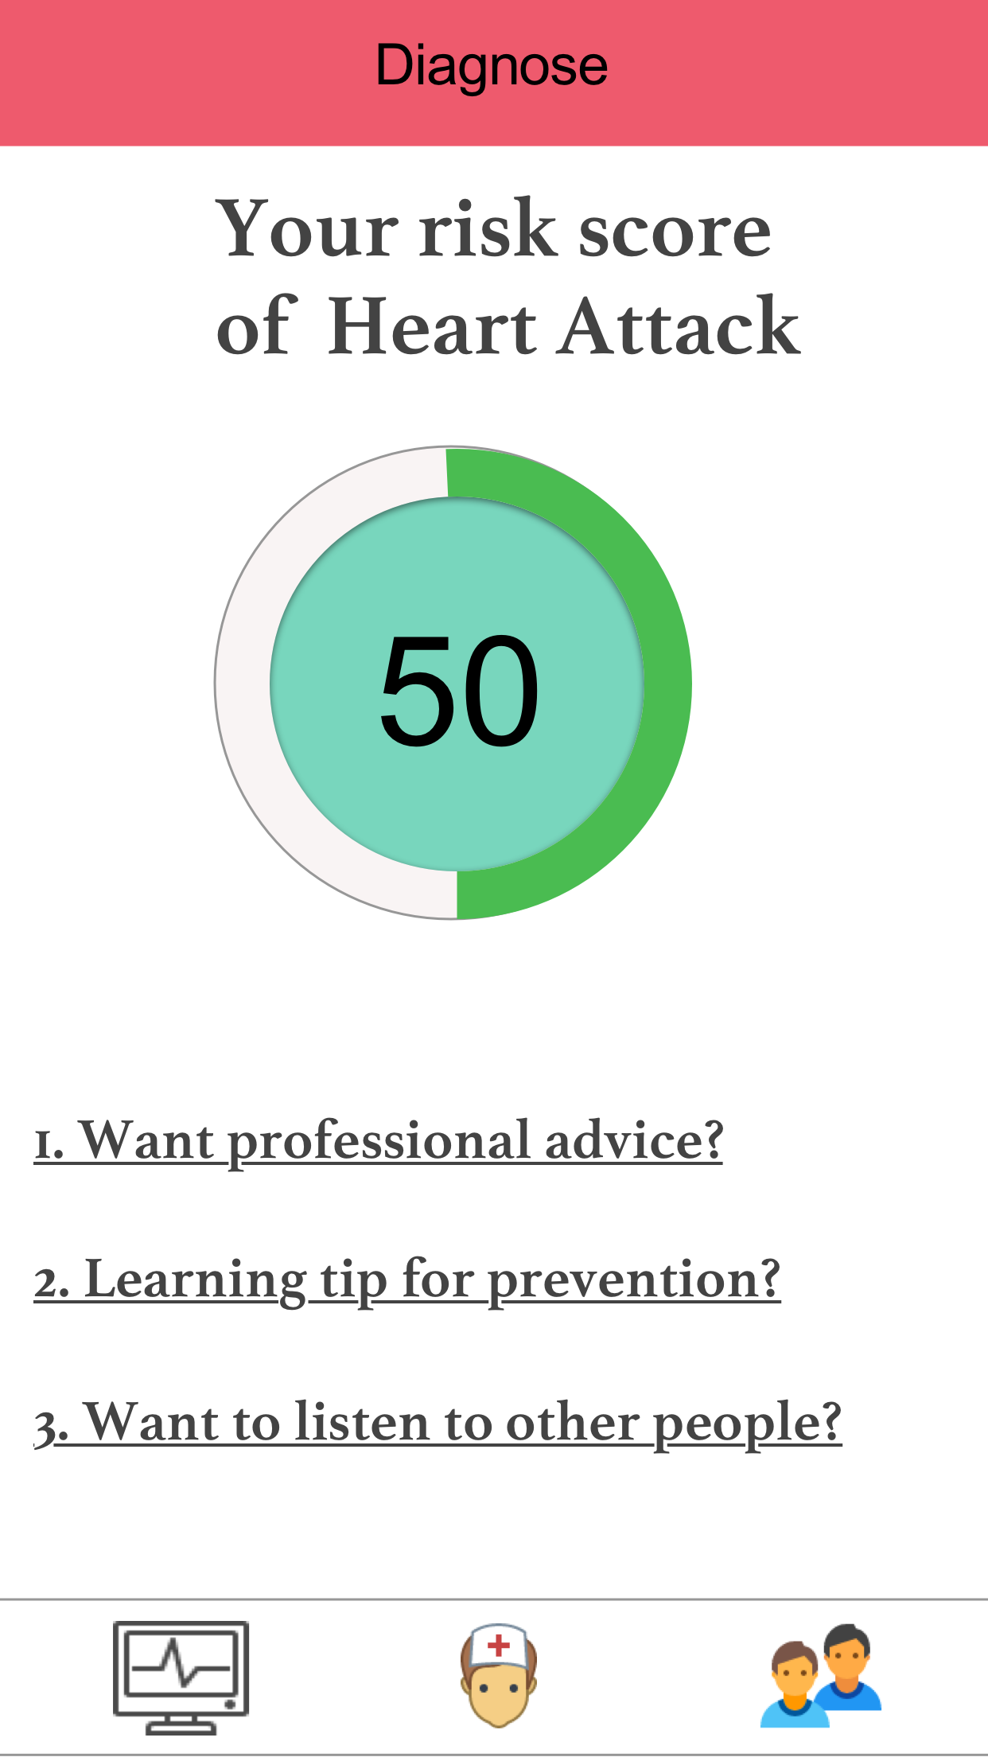
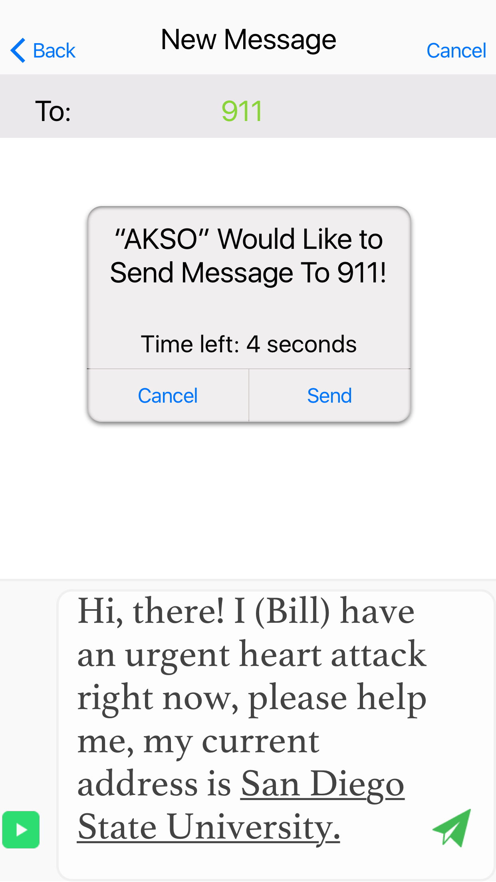






Machine Learning: Naive Bayes Model
Given a record with attributes (A1, A2,…,An) and we want to predict the risk score P(C| A1, A2,…,An ) under these conditions.
Feature selected: Health Record
TCP/IP
Wi-Fi/Cellular Network
Data stored and processed in the cloud
Doctor Diagnosis
Bluetooth/Zigbee Wireless
Notes:
This is Bill. He has a smartphone. He just installed our app and answered the questionnaires to get a cardiovascular risk score.
The risk assessment score was predicted using a Naïve Bayes Model.

Slide 5
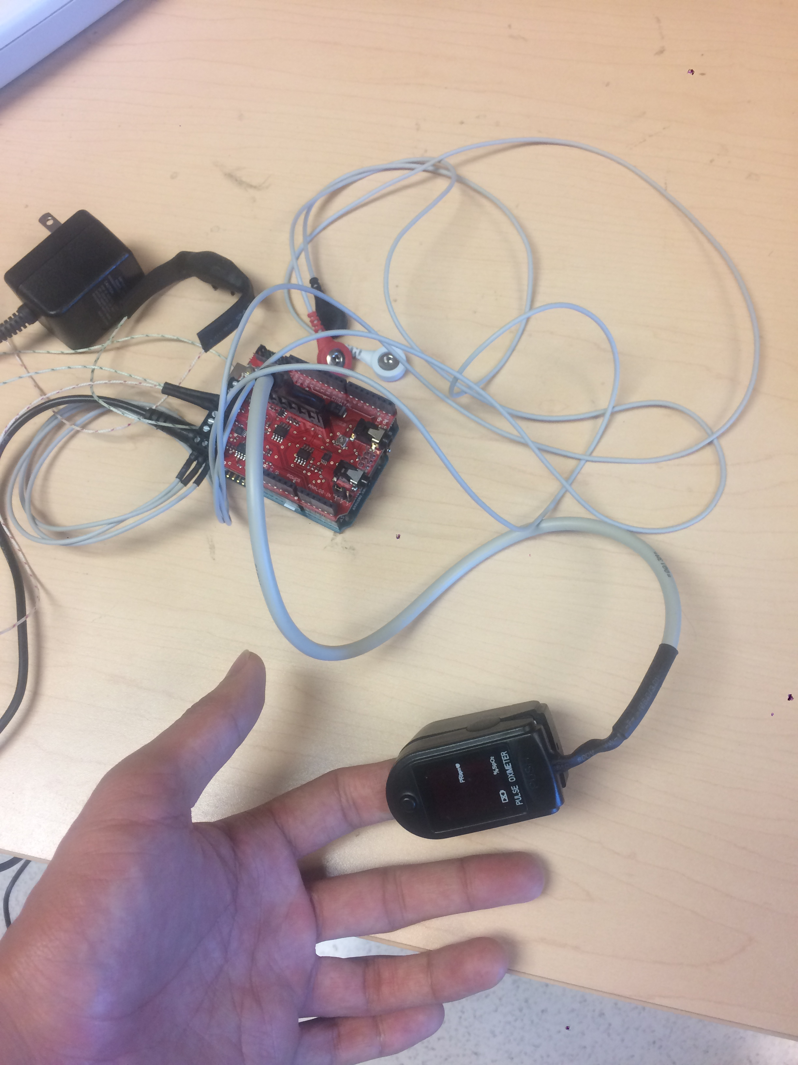
Results & Related Works
Dataset is too small!
Relationship between Heart Beat Rate and Heart Attack
Dataset from UCLA: http://www.stat.ucla.edu/projects/datasets/cardiac-explanation.html
Accuracy: 91.14%
Accuracy: 65.82%
 | Prediction(KNN)
Ground Truth |  | 0 | 1
 | 0 | 2 | 9
 | 1 | 5 | 142
 | Prediction(SVM)
Ground Truth |  | 0 | 1
 | 0 | 3 | 45
 | 1 | 9 | 101

Slide 6
Future Work
Fulfill our SaaS (Software As A Service) system we proposed :
App, Sensor, Machine Learning Model, Cloud Processing
Seek investors and promote our software.
Collect more medical record data from general public.
Cooperate with hospitals and doctors to provide customize service.
Notes:
Develop a more precise machine learning model.
Use Hadoop or Spark to process large data in cloud.
Develop a low-cost and energy efficient sensor to measure heart beat, blood pressure, and body temperature.
Create a web portal for doctors to access their patients’ profiles.

Slide 7
Acknowledgement
This work was supported by HACK4SD and all the sponsors.
Thank you to all the wonderful staffs and mentors.
Reference:
Weiss, J. C., Natarajan, S., Peissig, P. L., McCarty, C. A., & Page, D. (2012). Machine learning for personalized medicine: predicting primary myocardial infarction from electronic health records. AI Magazine, 33(4), 33.
http://www.stat.ucla.edu/projects/datasets/cardiac-explanation.html
Thank you!
Questions?

Slide 8
Questions?

