Slide 1

the problem
ArcBBQ

Slide 2



Team Members
Joey Lee
GIS
Karie Huang
GIS
Zhengcong Yin
Developer

Slide 3
Mental H
A mental health monitoring platform

Slide 4
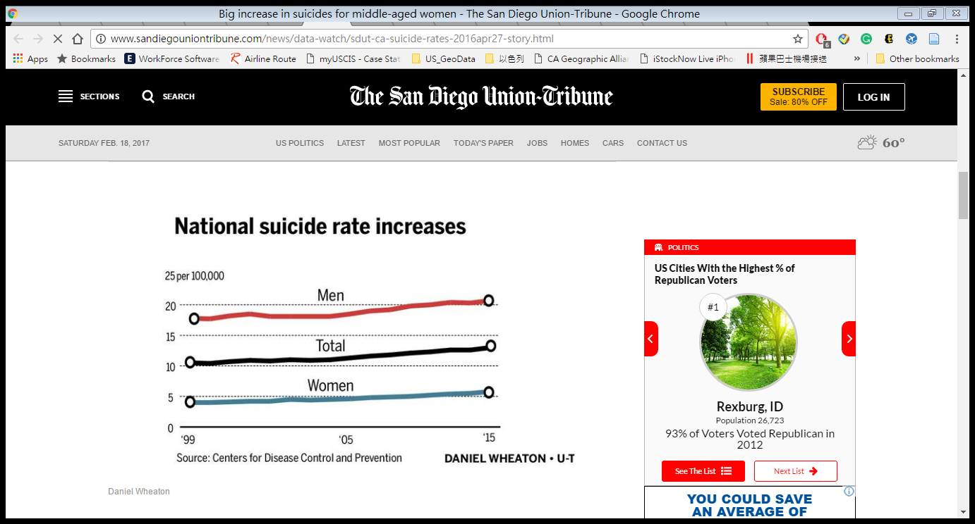
Why Mental health?
Invisible, but killed !

Slide 5
Why Mental health?
How can we share useful mental health information
and analytical tools in our local community?

Slide 6
Mental H
Visualizing Mental Health Info

Slide 7
Mental H
Exploring the Spatial Patterns of Local Mental Health Status

Slide 8
How – can we collect the data ?
Data | URL
Suicide Death 2010-2013 (livewell) | Livewell http://www.livewellsd.org/
Self Inflicted Hospitalization 2010-2013 (livewell) | Livewell http://www.livewellsd.org/
Chronic Alcohol Hospitalization 2010-2013 (livewell) | Livewell http://www.livewellsd.org/
Anxiety Hospitalization 2010-2013 (livewell) | Livewell http://www.livewellsd.org/
Mood Disorders Hospitalization 2010-2013 (livewell) | Livewell http://www.livewellsd.org/
Healthcare Facility Locations (California Health and Human Services Open Data Portal) | California Health and Human Services Open Data Portal https://chhs.data.ca.gov/
Twitter | Twitter API

Slide 9
How – does it work?
Community members
Crunch tweets
Mental Health Data
Mental H
dashboard
Mental Health Patterns
POI (hospitals/tweets)
ArcGIS API
Sentiment analysis

Slide 10
Mental H
DEMO!

Slide 11

Mental H

Slide 12
Mental H
Questions?

Slide 13
Mental H
Questions?

Slide 14
How to Collect Tweets?
1. We use Twitter Search API to collect Tweets. The key word we used is “San Diego.”
2. There are 46520 tweets. After filtering those tweets without coordinates, there are 12462 tweets remain.

Slide 15
The Challenges
Data cleaning.
Limited time to use Twitter streaming API for collecting tweets.
It is difficult to choose a proper key word for searching.
Migrating our database and website to a cloud server.
There are some issues in ArcGIS API.

Slide 16
Future Works
Running our database and website on a server.
Keep collecting the tweets on our server, and real-time analyzing the sentiment.
3. Improve the performance of sentiment analysis.

