Slide 1
San Diego ++
Nishant Billava
Anish Bivalkar
Kaivalya Deshpande
Alpita Masurkar
Deep Sanghvi
Gowtham Balasubramanian
Charles Weng

Slide 2
What’s our topic?
San Diego War Veterans Community

Slide 3
San Diego’s Veteran Demographics
Statistics:
222,348 in 2012
240,000 in 2016 (The San Diego Union Tribune)
It is estimated that San Diego’s veteran population will soon surpass Los Angeles’ veteran population making it one of the largest war veteran communities in the United States

Slide 4
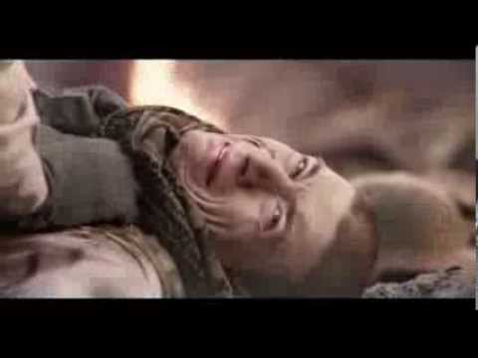
What made us think of this topic?

Slide 5
Here’s what people say...
“At the time I never knew of the benefits I was eligible for”
“Not knowing the services available to me as a female veteran.”
“He was in pain that he didn’t feel would ever stop. He made a decision in that moment that was a very bad decision.”
"I wish I would have been there every time with him at the VA — every visit, with everybody he met.”
“I feel like we are losing our friends left and right and no one is paying attention,”
“The system needs to be rebuilt from the ground up. It doesn’t work. It’s antiquated,”

Slide 6
San Diego Veterans
According to a 2012-13 Department of Veteran Affairs report, 26.2% people report having a disability
32.1% indicate that disability had interfered with them getting a job which pushes them into poverty
Veterans who have served in war or combat zones living in San Diego commonly face this issue- Post Traumatic Stress Disorder.

Slide 7
Who do these issues affect, the Target Groups
War veterans of San Diego
The veterans’ family and friends
The county of San Diego
The county has resources but doesn’t know how to reach out and help in the absence of adequate resources from federal agencies - VA and HUD
Long wait times. In San Diego, the wait time in 2012-13 was 319 days for a claim to be approved.
A common outcome is homelessness among veterans.

Slide 8
What can we do?
General solutions
Provide a platform where civilians can do something in return for the war veterans
What we will solve…
Veterans who are on the verge of being homeless and those who are already homeless as a result of PTSD, alcoholism and drug abuse.
Bridge the gap between the county and veterans by giving them information on veterans (i.e. location of homeless veterans)
As civilians, we can financially contribute to veterans’ past services

