Slide 1
EatWell San Diego
Team 215—TheDudeAbides
Osika Tripathi, Chelsea Obrochta, James O’Neill, Brandon Hugueley, Lambert Ninteman, Sindhu Venkhtesa, Richa Mishra, Archie Archbold, Xin Zhou, Giridhar Rao

Slide 2
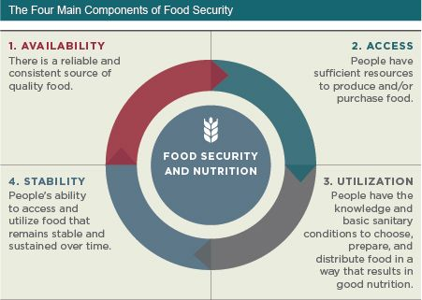
The Problem: Food Security in San Diego
423,130 people in San Diego County are food insecure (13% of total population).
151,440 children in San Diego County are food insecure.
Forced to Make Tough Choices
53% choose between paying for food and medicine/medical care
54% choose between paying for food and utilities
39% choose between paying for food and housing
57% choose between paying for food and transportation
27% choose between paying for food and education
67% purchase inexpensive, unhealthy food
35% water down food or drinks
Notes:
40% of households lack health insurance of any kind (including Medicaid)
49% eat food past its expiration date
45% sell or pawn personal property

Slide 3
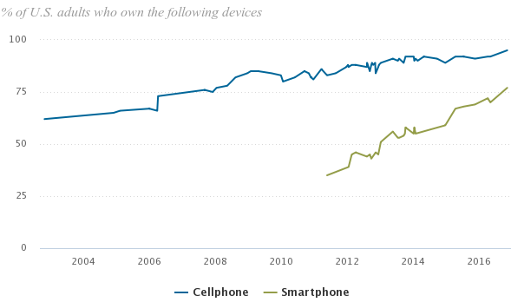
There Are Resources, But…
While 95% of Americans own a cellphone of some kind…
Only 77% own a smartphone
This means 18% of Americans can’t use web-based services from their phone.
Notes:
*Most resources are web-oriented or require internet access.
*Populations where this gap is even greater (e.g. Blacks, Latinos, 65+, those living in poverty) are also communities which have higher rates of food insecurity and are more vulnerable to hunger and it’s consequences.
*Of those not receiving SNAP benefits, 40% have never applied

Slide 4

Filling the Gap
The Solution:
A text-based service allowing those with no internet access to still get connected to the resources they need.

Slide 5
Impacts and Next Steps
Impacts:
Reduction in hunger and food insecurity among San Diegans
Less tough choices
Healthier, more resilient families
Next Steps:
Expansion through acquisition of other datasets regarding food assistance, health assistance programs, and other resources (e.g. Computer access locations).
Allow users to subscribe to alerts regarding food assistance and other programs (e.g. Medi-Cal, CalWorks, etc.) to encourage users to keep reaching out.
Notes:
*Of those not receiving SNAP benefits, 40% have never applied

