Slide 1


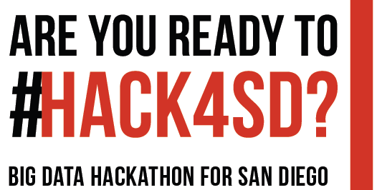

Team Formation Procedure
11:00 – 12:00: Team Formation and Group meeting/Discussion
Individuals should meet your group members now
Discuss the possible Hackathon topics
Each team will select one team coordinator
Each team coordinator should have or create a Github account
http://bigdataforsandiego.github.io/data/BigDataForSanDiego_Github.pdf
12:00 – 13:00: Lunch and Team Finalized (Pizza)
Each team coordinator will submit the team information
via Google Form by 12:30 pm!
Link: https://goo.gl/forms/PHLwFsKl1vJoduOh1
(This link is also available on the Hackathon site under agenda)
We will assign a Github repository for each team

