Slide 1
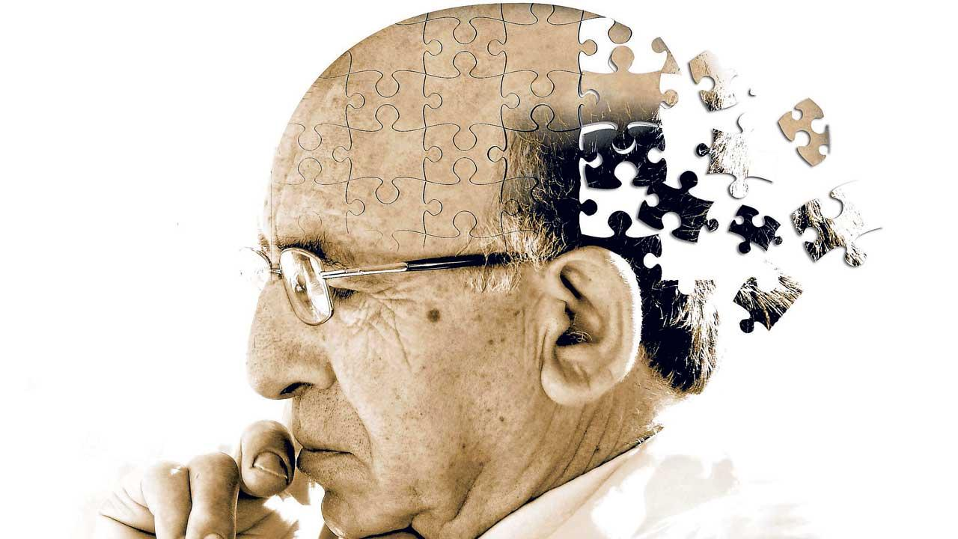
BigDataHachathon Presented by team: F.A.M.E-
Team members: Omar Aljedani, Gurami Geretchachvili, Nika Nizharadze
Kinjal Gala
Saipriyati Singh

Slide 2
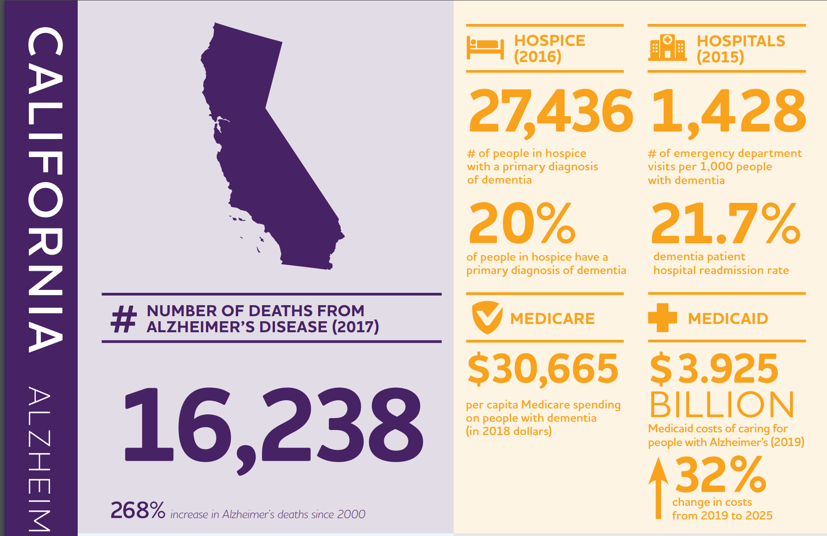
The Problem
Every 65 seconds someone develops Alzheimer’s disease and over 5.7 million Americans have the disease in the United States, according to the Alzheimer’s Association.

Slide 3
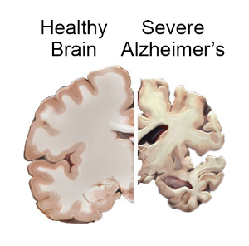
Alzheimer’s Disease:
it’s not just memory loss!
Progressive - symptoms gradually worsen over time
Brain shrinks dramatically - Nerve Cell death and Tissue loss
It does affect people younger than 65
Many are in their 40 s and 50 s
No cure
Primary

Slide 4
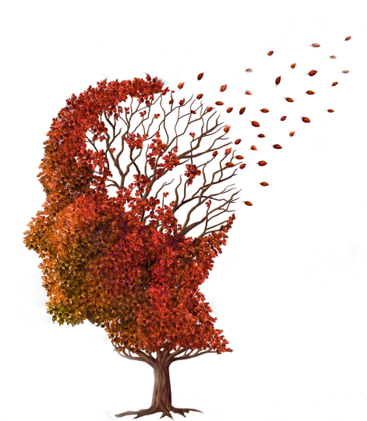
The Data
This dataset comprises information regarding the ADLs performed by two users on a daily basis in their own homes.
This dataset is composed by two instances of data, each one corresponding to a different user and summing up to 35 days of fully labelled data.
Sensor events were recorded using a wireless sensor network and data were labelled manually.

Slide 5
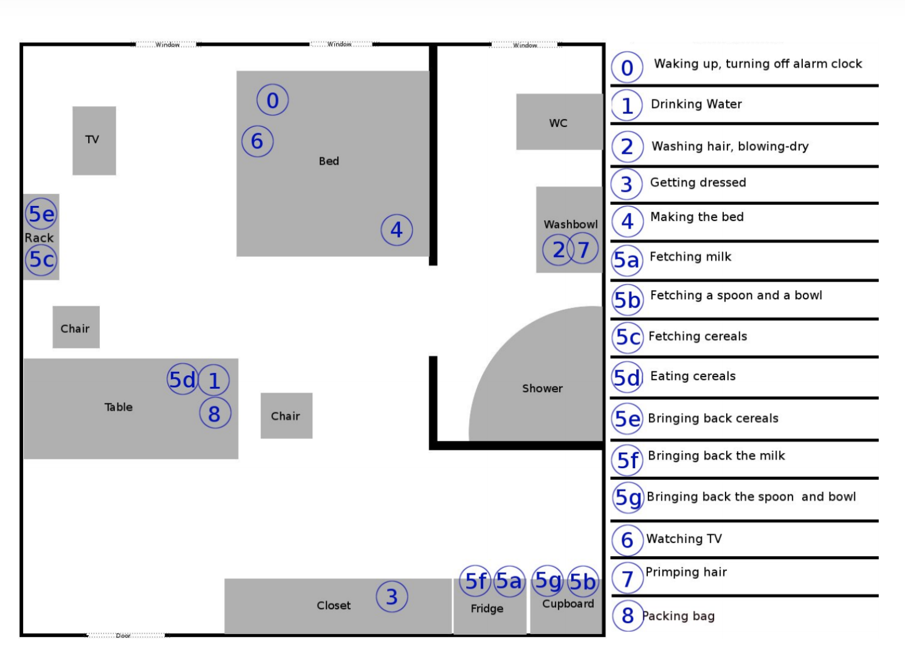

Slide 6
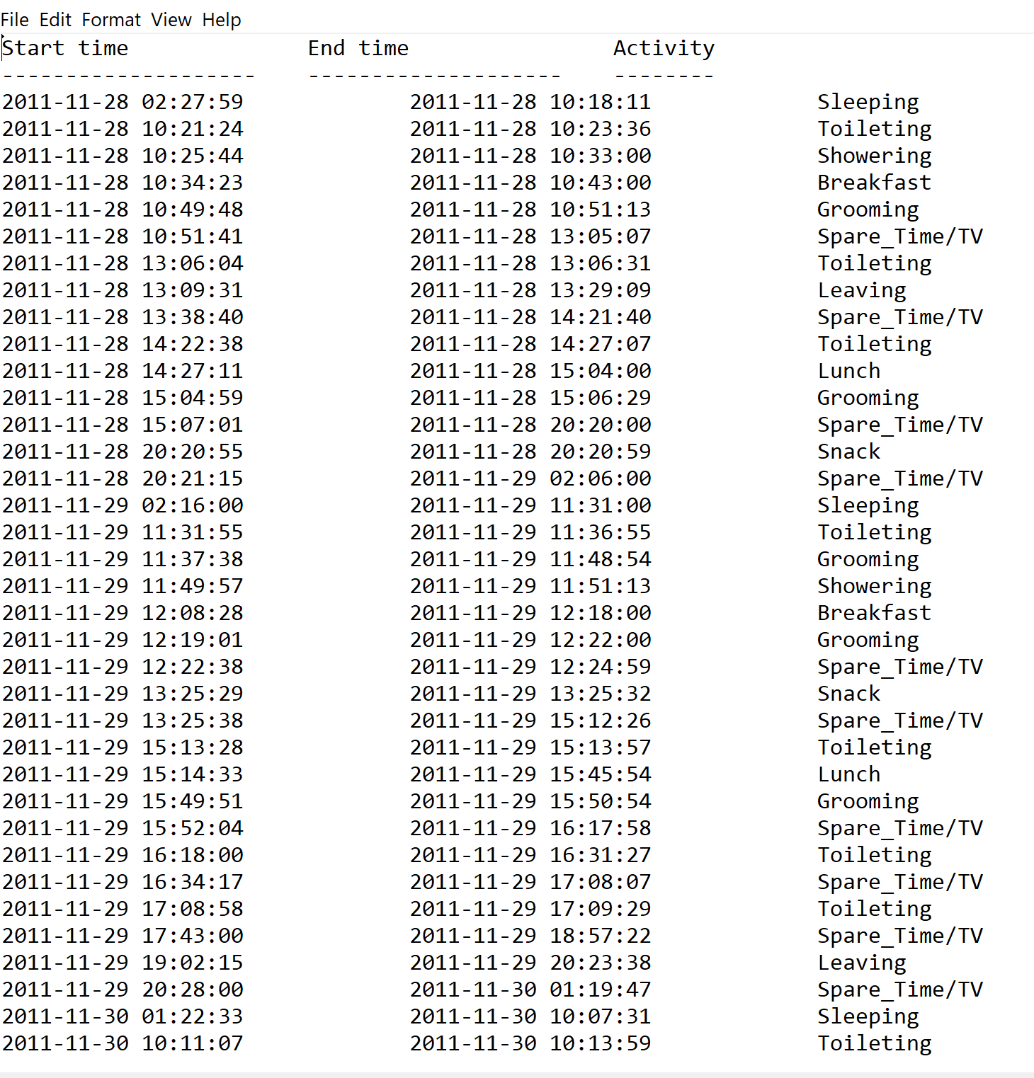

Slide 7
Sensors and te
https://drive.google.com/open?id=10jnCplY7JQEZpqtPTJiH2iiZdO1j3_xj

Slide 8

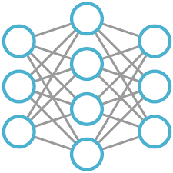


The Solution
Predict next activity using Machine Learning Algorithm
Gather Data
1
2
Send a text based on the next activity
Tex: Grooming time! 3

Slide 9
Team: F.A.M.E
Find And Manage Elderly

