Slide 1
Figuring It Out
Kian Agheli

Slide 2
Declaring Scope

Slide 3
“I’m okay, now what?”
“I’m ready to take next steps.”

Slide 4
Outlining Theory

Slide 5
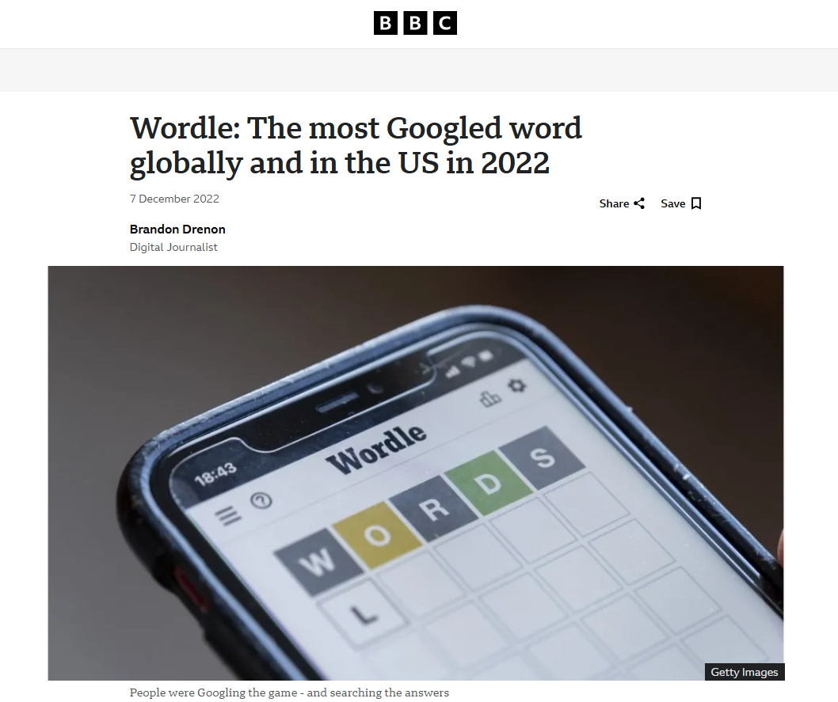
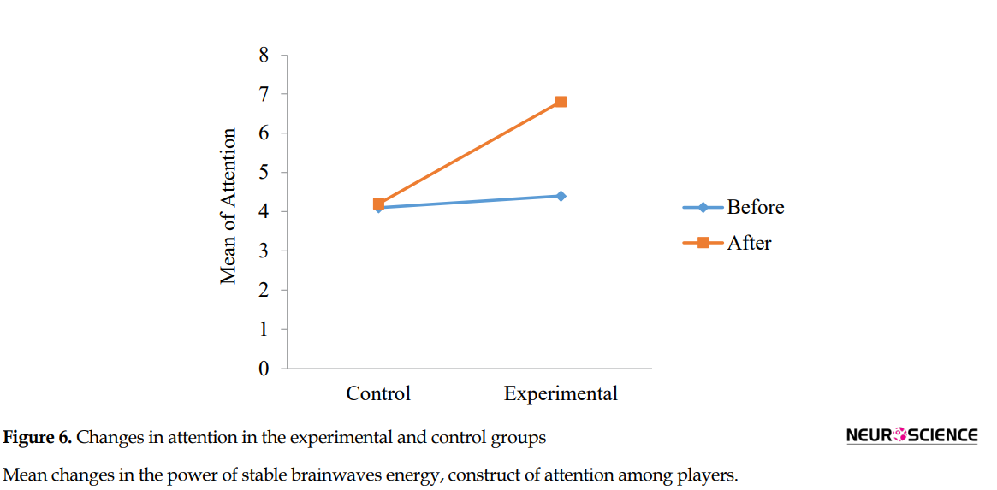
Studies
Positive Stress
Culture
Wordle
Image from [2]. See also [3].
Image from [4].

Slide 6
Applying Reality

Slide 7

Consistency
Integration
Community
Information
Recognition
Understanding

Slide 8
Conceptualizing Viability

Slide 9
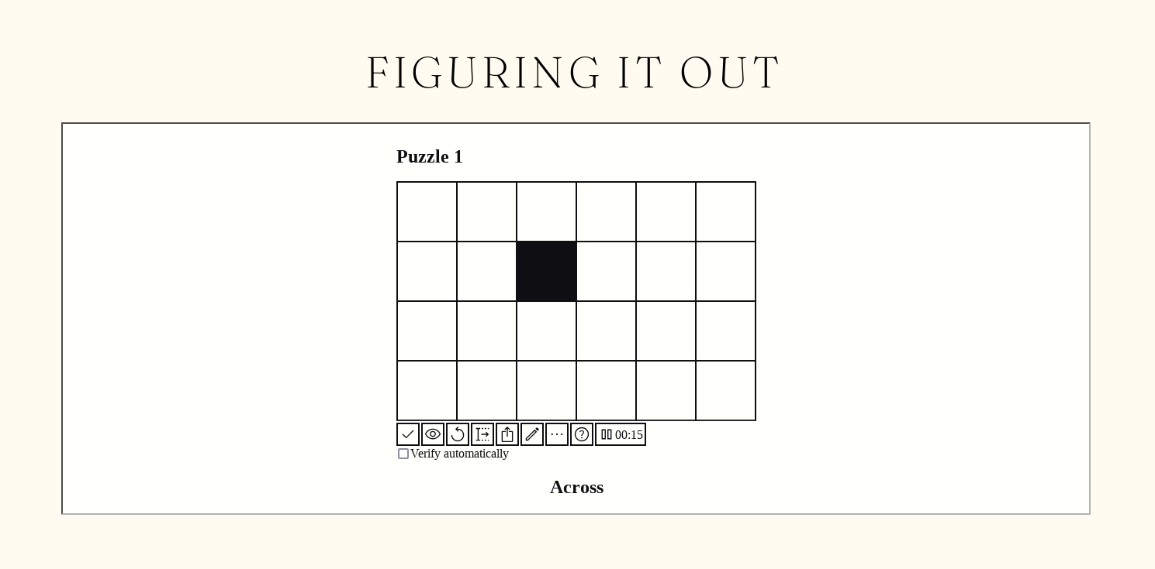
live @ mesacsclub.com/kaa/figuring

Slide 10
W O R K S C I T E D
[1] Drenon, Brandon. (2022). https://www.bbc.com/news/world-us-canada-63895493
[2] Aliyari, H., Sahraei, H., Golabi, S., Kazemi, M., Daliri, M. R., & Minaei-Bidgoli, B. (2021). The Effect of Brain Teaser Games on the Attention of Players Based on Hormonal and Brain Signals Changes. Basic and Clinical Neuroscience, 12(5), 587-596. http://dx.doi.org/10.32598/bcn.2021.724.9
[3] Al-Thaqib, A., Al-Sultan, F., Al-Zahrani, A., Al-Kahtani, F., Al-Regaiey, K., Iqbal, M., Bashir, S. (2018). Brain Training Games Enhance Cognitive Function in Healthy Subjects. Medical Science Monitor Basic Research, 24, 63-69. https://dx.doi.org/10.12659/MSMBR.909022
[4] Drenon, B. (2022, December 7). Wordle: The most Googled word globally and in the US in 2022. https://www.bbc.com/news/world-us-canada-63895493

