Slide 1
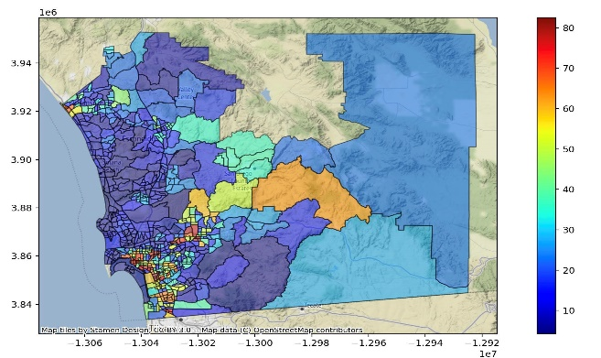
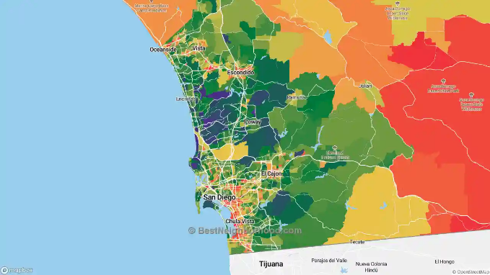
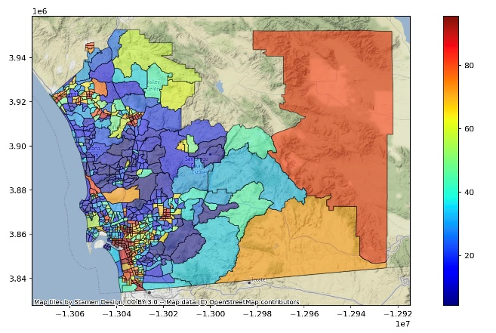
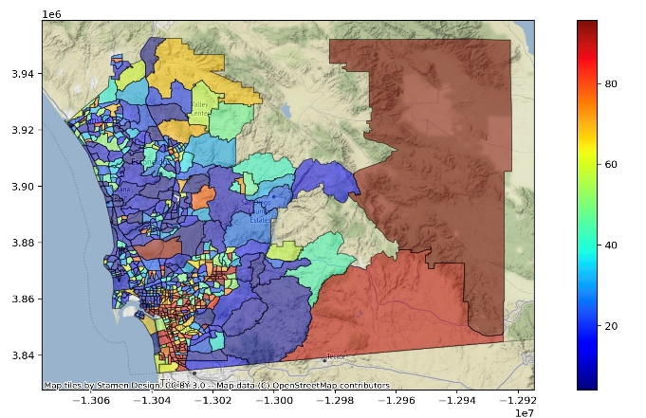
1
Healthcare Heatmaps
LA REJECTS
2
Our Project
Generates heat maps allowing citizens to see disparities in multiple variables raising awareness for communities that need it through auto generated infographics and more.
Cardiovascular
Income
3
Benefiters
Low Income Citizens
Government Officials
Communities in need
Community Leaders
Healthcare Workers
Poverty
Unemployment
4
Health Disparities

Slide 2

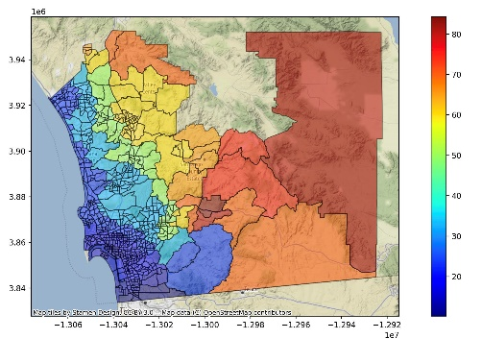
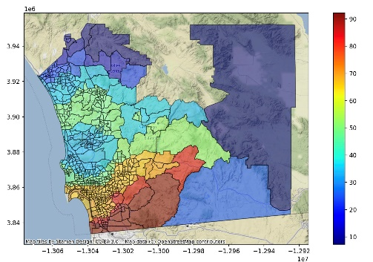

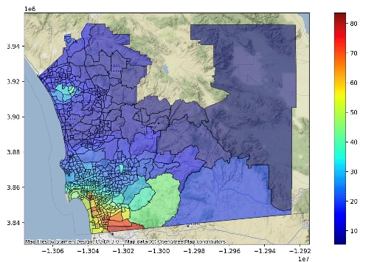
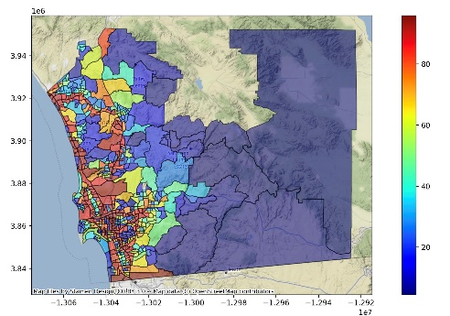
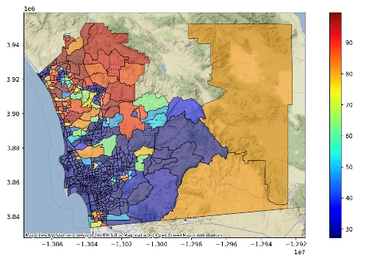
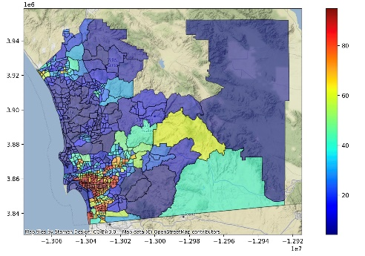
Additional Details
Ozone
Particulate Matter
Autogenerated Infographic
Toxic Release
Traffic
Pesticide
Asthma

