Slide 1

Sweat Breaker
202
An app to aid community health workers during heat waves.
Sweat Breaker presents an interface of the county’s cooling centers alongside live power outage data to quickly direct those in need to relief from the heat.
Notes:
Also make sure to address here:
Who does it help? Think of the user/customer/persona
What hackathon theme does it connect to and why
What data will you be using (describe briefly)
Provide additional details about your idea/current development here, including:
This can include visuals or a short video (no more than 1 minute), etc. here
How did your team collaborate on this idea and will collaborate in the future
How can this go to market in the future

Slide 2
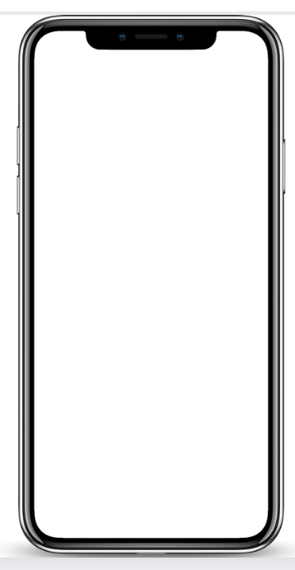
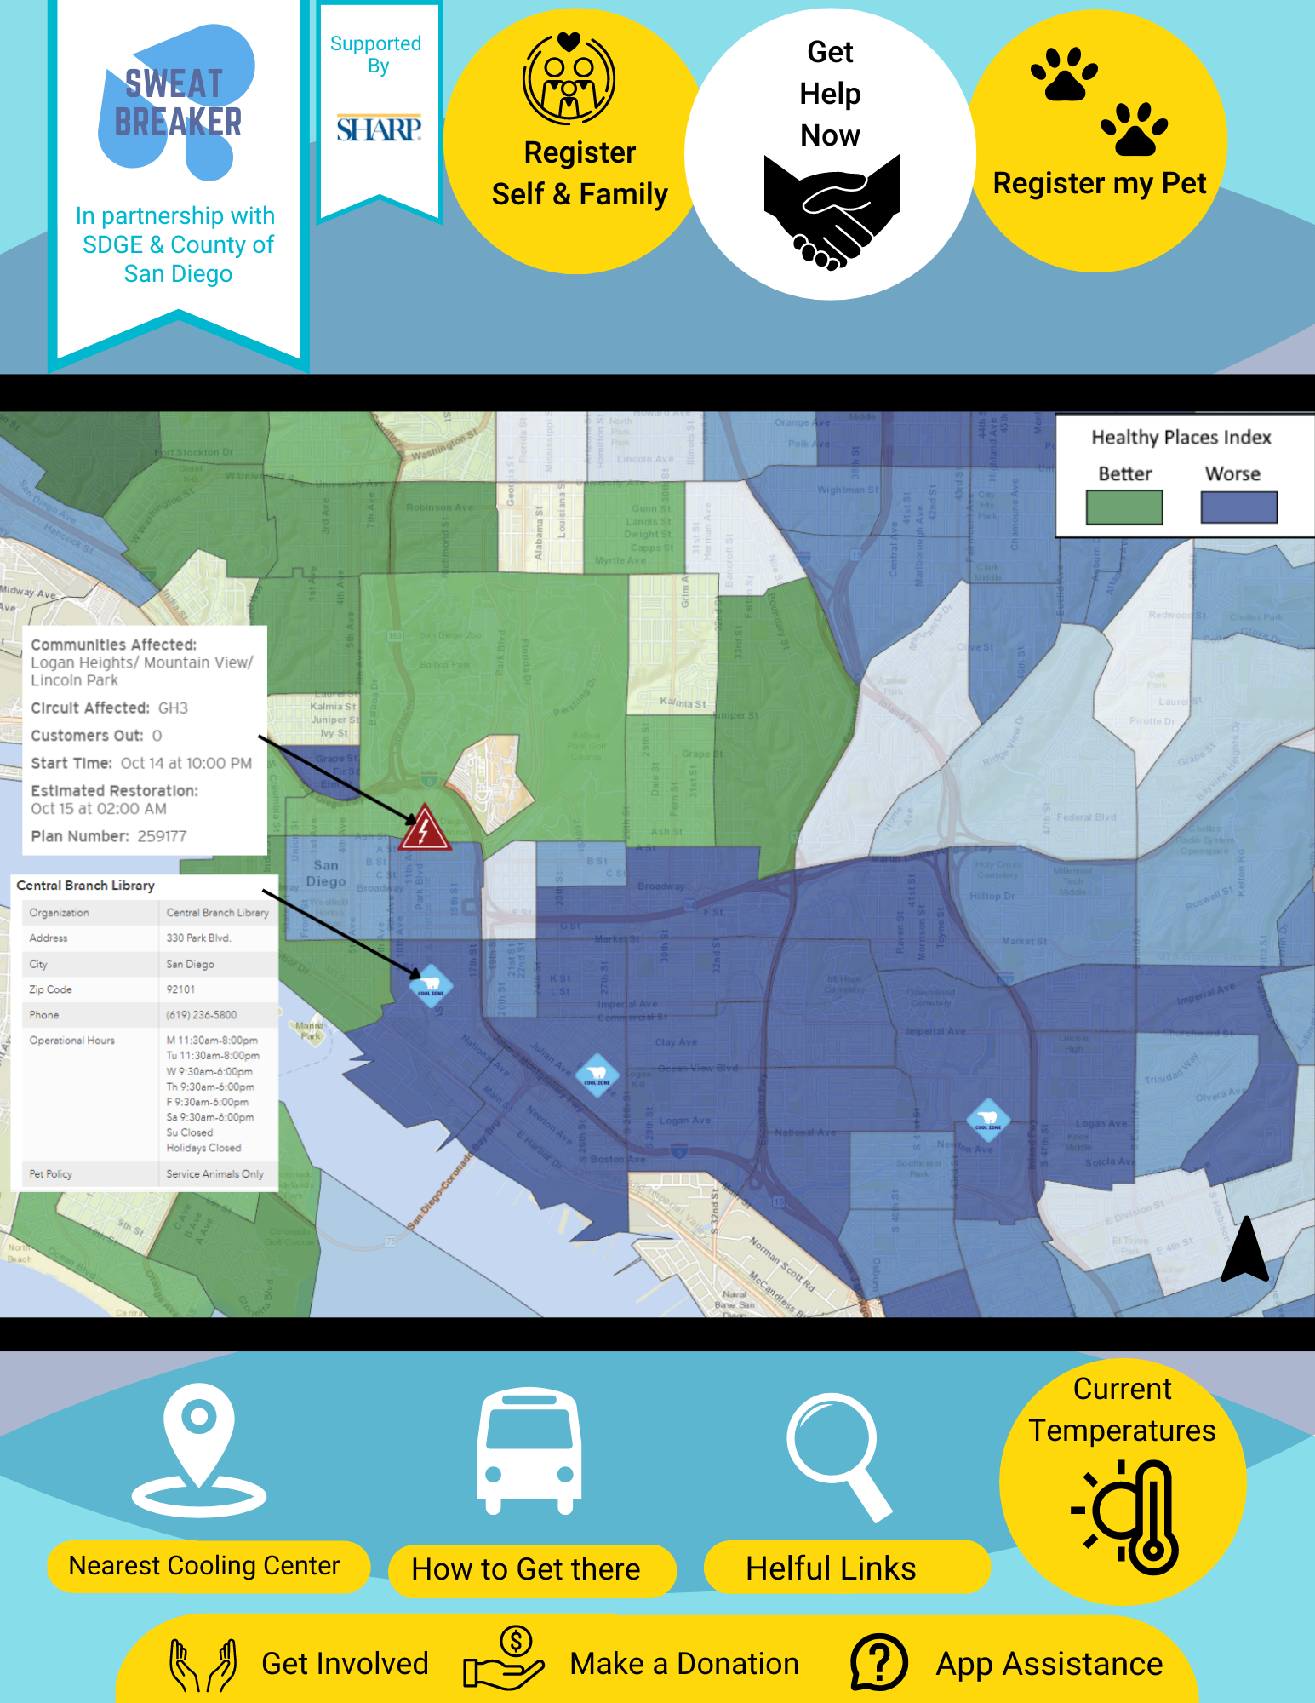
App Mockup
202
Power outage alerts from SDG&E
Locations, hours, and pet policies of cooling centers from Health and Human Services
Exports the selected cooling center to Google Maps for directions

