Slide 1
For-Loop-A-Doop
TEAM 205
Health Disparities Among Under Educated Females:
Team Idea:
Change our current culture toward preventative care, and create a movement for female healthcare education.
More research grounds about female health.
Who does it help?
Public health officials, policy makers, health-insurance companies
What hackathon theme does it connect to and why?
Tackling Real-world Challenges in Healthcare
What data will you be using?
We used two types of data sets, the first showed rates of preventable hospitalizations under selected medical conditions, and the second showed women ages 18-44 who received preventative services.

Slide 2
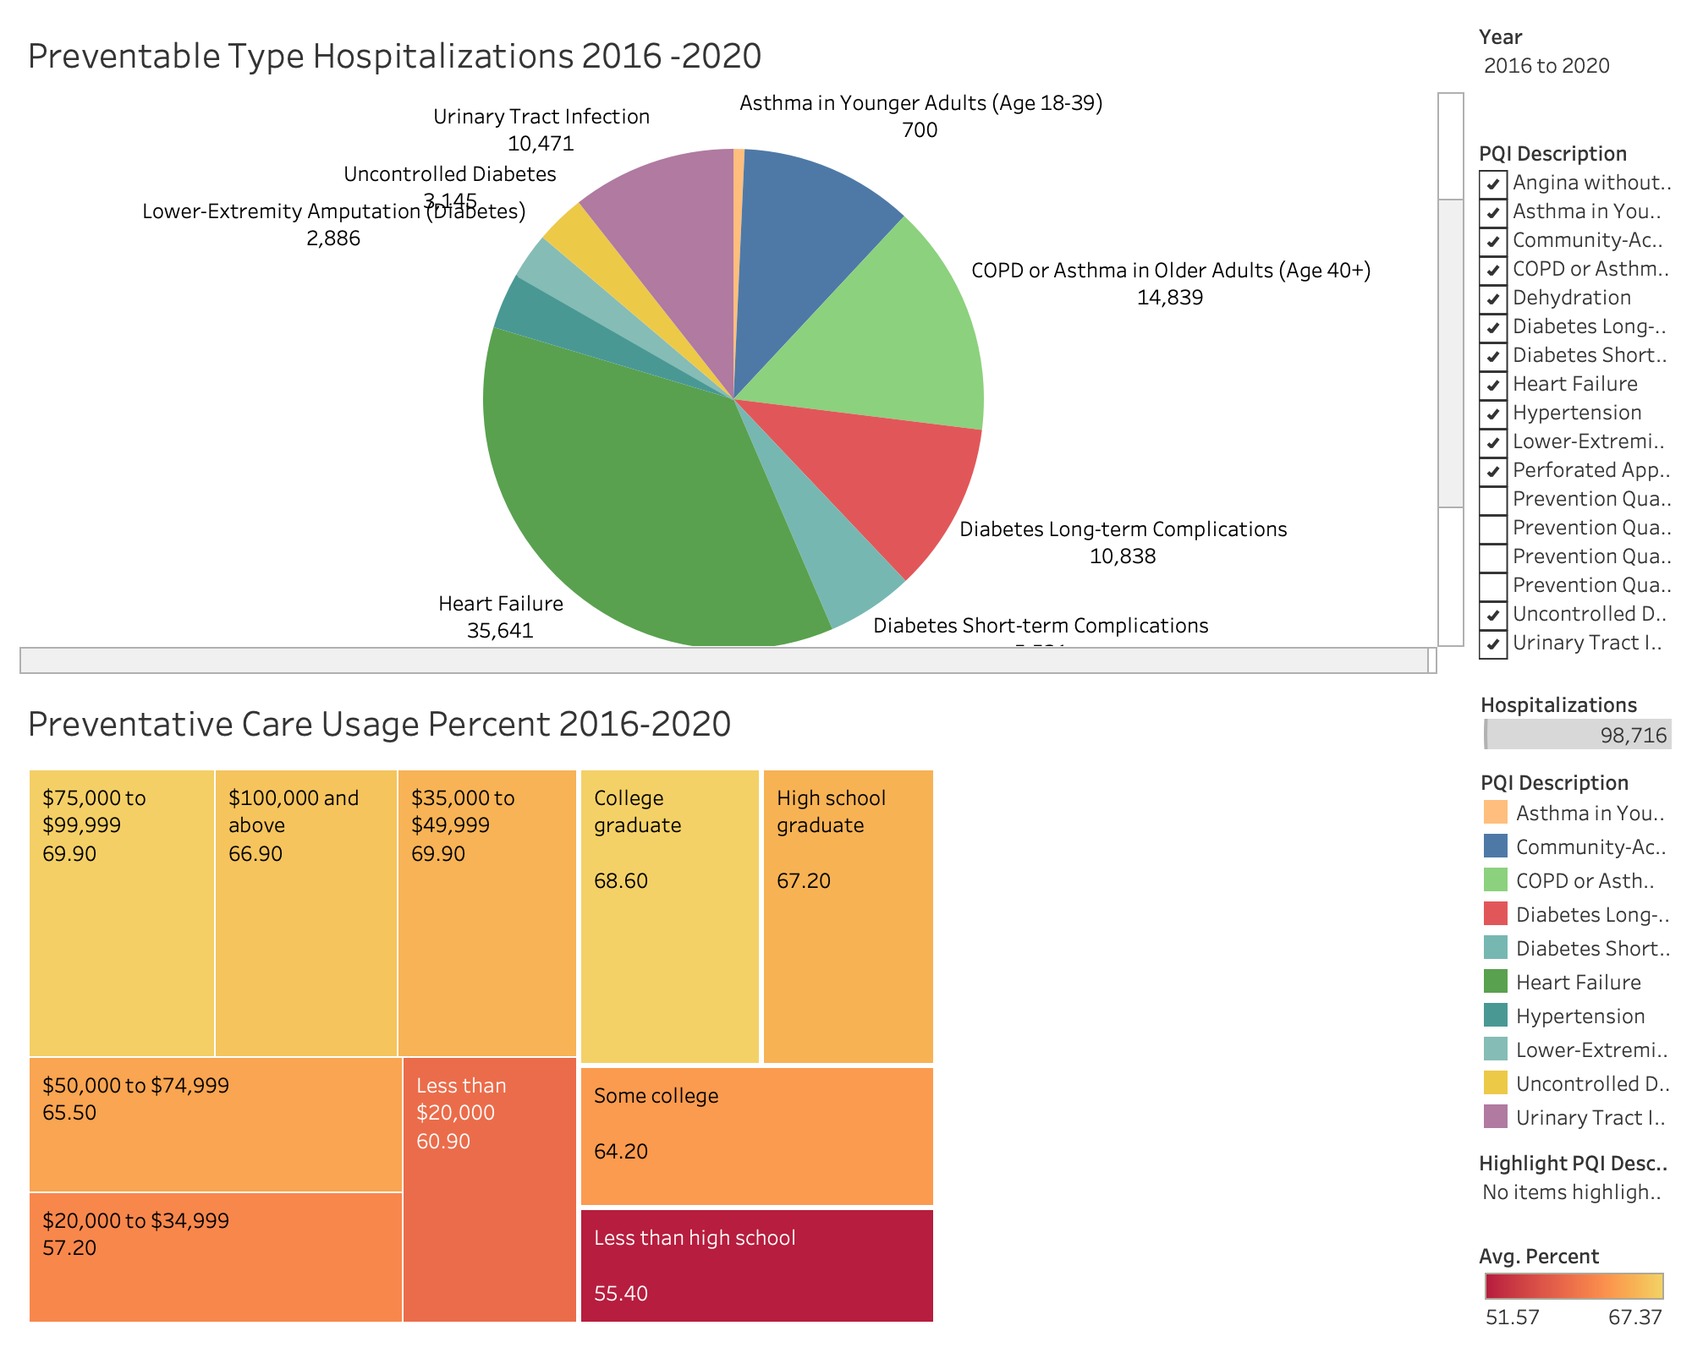
TEAM 205
Using data representing rates of preventable hospitalizations (under selected medical conditions), we calculated there to be 98,716 preventable hospitalizations that occurred from 2016-2020 in San Diego among women.
Using another data set indicating women ages 18-44 who received preventative services (2016-2022), we concluded many women are not taking advantage of the free preventative services available to them. The lowest percentage of women being those with under education.
Next steps include, acquiring data on under-education areas within San Diego county. Targeting those areas to increase awareness and education about free preventative care services for women. This provides a good starting point for assessing quality of health services in the community.
Notes:
there was limited research and data on women. So our first consensus that sphere should be policy changes for more research grounds for females.
In conclusion, we have identified a great cost with hospitals that could have been avoided. We have identified a preventative care use, especially among low education populations. So how can we close the gap?

