Slide 1
Gladiators: DAS(Depression, Anxiety, Stress) Sentiment Hotspots Analysis
Team 206
Identify and analyze the San Diego area hotspot that generates the most tweets with a predisposition toward one of the three mental health conditions of Depression, Stress, and Anxiety.
The application will help healthcare organizations to find the regions that represent significantly high number of depressive, anxious or stressful sentiments in the tweets.
Through this data healthcare organizations can set up counselling camps in the targeted locations to find potential patients suffering from DAS mood imbalances.
Our idea falls into the category of applying AI/ML in the field of healthcare for predictive analytics and decision making to indicate the hotspots with significant number of tweets that show depressive, anxious or stressful sentiments.
We use the prelabeled dataset on Kaggle with each tweet targeted to a specific sentiment. We train conventional and BERT transformer based models over this dataset.
We then use the tweets from Twitter to classify them into specific category of sentiment for different regions.
The classified tweets are then aggregated on the basis of category and geographical region to get the metrics and visualize the results for further investigation.

Slide 2
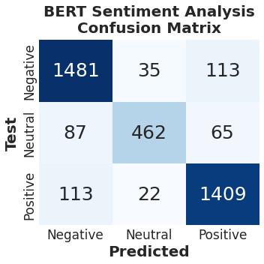
Team 206
Provide additional details about your idea/current development here, including:
How did your team collaborate on this idea and will collaborate in the future
→ We split the tasks into three teams, one dedicated towards data extraction and cleaning, the other two teams focused on data preprocessing and model building. We have a future scope of improving the accuracy of the model and build the web application with interactive user interface. To achieve our goal we will split into two teams, one with focus on model improvement and other with focus on application development.
How can this go to market in the future.
→ The product will be launched in the market in the form of web application used by healthcare providers to set up camps in the targeted areas. It will be useful for monetary benefit as well as for social campaigns.

