Slide 1
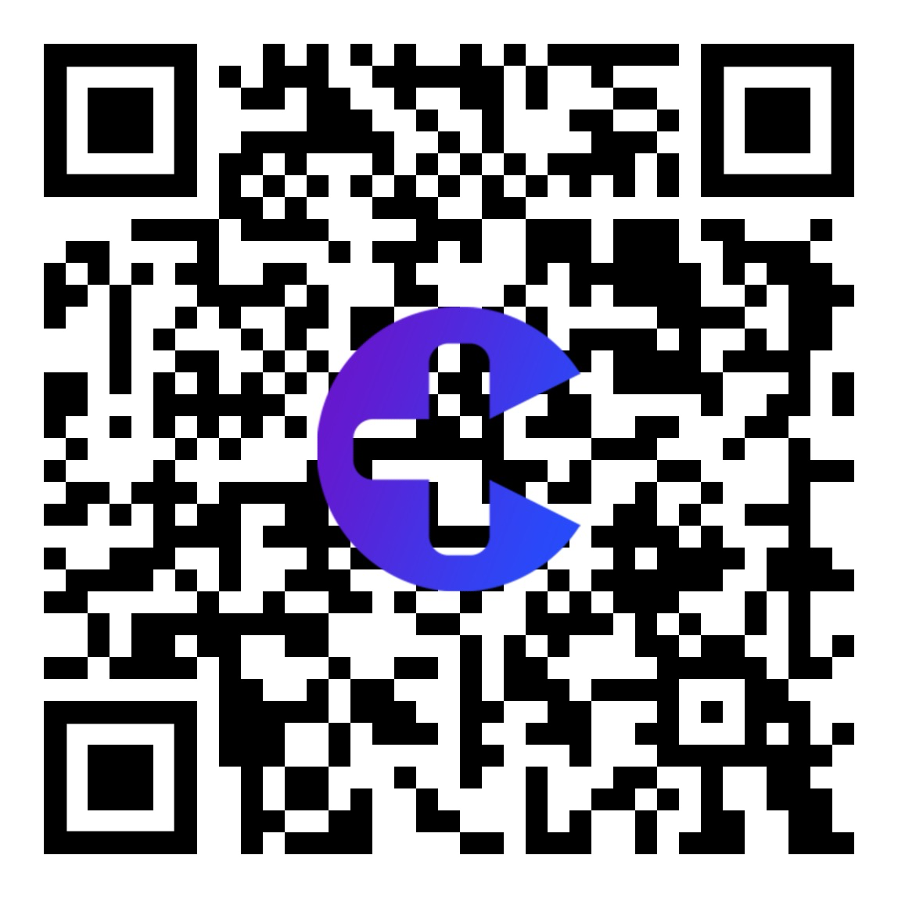

Si++: Carefy
Group 214
For people that live alone, from elders to college students, Carefy is a self-diagnosis easy to use app that uses Big Data and Machine Learning AI to analyze symptoms and images to deliver a reasonable pre-diagnosis.

Slide 2
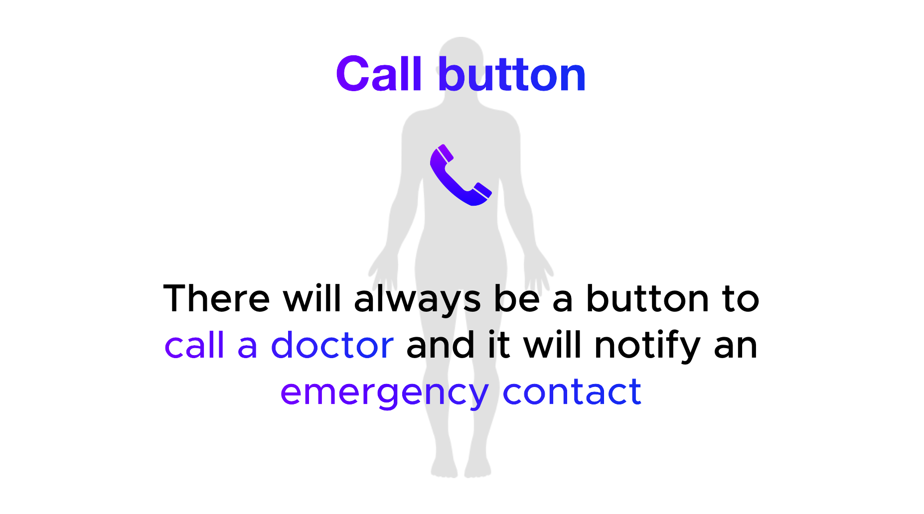
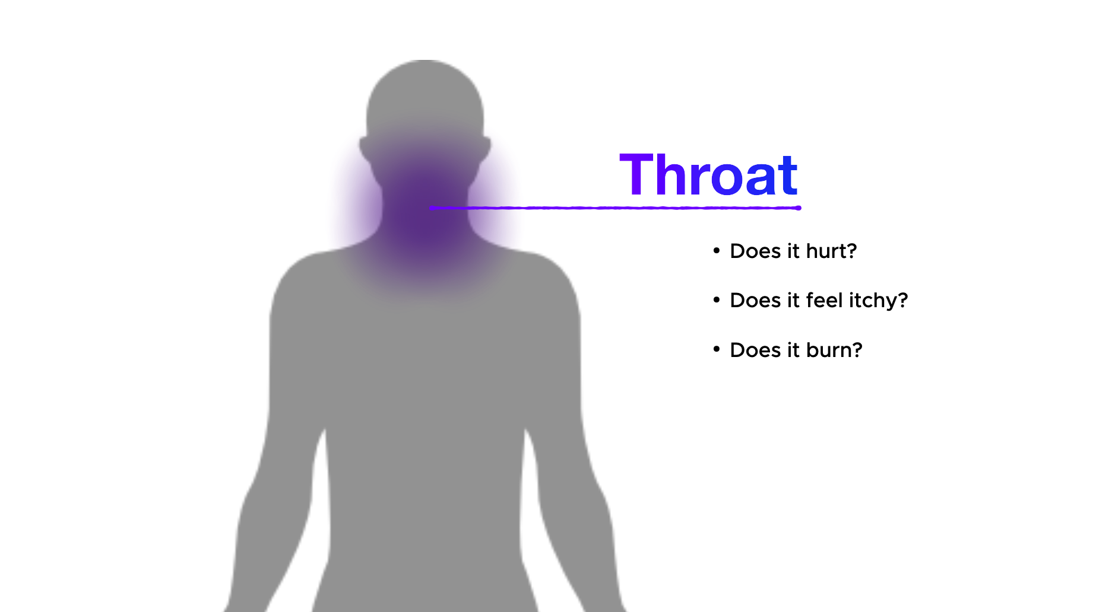
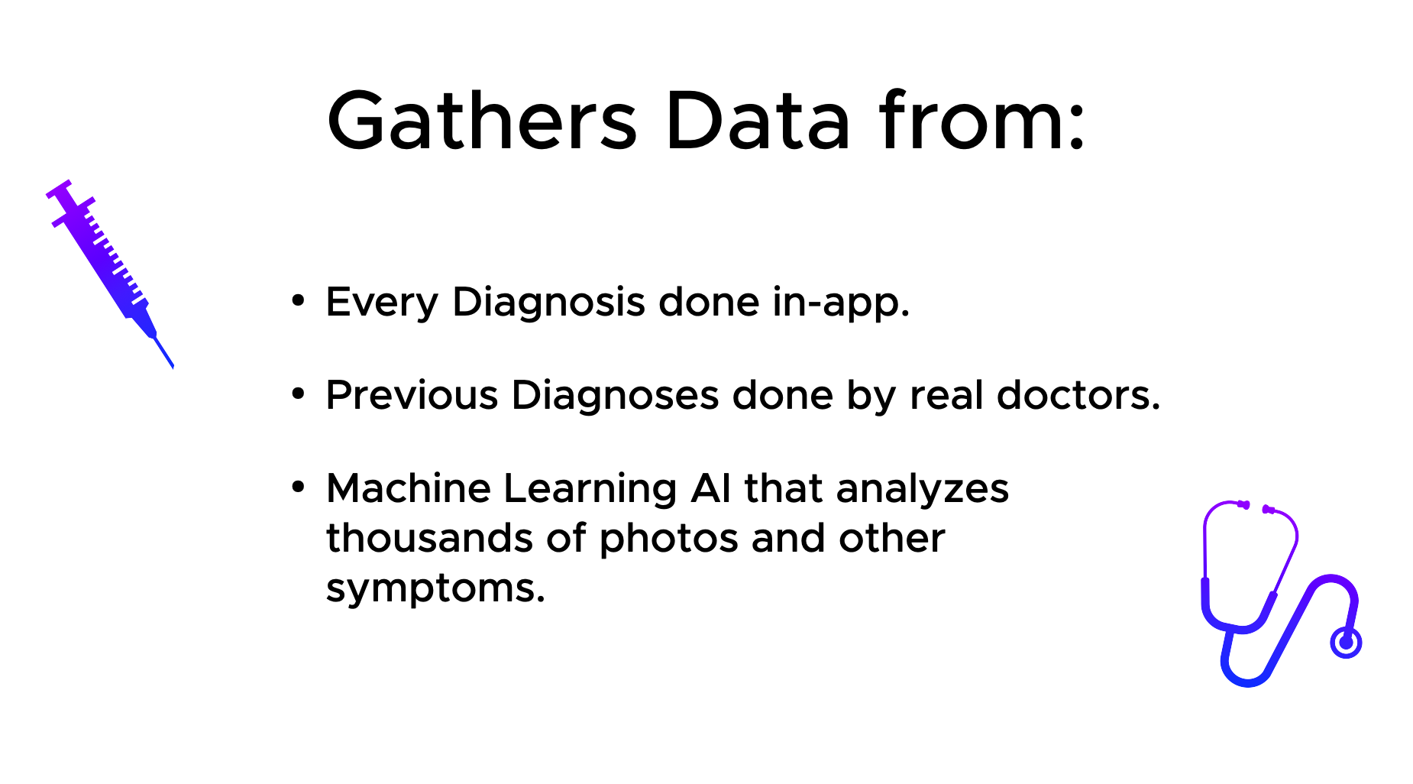
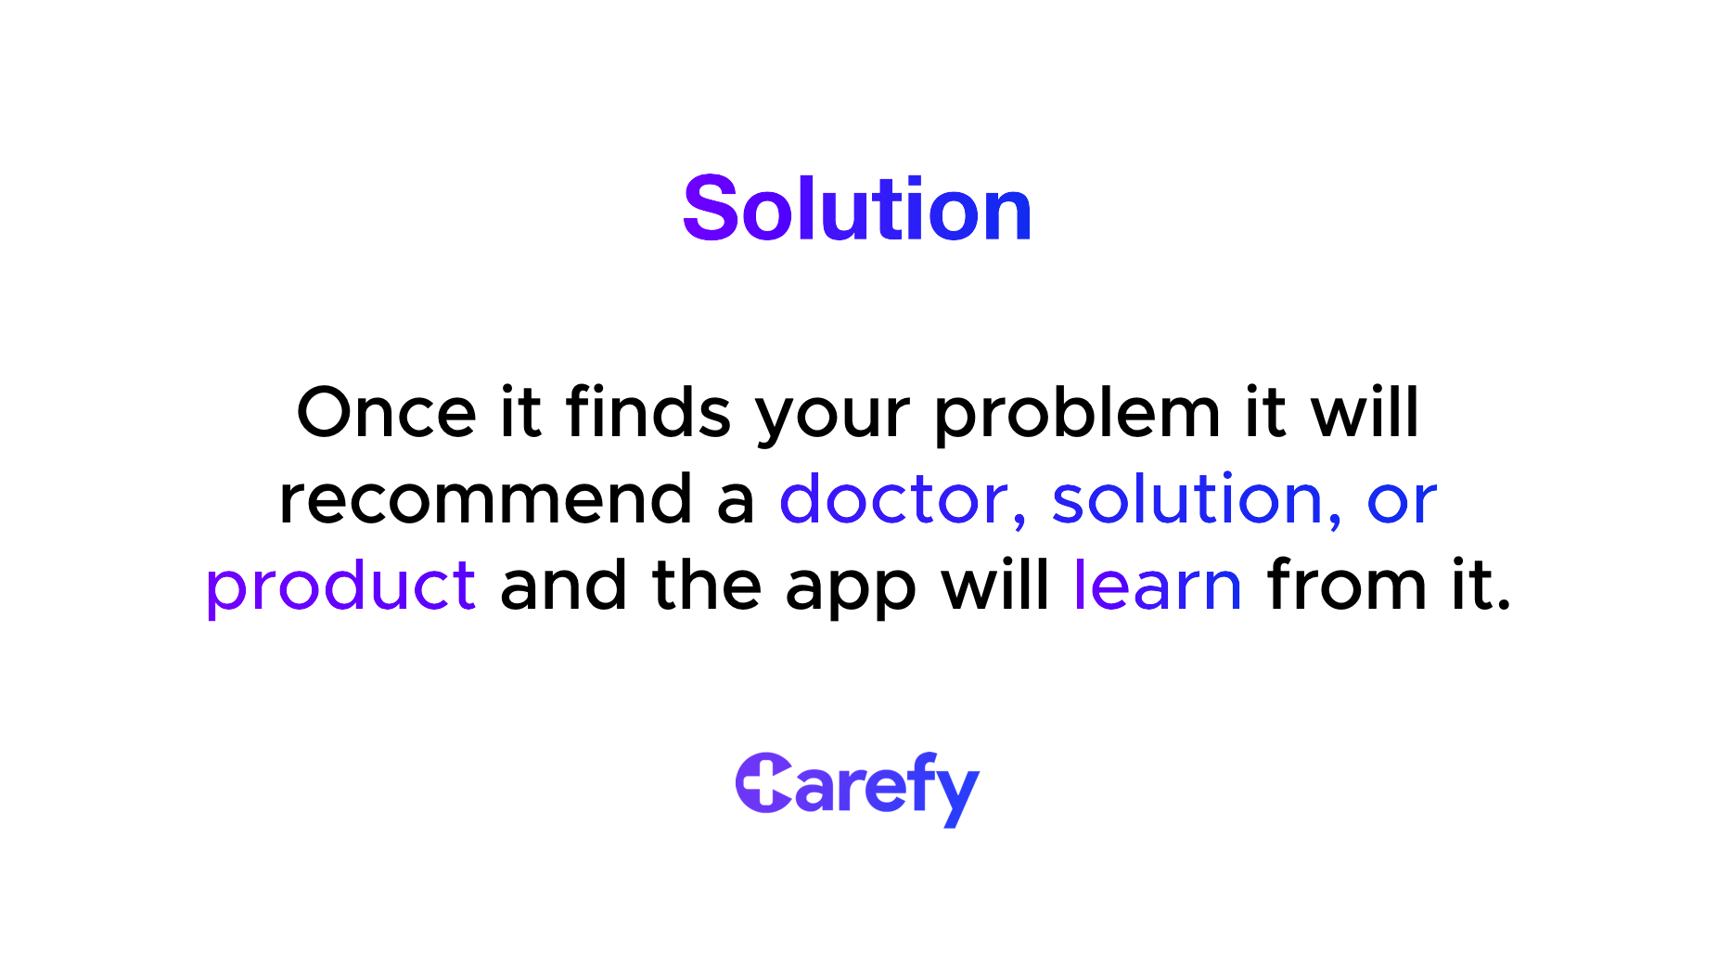
Group 214

Slide 3
Andres Ortiz Olaia Picabea Sebastian Kloster Francisco Castillo Manuel Castillo Ethian Chiu

