Slide 1
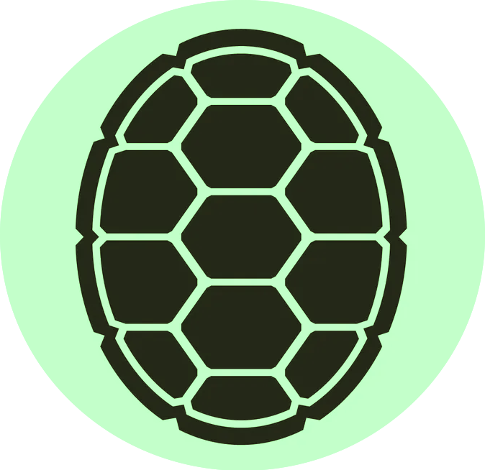
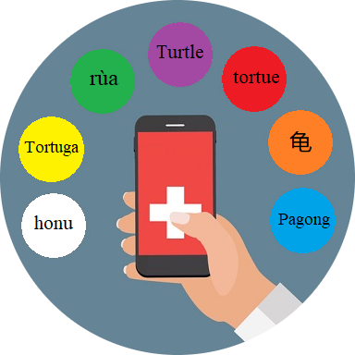
Team Turtle:
220
Team Idea: A multi-lingual mobile app, used by medical offices to translate patient forms, documents and voice.
Idea Description: This app will be used when patient's check-in, in the patient room and in pharmacy. It will help facilitate communication between health care workers and patients.
Who it helps: The implementation of this app in healthcare will benefit those whose primary language is not English.
Hackathon Theme: This app ultimately enhances the patient's experience because it helps facilitates communication between the patient and the healthcare worker to ensure clear understanding.
Health Disparities
Crush Language barriers
Better patient experience
Health Equity
Data used:
Top non-English languages spoken in San Diego

Slide 2
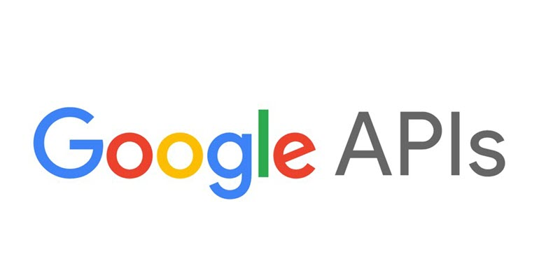
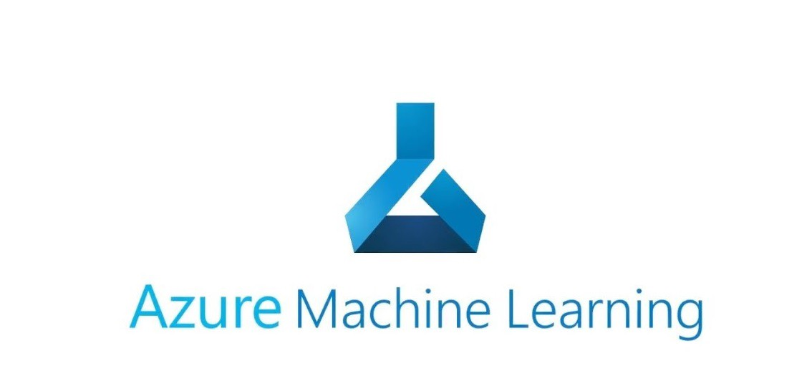
220
Mobile App
Kiosk mode
Provides Care Unit with Patient data
Provides outpatient documents
Scanning features
Vocal/ Text Translation to Vocal/ Text
Tablet Device
Built with Security in mind:
Memory Encryption
Communication Encryption to Care Unit's Infrastructure
Host Mobile App
Leveraging Google API
Leveraging Azure AI
Implement parallel to current services hosted at facilities

