Slide 1
Team Error 404

Slide 2
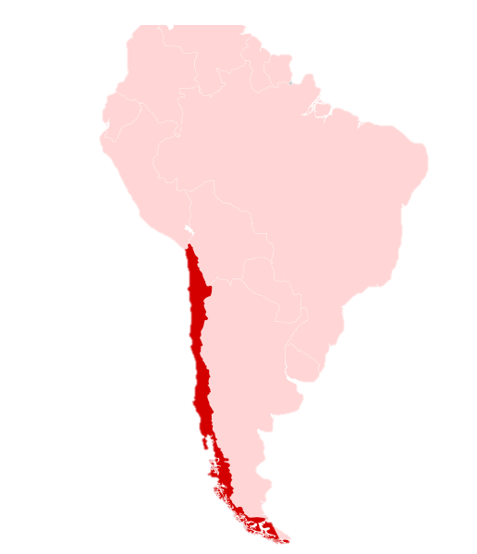
Source: https://data.worldbank.org/indicator/NY.GDP.MKTP.CD?most_recent_value_desc=false&locations=CL
Team 404
$317B
Notes:
That’s roughly the size of Chile’s Economy.
Source:
https://data.worldbank.org/indicator/NY.GDP.MKTP.CD?most_recent_value_desc=false&locations=CL
Which is one of the top 5 economies in Latin America
Source:
https://www.statista.com/statistics/802640/gross-domestic-product-gdp-latin-america-caribbean-country/

Slide 3
Source: https://diabetes.org/about-us/statistics/cost-diabetes
Team 404
$327B
Notes:
$327B
You need to add another $10B to approximate the “total economic cost of diagnosed diabetes” in the US, $327B
In 2017, the American Diabetes Association estimated the “total economic cost of diagnosed diabetes [to be] $327 billion.”
Source:
https://diabetes.org/about-us/statistics/cost-diabetes

Slide 4
Team 404
Diabetes
Notes:
Higher than normal blood sugar levels, but not high enough to be diagnosed as diabetes
Source: https://www.cdc.gov/diabetes/prevention/about-prediabetes.html

Slide 5
Team 404
Prediabetes
Notes:
Higher than normal blood sugar levels, but not high enough to be diagnosed as diabetes
Source: https://www.cdc.gov/diabetes/prevention/about-prediabetes.html

Slide 6
Source: https://www.cdc.gov/diabetes/basics/prediabetes.html
Team 404
Increased risk of developing
#1 Heart disease
#5 Stroke
#8 Type 2 diabetes
Notes:
In 2020,
Heart disease is the leading cause of death in the US @ ~700K
Stroke is the fifth most common cause of death in the US @ ~160K
diabetes was the 8th leading cause of death in the US @ 100K+

Slide 7
Our project:
Team 404
Good Eats
Notes:
Higher than normal blood sugar levels, but not high enough to be diagnosed as diabetes
Source: https://www.cdc.gov/diabetes/prevention/about-prediabetes.html

Slide 8

Jessica Cruz
Team 404
36 y.o. Latina
Recently diagnosed with prediabetes
Family history of diabetes
Single mother
2 teenagers
Works in retail

Slide 9
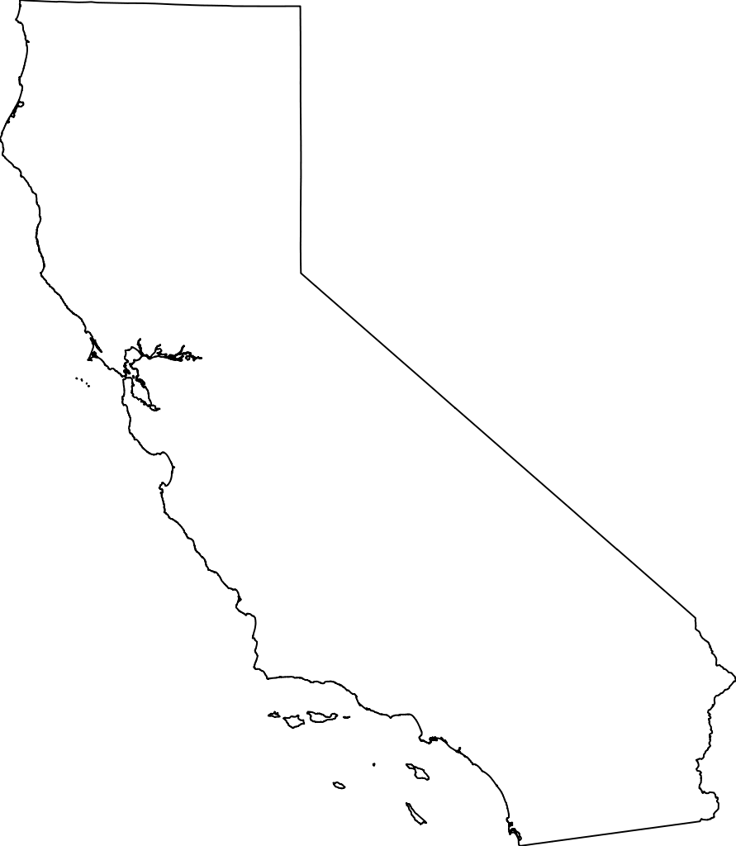
Source: https://healthpolicy.ucla.edu/publications/Documents/PDF/2016/prediabetes-brief-mar2016.pdf
Team 404
~50%
Notes:
Prediabetes affects nearly 13M adults in CA close to half the state’s population.
more than 13 million adults (46 percent of all adults in the state) are estimated to have prediabetes or undiagnosed diabetes.
An additional 2.5 million adults have diagnosed diabetes.
Altogether, 15.5 million adults (55 percent of all California adults) have prediabetes or diabetes.”

Slide 10

Source: https://www.cdc.gov/diabetes/basics/prediabetes.html
Team 404
~33%
Notes:
According to the CDC
“Approximately 96 million American adults .. have prediabetes.”
That’s the population of CA, TX, FL and CO
“Of those with prediabetes, more than 80% don’t know they have it.”
Source:
https://www.cdc.gov/diabetes/basics/prediabetes.html

Slide 11




Source: https://www.cdc.gov/diabetes/basics/prediabetes.html
Team 404
Notes:
According to the CDC
“Approximately 96 million American adults .. have prediabetes.”
That’s the population of CA, TX, FL and CO
“Of those with prediabetes, more than 80% don’t know they have it.”
Source:
https://www.cdc.gov/diabetes/basics/prediabetes.html

Slide 12
Error 404: Price aggregator and healthy recipes
Team 404
Get access to cheap and healthy food based on where you are. And with the help of a nutritionist make meals to meet your health goals.
Easier food decisions for heads of households.
It touches on the mobile, patient experience, and health disparity themes.
Data used grocery store prices, health disparity and comorbidity map data, consumer spending data.

Slide 13
Error 404: Price aggregator and healthy recipes
Team 404
Demo
Collaboration:
2 CS major to develop the backend
1 business major to develop the business and marketing strat
1 applied math major to analyze data and trends
1 comm major to refine and pitch
G2M: B2C app, live by March ‘23;

Slide 14
Team 404
“Prevention is so much better than healing, because it saves the labour of being sick.”
– Thomas Adams

