Slide 1
Phase 1: Data Fetch
In this phase, we extract all the data we need from mongo to build our Graph.
Basically, we extract 2 element's:
A file containing a list of nodes + some node features
Some files containing a list of edges + some edge features
Note: not all the features can be computed in the extraction phase, because some of them require the graph structure (phase 2). For example:
Page rank, degree centrality, total number of time user A reposted user B (edge feature)

Slide 2
Phase 1: Data Fetch
Problem:
With a database containing approxiamively 500 million of tweets, we cannot load all the tweets at once,
For example storing all the tweets in a simple python `list()` requires 681GB of RAM!
We need an optimized way to retrieve our data. We could explore some solutions:
Use a mongo cursor to iterate over a stream of tweets to save our RAM usage
Avoiding recursive queries and instead iterate over all tweets at once, sorted by `user.id`
Execute data extraction in user-based batches to optimize throughput and resource allocation.
Save intermediate results by creating checkpoint files and reuse them at merging phase.
Compute some features directly during the iteration by aggregating all user's tweets.

Slide 3
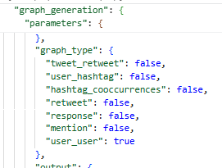
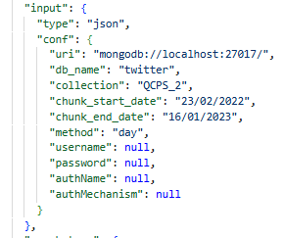
Properties File
In order for the user-user graph to be created, the task `user_user` must be set to `true` in the `properties/prop.json` file.
The database credentials must be correct, such as database, collection, ip, password,… (except if it's the local mongo database at 127.0.0.1, the default values are correct)

Slide 4
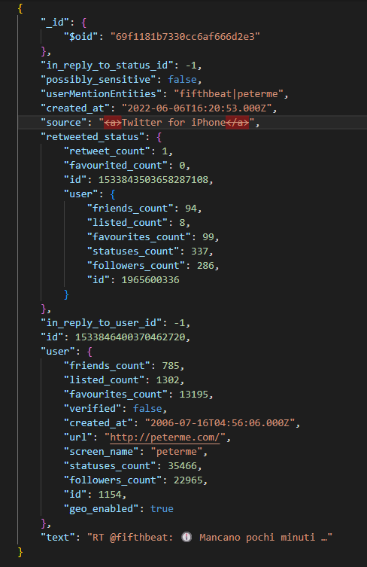
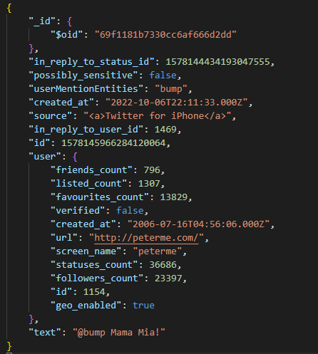
2. Mongo Database
Our mongo database has a collection called `QCPS_2`, containing over 500 million of tweets collected from feb 2022 to jan 2023.
However, we don't have a user collection, so we will use the user contained in the tweet instead.
The source tweet retweeted by this tweet
(this field exists only if the current tweet is a retweet)
reply tweet
User's profile at the time
when the tweet was published
retweet tweet ←

Slide 5
3. Fetched data
1. Extracting all tweets
2. Tweets sorted by users
3. Features computed by user batch
Mongo Database
Tweet 1
User A
Tweet 2
User B
Tweet 3
User C
Tweet 4
User B
Tweet 5
User A
Tweet 6
User A
Tweet 7
User C
Tweet 8
User C
Tweet 9
User C

Slide 6
3. Fetched data
1. Extracting all tweets
2. Tweets sorted by users
3. Features computed by user batch
Mongo Database
Tweet 1
User A
Tweet 5
User A
Tweet 6
User A
Tweet 2
User B
Tweet 4
User B
Tweet 3
User C
Tweet 7
User C
Tweet 8
User C
Tweet 9
User C

Slide 7
3. Fetched data
1. Extracting all tweets
2. Tweets sorted by users
3. Features computed by user batch
Mongo Database
Tweet 1
User A
Tweet 5
User A
User A
Tweet 6
User A
Once we finished iterating on all user A tweets, These tweets are aggregated to compute their features.
In reality, we use a batch of X users, per iteration and then create checkpoint files for performance reason
Tweet 2
User B
User B
Tweet 4
User B
Tweet 3
User C
Tweet 7
User C
User C
Tweet 8
User C
Tweet 9
User C

Slide 8
Phase 2: User features computation
We compute user features by iterating over every tweets, user by user. Since our tweets are ordered by user id. We know that when the next user id is different, we finished iterating over all the tweets of the current user. For example:
First tweet (by user A)
Second tweet (by user A)
Third tweet (by user A)
Fourth tweet (by user B)
The fourth tweet has a different user → It means that we finished iterating over all user A's tweet. So we can now aggregate their tweets and compute their features.
Note: There are 2 different steps in this features computation:
Iteration on every tweets + creating checkpoints for every batch + features/edges computation
Merging all checkpoints, creating a full list of nodes, edges, screen_name-id map + save as CSV
Once these steps are accomplished, the data extraction is finished, the next step is Graph construction.
User A's tweets
Different user id

Slide 9
4. Computing features
4. Features Computation
Tweet 1
User A
Tweet 5
User A
User A
Tweet 6
User A
Tweet 2
User B
User B
Tweet 4
User B
Tweet 3
User C
Tweet 7
User C
User C
Tweet 8
User C
Tweet 9
User C

Slide 10
4. Computing features
4. Features Computation
User A
User A features:
Tweet 1
User A
+
Tweet 5
User A
+
Tweet 6
User A
=
User B
User B features:
Tweet 2
User B
+
Tweet 4
User B
=
Batch 1
User C
User C features:
Tweet 3
User C
+
Tweet 7
User C
+
Tweet 8
User C
+
Tweet 9
User C
=

Slide 11
4. Computing features
5. For every batch, checkpoint files are created
User A
User B
User C
User D
User E
User F
…
Batch 1
User G
User H
User I
User J
User K
User L
…
Batch 2
User M
User N
User O
User P
User Q
User R
…
Batch 3
(The batch size is defined by us, for example 1000 users)

Slide 12

4. Computing features
5. For every batch, checkpoint files are created
User B
User C
User D
User E
User A
User F
Batch 1
User H
User I
User J
User K
User G
User L
Batch 2
User N
User O
User P
User Q
User M
User R
Batch 3
(The batch size is defined by us, for example 1000 users)

Slide 13
4. Computing features
5. For every batch, checkpoint files are created
Batch 1
user_features
edges_mention
edges_reply
edges_retweet
Screen_name_map
Batch 2
user_features
edges_mention
edges_reply
edges_retweet
Screen_name_map
Batch 3
user_features
edges_mention
edges_reply
edges_retweet
Screen_name_map
(The batch size is defined by us, for example 1000 users)

Slide 14
5. Merging batch results
5. For every batch, checkpoint files are created
Merged
user_features
user_features
user_features
edges_mention
edges_mention
edges_mention
edges_reply
edges_reply
edges_reply
edges_retweet
edges_retweet
edges_retweet
Screen_name_map
Screen_name_map
Screen_name_map
User nodes
Edges
Useful dictionary used
to build a mention graph
by finding user id via it
(The batch size is defined by us, for example 1000 users)

Slide 15
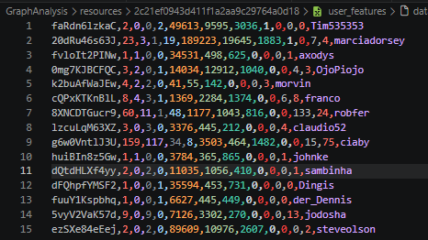
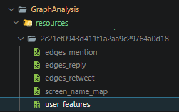
5. Merging batch results
Concretly, we generate a csv file containing all the features:
Each line in this file is a user node with its features.

Slide 16
5. Merging batch results
Note: the user id we saved in the csv file is actually an ID that was hashed and converted to base 62 in order to have a homogeneous data and to save some disc space
Stored tweet id in csv = base62( id )

Slide 17
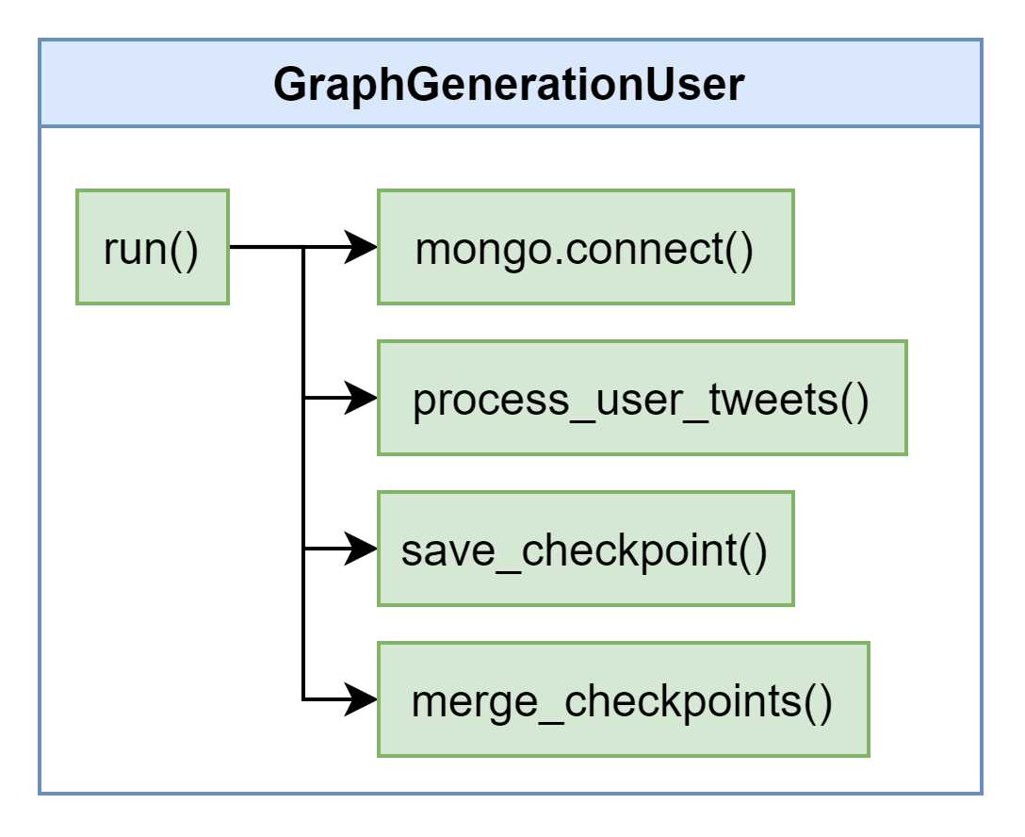
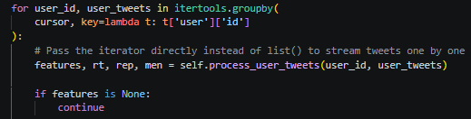
Concretly in the code
The logic is handled by the class `GraphGenerationUser`.
First we initialize a connection to Mongo database
Then we create a first cursor to extract all the users ordered by `user.id`
Then this cursor is grouped by the user id and delegated to the method `process_user_tweets()` to extract the features.
When a user batch is processed, a checkpoint is created `save_checkpoint()`
When we iterated over all tweets, the `merge_checkpoints()` is called to get the final result

