Slide 1
Productionizing your ML models
Emiel de Heij
Menno Liefstingh

Slide 2
Today’s subjects
About Vantage AI
About today’s case
What is an API?
Live demo: making a model endpoint with FastAPI
Containerization
Live demo: Deploying our model with Docker
Try it yourself

Slide 3









About us
Menno Liefstingh
Machine Learning Engineer at Vantage AI
Emiel de Heij
Machine Learning Engineer at Vantage AI
2014-2017: BSc Organization Studies
2018-2020: MSc Data Science & Entrepreneurship (joint degree)
2018-2020: Various projects for SMEs
as a freelancer
2020-2021: NLP Data Scientist
Currently: Data Scientist at the Ministry of Foreign Affairs (through Vantage AI)
2014-2018: BSc Artificial Intelligence
2019-2021: MSc Artificial Intelligence
2020: Web scraping/data science
2020-2021: Trainee Diagnostics & Prognostics
Currently: Machine Learning Engineer
(through Vantage AI)

Slide 4






Working as a consultant for Vantage AI
6-12 month assignments
36 hours per week for client + 4 hours training
Mentorship from BigData Republic expert
Fridays at our own office

Slide 5
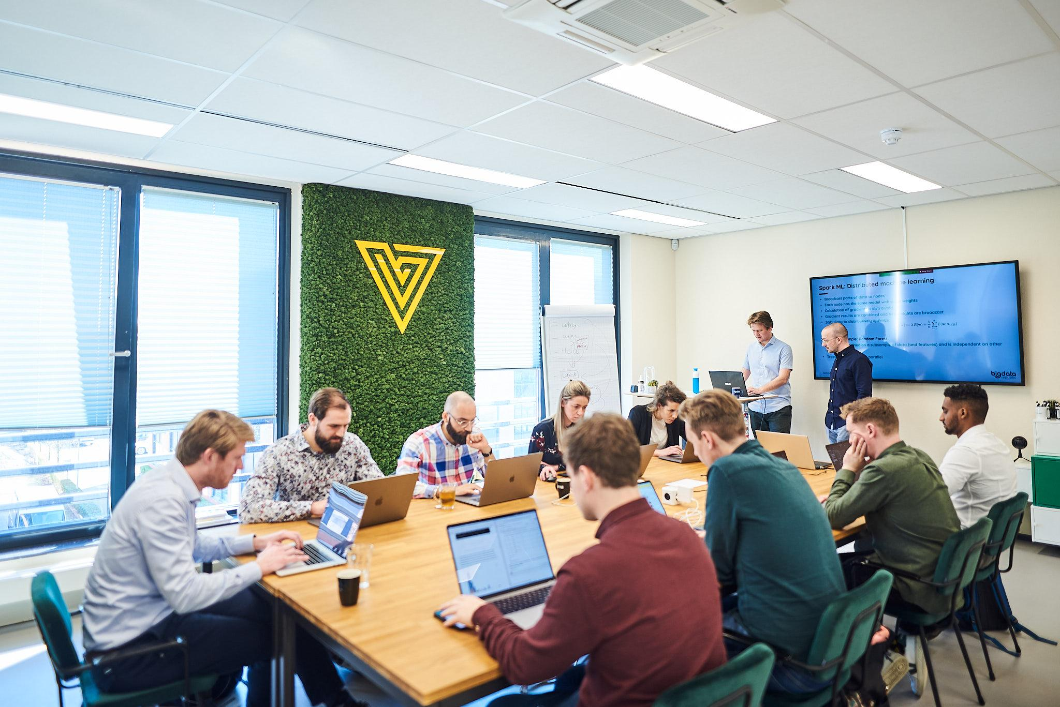
Vantage program
Training sessions every Friday morning on subjects we choose ourselves, like:
Docker
Kubernetes
Git
Advanced Python
Deep Learning
Testing
CI/CD
Apache Spark
Infrastructure as code

Slide 6
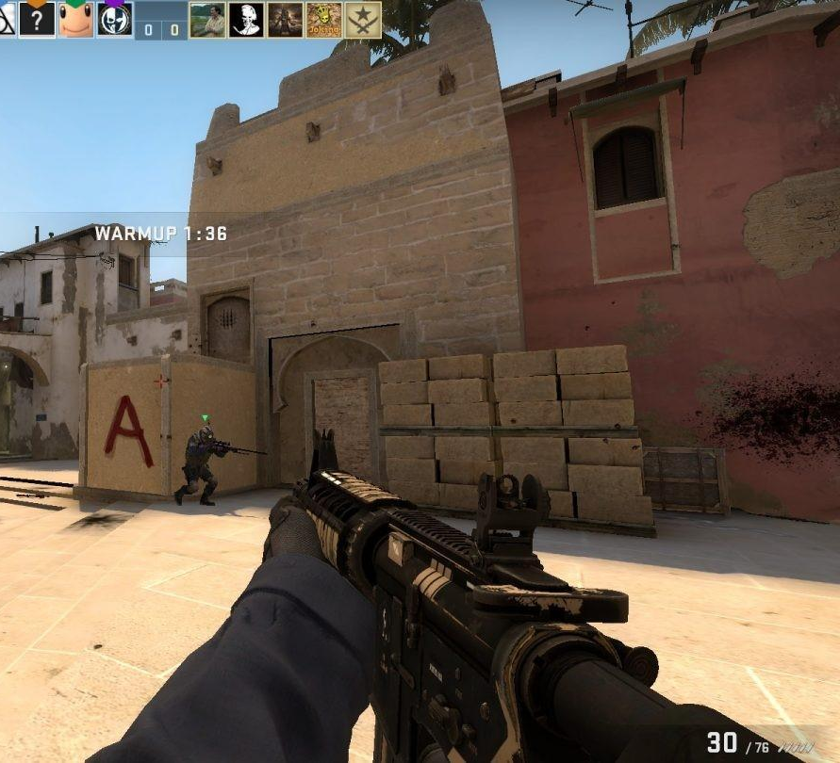
About the today’s case
LightGBM model that predicts the winner of a CS:GO round with +- 92% accuracy
+- 70 inputs:
Number of grenades, weapons etc. on each side
Player health
Map name, etc.
Confusion matrix looks good in notebook, let’s deploy the model! But how?

Slide 7
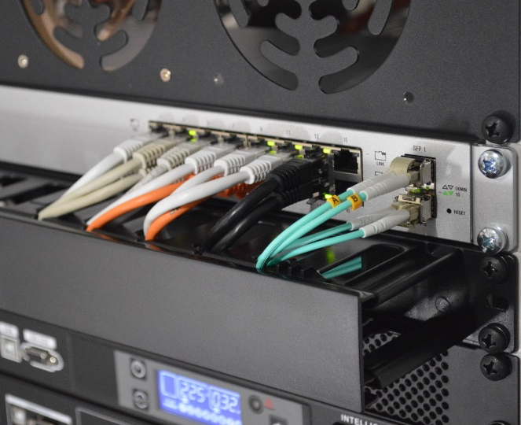
What is an API?

Slide 8
Application Programming Interface
Lets applications talk to each other
You can use API’s to:
Make a Twitter bot
Send data to your SQL server
Get F1 results
Make your own Reddit app, etc.
Today we’re making an API to serve a ML model

Slide 9
REST API’s
Representational State Transfer Application Program Interface
Allows applications to talk to each other over the internet (with http)
Different kinds of requests (API calls):
GET request: gets information from the API
POST requests: sends information and receives a result
PUT/PATCH are used for replacing or updating information
DELETE speaks for itself

Slide 10

Return codes
REST API’s work over http, and therefore use http status codes:
200: successful request
400: bad request
401: not authorized
404: not found
500: internal server error
503: service unavailable, etc.
418: google.com/teapot

Slide 11

Live demo: serving our model with FastAPI
Notes:
Why FastAPI?
Flask is historically used as a web framework for building APIs with python, however, FastAPI is gaining popularity fast and has some advantages on Flask.
First of all, it is fast.
Also: easy to debug, comes with built-in support for python type hints and it is robust: Get production-ready code. With automatic interactive documentation.

Slide 12

Containerization

Slide 13
Containerization
What if you want to deploy your model to a server?
You need to install the right dependencies for the server OS
Find a spot on the server to put your files
Make sure your installation doesn’t interfere with other things running on the server
Deal with things changing on the server -> your app breaking
Other apps can take up resources of your app

Slide 14

Enter Docker:
Docker is a framework for containerization
Apps run within a virtual container, separated from other apps
Docker containers run the same on any host machine: they have their own virtual OS installed
Enables microservice architectures: lots of different containers with simple tasks talking through each other through API’s

Slide 15
Main benefits of containerization
Containers run the same on any machine
Easy to use
Quickly build and test applications
Lightweight and quick: very little overhead
Enables better scalability
Tools like Kubernetes can be used to manage containers in production environments
Ask us about this if you’re interested and we (extra) have time!

Slide 16
Live demo: deploying our model with Docker

Slide 17

Try it yourself!
Clone github.com/Vantage-AI/docker-workshop
We are available for questions
Follow us on LinkedIn! ->

