Slide 1
Kubernetes basics
Part 2
Notes:
Make it less mystical
Not need to understand everything

Slide 2
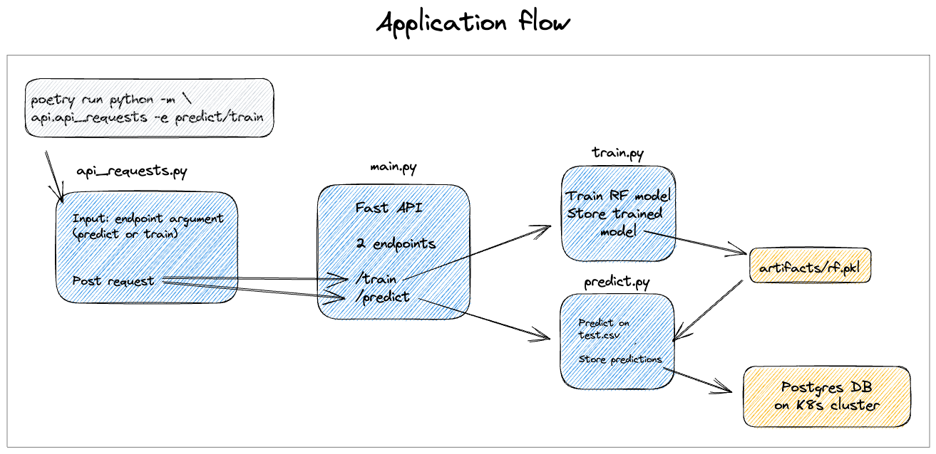
Architecture

Slide 3
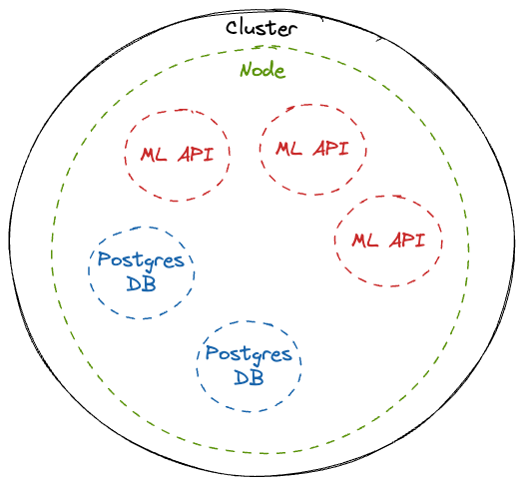
Architecture

Slide 4
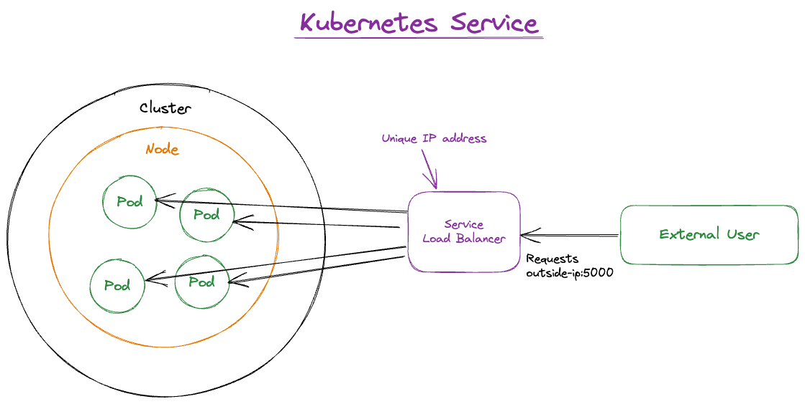
Service

Slide 5
Contents
Statefull vs Stateless
Storage on K8s
Components of K8s
Autoscaling
K8s at our clients

Slide 6
K8s Resources
Cluster
Nodes
Workloads
Pods
Deployments
DeamonSets
StatefulSets
ReplicaSets
Jobs
CronJobs
Config
ConfigMaps
Secrets
Resource Quotas
Limit Ranges
HPA
Pod Disruption Budgets
Priority Classes
Runtime Classes
Leases
Network
Services
Endpoints
Ingresses
Network Policies
Port Forwarding
Storage
Persistent Volume Claims
Persistent Volumes
Storage Classes
Namespaces
Events
Access Control
Service Accounts
Cluster Roles
Roles
Cluster Role Bindings
Role Bindings
Pod Security Policies
CRD
...
Nodes
Pods
Deployments
DeamonSets
StatefulSets
ReplicaSets
Jobs
CronJobs
ConfigMaps
Secrets
Resource Quotas
Limit Ranges
HPA
Pod Disruption Budgets
Priority Classes
create
get
describe
delete
edit
kubectl

Slide 7




Stateful vs Stateless
my-db
my-api
my-db-0
my-db-1
my-db-2
my-api-f2ik1e
my-api-4l21yx
my-api-ob572n
read
read
read
write
write
write
Notes:
Stateful – track states, example is database
Statefulset +
Own pvc
Reschedule pods, data will remain.
Persistent volume isn’t deleted when pod is deleted.
Pods are created/deleted one by one
Retain state and role
App must take care of cloning and data sync

Slide 8
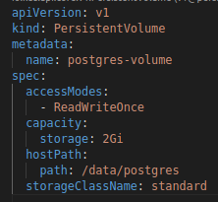


Storage on K8s
Persistent Volume
Persists when pod dies / reschedules
Accessable from all nodes
Survives when cluster crashes
NODE
NODE
NODE
200 Gb
my-app
10 Gb
10 Gb
Notes:
Persistent volume
- storage persists when pods dies/rescheduled
- storage available on alle nodes
- storage persist when cluster crashes
Storage backends
- local storage / remote! - 25#
Admin creates pv, Developer claims storage.
K8s matches pvc to pv
Mount pvc in pod and container

Slide 9
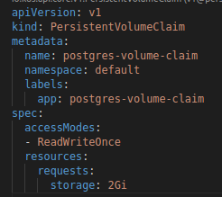
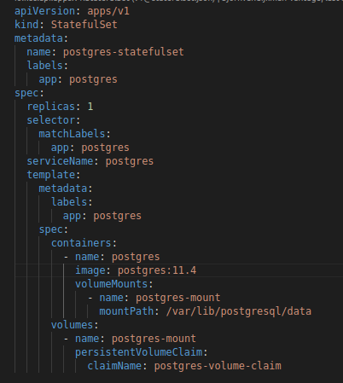

Storage on K8s
NODE
NODE
NODE
200 Gb
my-app
10 Gb
10 Gb
Notes:
Persistent volume
- storage persists when pods dies/rescheduled
- storage available on alle nodes
- storage persist when cluster crashes
Storage backends
- local storage / remote! - 25#
Admin creates pv, Developer claims storage.
K8s matches pvc to pv
Mount pvc in pod and container

Slide 10
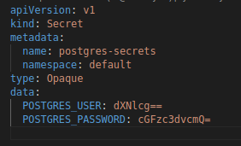
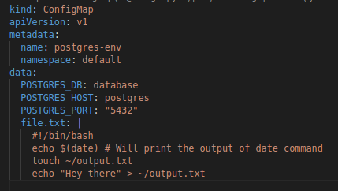


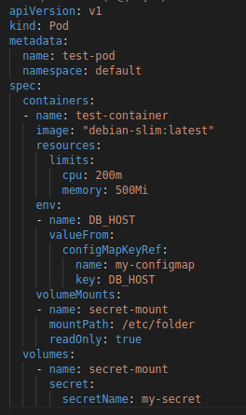
Storage on K8s
ConfigMap
Secret
NODE
NODE
NODE
200 Gb
my-app
10 Gb
10 Gb
Notes:
- stored in etcd
- secret is base64 encoded, because binary-data
- mount in pod, and in a (subset of) pods
- configure access to secret
- encrypt secrets at rest
- use external secret store provider

Slide 11
Components of K8s
MASTER
NODE
NODE
Starts pods
Handles user interaction with cluster
kubelet
kubelet
kube api
Intelligently handles communication between pods
Intelligently assigns pods to nodes
kube-proxy
kube-proxy
scheduler
Detect cluster state changes, and recover the desired state.
controller
Database with cluster state
etcd
PVs

Slide 12
Autoscaling
VerticalPodAutoscaler
HorizontalPodAutoscaler
Node auto scaling
NODE
NODE

Slide 13
Perks of K8s
High availability
Self healing
Disaster Recovery
Notes:
High availability (App must be smart)
Self healing
Disaster recovery
etcd snapshots
PV backups
backup cluster

Slide 14






K8s at our clients
Notes:
- private cluster
- 60 worker nodes, 20 met gpu, 5 master, 3 vault
- container registry
- s3 storage
- UI, Notebooks, Applications
- Netwerk, monitoring, security, Databronnen
-

Slide 15
Handson
PostgreSQL Database (volumes, configmaps, Secrets, statefullSet)
Monitoring on logging with Loki (helm chart)
StreamLit app (Deploy a custom dashboard)
Adminer (Deploy a user interface for the database)
Autoscaling (horizontalPodAutoscaler)

