Slide 1
Testing for Data Science
Notes:
Input and change of text and/or images
Select a textbox
Type or copy/paste your story
IMPORTANT: Pasting text should be done with unformated text (On Home tab use the Paste pulldown and choose Paste special… than choose Unformated text)
On Mac: Command + Control + V than choose unformated text
On Windows: On Home tab use the Paste pulldown and choose Paste special… than choose Unformated text (https://nutsandboltsspeedtraining.com/powerpoint-tutorials/paste-special-powerpoint/)
Select your text
Press ‘Tab’ on your keyboard to go to the next preset text style. We have 9 different styles on regular Text placeholders (Heading placeholders are always in 1 style)
Subheading QuickSand Bold blue 32 / 42 pt
Subheading QuickSand Bold turquoise 32 / 42 pt
Subheading QuickSand Bold white 32 / 42 pt
Body text Muli Light blue 28 / 38 pt
Body text Muli Light white 28 / 38 pt
Bullet Muli Light blue 28 / 48 pt
Bullet Muli Light white 28 / 48 pt
Quote QuickSand Regular turquoise 34 / 40 pt
Quote QuickSabd Regular white 34 / 40 pt
Press ‘Shift Tab’ to go to the previous style!
Change footer Testing for Data Science by going to the Insert tab, than choose Header & Footer, than check footer, and fill your title. Press Apply to all!
Change presentation date by going to the insert tab, than choose Date & Time, than check date & time, choose format. Press Apply to all! (Date is only present on presentation title slide, uncheck in Date & Time if you do not want a date on this slide!)
On many pages you can change the background image (i.e.Presentation slide): format background: insert image from file. Choose your picture from the Assets folder!
On content slides with a visual: change the default visual: format background: insert image from file (assets folder). Choose your picture! Possible change position by changing the offset percentages

Slide 2
What testing platforms are out there?
How many tests should you write?
How to make tests fast?
What is test driven development?
How to integrate test in your CI/CD?
How to test for Data Science?

Slide 3
Overview of last week
Folder structure
test_data.py
├── src
│ ├── data.py
│ └── model.py
├── tests
│ ├── pytest_basetemp
│ │ └── test_save_data0
│ │ └── file.csv
│ ├── conftest.py
│ ├── test_data.py
│ └── test_model.py
└── pyproject.toml
import pytest from src.data import read_data, save_data @pytest.mark.parametrize("location, expected", [("folder_a", 1000), ("folder_b", 1000)]) def test_read_data(location, expected): result = read_data(path=location) assert len(result) == expected def test_save_data(tmp_path): save_data(path=tmp_path)
pyproject.toml
[tool.pytest.ini_options] testpaths = [ "tests", ] markers = [ "slow: marks tests as slow (deselect with '-m \"not slow\"')", ] addopts = "--basetemp tests/pytest_basetemp" filterwarnings = [ 'ignore::DeprecationWarning' ]
Notes:
Mappenstructuur (welke keuzes kun je hierin maken)
Test discovery (bestanden, functies, classes, methods)
Conftest.py

Slide 4
What testing platforms are out there?
How many tests should you write?
How to make tests fast?
What is test driven development?
How to integrate test in your CI/CD?
How to test for Data Science?

Slide 5
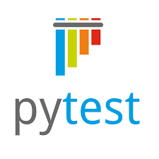




What testing platforms are out there?
What testing platforms are out there?
Notes:
Third party vs built in
Nose is an extension of unittest. Nose recommends to use Nose2, and Nose2 recommends to use Pytest.
Unittest is built in, but you can pip install some new functionality with unittest2

Slide 6
What testing platforms are out there?
def factorial(n: float) -> float: """Return the factorial of n, an exact integer >= 0. >>> [factorial(n) for n in range(6)] [1, 1, 2, 6, 24, 120] >>> factorial(30) 265252859812191058636308480000000 >>> factorial(-1) Traceback (most recent call last): ... ValueError: n must be >= 0 """ if not n >= 0: raise ValueError("n must be >= 0") if math.floor(n) != n: raise ValueError("n must be exact integer") if n+1 == n: # catch a value like 1e300 raise OverflowError("n too large") result = 1 factor = 2 while factor <= n: result *= factor factor += 1 return result
Notes:
Unreadable
Limits test structures
Verry little functionality
You can run doctests with pytest.

Slide 7
What testing platforms are out there?
from unittest import TestCase from src.utils import Connection class TestExample(TestCase): @classmethod def setUpClass(cls): cls.conn = Connection() @classmethod def tearDownClass(cls): cls.conn.close() def setUp(self): self.sess = self.conn.new_session() def tearDown(self): self.sess.close() def test_boolean(self): self.assertTrue(self.sess.is_up()) def test_session_status(self): self.assertEqual(self.sess.status(), "running") def test_multi_param_stuff(self): for i in range(10): with self.subTest(i): self.assertEqual(0, i)
import pytest from src.utils import Connection @pytest.fixture(scope='session') def connection(): conn = Connection() yield conn conn.close() @pytest.fixture def session(connection): sess = connection.new_session() yield sess sess.close() def test_boolean(session): assert session.is_up() def test_session_status(session): assert session.status() == "running" @pytest.mark.parametrize('i', range(10)) def test_multi_param_stuff(i): assert 0 == I
Notes:
Xunit style of tests
Different assertions
Pytest can run unittest
Different parametrizing
Different fixture settings

Slide 8
What testing platforms are out there?
How many tests should you write?
How to make tests fast?
What is test driven development?
How to integrate test in your CI/CD?
How to test for Data Science?
Notes:
I hope I convinced some of you of the power of tests. But maybe some are till worried about the amount of work that comes with it.
What are bennefits of Tests?
To have some measure about the amount of tests, you can meassure code coverage.
pip install
pytest --cov src
pytest --cov-report html --cov .

Slide 9
How many tests should you write?
Tests will…
…detect errors/bugs.
…prove correctness of code.
…ensure faster maintenance.
Guidelines:
Aim for a test coverage > 80%.
Write a test, before fixing a bug.
Notes:
Set the guidelines with your team.
Mutation testing
Test_driven development

Slide 10
What testing platforms are out there?
How many tests should you write?
How to make tests fast?
What is test driven development?
How to integrate test in your CI/CD?
How to test for Data Science?

Slide 11
How to make tests fast?
Tell test-runner where your tests are located
testpaths = [
"tests", # In pyproject.toml.
]
Find slow tests
pytest --durations=10 # Shows times of 10 slowest tests.
pytest --durations=-1 # Shows times of all tests.
Only run a selection of tests
pytest –m <marker> # Select by marker.
pytest –k <name> # Select by name.
pytest --last-failed (--lf) # Only runs test that failed in the last run.
pytest --failed-failed (--ff) # Runs failed tests before other tests.
pytest --new-first (--nf) # Runs new tests before other tests.
pytest –x # Stop if 1 test fails.
pytest --stepwise (--sw) # Runs tests until 1 fails, continues from that one the next time.
pytest --stepwise –stepwise-skip # Skips one failing test, in the stepwise process.
Notes:
The less time it takes to run tests, the more you will press that button to test your project.

Slide 12
How to make tests fast?
Monkeypatch (fixture)
Replaces functions, classes, dictionaries etc. with a “fake” version during a test.
data_model.py
test_data_model.py
from random import random class Employee: def __init__(self): self.salary = int(random() * 1000)
from data_model import Employee import data_model def test_employee(monkeypatch): monkeypatch.setattr(data_model, "random", lambda: 0.5) employee = Employee() assert employee.salary == 500
Notes:
Only test your own code!

Slide 13
How to make tests fast?
Monkeypatch (fixture)
Replaces functions, classes, dictionaries etc. with a “fake” version during a test.
app.py
test_app.py
import requests from datetime import date def max_temperature_on_day(day: date): response = requests.get(
f"https://www.weather.com/temperatures?day={day}") json_data = response.json() return max(json_data["temperatures"])
import requests from app import max_temperature_on_day class MockResponse: @staticmethod def json(): return {"temperatures": [7, 7, 6, 4, 4, 4, 7, 9, 13, 17, 16, 17, 17, 17, 18, 9, 9, 9, 8, 7, 8, 7, 7, 6]} def test_max_temperature_on_day(monkeypatch):
def mock_get(*args, **kwargs): return MockResponse() monkeypatch.setattr(requests, "get", mock_get)
result = max_temperature_on_day(day=date(12, 12, 2001)) assert result == 18
Notes:
Test should not dependent on external factors.
Show example of monkeypatching gridsearch.

Slide 14
How to make tests fast?
Cache
Place where pytest saves test_ids from discovery, outcomes of previous test runs, etc.
But you can also store your own values.
Clear the cache for a fresh run with: pytest --cache-clear
Terminal
$ pytest tests/test_cache.py::test_function
========================= test session starts ==========================
platform win32 -- Python 3.7.11, pytest-7.1.1, pluggy-0.13.1
cachedir: tests\.pytest_cache
rootdir: ...\testing_for_data_science_day_2, configfile: pyproject.toml
plugins: cov-2.9.0, env-0.6.2, mock-3.6.1
collected 1 item
tests\test_cache.py . [100%]
========================== 1 passed in 10.01s ==========================
$ pytest tests/test_cache.py::test_function
========================= test session starts ==========================
platform win32 -- Python 3.7.11, pytest-7.1.1, pluggy-0.13.1
cachedir: tests\.pytest_cache
rootdir: ...\testing_for_data_science_day_2, configfile: pyproject.toml
plugins: cov-2.9.0, env-0.6.2, mock-3.6.1
collected 1 item
tests\test_cache.py . [100%]
========================== 1 passed in 0.02s ===========================
The example
import pytest import time def expensive_computation(): time.sleep(10) # running expensive computation... @pytest.fixture def mydata(request): val = request.config.cache.get("example/value", None) if val is None: expensive_computation() val = 42 request.config.cache.set("example/value", val) yield val def test_function(mydata): assert mydata == 23
Notes:
Only test your own code!

Slide 15
What testing platforms are out there?
How many tests should you write?
How to make tests fast?
What is test driven development?
How to integrate test in your CI/CD?
How to test for Data Science?

Slide 16
What is test driven development?
Write a test that fails.
Write code to make the test pass.
Notes:
Super kleine loop, lijkt vervelend, maar je productie code sloot 1 minuut geleden nog aan bij je tests. De volledige functionaliteit is beschreven in je tests.
Dit beantwoord ook direct de vraag: hoeveel tests moet je schrijven?
Het geeft je ook volledig vertrouwen in je tests.
Het is niet iets wat je van de een op de andere dag kan toepassen, maar iets om te oefenen en uiteindelijk kan toepassen in je werk.
Demo -> aansturen op requirements.

Slide 17
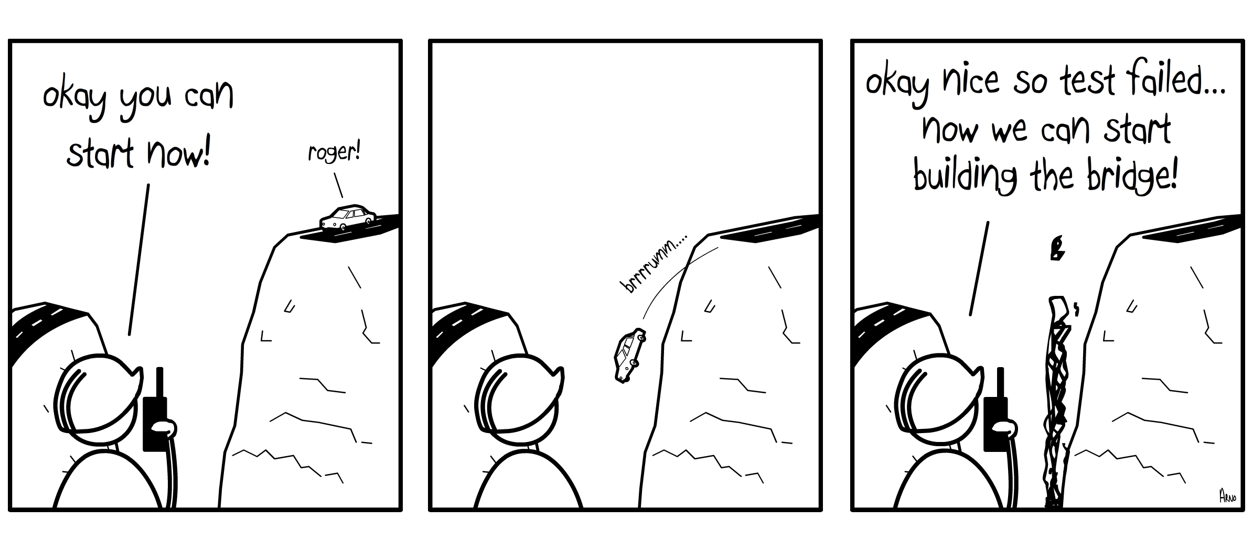
What is test driven development?
Notes:
Terugkomen op uitleg van ttd.

Slide 18
What testing platforms are out there?
How many tests should you write?
How to make tests fast?
What is test driven development?
How to integrate test in your CI/CD?
How to test for Data Science?

Slide 19
How to integrate test in your CI/CD?
integration tests
integration tests
integration tests
unit tests
run unit tests
manually
deploy
infra
deploy solution
deploy
infra
deploy solution
deploy
infra
deploy solution
Commit
Pull request
develop
Pull request
acceptance
Pull request
production
Show test results and coverage
in pull request timeline

Slide 20
What testing platforms are out there?
How many tests should you write?
How to make tests fast?
What is test driven development?
How to integrate test in your CI/CD?
How to test for Data Science?

Slide 21
How to test for Data Science?
No
import pandas as pd def read_article_data(filepath: str): return pd.read_csv(file=filepath) def test_read_article_data(): article_data = read_article_data() assert all(article_data.price > 0)
Compare numbers
import numpy as np
import pandas as pd
from pytest import approx
import numpy as np import pandas as pd from pytest import approx def test_add(): assert 0.1 + 0.2 == 0.3 # False assert 0.1 + 0.2 == approx(0.3) # True assert 0.1 + 0.2 == approx(0.3, rel=1e-6, abs=1e-12) # True def test_numpy(): assert np.array([0.1, 0.2]) + np.array([0.2, 0.4])\
== approx(np.array([0.3, 0.6])) assert np.array([0.1, 0.2]) + np.array([0.2, 0.1]) == approx(0.3) def test_pandas(): pd.testing.assert_frame_equal(pd.DataFrame([0.1, 0.2]) + pd.DataFrame([0.2, 0.4]), pd.DataFrame([0.2, 0.6]))
Don’t confuse testing with data validation.
Create dummy data.
- Commit it to the repo, to make test repeatable.
- Anonymize all personal data.
- Automate this process in a script.
Compare numbers with tolerances.
Yes
import pandas as pd import os def read_article_data(file_path: str): df = pd.read_csv(file_path) df = df[df.price > 0] return df def test_read_article_data(tmp_path): input_data = pd.DataFrame([["apple", 1.29], ["banana", -1]], columns=["id", "price"]) file_path = os.path.join(tmp_path, "bad_data.csv") input_data.to_csv(file_path) article_data = read_article_data(file_path) assert list(article_data.id) == ["apple"]
Notes:
Show how dummy_data.csv is created in repo. Creates webpage, because we don’t want to rely on internet connection, or changes from other resources. Tests are repeatable.

