Slide 1
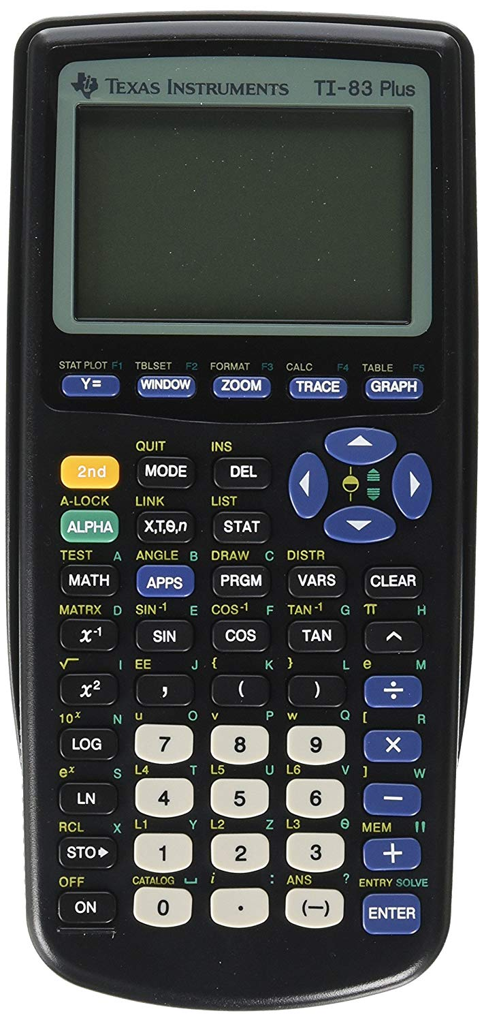
CPU
RAM
Display of 96 x 64 pixels
I/O link port
Powered by 4 AAA batteries

Slide 2
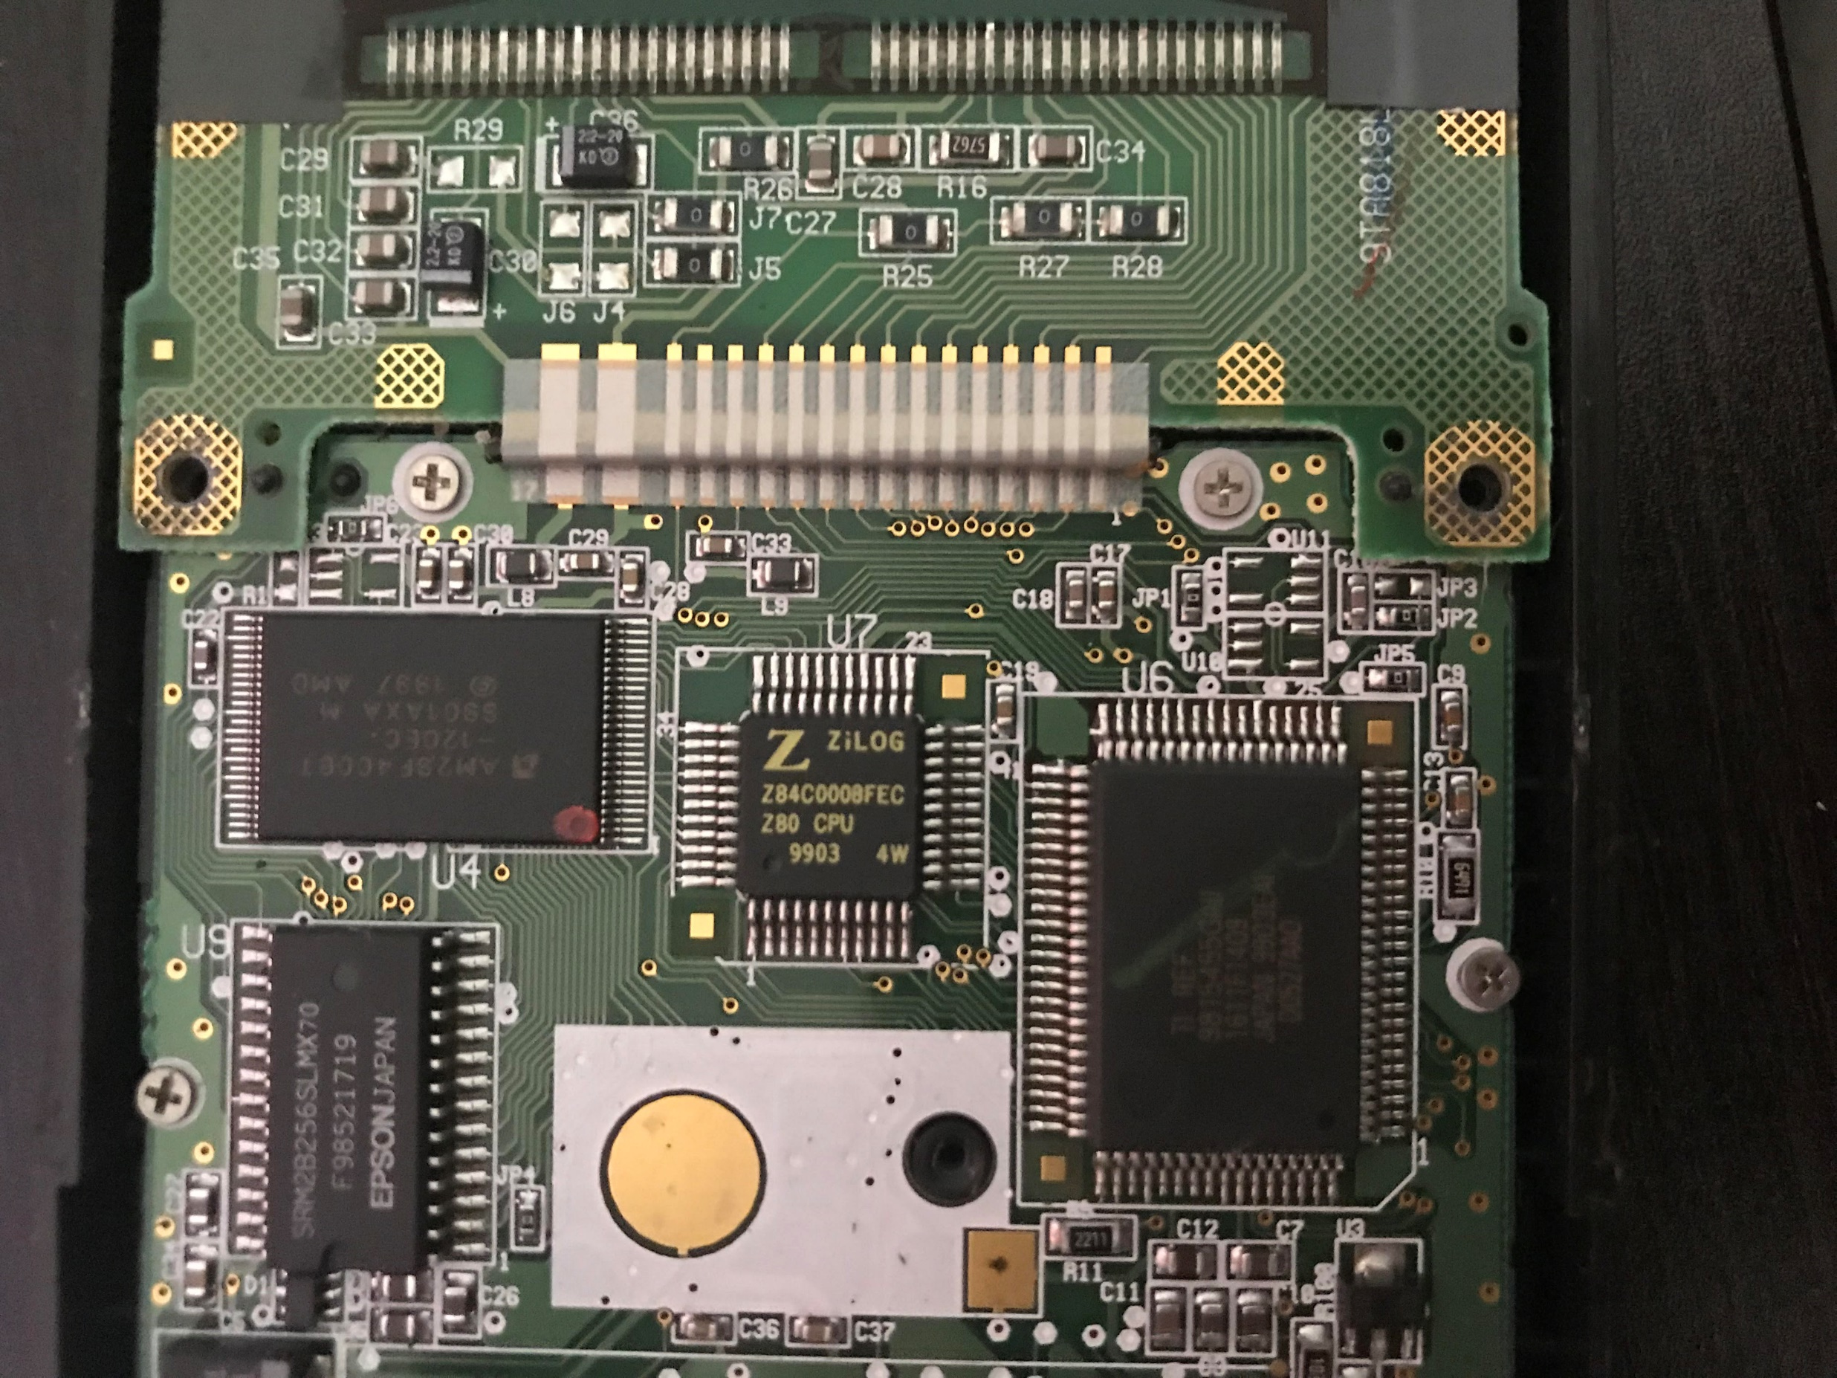
Circuit Board

Slide 3
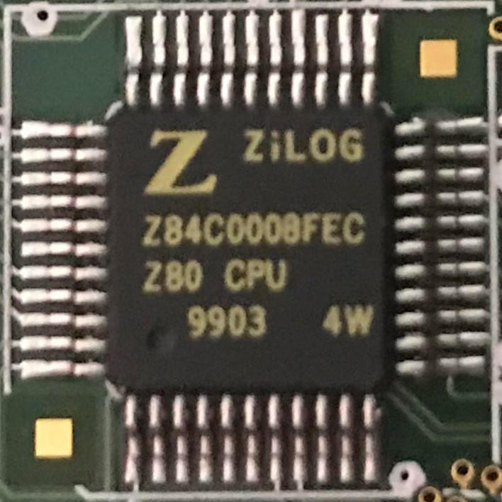
Central Processing Unit
Manufactured by ZiLOG
6 MHz
8-bit CPU
16-bit addressing
Can program in assembly

Slide 4
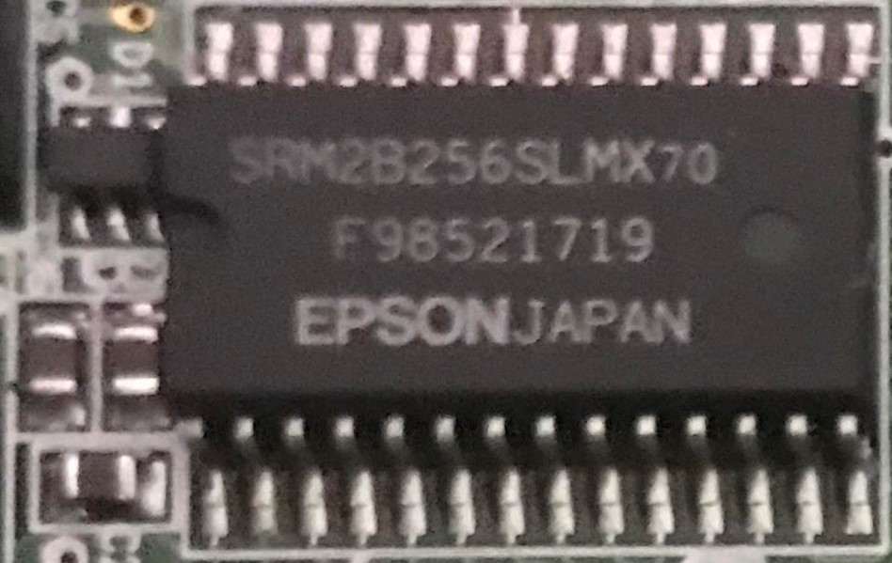
Random Access Memory
32 kB RAM
24 kB available to user
Can be read and written

Slide 5
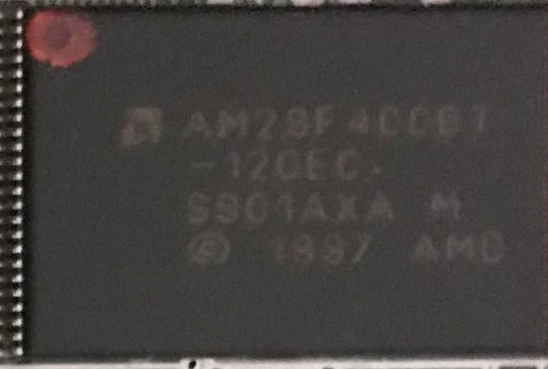
Flash ROM Memory
512 kB of Flash ROM
163 kB is available to the user
Non-volatile memory that can be erased and reprogrammed
User can store programs and data here

Slide 6
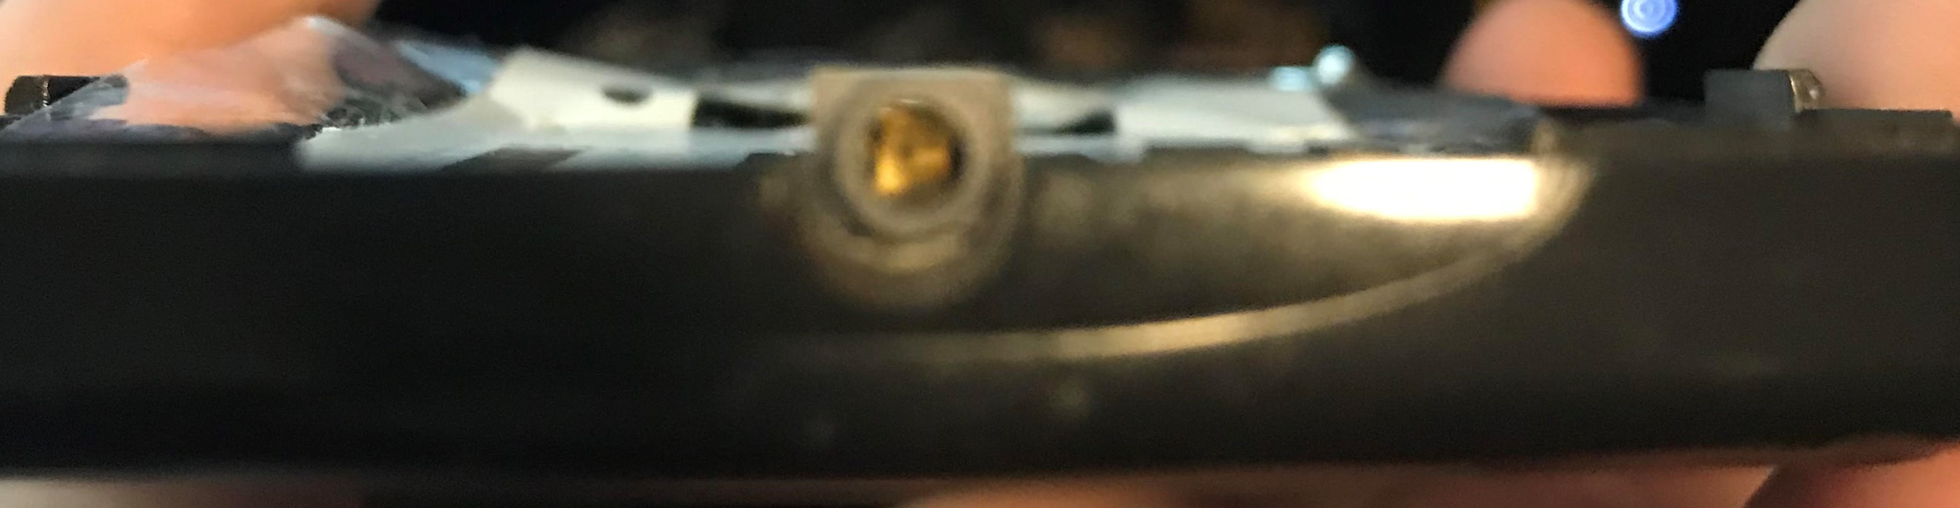
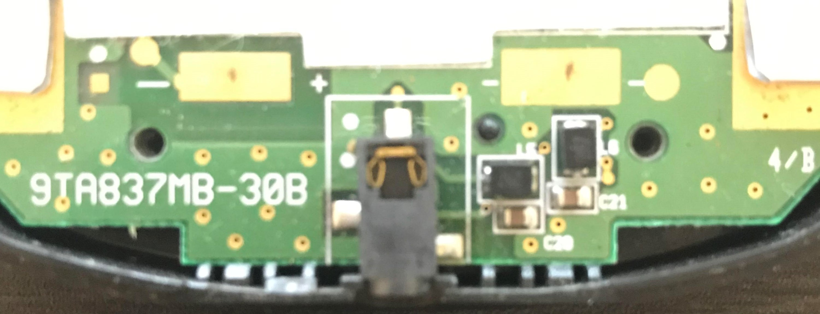
I/O Communication Port
Serial link port
Can load programs to the calculator
Able to program in assembly

