Slide 1
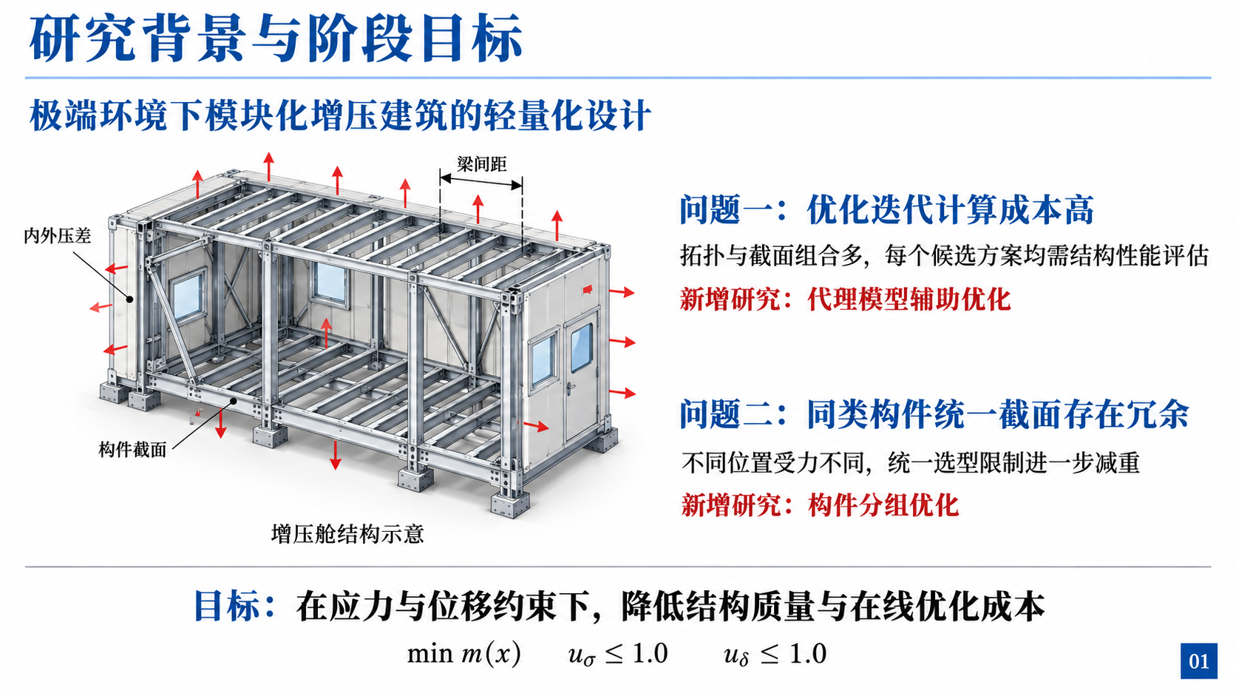
Notes:
Sources: README.md; project structural design and evaluation code. Building illustration is schematic.

Slide 2
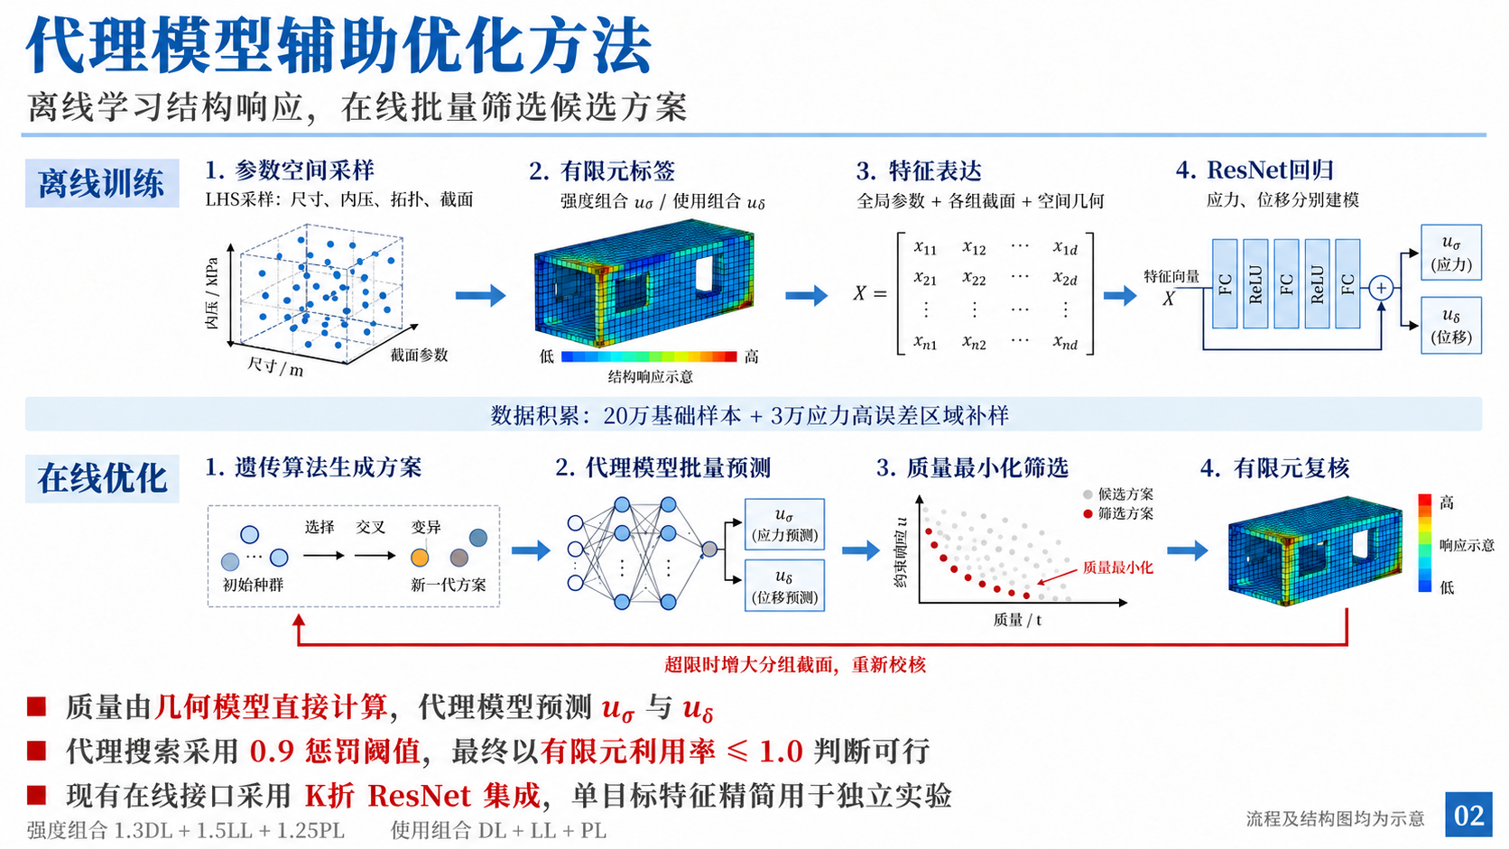
Notes:
Sources: src/analysis/surrogate_data.py; surrogate_model.py; evaluator.py; src/optimization/parallel_ga.py; grouped_workflow.py. All diagrams are schematic.

Slide 3
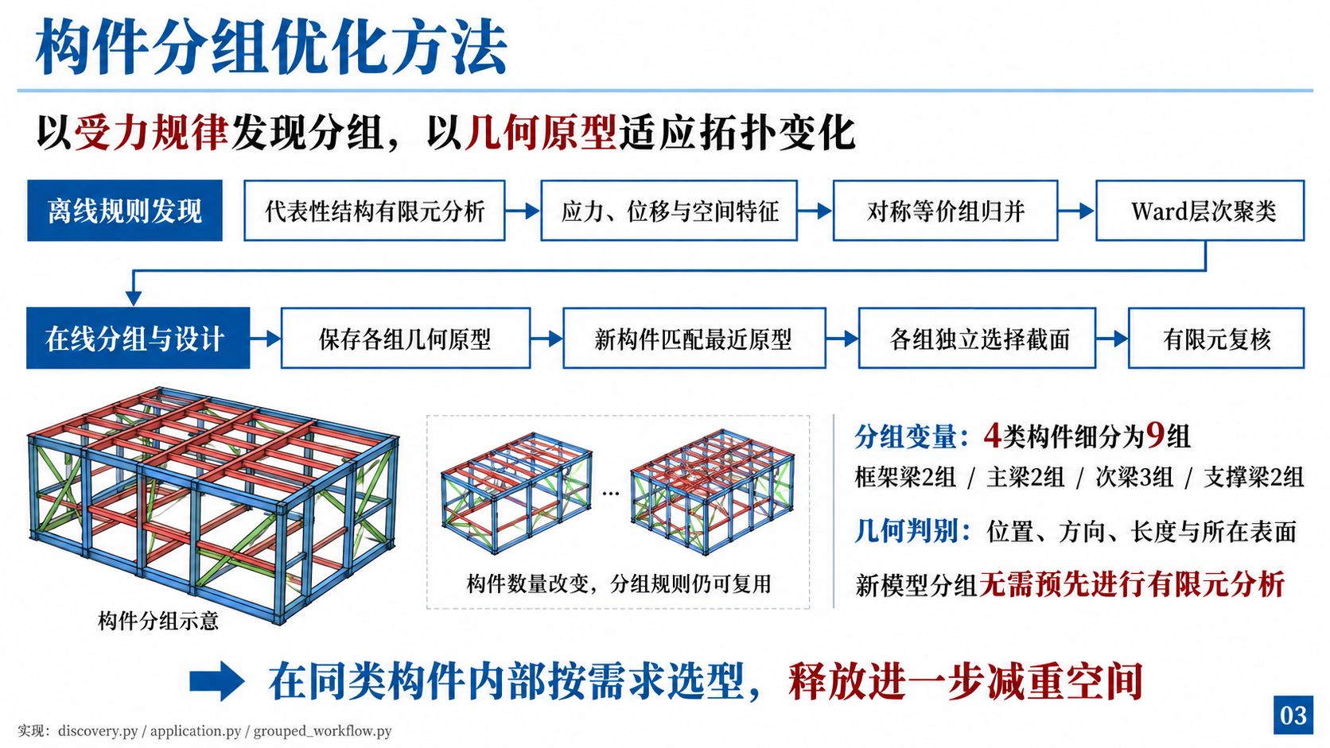
Notes:
Sources: src/structure/section_grouping/discovery.py; application.py; features.py. Grouping illustration is schematic.

Slide 4
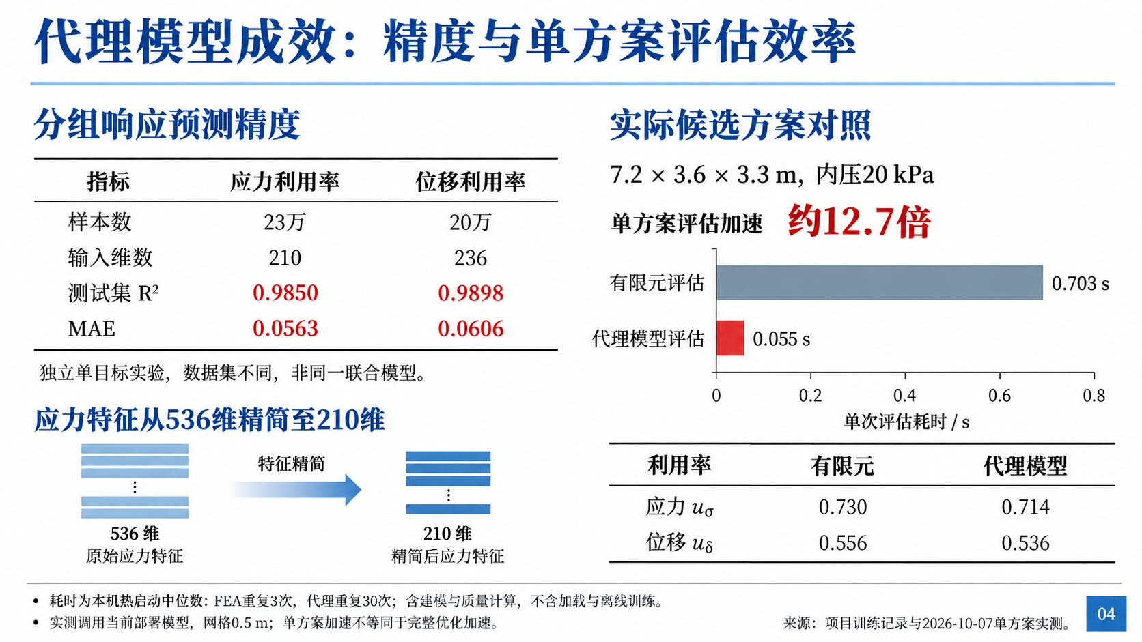
Notes:
Sources: benchmark.json; results/surrogate_data/engineering_230k_group_v2_tail/sigma_reduced_v2.json; results/surrogate_data/engineering_200k_group/delta_single_group_v1.json. Independent models; warm single-design timing, not end-to-end GA speedup.

Slide 5
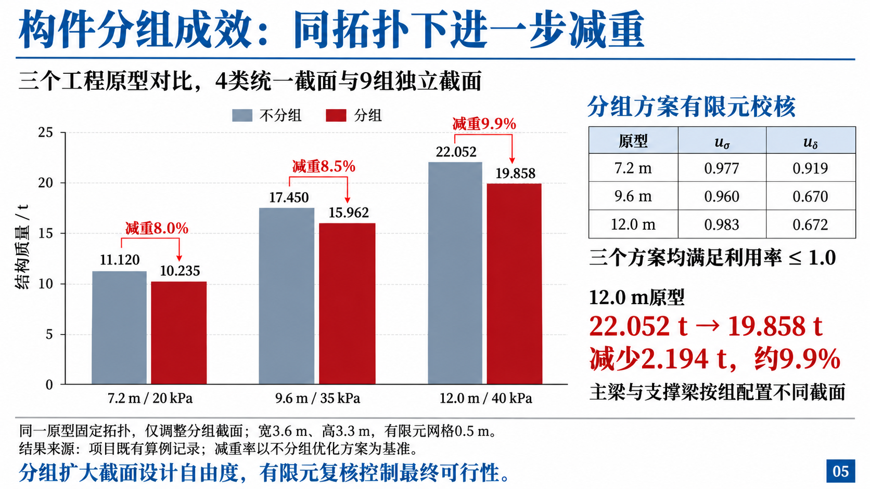
Notes:
Source: docs/section_grouping_optimization.md, section 5. Existing recorded cases, not rerun for this deck. Same topology comparison; mesh size 0.5 m.

