Slide 1
P5.JS
Library for creative coding!

Slide 2
What are we doing today?
Processing
Set Up
Live-Demo
References

Slide 3
Processing
“Processing has promoted software literacy, particularly within the visual arts, and visual literacy within technology.” – processing.org
Easy methods to draw to the screen
Visualization of data
JAVA (Processing), Python (Processing.py), Javascript (p5.js)

Slide 4
Set up
https://editor.p5js.org/

Slide 5
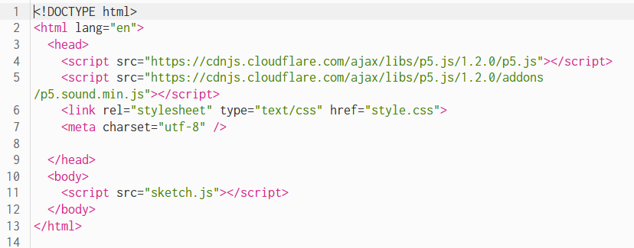
HTML

Slide 6
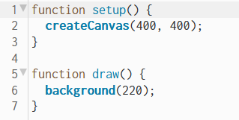
Javascript

Slide 7
DEMo in WEB-EDITOR

