Slide 1




BUSINESS PROPOSAL | ENDPOINT SECURITY
From Vulnerability Scanning to Real-Time Endpoint Protection
Nessus vs. CrowdStrike Falcon® Platform (EPP / EDR)
A comparative proposal for The Westin Resort Guam
PROPOSER
CLIENT
DATE
SECUKOREA Inc.
The Westin Resort Guam
September 2026
Solution
Notes:
Title slide. This proposal compares the resort's current tool, Nessus, with the CrowdStrike Falcon platform and recommends adding real-time endpoint protection.

Slide 2





EXECUTIVE SUMMARY
Nessus Finds Weaknesses. Falcon Stops Attacks.
The Westin Resort Guam already scans for vulnerabilities with Nessus. This proposal adds what scanning cannot provide: real-time prevention, detection and response on every endpoint — delivered from the cloud and backed by 24/7 experts.
WHERE WE ARE
THE GAP
OUR PROPOSAL
24/7 resort, lean IT team, scan-only security
Attacks move faster than scan cycles
CrowdStrike Falcon on every endpoint
Guest data, payments and front-desk systems must stay protected around the clock. Today Nessus reports vulnerabilities, but every fix and every incident depends on staff effort.
The fastest attackers now move from first access to other systems in 27 seconds. Between scans, a scanner cannot see or stop what happens on endpoints.
One lightweight sensor delivers next-gen antivirus (EPP) and EDR from the cloud — no on-site servers. SECUKOREA’s 24/7 support covers the staffing gap.
100%
273%
7×
97%
Detection & protection, zero false positives (MITRE ATT&CK® 2025)
Three-year ROI (Forrester Total Economic Impact™ study)
Named a Leader in the Gartner® Magic Quadrant™ for EPP
Willing to recommend (Gartner® Peer Insights™ for EPP, 2026)
Sources: CrowdStrike 2026 Global Threat Report; 2025 MITRE ATT&CK® Enterprise Evaluations; Forrester TEI of CrowdStrike Endpoint Security (commissioned, Nov 2025); Gartner® MQ for EPP (May 2026); Gartner® Peer Insights™ Customers’ Choice for EPP (2026).
02 | Nessus vs. CrowdStrike Falcon Platform · Proposal for The Westin Resort Guam
Notes:
Key message: Nessus tells us where we are exposed; Falcon stops attacks in real time. Walk through the situation, the gap, and the proposal, then point to the independent proof points.

Slide 3





01 CURRENT STATE
Current Environment & Security Challenges
24/7 Non-Stop Hospitality Operations
Guest personal data, payment processing, and front-desk and back-office systems must stay available and protected around the clock.
WHAT THE RESORT NEEDS
Automatic prevention of malware and ransomware
Limited On-Site Security Staffing
Real-time detection and containment of attacks
Without a dedicated security operations team, manual patching and case-by-case incident investigation are hard to sustain.
Low day-to-day workload for the IT team
Scan-Only Protection Today
Expert help available 24/7
Nessus identifies vulnerabilities, but it does not block malware or stop an attack in progress. Every follow-up action is manual.
Clear reporting for management and audits
A High-Value Target
Hotels hold payment card data and guest identities — a frequent target for ransomware and data theft, with direct impact on brand trust.
The goal is not more reports — it is fewer incidents.
03 | Nessus vs. CrowdStrike Falcon Platform · Proposal for The Westin Resort Guam
Notes:
Set the scene: a 24/7 resort with a lean IT team. Nessus is useful, but it only produces findings; the resort needs protection that acts on its own.

Slide 4



02 THREAT LANDSCAPE
Attackers Now Move Faster Than Any Scan Cycle
27 sec
89%
42%
78%
Fastest eCrime breakout time on record — from first foothold to other systems
Increase in attacks by AI-enabled adversaries in 2025
Increase in zero-day vulnerabilities exploited before public disclosure
Of surveyed organizations were hit by ransomware in the past year
WHAT THIS MEANS FOR A SCAN-BASED APPROACH
Nothing to scan for
Seconds, not weeks
Paying is no safety net
A zero-day exploited before disclosure has no scanner check yet — a scan cannot find what is not yet known.
A weekly or monthly scan cannot catch an intrusion that spreads to other systems within seconds.
83% of victims who paid a ransom were attacked again, and 93% had data stolen anyway.
Sources: CrowdStrike 2026 Global Threat Report; CrowdStrike State of Ransomware Survey.
04 | Nessus vs. CrowdStrike Falcon Platform · Proposal for The Westin Resort Guam
Notes:
The threat has changed. Breakout time is measured in seconds, and zero-days are exploited before any scanner can check for them. Scanning alone cannot keep pace.

Slide 5






03 EXISTING TOOL
What Nessus Does — and Where It Stops
1 SCAN
2 REPORT
3 MANUAL FOLLOW-UP
ENDS HERE
Periodic network and credentialed scans find vulnerabilities and misconfigurations
Findings are listed with severity ratings to help prioritize
IT staff research, patch and verify each finding by hand
No prevention · No detection · No response to live attacks
Where Nessus adds value
Where it falls short for the resort
Broad discovery of known vulnerabilities and misconfigurations
Point-in-time only — no visibility between scans
No malware or ransomware prevention — a separate antivirus is still needed (EPP)
Risk-rated findings that help set priorities
No detection or response to active attacks — no EDR capability
Useful for periodic audits and compliance checks
Remediation is fully manual — every finding adds IT workload
Sees known weaknesses, not attacker behavior — stealthy or new attacks go unnoticed
05 | Nessus vs. CrowdStrike Falcon Platform · Proposal for The Westin Resort Guam
Notes:
Be fair to Nessus: it is a good vulnerability scanner. But its job ends with a report. Prevention, detection, response and remediation are all left to the IT team.

Slide 6





04 A SIMPLE WAY TO SEE IT
A Safety Inspection vs. a 24/7 Security Team
NESSUS
CROWDSTRIKE FALCON
The Fire-Safety Inspection
Smoke Detectors, Sprinklers & a 24/7 Security Team
An inspector walks the building on a schedule, lists what needs fixing, and hands over a report. Valuable — but the inspector is gone when a fire actually starts.
Sensors on every endpoint spot danger the moment it appears, stop it automatically, and escalate to experts who are on duty around the clock.
VS
Finds known issues
Detects threats instantly
Reports on a schedule
Stops attacks automatically
Leaves the fixing to you
Experts respond 24/7
SECURITY LIFECYCLE
Discover
Prevent
Detect
Respond
Recover
Nessus covers Discover. Falcon covers the rest.
06 | Nessus vs. CrowdStrike Falcon Platform · Proposal for The Westin Resort Guam
Notes:
Analogy for non-technical stakeholders: Nessus is the scheduled fire-safety inspection. Falcon is the smoke detectors, sprinklers and security team that act when a fire actually starts.

Slide 7


05 THE VISIBILITY GAP
Between Scans, Endpoints Are Unwatched
Zero-day disclosed and exploited
Phishing email opens a backdoor
Ransomware hits a front-desk PC
Nessus
No visibility between scans
Scheduled scans
CrowdStrike Falcon
Always on
Blocked by behavior
Detected and contained
Stopped before encryption
Scan day
Week 2
Week 4
Week 6
Week 8
Week 10
Next scan
A scan shows where you were exposed on the day it ran. Falcon protects every endpoint every moment in between.
07 | Nessus vs. CrowdStrike Falcon Platform · Proposal for The Westin Resort Guam
Notes:
Illustrative timeline. Attacks do not wait for the next scan. Falcon runs continuously, so each of these events is blocked or contained when it happens. Event examples are illustrative.

Slide 8

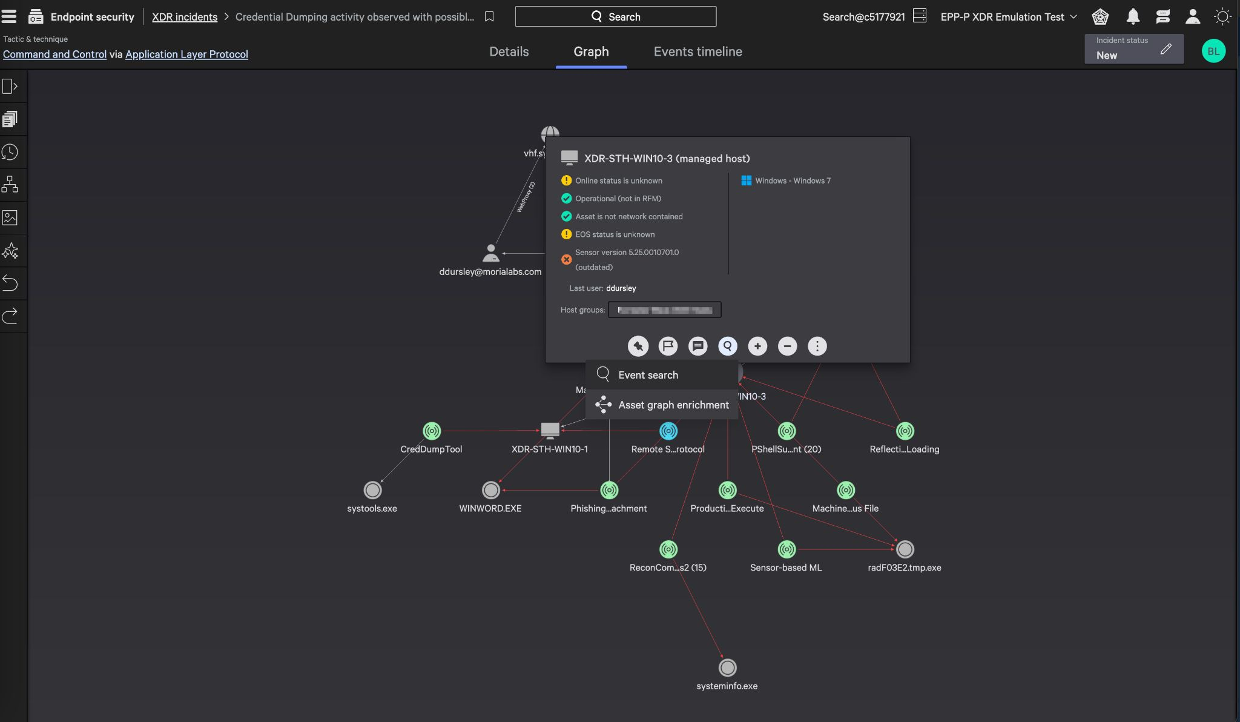






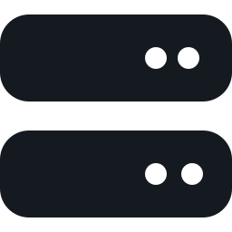


06 THE SOLUTION
CrowdStrike Falcon: One Sensor. One Platform.
Lightweight single sensor
Deploys in minutes with no complex tuning; covers all major operating systems, online or offline.
AI-native protection
Machine learning on the sensor and in the cloud stops malware, fileless and zero-day attacks.
Intelligence-fueled
Tracking of 281 adversary groups worldwide adds context to every detection.
Automated response
Kills malicious processes, quarantines files and isolates hosts — automatically or in one click.
Falcon console — investigation graph showing a detection's full attack path (illustrative)
Cloud-native console
ONE SENSOR PROTECTS
No management server to install or maintain on site — manage everything from one web console.
Workstations
Laptops
Servers
08 | Nessus vs. CrowdStrike Falcon Platform · Proposal for The Westin Resort Guam
Notes:
Falcon is one lightweight sensor and one cloud console. There is no on-site server to install or maintain. The same sensor protects the resort’s workstations, laptops and servers.

Slide 9






07 HOW IT WORKS
AI-Native Protection, From Sensor to Cloud
ON THE ENDPOINT
IN THE CLOUD
AUTOMATIC ACTIONS
Falcon Sensor
Falcon Platform
Block
Kill malicious processes before damage
Sensor machine learning
Inline malware prevention
Cloud machine learning
Models run at cloud scale
Contain
Isolate a host from the network in one click
Indicators of Attack (IOAs)
Stops malicious behavior, not just files
Adversary threat intelligence
Context on who is attacking and how
Investigate
See the full attack path
Online or offline
Protection even without a connection
Automated Leads
Surfaces subtle early signs of attack
Lightweight
Minimal impact on hotel systems
Severity scoring
Ranks detections so critical ones come first
Automate
Run response workflows and playbooks
Detects by behavior, not only by signature — so new and unknown attacks are stopped too.
09 | Nessus vs. CrowdStrike Falcon Platform · Proposal for The Westin Resort Guam
Notes:
Prevention starts on the sensor with machine learning and behavioral Indicators of Attack, and continues in the cloud with larger models and threat intelligence. The result is automatic blocking and fast containment.

Slide 10







08 PROPOSED SCOPE
Falcon Modules Proposed for The Westin Resort Guam
FALCON LICENSES IN THIS PROPOSAL
Falcon Prevent
Falcon Insight
NEXT-GEN ANTIVIRUS (EPP)
ENDPOINT DETECTION & RESPONSE (EDR)
AI/ML-based next-gen antivirus that stops malware, ransomware, fileless and zero-day attacks — online or offline. 100% ransomware prevention in SE Labs testing.
Continuous endpoint monitoring with full attack visibility, one-click host containment and remote response — 95% faster mean time to respond.
INCLUDED — SECUKOREA TECHNICAL SUPPORT
24/7 Remote Support
Dedicated Engineer
Incident Assistance
Health Checks & Reports
OVERSEAS SITES
ONE CONTACT
ANALYSIS & ESCALATION
STABLE OPERATIONS
Round-the-clock remote help for the resort, regardless of time zone.
A named engineer who knows the resort’s systems handles day-to-day requests.
Help reviewing detections, with SK shieldus IR specialists when needed.
Regular checks of sensors and policies, with reports to management.
10 | Nessus vs. CrowdStrike Falcon Platform · Proposal for The Westin Resort Guam
Notes:
The proposal covers two Falcon licenses: Falcon Prevent (next-gen antivirus) and Falcon Insight (EDR), both on the same single sensor. They are backed by SECUKOREA’s 24/7 remote technical support and a dedicated engineer.

Slide 11

09 REAL-WORLD CASE
One Real Attack, Step by Step: Scanner vs. Falcon
PUNK SPIDER (eCrime group) targeting a North American company — attempted data theft and Akira ransomware. Outcome: fully blocked by Falcon.
Attack stage | What the attacker did | Nessus | CrowdStrike Falcon
1 Initial access | Exploited a known VPN flaw (CVE-2024-3400) with stolen credentials | Could flag the CVE — only if the device was in scan scope and scanned in time. Cannot stop the exploit. | Unmanaged VPN appliance — no Falcon sensor installed
2 Lateral movement | Used Remote Desktop with a service account to reach an internal system | Not visible — scanners do not monitor activity | Detected. First Falcon alert, confirmed by OverWatch threat hunters
3 Credential access | Tried to dump credentials and add users to admin groups | Not visible — scanners do not monitor activity | Blocked. Privilege escalation attempts stopped
4 Persistence & evasion | Tried to install tunneling and remote-access tools | Not visible — scanners do not monitor activity | Blocked. Tools prevented from executing
5 Reconnaissance | Ran tools to map network file shares | Not visible — scanners do not monitor activity | Blocked. Both tools prevented from running
6 Collection & impact | Archived data, tried to exfiltrate it, then launched Akira ransomware | Not visible — scanners do not monitor activity | Contained & blocked. Exfiltration detected and host isolated; ransomware stopped before any encryption
Lesson: scanning and endpoint protection are complementary — but only endpoint protection stopped this attack. Every endpoint should run a sensor.
11 | Nessus vs. CrowdStrike Falcon Platform · Proposal for The Westin Resort Guam
Notes:
A real intrusion documented by CrowdStrike. The first step used a device without a Falcon sensor; from lateral movement onward, Falcon detected or blocked every step. A scanner would at best have flagged the VPN vulnerability.

Slide 12
10 COMPARISON
Head-to-Head: Nessus vs. CrowdStrike Falcon
Criteria | Nessus (current) | CrowdStrike Falcon (proposed)
Primary purpose | Vulnerability scanning and reporting | Prevent, detect and respond to attacks on every endpoint
Protection model | Periodic, point-in-time scans | Continuous, real-time — 24/7
Malware & ransomware prevention (EPP) | Not provided | AI/ML next-gen antivirus — 100% ransomware prevention (SE Labs)
Attack detection & response (EDR) | Not provided | Behavioral detection with full attack visibility and host containment
Zero-day & fileless attacks | Only once a check for the flaw is published | Behavior-based — no prior signature needed
Remediation | Manual — guidance only | Automated response actions and workflows
24/7 expert support | Not available | Included — SECUKOREA 24/7 support, SK shieldus escalation
Infrastructure | Scanner host, credentials and scan schedules to maintain | Cloud-native — one lightweight sensor, no on-site server
IT team workload | High — analyze reports, patch and verify by hand | Low — automated prevention and response
Vulnerability visibility | Core strength (periodic) | Complementary — Nessus stays in place for periodic scans
12 | Nessus vs. CrowdStrike Falcon Platform · Proposal for The Westin Resort Guam
Notes:
Side-by-side summary. Nessus remains strong at periodic vulnerability discovery; Falcon adds everything needed to actually stop attacks, with lower day-to-day workload.

Slide 13
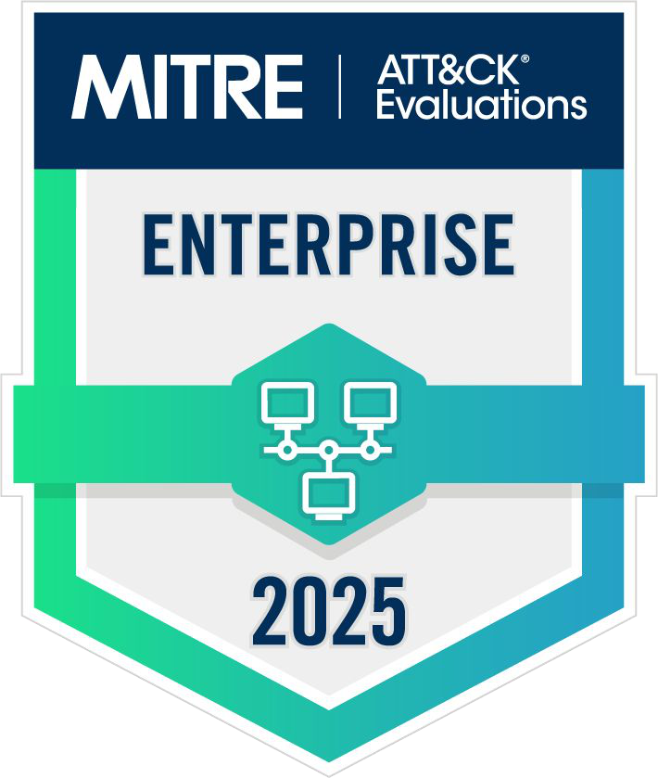
11 INDEPENDENT VALIDATION
Proven by Independent Testing and Customers
Leader
100%
Named a Leader seven consecutive times, including the 2026 Gartner® Magic Quadrant™ for Endpoint Protection Platforms
Ransomware protection and total accuracy — SE Labs Enterprise Advanced Security EDR Ransomware Test (2024)
100% Detection
100% Protection
Zero False Positives
273%
97%
Three-year ROI — Forrester Consulting Total Economic Impact™ study, commissioned by CrowdStrike (2025)
Willing to recommend — 2026 Gartner® Peer Insights™ Customers' Choice for EPP (800 reviews)
2025 MITRE ATT&CK® Enterprise Evaluations
Gartner does not endorse any vendor, product or service depicted in its research publications. GARTNER, MAGIC QUADRANT and PEER INSIGHTS are trademarks of Gartner, Inc. and/or its affiliates. Also trusted by 74,000+ direct and MSSP end customers worldwide.
13 | Nessus vs. CrowdStrike Falcon Platform · Proposal for The Westin Resort Guam
Notes:
Independent evidence: perfect MITRE ATT&CK 2025 result, Gartner Magic Quadrant leadership, SE Labs ransomware testing, Forrester ROI and Gartner Peer Insights customer ratings.

Slide 14




12 CUSTOMER RESULTS
Results Customers Have Achieved
HOSPITALITY
EDUCATION
MULTI-BRAND ENTERPRISE
Hospitality chain
Coventry University
Anywhere Real Estate
100K
94%
500×
agents deployed in one day
less time spent resolving threats
fewer alerts
During a CrowdStrike incident response engagement with a hospitality chain, 100,000 Falcon agents were rolled out in a single day.
Consolidated endpoint protection and response on one cloud-native Falcon agent. Average incident resolution fell from 2–3 days to under 1 hour.
A decentralized, multi-brand organization unified endpoint and identity protection on Falcon — 98% of remaining alerts are true positives.
“Ever present… always protecting you… you almost forget it’s there.” — Director of Cyberdefense, healthcare company (Forrester TEI study)
14 | Nessus vs. CrowdStrike Falcon Platform · Proposal for The Westin Resort Guam
Notes:
Three customer outcomes: speed of deployment in hospitality, much faster incident resolution in education, and far fewer, more accurate alerts in a distributed multi-brand organization.

Slide 15


13 RECOMMENDATION
Recommendation: Keep Visibility, Add Protection
CrowdStrike Falcon cloud console
Policies · Detection · Response · Reporting — no on-site server
OUR RECOMMENDATION
Add Falcon to Every Endpoint
Deploy Falcon on all endpoints for real-time protection. Keep Nessus for periodic audits and network-device scanning.
Benefit: Fastest path to protection; no disruption to existing processes.
Front desk & PMS workstations
Back-office & admin PCs
Servers
POS & payment terminals
Falcon sensor
Falcon sensor
Falcon sensor
Falcon sensor
WHAT STAYS THE SAME
Nessus Keeps Its Role
Nessus (existing)
Periodic vulnerability and compliance scans, e.g. network devices and audits
Existing Nessus scans, audit processes and network-device checks continue unchanged. Falcon works alongside them — nothing is removed or replaced.
SECUKOREA
24/7 remote support, dedicated engineer and regular reporting
Benefit: Real-time protection added without changing what already works.
Nessus finds weaknesses. Falcon stops attacks. Together, they cover the resort end to end.
15 | Nessus vs. CrowdStrike Falcon Platform · Proposal for The Westin Resort Guam
Notes:
A low-risk path: Falcon is added to every endpoint without changing existing Nessus processes. Periodic and audit-driven vulnerability scans continue exactly as they do today.

Slide 16

14 TECHNICAL SUPPORT
SECUKOREA 24/7 Technical Support
ESCALATION · SK SHIELDUS
24/7 Remote Support for Overseas Sites
Incident response specialists on duty 24/7
Round-the-clock remote support built for overseas operations — help is available regardless of time zone or local business hours.
Critical alerts: call within 30 min, first action within 2 hrs (SLA)
Dedicated Engineer Matching
Investigation across network devices and servers
A named SECUKOREA engineer works as an extension of your IT team — learning the resort's systems in depth and handling day-to-day requests quickly and consistently.
EDR events correlated with other security logs
One Point of Contact
Malware analysis by experienced IR analysts
Support, licensing and renewals through one partner, with escalation to SK shieldus and CrowdStrike when needed.
When needed, CrowdStrike partner SK shieldus steps in.
16 | Nessus vs. CrowdStrike Falcon Platform · Proposal for The Westin Resort Guam
Notes:
SECUKOREA is the first line of support: 24/7 remote technical support tailored to overseas sites, and a dedicated engineer matched to the resort for stable day-to-day operation. When deeper help is needed, CrowdStrike partner SK shieldus provides escalation support: 24/7 incident response specialists, a 30-minute call and 2-hour initial response SLA for critical events, investigation across network devices and servers, correlation with other security logs, and malware analysis.

Slide 17






15 EXPECTED BENEFITS
From Scan-Only to Always-On Protection
TODAY · NESSUS ONLY
WITH CROWDSTRIKE FALCON
Vulnerability reports, but no protection
Real-time prevention on every endpoint
Blind between scheduled scans
Continuous monitoring, 24/7
Manual patching and investigation
Automated containment and response
No defense against ransomware in progress
Proven ransomware protection
Limited insight for management
Clear dashboards and executive reports
Protect guest trust
Business continuity
Lower IT workload
Compliance support
Keep guest data and payments safe
Avoid downtime at the front desk and back office
Automation plus SECUKOREA 24/7 support
Supports PCI DSS and data-protection requirements
17 | Nessus vs. CrowdStrike Falcon Platform · Proposal for The Westin Resort Guam
Notes:
Summarize the before and after, then the four business outcomes that matter to hotel management: guest trust, continuity, IT workload and compliance.

Slide 18



Q & A
Thank You
Real-time endpoint protection for The Westin Resort Guam — powered by CrowdStrike Falcon.
secukorea@secukorea.com
+82-2-3400-0877
www.secukorea.com
Solution
Notes:
Thank the audience and open the floor for questions.

