Slide 1
Determining Winners in the 2013 Men’s Wimbledon Tournament
David Harter
Joe Holland

Slide 2
Vision Statement
To predict the winner of a tennis match based on statistics compiled during competition
Was it Accomplished?
With an AUC value of roughly 96% , our model proved successful in correctly
predicting the match winner for the Men’s Wimbledon 2013 tournament.

Slide 3
How Did We Get Here?
Total of 42 Variables
Examples:
Aces Won
Double Faults Committed
Second Serve Won
Types of Variables:
Numeric : Sport statistics, so most variables in our dataset
Categorical : Names of Players, Outcome of Match
Data compiled by “Tennis Major Tournament Statistics Data Set” at the UCI Machine Learning Repository

Slide 4
Analytics and Interpretation
Variable Summaries
Aces Won
Max: 28
Looking at the match of the player who tallied 28 Aces produced a win
Double Faults Committed
Max: 11
Player who committed 11 double faults in one match lost
Second Serve Won
Max: 38
Player ended the match with a win
Logistic Regression Considered Best Model
Player 1 Win = 1
Player 2 Win = 0

Slide 5
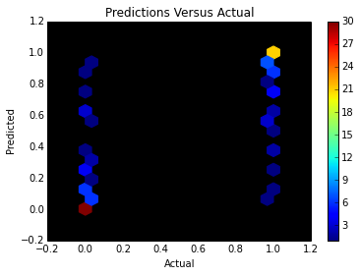
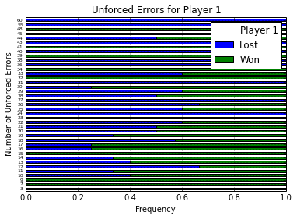
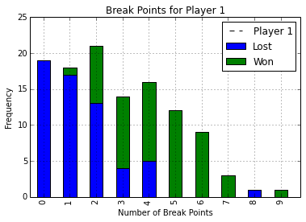
Visuals

Slide 6
Algorithm Implemented
Logistic Regression
After running the summary of full model, reduced model to variables only of significance
Coefficients:
Estimate Std. Error z value Pr(>|z|)
(Intercept) -16.76702 6.50755 -2.577 0.009979 **
Aces_Won_for_Player_1 0.14450 0.06230 2.319 0.020376 *
Second_Serve_Won_for_Player_1 0.14985 0.07025 2.133 0.032912 *
First_Serve_Percentage_for_Player_1 0.17642 0.08337 2.116 0.034340 *
Unforced_Errors_Committed_by_Player_1 -0.16538 0.04693 -3.524 0.000425 ***
Break_Points_Won_by_Player_1 1.46121 0.32174 4.542 5.58e-06 ***

Slide 7
Model Results
The final reduced model has variation on accuracy and precision based on the testing and training sets chosen
Accuracy ranges from 82% to as high as 96%, with a precision directly correlated as well
Ex: Winner_of_Match
pred 0 1
FALSE 3 1
TRUE 0 6
accuracy
[1] 0.9
precision
[1] 1
AUC value remains steady at roughly 96% no matter the testing or training sets
Example: auc_calc@y.values
[[1]]
[1] 0.9698661

Slide 8
Recommendation
We have successfully created an algorithm to predict the winner of a tennis match in the Men’s Wimbledon 2013 to a significant degree of accuracy
2 most significant variables:
Unforced Errors Committed
Break Points Won
We would suggest if looking to make a proper prediction to begin with investigating the player’s tendencies in these 2 areas

