Slide 1
Reading the regulatory genome with AlphaGenome
GCTGATAAGGCAGCTGTTAG
M02 | MULTIOMICS
AlphaGenome
DNase-seq
From DNA sequence to multimodal predictions and variant effects
RNA-seq
H3K27ac
ISCB-LATAM 2026, Lima | Tutorial IP3
Case study: TAL1 in T-cell acute lymphoblastic leukemia
Real AlphaGenome prediction: T cells, 131 kb around TAL1 (hg38)
Notes:
Welcome to Module 2. In the next 45 minutes we focus on the regulatory genome. The graphic on the right is a real AlphaGenome prediction: we gave the model 131 kb of DNA around the TAL1 gene and it returned chromatin accessibility, RNA-seq and the H3K27ac histone mark for T cells, with no experiment involved. We start with 15 minutes of theory (why these models exist, how AlphaGenome works and how it scores variants), then two hands-on exercises built around one case: non-coding mutations that switch on the TAL1 oncogene in T-ALL.

Slide 2



WHY SEQUENCE-TO-FUNCTION MODELS?
~98%
of the human genome does not code for proteins
Sequence
Model
Readouts
DNA around a gene, reference or with a variant
Learns the regulatory code from thousands of experiments
Expression, accessibility, splicing and 3D contacts per cell type
~90%
of trait- and disease-associated GWAS variants fall outside protein-coding sequence
Key idea: if a model predicts function from sequence, we can ask what changes when a single base changes, in any cell type, without running a new experiment.
Hindorff et al., PNAS 106, 9362-9367 (2009); Maurano et al., Science 337, 1190-1195 (2012)
Notes:
Almost all of our genome is non-coding, and most variants found by GWAS land there too. For a coding variant we can read the amino acid change; for a non-coding variant we usually cannot tell which gene it affects, in which cell type, or how. Measuring this experimentally for every variant and every tissue is impossible. Sequence-to-function models learn the mapping from DNA sequence to molecular readouts (expression, chromatin accessibility, splicing, 3D contacts) from large consortia data. Once trained, we can change one base in silico and compare predictions. That is exactly what we will do in Exercise 2.

Slide 3
THE MODEL LANDSCAPE
Input length (log scale) | output resolution
The trade-off
Long context reaches distant enhancers. Fine resolution resolves motifs and splice sites. Earlier models had to choose, and most covered one or a few data types.
AlphaGenome
1 Mb of context at 1 bp resolution, 11 output types and two species in a single model.
Jaganathan et al., Cell (2019); Kelley, PLoS Comput Biol (2020); Avsec et al., Nat Methods (2021); Linder et al., Nat Genet (2025); Avsec et al., Nature (2026)
Notes:
AlphaGenome did not appear from nowhere. SpliceAI predicts splicing at single-base resolution but only sees 10 kb. Basenji2 and Enformer, from the same DeepMind group, read much longer sequences but summarize the output in 128 bp bins. Borzoi pushed the context to half a megabase at 32 bp. The bars show input length on a log scale. The pattern is a trade-off: longer context or finer resolution, and usually one or a few data types. AlphaGenome is the first to combine 1 Mb of context with base-pair output across all modalities at once, which is why it can score splicing and enhancer variants with the same model.

Slide 4
WHAT GOES IN, WHAT COMES OUT
INPUT
OUTPUT: GENOME TRACKS
ACGTTGCAGATAAG
1 bp
RNA-seq, CAGE, PRO-cap, DNase, ATAC, splicing
Up to 1 Mb of DNA
128 bp
Histone and TF ChIP-seq
AlphaGenome
1,048,576 bp, human or mouse
Four API lengths, from 16 kb to 1 Mb
Optional: a variant (REF > ALT)
2,048 bp
Contact maps (3D genome)
5,930 human 1,128 mouse tracks
Hundreds of cell types and tissues. You pick them with ontology terms.
Avsec et al., Nature (2026). The alphagenome API v0.10.0 serves 5,563 human and 1,038 mouse tracks.
Notes:
The input is just DNA: up to one megabase, from human or mouse. Through the API you choose one of four lengths, from 16 kb to 1 Mb, and you can add a variant to compare the reference and alternative alleles. The output is a set of genome tracks, the same kind of signal you would see in a genome browser. Most come at single-base resolution, histone and transcription factor ChIP-seq at 128 bp, and contact maps at 2 kb. The paper reports about 5,900 human and 1,100 mouse tracks; the public API exposes slightly fewer. You never download all of them: you filter by output type and by ontology term, for example the T cell term we will use in the exercises.

Slide 5
INSIDE THE MODEL
DNA sequence
one-hot, 1 bp
skip connections
1 bp embeddings
per position
1 bp heads
RNA-seq, CAGE, PRO-cap, DNase, ATAC, splice sites, usage, junctions
Conv encoder
pools 1 bp to 128 bp
Conv decoder
upsamples to 1 bp
Transformer tower: 9 layers
8,192 tokens of 128 bp (1 Mb)
128 bp heads
Histone and TF ChIP-seq
Pairwise map
2,048 bp x 2,048 bp
Pairwise head
Contact maps
Adapted from Avsec et al., Nature (2026) and github.com/google-deepmind/alphagenome_research (model.py). Training data: ENCODE, GTEx, FANTOM5, 4D Nucleome.
Notes:
The architecture is a U-Net with a transformer in the middle. A convolutional encoder reads the one-hot DNA and pools it seven times, from 1 bp to 128 bp, so a megabase becomes 8,192 tokens. Nine transformer layers let every region attend to every other region, which is how a distant enhancer can influence a promoter. In parallel the model keeps a pairwise map at 2 kb resolution that feeds the contact-map head. A convolutional decoder then upsamples back to single bases, using skip connections from the encoder to recover fine detail. Different output heads read from each resolution. It was trained on ENCODE, GTEx, FANTOM5 and 4D Nucleome data; according to DeepMind, one model trains in about four hours, half the compute used for Enformer.

Slide 6





11 OUTPUT TYPES, 5 BIOLOGICAL QUESTIONS
Gene expression
Chromatin accessibility
Histone marks and TF binding
RNA-seq, CAGE, PRO-cap
DNase-seq, ATAC-seq
Histone ChIP-seq, TF ChIP-seq
1,225 tracks | 1 bp
472 tracks | 1 bp
2,733 tracks | 128 bp
Splicing
3D genome
Choosing tracks
Splice sites, splice site usage, splice junctions
Contact maps (Hi-C, Micro-C)
Ontology terms, e.g. CL:0000084 (T cell), UBERON:0002048 (lung)
1,105 tracks | 1 bp
28 tracks | 2,048 bp
model.output_metadata()
Human track counts from the alphagenome API v0.10.0 output metadata.
Notes:
The eleven output types answer five questions. Is the gene expressed? RNA-seq, CAGE and PRO-cap, which also mark where transcription starts. Is the chromatin open? DNase and ATAC. Which histone marks and transcription factors are there? ChIP-seq, at 128 bp. How is the RNA spliced? Splice sites, their usage and the junctions. How does the DNA fold? Contact maps. Each output type has many tracks, one per cell type, assay or strand, and you select them with ontology terms: CL for cell types, UBERON for tissues. In Exercise 1 you will compare T cells against a non-blood tissue at the TAL1 locus.

Slide 7
SCORING A VARIANT: REF VS ALT
1. Two sequences
2. Predict both
3. Compare
4. Summarize
ALT minus REF
REF GATTACAG
ALT GATTGCAG
1 score
per track or per gene, ready to rank
Illustrative
Illustrative
Scorer | What it measures | Used for
CenterMaskScorer | Signal change in a window around the variant (501 bp; 2,001 bp for histone marks) | DNase, ATAC, ChIP, CAGE, PRO-cap
GeneMaskLFCScorer | Log fold change of a gene's expression over its exons | RNA-seq
Splicing and 3D scorers | Changes in splice sites, usage and junctions; contact disruption | Splicing, contact maps
Scorers: alphagenome API v0.10.0 (RECOMMENDED_VARIANT_SCORERS, 19 presets). About 1 s per variant: Google DeepMind (2025).
Notes:
Variant effect prediction is a simple idea. Take the reference sequence and the same sequence with the alternative allele, predict both, and compare. The difference track shows where and how much the signal changes. A scorer then turns that difference into one number per track or per gene so we can rank variants. For accessibility and ChIP we look in a small window around the variant; for expression we compute a log fold change over the gene's exons; there are dedicated scorers for splicing, polyadenylation and 3D contacts. The API ships a recommended set, and scoring a variant takes about a second. The curves here are illustrative; in Exercise 2 you will see the real ones for the TAL1 enhancer insertion.

Slide 8


STRENGTHS AND LIMITATIONS
Strengths
Limitations
One model for 11 output types, human and mouse
1 Mb of context at base-pair resolution
Matches or beats the best external models in 25 of 26 variant effect benchmarks
Fast: about 1 s to score a variant
Free API for non-commercial research; weights released
Very distant elements (over 100 kb) remain hard to capture
Cell- and tissue-specific patterns are still a challenge
Not designed or validated for personal genome prediction
Predicts molecular effects, not complex traits or disease
Research use only: not validated for clinical decisions
Treat predictions as hypotheses: check them against independent data, as we will do in Exercise 2.
Avsec et al., Nature (2026); Google DeepMind, AlphaGenome announcement (2025); alphagenome.google/terms
Notes:
AlphaGenome is the most complete sequence-to-function model available today: one model, all modalities, long context and base-pair output, and it matches or beats specialized models in 25 of 26 variant benchmarks. But the authors are explicit about its limits. Effects of elements more than about 100 kb away are still hard to capture. Cell-type specificity is imperfect. It was trained on the reference genome, so it is not meant to predict a person's phenotype from their genome, and molecular effects are not the same as disease risk. The terms also forbid clinical use. The take-home: use predictions to prioritize and generate hypotheses, then validate them, which connects with the last objective of this workshop.

Slide 9
GETTING ACCESS
1
Request a key
2
Store it as a secret
3
Connect
alphagenome.google/api
Free for non-commercial use. Accept the terms.
ALPHA_GENOME_API_KEY
Colab Secrets or Codespaces secrets. Never paste it in a notebook.
pip install alphagenome
Create a client and start predicting.
import os
from alphagenome.models import dna_client
# Colab: api_key = userdata.get("ALPHA_GENOME_API_KEY")
api_key = os.environ["ALPHA_GENOME_API_KEY"]
model = dna_client.create(api_key)
Usage limits
Rate-limited and shared: fine for thousands of predictions, not for millions.
Not for clinical use.
Step-by-step: QUICKSTART.md
alphagenomedocs.com; alphagenome.google/terms; modules/M02_multiomics_alphagenome/QUICKSTART.md
Notes:
To run the exercises with live predictions you need your own API key. Request it at alphagenome.google/api with a Google account; it is free for non-commercial research. Store it as a secret called ALPHA_GENOME_API_KEY, exactly with that spelling, in Colab Secrets or as a Codespaces secret, and never paste it into a notebook or commit it to GitHub. Then install the package and create a client with two lines of code. The API is rate-limited and shared by everyone in this room, so run the cells when we ask and avoid loops over thousands of variants. The QUICKSTART file in the repository walks through every step.

Slide 10

EXERCISE 1: READ THE TAL1 LOCUS
Use AlphaGenome as a virtual assay: predict expression, open chromatin and an active enhancer mark around TAL1 in three cell types.
Questions to answer
Define the window
Where is TAL1, and on which strand is it transcribed?
In which cell type are its promoter and enhancers open and acetylated?
Is TAL1 expressed in normal T cells?
1
1 Mb around TAL1: interval.resize(2**20)
2
Predict
predict_interval: RNA-seq, DNase, H3K27ac
3
Pick cell types
CD34+ progenitor, T cell and liver (ontology terms)
4
Plot
plot_components with the gene annotation
01_explore_locus_TAL1.ipynb | 12 min
Adapted from the AlphaGenome example notebook (TAL1 locus), github.com/google-deepmind/alphagenome (Apache 2.0)
Notes:
Exercise 1 treats AlphaGenome as a virtual experiment. You will take a 1 Mb window centered on TAL1 and ask the model for three readouts: RNA-seq for expression, DNase for open chromatin and H3K27ac for active promoters and enhancers. You will compare three contexts: CD34+ hematopoietic progenitors, where TAL1 normally works; mature T cells; and liver as an unrelated tissue. Keep the three questions in mind while you run the cells. The most important one is the last: is TAL1 on in normal T cells? The answer sets up Exercise 2. You have about 12 minutes.

Slide 11
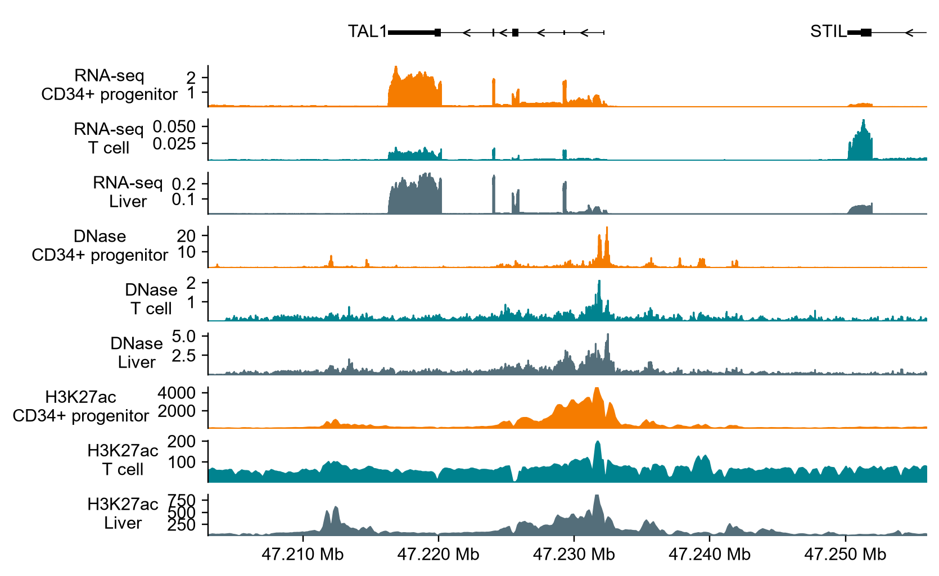
EXERCISE 1: WHAT YOU SHOULD SEE
Predicted TAL1 RNA-seq (mean over exons)
ON in progenitors. Open promoter and broad H3K27ac around its start site.
OFF in T cells. About 191 times less RNA than in CD34+ cells, and no open chromatin.
AlphaGenome API v0.10.0, predict_interval on chr1 (hg38), 1 Mb input; view: 53 kb around TAL1. Ontology terms CL:0001059, CL:0000084, UBERON:0002107.
Notes:
This is what the notebook should produce. Each row is a predicted track; orange is CD34+ progenitors, teal T cells, grey liver. TAL1 sits on the minus strand, so it is transcribed from right to left. In progenitors the model predicts strong RNA-seq over the TAL1 exons, open chromatin at the promoter and a broad H3K27ac domain around the start site. In mature T cells all of that is gone: predicted TAL1 RNA is about 191 times lower, while the neighboring gene STIL stays on. Note the different y-axis scales between rows. This matches biology: TAL1 is needed in early blood progenitors and is switched off during T-cell development. So if a leukemic T cell expresses TAL1, something has turned the switch back on.

Slide 12
TAL1 IN T-ALL: A SWITCH THAT SHOULD BE OFF
MYB
binds the new motif
CBP
acetylates H3K27
Super-enhancer
TAL1 complex joins
TAL1 ON
from one allele
+CGTTTCCTAACC
TAL1 (minus strand)
MuTE site
12 bp insertion (Jurkat)
7.5 kb upstream of the TSS
25%
of T-ALL carry the TAL1d deletion, the classic way to activate TAL1
5.5%
of pediatric T-ALL (8 of 146) carry MuTE indels of 2 to 18 bp at one hotspot
100%
of those indels create a new binding motif for the MYB transcription factor
Mansour et al., Science 346, 1373-1377 (2014). Gene model schematic, not to scale.
Notes:
Why TAL1? TAL1 is a master transcription factor of blood progenitors that must be silenced as T cells mature. In T-cell acute lymphoblastic leukemia it is often switched back on. The classic route is a large deletion, TAL1d, found in about a quarter of cases. In 2014 Mansour and colleagues found a subtler route: small insertions of 2 to 18 bases at a single hotspot 7.5 kb upstream of TAL1, in 8 of 146 pediatric patients and in the Jurkat cell line. Every one of those insertions creates a binding site for MYB. MYB recruits CBP, which acetylates H3K27, and a super-enhancer forms that drives TAL1 from the mutated allele only. The question for Exercise 2: can AlphaGenome, which never saw these patients, predict this from sequence?

Slide 13
EXERCISE 2: IS THIS VARIANT ONCOGENIC?
chr1:47239296 C > CCGTTTCCTAACC
Jurkat T-ALL cell line: 12 bp insertion 7.5 kb upstream of TAL1 (hg38)
1. Predict
2. Score
3. Validate
4. Explain
REF vs ALT with predict_variant
TAL1 log fold change with score_variant
Against random 12 bp insertions at the same site
In silico mutagenesis: which bases matter?
Ask yourself: does the insertion switch TAL1 on? Would any 12 bp insertion do the same? Which bases drive the effect?
02_score_variant_TAL1.ipynb | 12 min
Variant from Mansour et al., Science (2014). Workflow adapted from the AlphaGenome TAL1 example notebook (Apache 2.0).
Notes:
Now we test the Jurkat insertion directly. Step one: predict the reference and the mutated sequence and look at the difference tracks. Step two: summarize the effect on TAL1 with the gene-level log fold change scorer. Step three is the part people often skip: is the effect specific to this sequence, or would any 12 bp insertion at that spot do the same? We test that with random insertions of the same length. Step four: in silico mutagenesis, mutating each base of the inserted sequence to see which ones the prediction depends on. If the model has learned real biology, those bases should form a MYB motif.

Slide 14
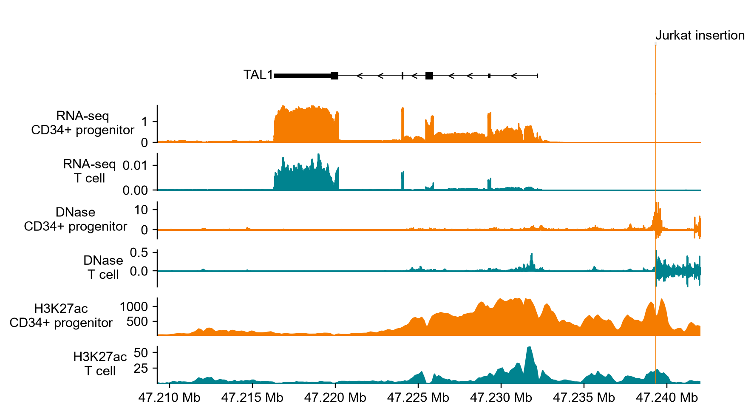
EXERCISE 2: TAL1 SWITCHES ON
Predicted change: ALT minus REF (above zero = gained with the insertion)
1.8x
TAL1 RNA in CD34+ cells
natural-log FC +0.61; quantile > 0.9999 vs common variants
3.5x
DNase at the insertion
log2 change +1.83 in a 501 bp window
3.7x
H3K27ac around it
log2 change +1.88 in a 2,001 bp window
AlphaGenome API v0.10.0: predict_variant and score_variant (RECOMMENDED_VARIANT_SCORERS), CD34+ progenitor CL:0001059 and T cell CL:0000084.
Notes:
Here is the prediction. The plot shows ALT minus REF, so anything above zero is gained because of the insertion. In CD34+ cells the model predicts a new DNase peak right at the insertion, a large gain of H3K27ac spreading toward TAL1, and more RNA over every TAL1 exon: the super-enhancer signature described by Mansour. In T cells the direction is the same but the absolute change is small, because the model starts from a locus that is silent. The gene-level score puts TAL1 at about 1.8-fold, higher than almost every common variant used to calibrate the quantiles. The jagged DNase signal to the right of the insertion comes from comparing sequences of different lengths; focus on the peak at the site.

Slide 15
IS THE EFFECT SPECIFIC TO THIS SEQUENCE?
30 of 30
random 12 bp insertions at the same site score below Jurkat.
+0.38 vs +0.00
median TAL1 ln fold change, published vs random.
2 of 15
published variants score like random ones: the model misses them.
Random sequences (n = 97)
Published T-ALL variants (n = 15)
Published variants: Mansour 2014, Liu 2017, Liu 2020, Smith 2023 (as listed in the AlphaGenome TAL1 example notebook). Background: random sequences, same position and length.
Notes:
A big score alone is not convincing: maybe any extra DNA at that spot raises TAL1. So we compare against controls. Grey dots are random sequences of the same length inserted at the same positions as each published variant; teal dots are variants reported in T-ALL patients and cell lines; the large orange dot is Jurkat. The Jurkat insertion scores higher than 30 of 30 random 12 bp insertions, and the published variants have a median ln fold change of 0.38 versus 0.00 for random sequences. The model is responding to the specific sequence, not to the mere presence of an insertion. It is not perfect: 2 published variants (Patient_2, intergenic SNV 1) score like random sequences, so a low score does not rule a variant out. This is the validation step from the workshop objectives.

Slide 16
WHICH BASES MATTER? (ISM)
Letter height = drop in predicted TAL1 gain when that base is mutated (mean of 3 substitutions, CD34+)
T
T
A
C
C
G
T
T
T
C
C
T
A
A
C
C
G
T
C
T
+0.23
+0.06
+0.12
+0.14
+0.36
+0.15
+0.27
+0.08
+0.07
+0.10
+0.22
+0.47
+0.52
+0.46
+0.11
+0.51
+0.13
+0.15
reference
12 bp insertion
reference
MYB (AACGG, minus strand)
MYB (TAACCG)
Reading: the tallest letters spell the MYB motif TAACCG, and its variable N position barely matters, just as the consensus YAACNG predicts.
ISM on the ALT allele: 20 positions x 3 substitutions scored with GeneMaskLFCScorer. MYB core motif YAACNG; Mansour et al. (2014) report two MYB motifs created by the Jurkat insertion.
Notes:
Finally, we ask which bases the prediction depends on. We take the mutated sequence, change each base to the three alternatives, and score TAL1 again. Big letters are bases where any change erases most of the predicted TAL1 gain; small grey letters barely matter. The tallest letters spell TAACCG, a MYB site created where the insertion meets the reference G, and the fifth position, which is variable in the MYB consensus YAACNG, is one of the least important. A second, weaker MYB-like site sits at the start of the insertion. This matches the two MYB motifs Mansour and colleagues described experimentally. The model was never told about MYB; it learned that motif from data. This is how we turn a black-box score into a testable hypothesis: knock out MYB binding and TAL1 should drop.

Slide 17
KEY TAKEAWAYS
1
AlphaGenome reads regulation from sequence alone: TAL1 is predicted ON in progenitors and OFF in T cells.
Readings
Avsec et al. Advancing regulatory variant effect prediction with AlphaGenome. Nature 649, 1206-1218 (2026)
Mansour et al. An oncogenic super-enhancer formed through somatic mutation of a noncoding intergenic element. Science 346, 1373-1377 (2014)
Liu et al. Discovery of regulatory noncoding variants in individual cancer genomes by using cis-X. Nat Genet 52, 811-818 (2020)
AlphaGenome docs: example analysis workflow, TAL1 locus (alphagenomedocs.com)
2
A 12 bp non-coding insertion is predicted to create an enhancer and raise TAL1 about 1.8-fold, the mechanism seen in T-ALL.
3
Trust comes from controls: random insertions and in silico mutagenesis show the effect is specific and motif-driven.
4
Predictions are hypotheses for the lab, not diagnoses: validate before drawing biological or clinical conclusions.
All predictions in this module: AlphaGenome API v0.10.0, generated October 2026.
Notes:
Four things to take home. First, a sequence model can recover cell-type-specific regulation without any experiment on your side. Second, it can propose a mechanism for a non-coding variant, here a new enhancer that switches on an oncogene, matching what was found in patients. Third, the score is only the start: matched random controls and mutagenesis are what make the result believable. Fourth, these are research predictions; they prioritize experiments, they do not replace them, and they are not validated for clinical use. The readings on the right are a good next step, starting with the AlphaGenome paper.

