Slide 1
// OOP 2 · MSC1052 · SPRING 2026
$
Linux System
Activity Monitor
A real-time Qt 6 desktop application reading the Linux /proc filesystem
TEAM SUSAMBIL
Karimov Shermuhammad · U2510108
Zayniddinov Fazliddin · U2510201
Zoxidov Mirahmad · U2510110
Shaislamov Shakhruz · U2510293
Faxriddinov Husniddin · U2510116
Idrisov Shohjahon · U2510137
INSTRUCTOR
Prof. Sharof Suvonov

Slide 2
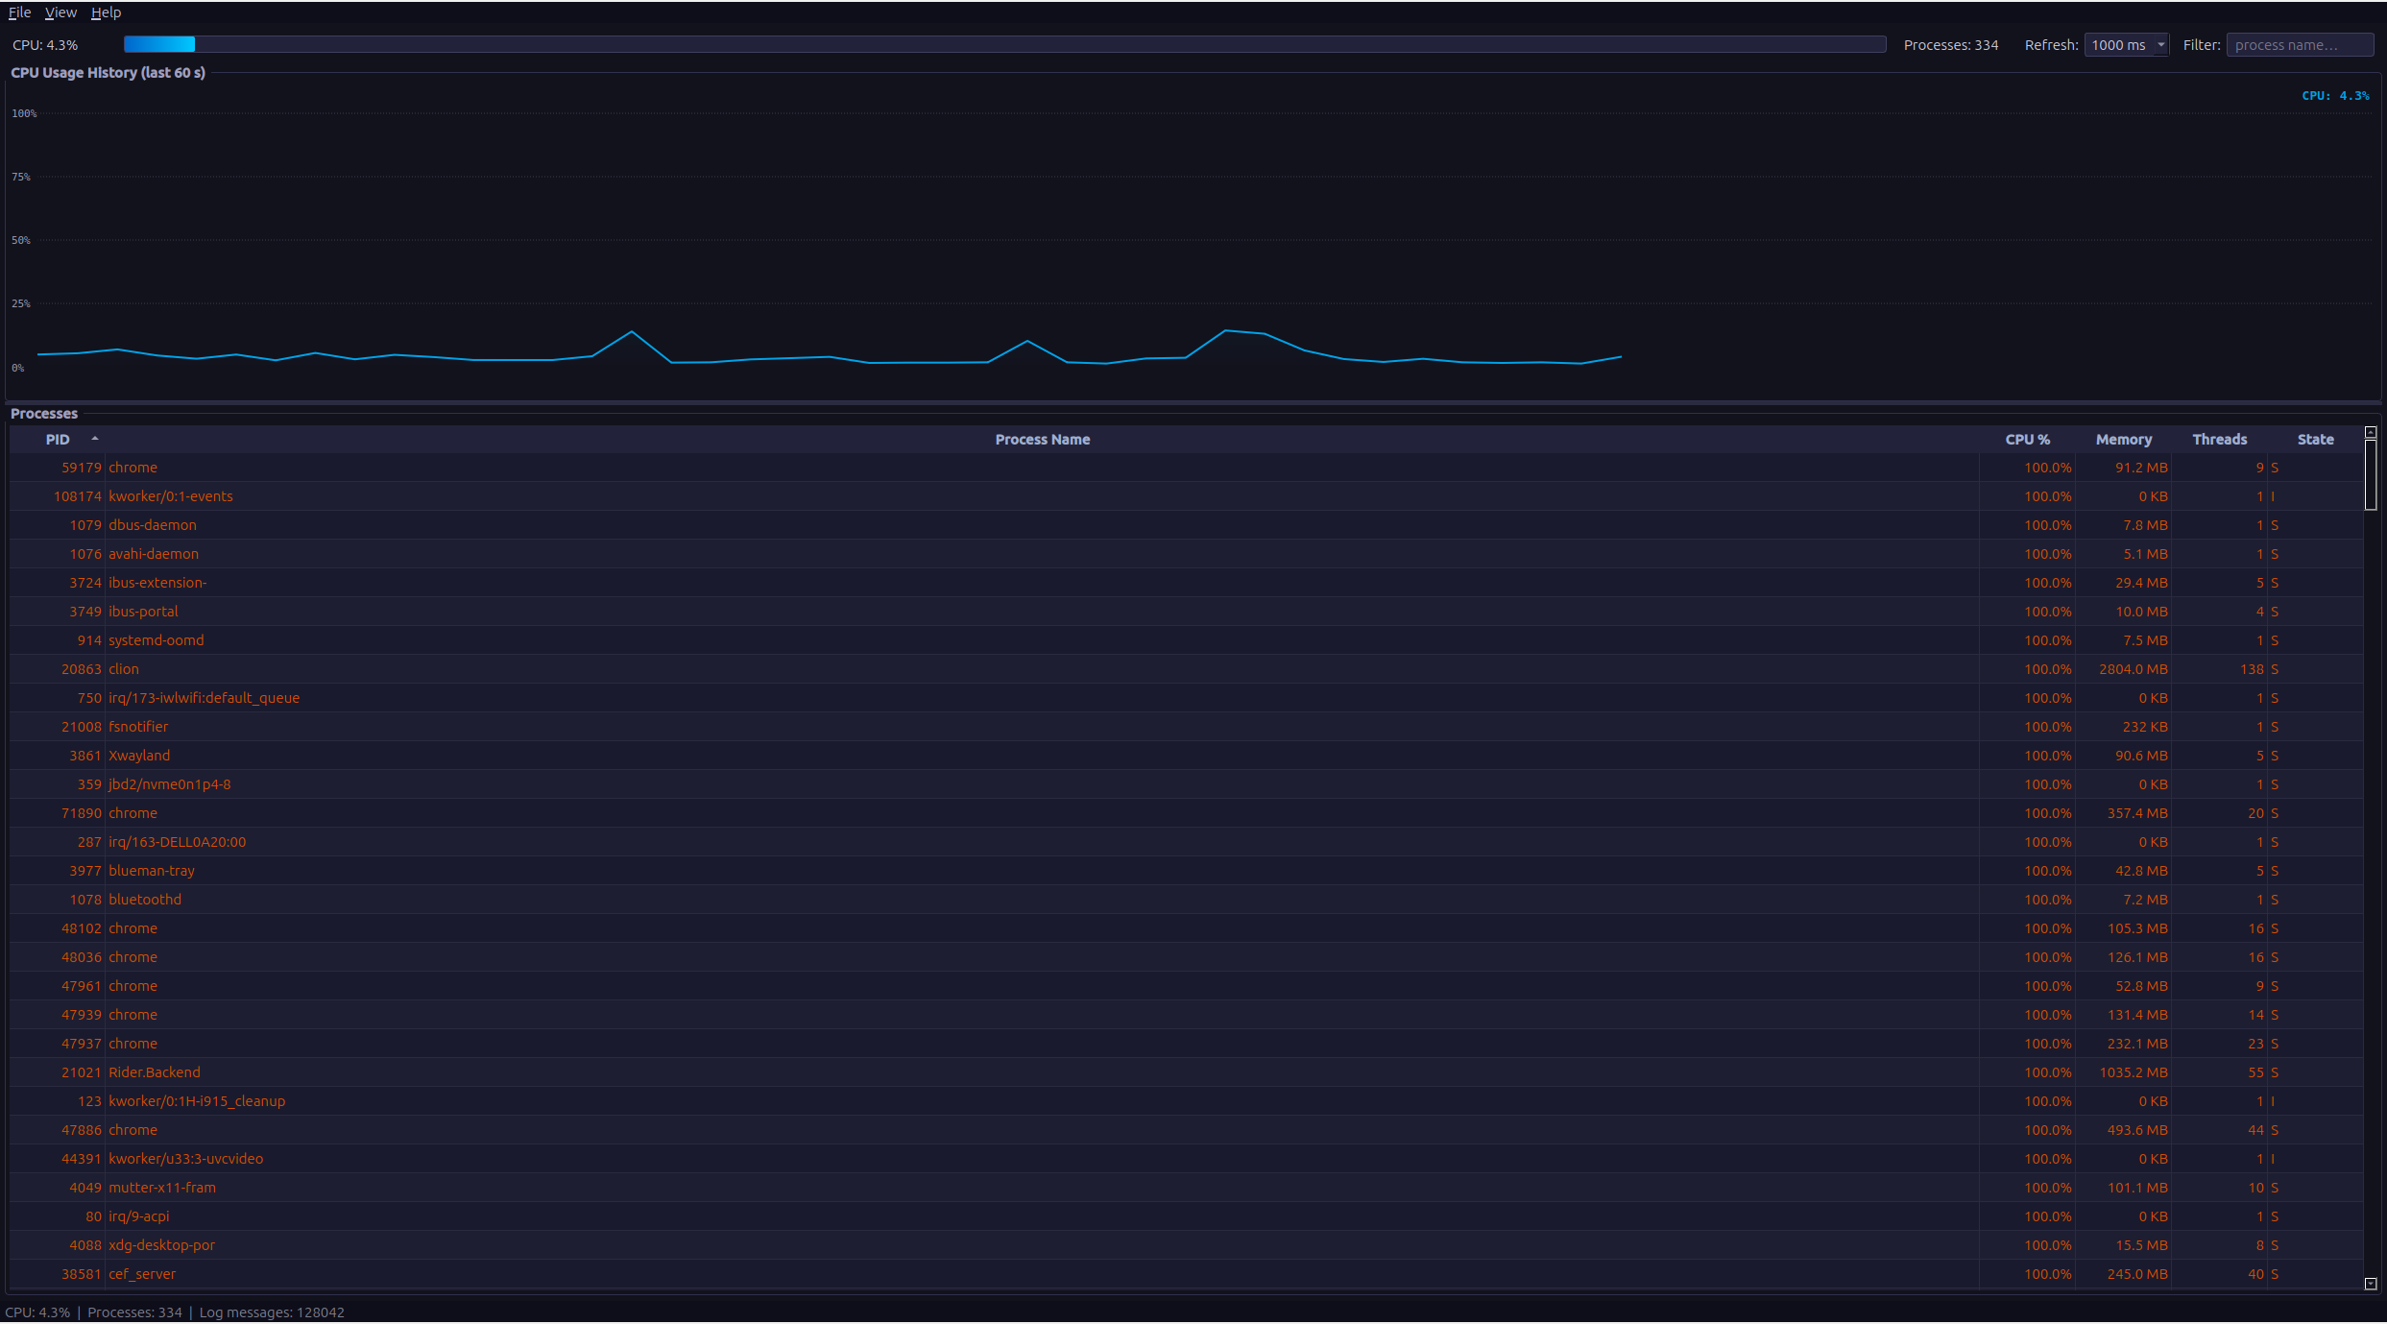
01 · GOAL
Project Objective
Build a real-time desktop monitor that visualizes live Linux system activity, while exercising every major OOP concept from the course.
REAL-TIME
EDUCATIONAL
PORTABLE
Reads /proc every 0.5–2s and renders a live CPU graph + process table.
Demonstrates inheritance, polymorphism, templates, exceptions, file I/O.
Qt 6 + C++17 + CMake — runs on Ubuntu, Fedora, Arch with one build command.
Linux System Activity Monitor · OOP 2 (MSC1052) · Spring 2026
2 / 14

Slide 3
02 · TEAM
Team Susambil · 6 members, 3 modules
GUI
CORE
UTILS
Qt 6 graphical interface
Business logic & /proc readers
Logger, templates & helpers
Shermuhammad Karimov
Husniddin Faxriddinov
Shohjahon Idrisov
U2510108
U2510116
U2510137
Mirahmad Zoxidov
Fazliddin Zayniddinov
U2510110
U2510201
Shakhruz Shaislamov
U2510293
Collaborated through GitHub · github.com/BigOtron/susambil-project
Linux System Activity Monitor · OOP 2 (MSC1052) · Spring 2026
3 / 14

Slide 4
03 · TOOLS
Tech Stack
LANGUAGE
GUI
C++17
Qt 6.2+
Modern STL, smart pointers, lambdas
QMainWindow, QPainter, signals & slots
BUILD
COMPILER
CMake 3.16
GCC 11+
Out-of-source, cross-distro support
Or Clang 14+, C++17 required
DATA SOURCE
REPOSITORY
/proc
GitHub
Linux virtual filesystem (no libs)
Branches, pull requests, code review
Linux System Activity Monitor · OOP 2 (MSC1052) · Spring 2026
4 / 14

Slide 5
04 · FEATURES
What it does
01
Live CPU graph
02
Process table
Scrolling 60-second line graph rendered with QPainter, with gradient fill and grid lines.
Every running process with PID, name, CPU %, memory, threads, state — sortable by any column.
03
Configurable refresh
04
Live filter
Switch between 500 ms / 1000 ms / 2000 ms update intervals from the View menu.
Type any text in the filter box to instantly hide processes whose name doesn't match.
05
Status coloring
06
Persistent logging
Zombie processes shown in red, stopped in yellow, high-CPU (>50%) in orange.
All events, errors and ticks written to monitor.log with timestamps via singleton Logger.
Linux System Activity Monitor · OOP 2 (MSC1052) · Spring 2026
5 / 14

Slide 6
05 · DESIGN
System Architecture
GUI
MainWindow
CpuGraphWidget
ProcessTableModel
AboutDialog
UTILS
Cross-cutting
Logger
CORE
IDataReader
SystemInfo
CpuInfo
ProcessInfo
Formatter
RingBuffer
/proc
/proc/stat
/proc/[pid]/stat
/proc/[pid]/status
Linux kernel
Layered architecture: GUI never reads /proc directly — Core readers do, then expose model objects upstream.
Linux System Activity Monitor · OOP 2 (MSC1052) · Spring 2026
6 / 14

Slide 7
06 · SRC/CORE
Core Module · classes & inheritance
IDataReader
Pure abstract interface — read() = 0
interface
KEY RELATIONSHIPS
IRenderable
Pure abstract — toDisplayString() = 0
interface
INHERITANCE
SystemInfo
Abstract base — source path + timestamp
abstract
SystemInfo → CpuInfo, ProcessInfo
CpuInfo
Derived — CPU tick counters + usage %
derived
INTERFACE IMPL
IDataReader → CpuReader, ProcessReader
ProcessInfo
Derived — single process entry (pid, name, mem…)
derived
INTERFACE IMPL
ProcessList
Container — vector<ProcessInfo> with sort/filter
container
IRenderable → SystemInfo (transitive)
CpuReader
Reads /proc/stat → fills a CpuInfo snapshot
reader
COMPOSITION
ProcessList owns vector<ProcessInfo>
ProcessReader
Scans /proc/[pid]/ → fills a ProcessList
reader
EXCEPTION
MonitorExceptions
Custom exception hierarchy (FileReadException, …)
exceptions
FileReadException : std::runtime_error
Owned by Husniddin · Fazliddin · Shakhruz
Linux System Activity Monitor · OOP 2 (MSC1052) · Spring 2026
7 / 14

Slide 8
07 · SRC/GUI
GUI Module · Qt 6 widgets
MainWindow
CpuGraphWidget
: QMainWindow
: QWidget
Composes all subsystems. Drives the 1-second QTimer that triggers every refresh. Owns the readers and the process list.
Custom-painted live graph using QPainter — antialiased line, gradient fill, dotted gridlines, percentage axis labels.
ProcessTableModel
AboutDialog
: QAbstractTableModel
: QDialog
Bridges ProcessInfo data to QTableView. Implements rowCount, columnCount, data, headerData. Supports per-column sort.
Modal dialog opened from Help → About. Shows application info, version, course details, contributors.
Owned by Shermuhammad · Mirahmad
Linux System Activity Monitor · OOP 2 (MSC1052) · Spring 2026
8 / 14

Slide 9
08 · SRC/UTILS
Utils Module · templates & helpers
Logger
Formatter
RingBuffer<T>
SINGLETON
FUNCTION TEMPLATES
CLASS TEMPLATE
Single global instance via static getInstance()
Writes timestamped lines to monitor.log
Levels: INFO, WARN, ERROR, DATA
Thread-safe append, never crashes on disk full
template<T> clamp(T value, T lo, T hi)
template<T> calculatePercent(T part, T total)
Overloaded formatValue() — int, double, size_t
Compile-time polymorphism (function overloading)
Fixed-size circular buffer (60 samples default)
push_back(value) — auto-overwrites oldest entry
Random-access iteration for chart rendering
Used by CpuGraphWidget for 60-second history
Owned by Shohjahon
Linux System Activity Monitor · OOP 2 (MSC1052) · Spring 2026
9 / 14

Slide 10
09 · UML
UML Class Diagram (simplified)
«interface»
IDataReader
«interface»
IRenderable
SystemInfo
+ read() = 0
+ toDisplayString() = 0
# sourcePath : string
# timestamp : time_t
+ toDisplayString() override
CpuReader
CpuInfo
ProcessInfo
ProcessList
+ read() : CpuInfo
- user, nice, system : u64
- idle, iowait : u64
+ usagePercent() : double
+ operator-(other)
- pid : int
- name : string
- cpuPct : double
- memKB : size_t
+ operator<(other)
- items : vector<ProcessInfo>
+ sortBy(col)
+ filter(text)
ProcessReader
+ read() : ProcessList
Solid arrow = inheritance · Dashed arrow = interface implementation
Linux System Activity Monitor · OOP 2 (MSC1052) · Spring 2026
10 / 14

Slide 11
10 · RUBRIC
OOP Features Implemented
FEATURE | WHERE IN OUR CODE
Classes & Objects | SystemInfo, CpuInfo, ProcessInfo, ProcessList, all readers
Constructors & Destructors | Default, parameterized, copy ctors on data classes
Function Overloading | Formatter::formatValue() for int, double, size_t
Operator Overloading | CpuInfo::operator-(), ProcessInfo::operator< for sort
Runtime Polymorphism | IDataReader::read() — virtual, called via base ptr
Compile-time Polymorphism | Function templates (clamp, calculatePercent), class template RingBuffer<T>
Single Inheritance | SystemInfo → CpuInfo
Hierarchical Inheritance | SystemInfo → { CpuInfo, ProcessInfo }
Multiple Inheritance | SystemInfo + IRenderable — Qt-side: MainWindow : QMainWindow
Static Members | Logger::getInstance(), Formatter helpers
File Handling | All readers use ifstream on /proc; Logger writes monitor.log
Exception Handling | Custom FileReadException, ParseException — caught per tick
GUI | Qt 6 — QMainWindow, QTimer, QPainter, QAbstractTableModel
Linux System Activity Monitor · OOP 2 (MSC1052) · Spring 2026
11 / 14

Slide 12
11 · ROBUSTNESS
File Handling & Exceptions
FILE HANDLING
EXCEPTION HIERARCHY
Reading from /proc and writing logs
MonitorExceptions.h
std::ifstream on /proc/stat — parses CPU tick counters every refresh.
std::ifstream on /proc/[pid]/status — extracts Name, VmRSS, Threads, State.
std::ofstream in append mode — Logger writes timestamped lines to monitor.log.
Buffered reads with explicit close on every cycle — no file descriptor leaks.
class MonitorException
: public std::runtime_error;
class FileReadException
: public MonitorException;
class ParseException
: public MonitorException;
try { reader.read(); }
catch (FileReadException& e) {
Logger::get().warn(e.what());
}
Linux System Activity Monitor · OOP 2 (MSC1052) · Spring 2026
12 / 14

Slide 13
12 · WORKFLOW
GitHub Collaboration
20
3
6
1
COMMITS
MODULES
CONTRIBUTORS
MAIN BRANCH
1
1. Plan
Split the codebase into core / gui / utils. Each pair owns a directory.
2
2. Branch
Feature branches per task (e.g. feat/cpu-graph, feat/process-table).
3
3. Commit
Small, focused commits with meaningful messages. Push to remote daily.
4
4. Review
Pull requests reviewed by at least one teammate before merging into main.
5
5. Merge
Squash-merge into main. CMake build verified locally before release.
Linux System Activity Monitor · OOP 2 (MSC1052) · Spring 2026
13 / 14

Slide 14
// CONCLUSION
We shipped a real-time
Linux system monitor.
Built with Qt 6 and modern C++17, it covers every OOP concept on the rubric: inheritance, polymorphism (runtime and compile-time), templates, operator and function overloading, static members, file I/O, and custom exception handling — all wrapped in a clean three-module architecture.
Three layered modules — clean separation of concerns
Live UI driven by a single QTimer and a RingBuffer
Zero external libraries beyond Qt — pure /proc parsing
Thank you · Questions?
github.com/BigOtron/susambil-project

