Slide 1
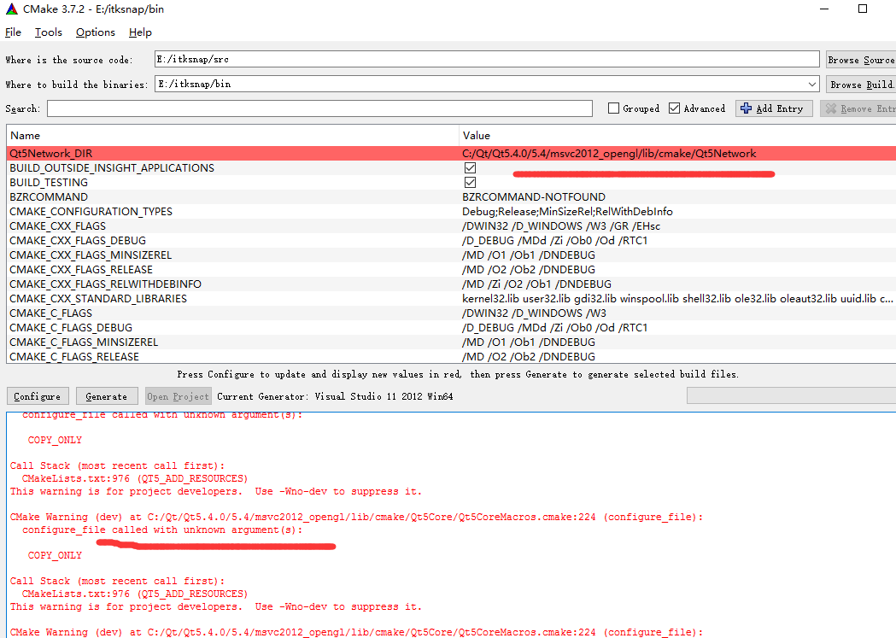
1.Cmake Configure ITK_SNAP时报的错

Slide 2
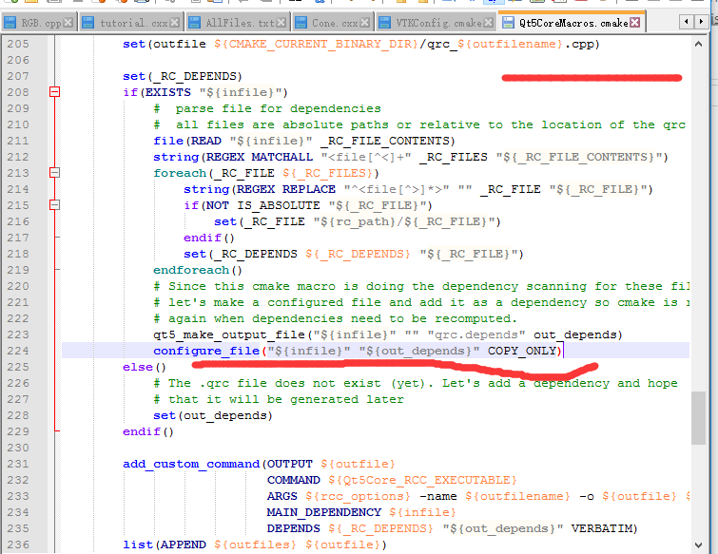

Slide 3
2.Cmake Generate ITK_SNAP时报的错
CMake Warning (dev) at CMakeLists.txt:1041 (ADD_EXECUTABLE):
Policy CMP0028 is not set: Double colon in target name means ALIAS or
IMPORTED target. Run "cmake --help-policy CMP0028" for policy details.
Use the cmake_policy command to set the policy and suppress this warning.
Target "ITK-SNAP" links to target "Qt5::Concurrent" but the target was not
found. Perhaps a find_package() call is missing for an IMPORTED target, or
an ALIAS target is missing?
This warning is for project developers. Use -Wno-dev to suppress it.
CMake Warning (dev) at CMakeLists.txt:1041 (ADD_EXECUTABLE):
Policy CMP0028 is not set: Double colon in target name means ALIAS or
IMPORTED target. Run "cmake --help-policy CMP0028" for policy details.
Use the cmake_policy command to set the policy and suppress this warning.
Target "ITK-SNAP" links to target "Qt5::Concurrent" but the target was not
found. Perhaps a find_package() call is missing for an IMPORTED target, or
an ALIAS target is missing?
This warning is for project developers. Use -Wno-dev to suppress it.
CMake Warning (dev) at CMakeLists.txt:1041 (ADD_EXECUTABLE):
Policy CMP0028 is not set: Double colon in target name means ALIAS or
IMPORTED target. Run "cmake --help-policy CMP0028" for policy details.
Use the cmake_policy command to set the policy and suppress this warning.
Target "ITK-SNAP" links to target "Qt5::Concurrent" but the target was not
found. Perhaps a find_package() call is missing for an IMPORTED target, or
an ALIAS target is missing?
This warning is for project developers. Use -Wno-dev to suppress it.

Slide 4
CMake Warning (dev) at CMakeLists.txt:1041 (ADD_EXECUTABLE):
Policy CMP0028 is not set: Double colon in target name means ALIAS or
IMPORTED target. Run "cmake --help-policy CMP0028" for policy details.
Use the cmake_policy command to set the policy and suppress this warning.
Target "ITK-SNAP" links to target "Qt5::Concurrent" but the target was not
found. Perhaps a find_package() call is missing for an IMPORTED target, or
an ALIAS target is missing?
This warning is for project developers. Use -Wno-dev to suppress it.
CMake Warning (dev) at CMakeLists.txt:990 (ADD_LIBRARY):
Policy CMP0028 is not set: Double colon in target name means ALIAS or
IMPORTED target. Run "cmake --help-policy CMP0028" for policy details.
Use the cmake_policy command to set the policy and suppress this warning.
Target "itksnapui_qt" links to target "Qt5::Concurrent" but the target was
not found. Perhaps a find_package() call is missing for an IMPORTED
target, or an ALIAS target is missing?
This warning is for project developers. Use -Wno-dev to suppress it.
CMake Warning (dev) at CMakeLists.txt:990 (ADD_LIBRARY):
Policy CMP0028 is not set: Double colon in target name means ALIAS or
IMPORTED target. Run "cmake --help-policy CMP0028" for policy details.
Use the cmake_policy command to set the policy and suppress this warning.
Target "itksnapui_qt" links to target "Qt5::Concurrent" but the target was
not found. Perhaps a find_package() call is missing for an IMPORTED
target, or an ALIAS target is missing?
This warning is for project developers. Use -Wno-dev to suppress it.

Slide 5
CMake Warning (dev) at CMakeLists.txt:990 (ADD_LIBRARY):
Policy CMP0028 is not set: Double colon in target name means ALIAS or
IMPORTED target. Run "cmake --help-policy CMP0028" for policy details.
Use the cmake_policy command to set the policy and suppress this warning.
Target "itksnapui_qt" links to target "Qt5::Concurrent" but the target was
not found. Perhaps a find_package() call is missing for an IMPORTED
target, or an ALIAS target is missing?
This warning is for project developers. Use -Wno-dev to suppress it.
CMake Warning (dev) at CMakeLists.txt:990 (ADD_LIBRARY):
Policy CMP0028 is not set: Double colon in target name means ALIAS or
IMPORTED target. Run "cmake --help-policy CMP0028" for policy details.
Use the cmake_policy command to set the policy and suppress this warning.
Target "itksnapui_qt" links to target "Qt5::Concurrent" but the target was
not found. Perhaps a find_package() call is missing for an IMPORTED
target, or an ALIAS target is missing?
This warning is for project developers. Use -Wno-dev to suppress it.
CMake Warning (dev) at CMakeLists.txt:1187 (ADD_EXECUTABLE):
Policy CMP0028 is not set: Double colon in target name means ALIAS or
IMPORTED target. Run "cmake --help-policy CMP0028" for policy details.
Use the cmake_policy command to set the policy and suppress this warning.
Target "Test_OrientationWidget" links to target "Qt5::Concurrent" but the
target was not found. Perhaps a find_package() call is missing for an
IMPORTED target, or an ALIAS target is missing?
This warning is for project developers. Use -Wno-dev to suppress it.

Slide 6
CMake Warning (dev) at CMakeLists.txt:1187 (ADD_EXECUTABLE):
Policy CMP0028 is not set: Double colon in target name means ALIAS or
IMPORTED target. Run "cmake --help-policy CMP0028" for policy details.
Use the cmake_policy command to set the policy and suppress this warning.
Target "Test_OrientationWidget" links to target "Qt5::Concurrent" but the
target was not found. Perhaps a find_package() call is missing for an
IMPORTED target, or an ALIAS target is missing?
This warning is for project developers. Use -Wno-dev to suppress it.
CMake Warning (dev) at CMakeLists.txt:1187 (ADD_EXECUTABLE):
Policy CMP0028 is not set: Double colon in target name means ALIAS or
IMPORTED target. Run "cmake --help-policy CMP0028" for policy details.
Use the cmake_policy command to set the policy and suppress this warning.
Target "Test_OrientationWidget" links to target "Qt5::Concurrent" but the
target was not found. Perhaps a find_package() call is missing for an
IMPORTED target, or an ALIAS target is missing?
This warning is for project developers. Use -Wno-dev to suppress it.
CMake Warning (dev) at CMakeLists.txt:1187 (ADD_EXECUTABLE):
Policy CMP0028 is not set: Double colon in target name means ALIAS or
IMPORTED target. Run "cmake --help-policy CMP0028" for policy details.
Use the cmake_policy command to set the policy and suppress this warning.
Target "Test_OrientationWidget" links to target "Qt5::Concurrent" but the
target was not found. Perhaps a find_package() call is missing for an
IMPORTED target, or an ALIAS target is missing?
This warning is for project developers. Use -Wno-dev to suppress it.

Slide 7
CMake Warning (dev) at CMakeLists.txt:1041 (ADD_EXECUTABLE):
Policy CMP0028 is not set: Double colon in target name means ALIAS or
IMPORTED target. Run "cmake --help-policy CMP0028" for policy details.
Use the cmake_policy command to set the policy and suppress this warning.
Target "ITK-SNAP" links to target "Qt5::Concurrent" but the target was not
found. Perhaps a find_package() call is missing for an IMPORTED target, or
an ALIAS target is missing?
This warning is for project developers. Use -Wno-dev to suppress it.
CMake Warning (dev) at CMakeLists.txt:990 (ADD_LIBRARY):
Policy CMP0028 is not set: Double colon in target name means ALIAS or
IMPORTED target. Run "cmake --help-policy CMP0028" for policy details.
Use the cmake_policy command to set the policy and suppress this warning.
Target "itksnapui_qt" links to target "Qt5::Concurrent" but the target was
not found. Perhaps a find_package() call is missing for an IMPORTED
target, or an ALIAS target is missing?
This warning is for project developers. Use -Wno-dev to suppress it.
CMake Warning (dev) at CMakeLists.txt:1187 (ADD_EXECUTABLE):
Policy CMP0028 is not set: Double colon in target name means ALIAS or
IMPORTED target. Run "cmake --help-policy CMP0028" for policy details.
Use the cmake_policy command to set the policy and suppress this warning.
Target "Test_OrientationWidget" links to target "Qt5::Concurrent" but the
target was not found. Perhaps a find_package() call is missing for an
IMPORTED target, or an ALIAS target is missing?
This warning is for project developers. Use -Wno-dev to suppress it.

Slide 8
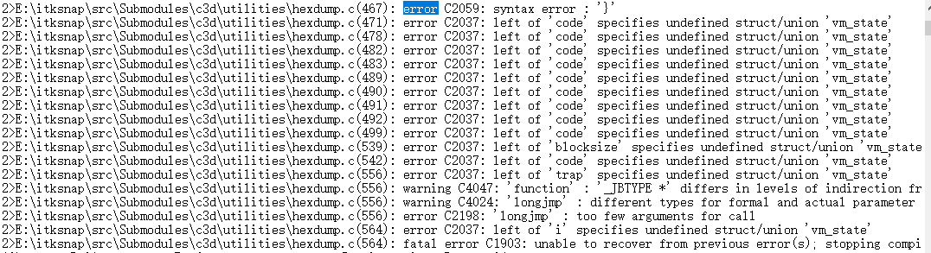

Slide 9
2>E:\itksnap\src\Submodules\c3d\utilities\hexdump.c(168): error C2059: syntax error : '['
2>E:\itksnap\src\Submodules\c3d\utilities\hexdump.c(194): error C2061: syntax error : identifier 'hxd_isspace'
2>E:\itksnap\src\Submodules\c3d\utilities\hexdump.c(194): error C2059: syntax error : ';'
2>E:\itksnap\src\Submodules\c3d\utilities\hexdump.c(194): error C2059: syntax error : 'type'
2>E:\itksnap\src\Submodules\c3d\utilities\hexdump.c(203): error C2146: syntax error : missing ')' before identifier 'nlok'
2>E:\itksnap\src\Submodules\c3d\utilities\hexdump.c(203): error C2081: '_Bool' : name in formal parameter list illegal
2>E:\itksnap\src\Submodules\c3d\utilities\hexdump.c(203): error C2061: syntax error : identifier 'nlok'
2>E:\itksnap\src\Submodules\c3d\utilities\hexdump.c(203): error C2059: syntax error : ';'
2>E:\itksnap\src\Submodules\c3d\utilities\hexdump.c(203): error C2059: syntax error : ')'
2>E:\itksnap\src\Submodules\c3d\utilities\hexdump.c(203): error C2449: found '{' at file scope (missing function header?)
2>E:\itksnap\src\Submodules\c3d\utilities\hexdump.c(208): error C2059: syntax error : '}'
2>E:\itksnap\src\Submodules\c3d\utilities\hexdump.c(267): warning C4013: 'getint' undefined; assuming extern returning int
2>E:\itksnap\src\Submodules\c3d\utilities\hexdump.c(403): error C2059: syntax error : '['
2>E:\itksnap\src\Submodules\c3d\utilities\hexdump.c(438): warning C4034: sizeof returns 0
2>E:\itksnap\src\Submodules\c3d\utilities\hexdump.c(461): error C2061: syntax error : identifier '_Bool'
2>E:\itksnap\src\Submodules\c3d\utilities\hexdump.c(462): error C2059: syntax error : '}'
2>E:\itksnap\src\Submodules\c3d\utilities\hexdump.c(467): error C2059: syntax error : '}'
2>E:\itksnap\src\Submodules\c3d\utilities\hexdump.c(471): error C2037: left of 'code' specifies undefined struct/union 'vm_state'
2>E:\itksnap\src\Submodules\c3d\utilities\hexdump.c(478): error C2037: left of 'code' specifies undefined struct/union 'vm_state'
2>E:\itksnap\src\Submodules\c3d\utilities\hexdump.c(482): error C2037: left of 'code' specifies undefined struct/union 'vm_state'
2>E:\itksnap\src\Submodules\c3d\utilities\hexdump.c(483): error C2037: left of 'code' specifies undefined struct/union 'vm_state'
2>E:\itksnap\src\Submodules\c3d\utilities\hexdump.c(489): error C2037: left of 'code' specifies undefined struct/union 'vm_state'
2>E:\itksnap\src\Submodules\c3d\utilities\hexdump.c(490): error C2037: left of 'code' specifies undefined struct/union 'vm_state'
2>E:\itksnap\src\Submodules\c3d\utilities\hexdump.c(491): error C2037: left of 'code' specifies undefined struct/union 'vm_state'
2>E:\itksnap\src\Submodules\c3d\utilities\hexdump.c(492): error C2037: left of 'code' specifies undefined struct/union 'vm_state'
2>E:\itksnap\src\Submodules\c3d\utilities\hexdump.c(499): error C2037: left of 'code' specifies undefined struct/union 'vm_state'
2>E:\itksnap\src\Submodules\c3d\utilities\hexdump.c(539): error C2037: left of 'blocksize' specifies undefined struct/union 'vm_state'
2>E:\itksnap\src\Submodules\c3d\utilities\hexdump.c(542): error C2037: left of 'code' specifies undefined struct/union 'vm_state'
2>E:\itksnap\src\Submodules\c3d\utilities\hexdump.c(556): error C2037: left of 'trap' specifies undefined struct/union 'vm_state'
2>E:\itksnap\src\Submodules\c3d\utilities\hexdump.c(556): warning C4047: 'function' : '_JBTYPE *' differs in levels of indirection from 'int'
2>E:\itksnap\src\Submodules\c3d\utilities\hexdump.c(556): warning C4024: 'longjmp' : different types for formal and actual parameter 1
2>E:\itksnap\src\Submodules\c3d\utilities\hexdump.c(556): error C2198: 'longjmp' : too few arguments for call
2>E:\itksnap\src\Submodules\c3d\utilities\hexdump.c(564): error C2037: left of 'i' specifies undefined struct/union 'vm_state'
2>E:\itksnap\src\Submodules\c3d\utilities\hexdump.c(564): fatal error C1903: unable to recover from previous error(s); stopping compilation
10>------ Build started: Project: markdown_docs, Configuration: Debug x64 ------
6> itkPovRayDF3ImageIOFactory.cxx
7> itkVoxBoCUBImageIOFactory.cxx

Slide 10
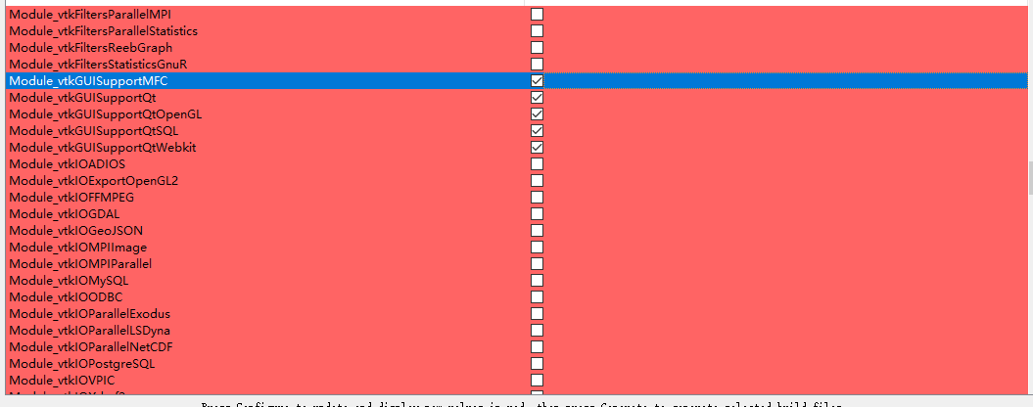

Slide 11
