Slide 1
Computer Security Capstone
Project III: Ransomware Propagation and Payload
Chi-Yu Li (2026 Spring)
Computer Science Department
National Yang Ming Chiao Tung University

Slide 2
Goals
Understand how a ransomware propagates and executes
You will learn about the operation of
  Dictionary attacks
  Ciphering and deciphering
  Digital signature
  Compressed viruses
  Worm propagation
  Ransomware
  PQC - KEM

Slide 3


Attack Scenario
Attacker
Victim
You are going to play the role of an attacker
Assume that you know the IP of the victim and the username of his/her SSH account, you are asked to
  Crack the victim’s SSH password
  Install a compressed virus in an affected program with
  attacker’s signature generated by quantum safe algorithm
  (Virus payload) Download and trigger a ransomware worm
Consider the affected program: /app/date in victim.
  When it is running, the virus payload is executed
SSH
Compressed Virus in date
date executed
Attack
server
worm

Slide 4
Grading
Task I: Crack SSH password (10%)
Task II: Create a compression virus with the propagation of the ransomware worm (20%)
Task III: Prepare the ransomware payload & PQC KEM (20%)
Questions during demo (50%)

Slide 5
Task I: Crack SSH password
Cracking the victim’s password by launching a dictionary attack
  Assume that the victim’s username is known as csc2026
  Assume that the password is created based on the victim’s personal information
    A file including the victim’s personal information: /app/victim.dat in attacker container
      One row contains an information entry
    The password is composed of one or few information entries
Hints
  Try strings combination in Python: itertools
  Automatic SSH and SFTP operation in Python: paramiko

Slide 6
Task II: Compression Virus with Ransomware Propagation
Infect /app/date in victim by embedding your compression virus
Infected ‘date’ shall
  Keep the same size as the original ‘date’
    The original ‘date’ shall be compressed
  Contain the virus payload and the functionality of the original ‘date’
  Finish the execution of the payload before the end of the ‘date’ execution
The virus payload shall
  Fetch a ransomware worm from the attack server
  Execute the ransomware worm

Slide 7
Task II: Compression Virus with Ransomware Propagation
Requirements
  The infection cannot leave any files except the infected ‘date’ on the victim container
  The last 512 bytes of the infected ‘date’ should be the signature generated by
  Dilithium3 algorithm
  The size of infected ‘date’ should be identical to the original one
Hints
  Compress ‘date’ using a compression algorithm
  Minimize the virus size with various methods
    e.g., using /dev/tcp/host/port to build tcp connections, gcc flags and strip
  Execute a program using the exec() family
  Use ‘openssl dgst’ to create & verify your signature

Slide 8
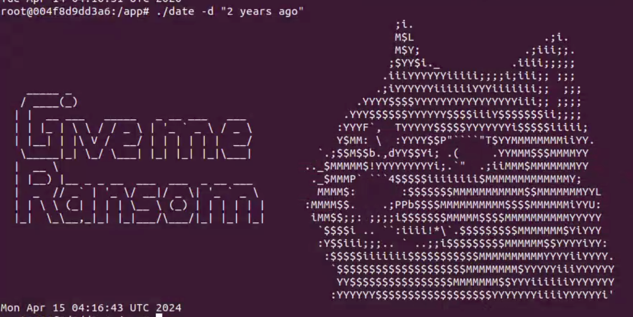
Task III: Ransomware Payload & PQC KEM
Two major actions
  Encrypting all picture files with jpg subtype in
  /app/Pictures at the victim using AES key and iv fetched from our key server (next slides).
  Show a graph indicating a message requesting
  ransom (check the banner file for the source)
Requirements
  Using a key and iv to do AES encryption & decryption
Hints
  Sample codes for AES encryption & decryption

Slide 9
Task III: Ransomware Payload & PQC KEM
Interact with Kyber-512 Based Key Server
  The server owns the private key, and you acts as a client.
  You receive a public key from the server, uses it to create a ciphertext and a shared secret using Kyber-512, then sends only the ciphertext back to server.
  The server decapsulates that ciphertext and computes the shared secret. If the shared is the same , the server would return a pair of AES Key and IV for your jpg image encryption.
Note
  You should not hardcode the Key and IV, fetch it dynamically when you run the ransomware.

Slide 10
Task III: Ransomware Payload & PQC KEM
Server API Endpoint
  GET http://140.113.207.249:8080/kem/public-key
    Example response
      {"session_id": "example-session-id","public_key": "base64-public-key"}
  POST http://140.113.207.249:8080/kem/decapsulate
    Content-Type: application/json
    Request body:
      {"session_id": "example-session-id", "ciphertext": "base64-ciphertext"}
    Example response :
      { "key": "32_hex_characters", "iv": "16_hex_characters"}
      Use this Key and IV to encrypt your jpg files.

Slide 11

Task III: Ransomware Payload & PQC KEM
Note : You must log the Key and IV you obtained from the key server in the terminal of the attacker container.
  Other debug logs are allowed.
If the log cannot be found in the terminal, we would regard image decryption as failed.
Log Format :

Slide 12
Requirements
You need to develop/run your program in the given containers.
  Resource is provided in /app
    username/password: csc2026/csc2026
    Note: the victim’s password will be changed based on a new victim.dat file in the demo
  Please complete your project under the path: /home/csc2026/${yourstudentID}
You are allowed to use C/C++, Shell Script or/and Python (Recommended).
You are allowed to team up; each team has at most 2 students
  Teams: discussions are allowed, but no collaboration
Please submit your source codes to E3
Please email your questions to csc2026@nemslab.tw

Slide 13
Important: How to set up environment?
Build the project3 image
  Linux: “ docker compose build ”
Create the project3 containers
  Linux: “ docker compose up -d ”
Enter the attacker container
  Linux: “ docker exec -it attacker bash ”
Enter the victim container
  Linux: “ docker exec -it victim bash ”

Slide 14
Important: How to Prepare Your Attack Programs?
Must provide a Makefile which compiles your source codes into at least two executable files: crack_attack and attack_server
Test requirements for your program
  Must be run in the given containers without any additional tools or libraries
  Must work for the following two test commands
    ./crack_attack <Victim IP> <Attacker IP> <Attacker port>
    ./attack_server <Attacker port>

Slide 15
Important: Major Demo Steps (Not Exactly the Same)
Attacker container
  Run “make“ to compile your source codes
  Run “./attacker_server <Attacker port>” to set up the attacker server
  Run “./crack_attack <Victim IP> <Attacker IP> <Attacker port>” to crack the victim’s password and infect ‘date’ in victim
Victim container
  Check the size of ‘date’ and any additional files generated
  Run 1 commands of ‘date’
    ‘date’ shall perform its original function
    Only the jpg files in /app/Pictures are encrypted with the given security context
    A ransom graph shall show up
  Check whether the encrypted files can be decrypted

Slide 16
Project Submission
Due date: 5/20 11:55 PM (Late submissions will not be accepted)
Makeup submission (75 % at most): After the final
Submission rules
  Put all your files into a directory and name it using your student ID(s)
    If your team has two members, please concatenate your IDs separated by “-”
  Zip the directory and upload the zip file to E3
  Wrong folder format or containing __MACOSX would receive 10 points deduction.
  A sample of the zip file: 1234567-7654321.zip
    1234567-7654321
      ├ Makefile
      ├ crack_attack.c
      ├ attack_server.c
      └ {other files you have}

Slide 17
Appendix: Quantum-Safe Cryptos (QSC)
Conventional cryptographic algorithm bases on some mathematic problems that is difficult to be cracked via modern computers
Quantum computers can use Shor’s algorithm to solve these kinds of problems efficiently, thus threatens several crypto algorithms (e.g., RSA, ECDSA, ECDHE, …)
New algorithms that can resist this kind of threats are called quantum-safe cryptos

Slide 18
Appendix: QSC in Practice
OpenSSL introduces provider mechanism to embrace algorithms from third-parties
Open Quantum Safe Project implements algorithms and adapt them with the provider interface into OpenSSL framework
Check oqs-provider / USAGE.md to know its usage
You can check the availability of QSC in your container with the command:
$ openssl list –providers
Providers:
oqsprovider
name: OpenSSL OQS Provider
status: active

Slide 19
Appendix: The Process of PQC KEM (Kyber-512)
Key generation (server side):
  The server generates a public/private key pair using the Kyber-512 parameters (based on lattice cryptography, specifically the Module-LWE problem). It sends the public key to the client while keeping the private key secret.
Encapsulation (client side):
  The client uses the server’s public key to create a shared secret and a corresponding ciphertext. It sends this ciphertext to the server; the shared secret is kept locally by the client.
Decapsulation (server side):
  The server uses its private key to decrypt (decapsulate) the ciphertext and recover the same shared secret. Now both client and server independently hold the identical secret, which can be used for symmetric encryption (e.g., secure communication).

Slide 20
Questions?

