Slide 1
Software Defects
"The president stated that it was a software anomaly that caused the missile to go off course…"

Slide 2
Agenda
What is a BUG?
What is the goal of testers?
Defects on different stages of software development
Types of defects and problems
Description of the defect’s attributes and statuses
Defect tracking procedure
Defect Tracking systems

Slide 3
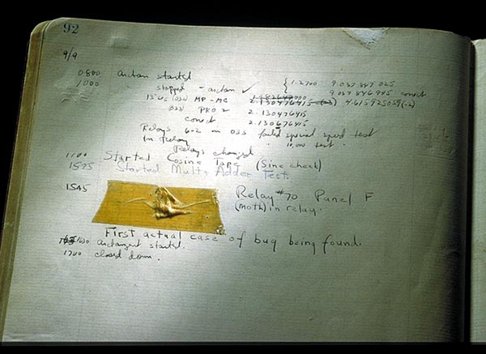
What is Bug?

Slide 4

What is Bug?
Bug is a mismatch between the expected result and actual result of software program behavior.
Bug is a problem that causes a program to crash or produce invalid output.

Slide 5

What is the goal of testers?
The goal of a software tester is to find bugs.
The goal of a software tester is to find bugs and find them as early as possible.
The goal of a software tester is to find bugs, find them as early as possible and make sure they get fixed.

Slide 6
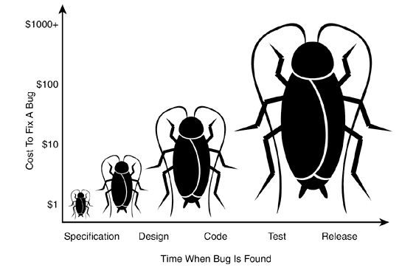
Bugs on different stages
Specification
Design
Code
Testing
Release

Slide 7
Reasons of registering a new bug
The software does (doesn't do) something that the product specification says it shouldn’t (should) do.
The software is difficult to understand, hard to use, slow, or in the software tester's eyes will be viewed by the end user as just plain not right.

Slide 8
Types / Categories of problems in a program
Core dump
Business Logic
Deficiency
Interface
Enhancement
Grammar
Other
Inconvenient use
Non-functional

Slide 9
Whether each problem is a bug?
Bug, Error, Defect, Issue, Failure, Task and so on…

Slide 10

Types of Defects
Is everything related to program behavior?
What about requirements?
Something else?

Slide 11

Other types of registered issues
Environment
External - 3rd Party
Performance
Hardware
Installation
Refactoring
Requirement
Test Case

Slide 12
Defect attributes to describe an issue?
Summary
Defect ID
Problem category
Description
Detected by
Problem type
Detected on
Severity
Detected in Version
Priority
Project
Assigned to
Status

Slide 13
Parent and Child defects
Defect# 33112
Parent Defect
Defect# 89431
Child Defect
Defect# 84651
Defect# 6234
Parent Defect

Slide 14
Defect reporting tips
Review entire list of reported defects. Make sure you are not entering a duplicate before registering the item
Provide clear and laconic Summary to the reported defect
Provide clear and understandable Description to the reported defect
Always spell check reported by you defects entries!
Set proper defect Priority and Severity

Slide 15

Quiz
1. Please, give definition of following concepts: Defect, Defect Tracking.
2. Describe the difference between Deficiency and Enhancement problem types.
3. What types of the defects and problems in software do you know?
4. Please, name several defects attributes.
5. What is the reason of creation Parent and Child defects?
6. What is the goal of testers?

Slide 16
Defect tracking procedure
Creation of new defect
NEW
CLOSED
Problem Type: Not a Defect
Evaluation problem
EVALUATED
Evaluation review
OPEN
Coding
IMPLEMENTED
Code review
REVIEWED
Internal Testing
REWORK
FIXED
Testing
TESTED
Testing review
CLOSED

Slide 17
Defect tracking system
Why do we need to report defects?
Defect Tracking System is software application that is designed to help testers and programmers keep track of reported software defects in their work.
Общий и единый процесс документации дефектов
Не измерять результат в попугаях
Планировать тестирование
Планировать разработку

Slide 18
Defect tracking system
Why do we need to report defects?
Defect Tracking System is software application that is designed to help testers and programmers keep track of reported software defects in their work.
Defect Tracking System common tasks:
Collect defect records
Assign defect record to the responsible person
Collect defect history
Find defect by defined condition
Filter defect list by defined condition
Close defect record

Slide 19


Open source Bug tracking systems
Bugzilla is written in Perl, and works on various databases including MySQL and Oracle.
Features
Time tracking
Private attachment and commenting
Flexible reporting and charting (via email).
Adding custom fields and workflows.
Email notifications controlled by user preferences
Automatic duplicate bug detection
File/Modify Bugs By Email
Request System
Mantis is written in PHP, and works on various databases including MySQL, MS SQL, PostgreSQL.
Features
Web based, support any platform that runs PHP
Source code integration
Time tracking
Issue relationship graph
Custom fields and workflow
Anonymous access

Slide 20

Open source Bug tracking systems
Trac is written in Python.
Features:
wiki, and integration to subversion
simplistic web interface
project management features: roadmap and milestone tracking
Readmine is written in Ruby on Rails. Apart from tracking issues, it provides a full project management features.
Features
Project management including
Project Wiki
Time Tracking
Flexible issue tracking system
Multiple database support

Slide 21
Adding a new defect. Practice
User Registration
Login:
Password:
Confirm Password:
Save
Cancel
Congratulation!
New user was successfully added.
OK
Requirement:
System should allow to register a new user

Slide 22
Adding a new defect. Practice
User Registration
Login:
Password:
Confirm Password:
Save
Cancel
Defect:
Values entered in “Password” and “Confirm Password” do not match, but user was registered successfully.

Slide 23
Adding a new defect. Example
Detection Info
By: jkad
On: 1/10/2011
Version: 1.1.8.2.1
Project: RPTG
Priority: 1-Low
Severity: Critical
Summary: Exception appears on adding a new user.
Description:
Initial conditions: Windows 7 OS is installed. Problem doesn't reproduce in Windows Vista and Windows XP.
Scenario:
1. Select “User Registration" option from Main Menu.
2. In opened “User Registration" enter appropriate values to “Login”, “Password” and “Confirm Password” fields accordingly.
3. Press “Save” button.
Expected result: User was successfully registered.
Actual result: Unhandled exception appears.
Problem also reproduced: If {…}.
Exception screen shot and description see in attach.

Slide 24
Quiz
1. What is Defect Tracking system?
2. What Defect Tracking systems do you know?
Name the main their features.
3.Describe the main features of defect tracking process.
4. Describe the defect’s lifecycle and it’s main statuses.

