Slide 1
Requirements Analysis
CIS 375
Bruce R. Maxim
UM-Dearborn

Slide 2
Requirements Analysis
Software engineering task bridging the gap between system requirements engineering and software design.
Provides software designer with a model of:
  system information
  function
  behavior
Model can be translated to data, architectural, and component-level designs.
Expect to do a little bit of design during analysis and a little bit of analysis during design.

Slide 3
Analysis Objectives
Identify customer’s needs.
Evaluate system for feasibility.
Perform economic and technical analysis.
Allocate functions to system elements.
Establish schedule and constraints.
Create system definitions.

Slide 4
Software Requirements Analysis Phases
Problem recognition
Evaluation and synthesis
  focus is on what not how
Modeling
Specification
Review

Slide 5
Management Questions
How much effort put towards analysis?
Who does the analysis?
Why is it so difficult?
Bottom line - who pays for it?

Slide 6
Feasibility Study
Economic feasibility
  cost/benefit analysis
Technical feasibility
  hardware/software/people, etc.
Legal feasibility
Alternatives
  there is always more than one way to do it

Slide 7
System Specification
Introduction.
Functional data description.
Subsystem description.
System modeling and simulation results.
Products.
Appendices.

Slide 8
Requirements
Requirement
  features of system or system function used to fulfill system purpose.
Focus on customer’s needs and problem, not on solutions:
  Requirements definition document
    (written for customer).
  Requirements specification document
    (written for programmer; technical staff).

Slide 9
Types of Requirements - 1
Functional requirements:
  input/output
  processing.
  error handling.
Non-functional requirements:
  Physical environment (equipment locations, multiple sites, etc.).
  Interfaces (data medium etc.).
  User & human factors (who are the users, their skill level etc.).

Slide 10
Types of Requirements - 2
Non-functional requirements (continued):
  Performance (how well is system functioning).
  Documentation.
  Data (qualitative stuff).
  Resources (finding, physical space).
  Security (backup, firewall).
  Quality assurance (max. down time, MTBF, etc.).

Slide 11
Requirement Validation
Correct?
Consistent?
Complete?
  Externally - all desired properties are present.
  Internally - no undefined references.
Each requirement describes something actually needed by the customer.
Requirements are verifiable (testable)?
Requirements are traceable.

Slide 12
Requirements Definition Document
General purpose of document.
System background and objectives.
Description of approach.
Detailed characteristics of proposed system (data & functionality).
Description of operating environment.

Slide 13
Software Requirements Elicitation
Customer meetings are the most commonly used technique.
Use context free questions to find out
  customer's goals and benefits
  identify stakeholders
  gain understanding of problem
  determine customer reactions to proposed solutions
  assess meeting effectiveness
Interview cross section of users when many users are anticipated.

Slide 14
F.A.S.T. - 1
Facilitated application specification technique
Meeting between customers and developers at a neutral site (no home advantage).
Goals
  identify the problem
  propose elements of solution
  negotiate different approaches
  specify preliminary set of requirements

Slide 15
F.A.S.T. - 2
Rules for participation and preparation established ahead of time.
Agenda suggested
  brainstorming encouraged
Facilitator appointed.
Definition mechanism
  sheets, flipcharts, wallboards, stickers, etc.

Slide 16
Q.F.D. - 1
Quality Function Deployment
Customer’s needs imply technical requirements:
  Normal requirements
    (minimal functional & performance).
  Expected requirements
    (important implicit requirements, i.e. ease of use).
  Exciting requirements
    (may become normal requirements in the future, highly prized & valued).

Slide 17
Q.F.D. - 2
Function Deployment:
  Determines value of required function.
Information Deployment:
  Focuses on data objects and events produced or consumed by the system.
Task Deployment:
  product behavior and implied operating environment.

Slide 18
Q.F.D. - 3
Value Analysis makes use of:
  Customer interviews.
  Observations.
  Surveys.
  Historical data.
to create
  Customer Voice Table
  extract expected requirements
  derive exciting req.

Slide 19
Use Cases
Scenarios that describe how the product will be used in specific situations.
Written narratives that describe the role of an actor (user or device) as it interacts with the system.
Use-cases designed from the actor's point of view.
Not all actors can be identified during the first iteration of requirements elicitation, but it is important to identify the primary actors before developing the use-cases.

Slide 20
User Profile - Example
Full Control (Administrator)
Read/Write/Modify All (Manager)
Read/Write/Modify Own (Inspector)
Read Only (General Public)

Slide 21
Use Case Example - 1
Read Only Users
  The read-only users will only read the database and cannot insert, delete or modify any records.
Read/Write/Modify Own Users
  This level of users will be able to insert new inspection details, facility information and generate letters. They will be also able to modify the entries they made in the past.

Slide 22
Use Case Example - 2
Read/Write/Modify All Users
  This level of users will be able to do all the record maintenance tasks. They will be able to modify any records created by any users.
Full Control Users
  This is the system administrative level which will be able to change any application settings, as well as maintaining user profiles.

Slide 23
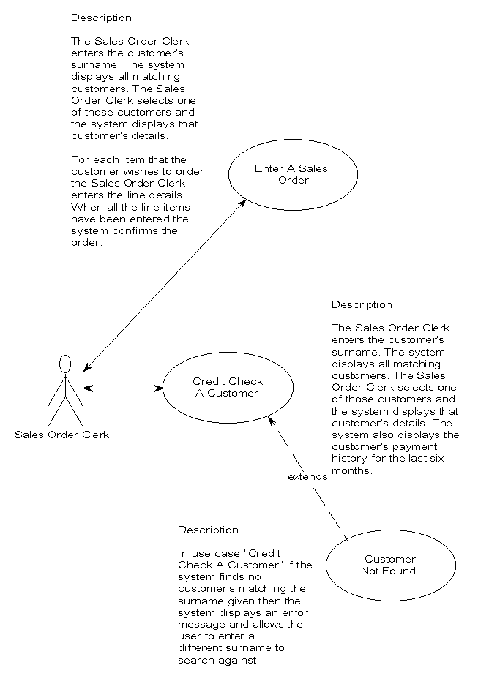

Slide 24
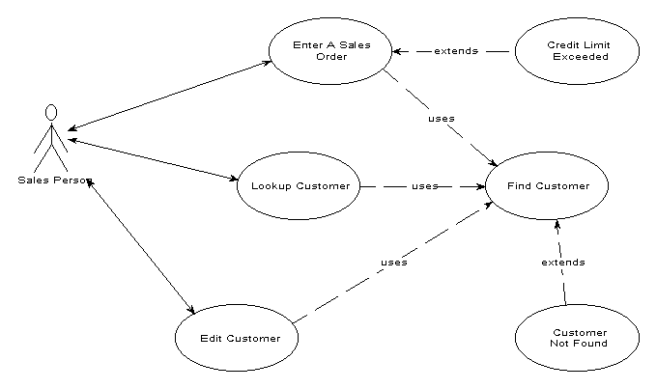

Slide 25
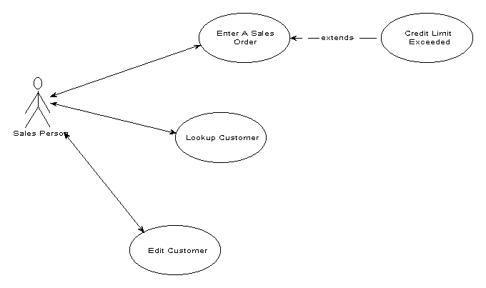

Slide 26
Analysis Principles
Information domain of problem must be presented & understood.
Models depicting system information, functions, and behavior should be developed.
Models and problems must be partitioned in a manner that uncovers detail in layers.
Analysis proceeds from essential information toward implementation detail
Must be traceable.

Slide 27
Information Domain
Encompasses all data objects that contain numbers, text, images, audio, or video.
Information content or data model
  shows the relationships among the data and control objects that make up the system
Information flow
  represents manner in which data and control objects change as each moves through system
Information structure
  representations of the internal organizations of various data and control items

Slide 28
Modeling
Data model
  shows relationships among system objects
Functional model
  description of the functions that enable the transformations of system objects
Behavioral model
  manner in which software responds to events from the outside world

Slide 29
Partitioning
Process that results in the elaboration of data, function, or behavior.
Horizontal partitioning
  breadth-first decomposition of the system function, behavior, or information, one level at a time.
Vertical partitioning
  depth-first elaboration of the system function, behavior, or information, one subsystem at a time.

Slide 30
Requirements Views
Essential view
  presents the functions to be accomplished and the information to be processed while ignoring implementation
Implementation view
  presents the real world realization of processing functions and information structures
Avoid the temptation to move directly to the implementation view and assuming that the essence of the problem is obvious.

Slide 31
Specification Principles - 1
Separate functionality from implementation.
A process-oriented specification language is needed.
Specification must encompass the system containing the software component.
Specification must encompass the environment.
System specification = cognitive model.

Slide 32
Specification Principles - 2
Specification must be operational (talk about how it works).
Must be tolerant of incompleteness and easy to add to.
Specification must be localized and loosely coupled (pieces of things are independent of each other).

Slide 33
Specification Representation
Representation format and content should be relevant to the problem.
Information contained within the specification should be nested.
Diagrams and other notational forms should be restricted in number and consistent in use.
Representations should be revisable.

Slide 34
Specification Review
Conducted by customer and software developer.
Once approved, the specification becomes a contract for software development.
The specification is difficult to test in a meaningful way.
Assessing the impact of specification changes is hard to do.

Slide 35
Requirements Review
Goals & objectives review.
Compare requirements to goals & objectives.
Consider system operating environment.
Assess and document all risks in system developmental operation.
Discuss testing procedure.

Slide 36
Evaluating Specification Techniques - 1
Requirements are understandable to naive user.
Requirements form basis for design and testing.
Automated requirements checking?
Requirements form external view of system.

Slide 37
Evaluating Specification Techniques - 2
Technique aid in organizing and structuring requirements.
Technique for prototyping.
Automatic test case generation from requirements.
Appropriate for application.

Slide 38
Prototyping and Specification
Throwaway prototyping
  prototype only used as a demonstration of product requirements
  finished software is engineered using another paradigm
Evolutionary prototyping
  prototype is refined to build the finished system
Customer resources must be committed to evaluation and refinement of the prototype.
Customer must be capable of making requirements decisions in a timely manner.

Slide 39
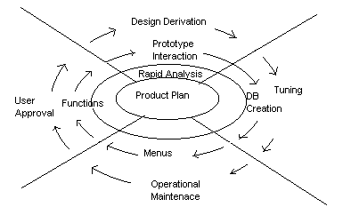
Evolutionary Rapid Prototyping

Slide 40
E.R.P. Process
Goal is to write less throw away code than spiral model
Starts with project plan and plans for software evolution
Risks/Unknowns favoring ERP use:
  Customer requirements
  Technology
  Interfaces

Slide 41
E.R.P. Risks
Premature delivery.
Premature design selection.
Features in prototype can get lost in final product.
There is a tendency to choose efficiency of production over product modifiability.

Slide 42
E.R.P. Advice
Focus on what will take least amount of programming time over maintainability.
With rapid prototyping don’t write code until ready.
Spiral model any code written may be thrown out after risk assessment.

Slide 43
E.R.P. Analysis
What.
When.
Cost.
Completion.
Re-use.
Contingencies.
Rewards.

Slide 44
Implementation and Testing
Code.
Test.
Debug.
Go to 1 (repeat).

Slide 45
Each Spin Cycle
Each module is evaluated and rated:
  Leave as is.
  Rewrite.
  Replace with existing code.
  Discard, is no longer needed.

Slide 46
Re-implementation Symptoms
Prototype contains spaghetti code.
Prototype cannot be extended to meet full user requirements.
Work to fix time implies less work to start again.

