Slide 1
Introduction to
Software testing

Slide 2

Inputs and Outputs
Inputs
Outputs

Slide 3
Inputs and Outputs
User Interface (UI)
Program Interface (API)
Net Protocol
File System
Environment State
Events

Slide 4
What is Operating System (OS)?
Комплекс программ (программная оболочка), осуществляющий взаимодействие компьютерного оборудования (hardware) с внешним миром (прикладные программы, пользователь и т.п.) посредством предоставляемых интерфейсов

Slide 5
Какие виды ОС вы знаете?
Однозадачные - Многозадачные
Пользовательские – Серверные
(Клиентские, имеющие UI -
Командные, не имеющие UI)
Однопользовательские – многопользовательские
Открытые – Закрытые
Платные – Бесплатные
16-, 32-, 64- разрядные

Slide 6
Какие ОС вы знаете?
Windows / MS-Dos
Unix
Linux
Android
iOS
NetWare

Slide 7
Какие виды программ вы знаете?
Desktop / Mobile application
Console application
GUI (Window) application
Web application
Service application

Slide 8
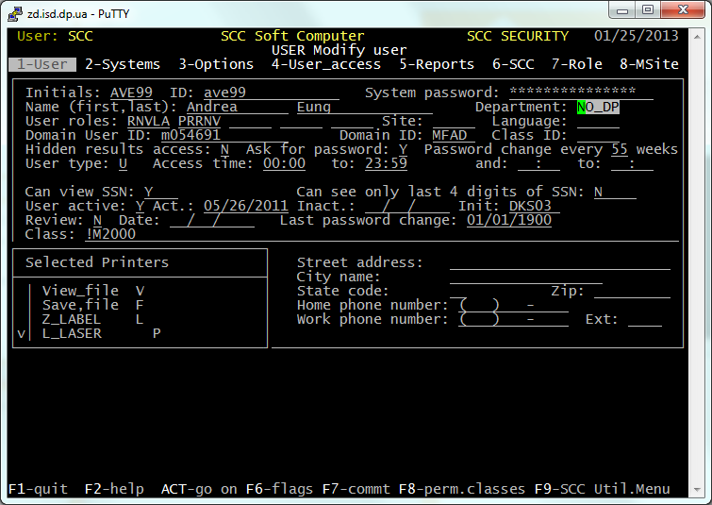
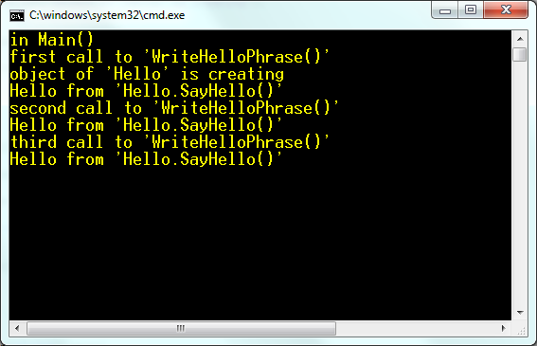
Какие виды программ вы знаете?

Slide 9
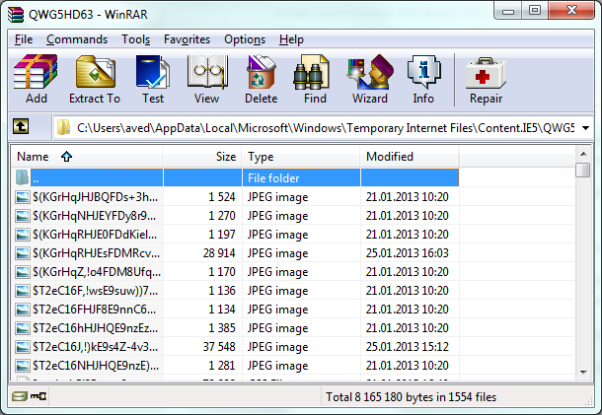
Какие виды программ вы знаете?

Slide 10
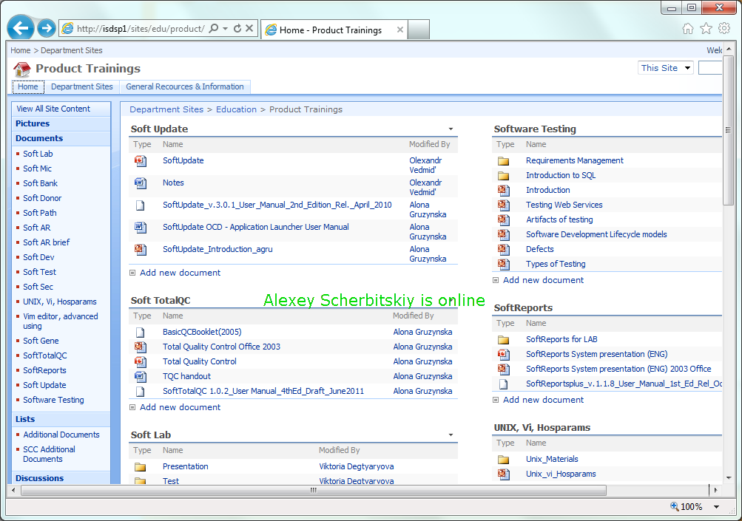
Какие виды программ вы знаете?

Slide 11

Какие есть GUI элементы управления?
Button
Text box
Check box
Radio button
Combo box
Label
Scroll bar
Spin button

Slide 12
Архитектура программного обеспечения
Architecture
Three-Tier Architecture
One Tier
Client-Server
Thin Client
Rich Client

Slide 13
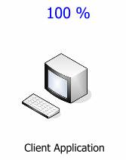
Software Architecture – Одноуровневая

Slide 14
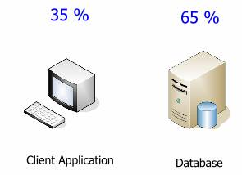
Software Architecture – Двухуровневая

Slide 15
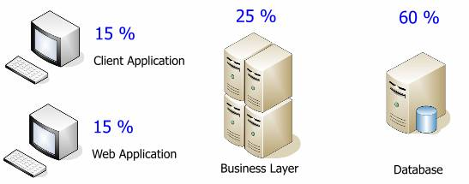
Software Architecture – Трехуровневая

Slide 16
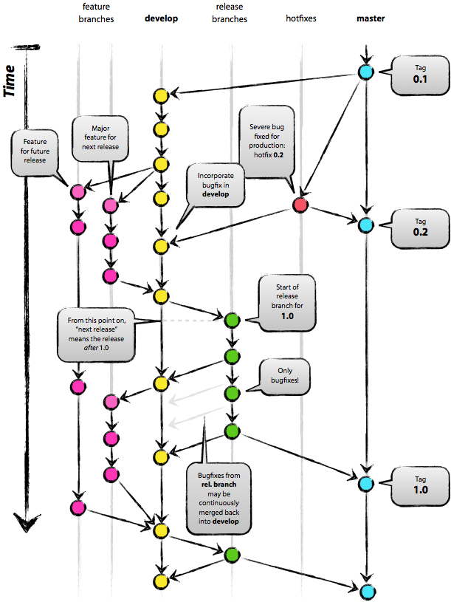
Системы контроля версий проектов

Slide 17
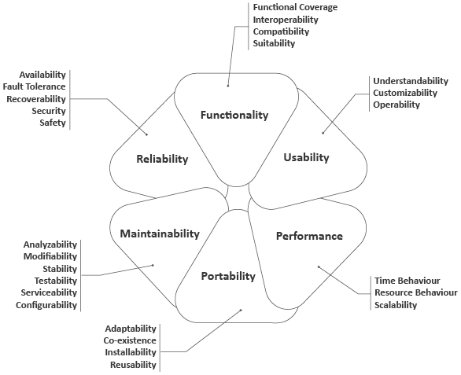
Quality - Качество
Definition (Определение): степень, с которой компонент, система или процесс соответствует определенным требованиям и/или пользовательским ожиданиям.

Slide 18
Quality Assurance. Quality Control. Software Testing.
QA
QC
Software Testing

Slide 19
Roles
Product Specialist (PDS)
Business Analyst (BA)
Quality Control/Product Testers
Designs and creates Test
Executes Test Cases
Maintains testing environments
Performs Functional, System, and Installation Testing across new and existing applications
Streamlines and enhances the testing lifecycle to ensure test planning, execution, and reporting is effective, efficient, standardized, coordinated, and integrated
Maintains all types of testing documentation

Slide 20
Roles
Testing Management
Creates and monitors QC testing project plan
Monitors all testing activities
Requests creation of the environments for testing and verifies the SW installation
Creates tasks for all testing activities (creating Test Cases, running Test Cases)
Creates Test Sets for testing activities
Reconciles Test Cases from Test Set with Change List
Produces and verifies Testing Summary Report
Product Management
Reviews new functionalities of a product
Reviews requirements and functional specifications for testing
Reviews and signs Test Plan
Reviews and approves Test Cases and Test Sets
Verifies criticality of defects
Performs Exploratory Testing and System Testing as appropriate
Recommends corrective actions and follow-up on testing
Performs final review and signs off on all system Testing Summary Reports

Slide 21
Testing work Process
Change Code Request
Validating (BA, PDS)
Creating functional requirements (BA)
Implementing
(Developers)
TC development
(QC)
TC review
(BA)
Testing
(QC)
Presentation to clients
(BA)
Closed

Slide 22

Quiz
1. What is Software Testing?
2. Name the main testing axioms.
3. What is quality? Please, describe the main aspects of quality.
4. Please, describe the Reliability as an aspect of quality.
5. Describe the difference between Testing, QA and QC functions.
6. How do you understand an axiom “Testing can’t show that bugs don’t exist”?
7. Describe the roles of team members that take part in testing process.
8. Describe testing work process.
9. What types of Software Architecture do you know?
10. True or False: The test team is responsible for quality.

