Slide 1
Requirements
(selected from
Ian Sommerville slides for “Software Engineering”)

Slide 2
Topics covered
The requirements engineering process
The software requirements document
Requirements validation
Requirements evolution

Slide 3
Requirements engineering
The process of establishing the services that the customer requires from a system and the constraints under which it operates and is developed
Requirements may be functional or non-functional
  Functional requirements describe system services or functions
  Non-functional requirements is a constraint on the system or on the development process

Slide 4
What is a requirement?
It may range from a high-level abstract statement of a service or of a system constraint to a detailed mathematical functional specification
This is inevitable as requirements may serve a dual function
  May be the basis for a bid for a contract - therefore must be open to interpretation
  May be the basis for the contract itself - therefore must be defined in detail
  Both these statements may be called requirements

Slide 5
Requirements definition/specification
Requirements definition
  A statement in natural language plus diagrams of the services the system provides and its operational constraints. Written for customers
Requirements specification
  A structured document setting out detailed descriptions of the system services. Written as a contract between client and contractor
Software specification
  A detailed software description which can serve as a basis for a design or implementation. Written for developers

Slide 6
Wicked problems
Most large software systems address wicked problems
Problems which are so complex that they can never be fully understood and where understanding develops during the system development
Therefore, requirements are normally both incomplete and inconsistent

Slide 7
Reasons for inconsistency
Large software systems must improve the current situation. It is hard to anticipate the effects that the new system will have on the organisation
Different users have different requirements and priorities. There is a constantly shifting compromise in the requirements
System end-users and organisations who pay for the system have different requirements
Prototyping is often required to clarify requirements

Slide 8
Requirements document structure
Non-functional requirements definition
  Define constraints on the system and the development process
System evolution
  Define fundamental assumptions on which the system is based and anticipated changes
Requirements specification
  Detailed specification of functional requirements
Appendices
  System hardware platform description
  Database requirements (as an ER model perhaps)
Index

Slide 9
Ethnographic analysis
A social scientists spends a considerable time observing and analysing how people actually work
People do not have to explain or articulate their work
Social and organisational factors of importance may be observed
Ethnographic studies have shown that work is usually richer and more complex than suggested by simple system models

Slide 10
Social and organisational factors
Software systems are used in a social and organisational context. This can influence or even dominate the system requirements
Social and organisational factors are not a single viewpoint but are influences on all viewpoints
Good analysts must be sensitive to these factors but currently no systematic way to tackle their analysis

Slide 11
Requirements definition
Should specify external behaviour of the system so the requirements should not be defined using a computational model
Includes functional and non-functional requirements
  Functional requirements are statements of the services that the system should provide
  Non-functional requirements are constraints on the services and functions offered by the system

Slide 12
Writing requirements definitions
Natural language, supplemented by diagrams and tables is the normal way of writing requirements definitions
This is universally understandable but three types of problem can arise
  Lack of clarity. Precision is difficult without making the document difficult to read
  Requirements confusion. Functional and non-functional requirements tend to be mixed-up
  Requirements amalgamation. Several different requirements may be expressed together

Slide 13
Editor grid requirement
2.6 Grid facilities To assist in the positioning of entities on a diagram,
the user may turn on a grid in either centimetres or inches, via an
option on the control panel. Initially, the grid is off. The grid may be
turned on and off at any time during an editing session and can be
toggled between inches and centimetres at any time. A grid option
will be provided on the reduce-to-fit view but the number of grid
lines shown will be reduced to avoid filling the smaller diagram
with grid lines.

Slide 14
Defining requirements
Editor requirement mixes up functional and non-functional requirements and is incomplete
Easy to criticise but hard to write good requirements definitions
Use of a standard format with pre-defined fields to be filled means that information is less likely to be missed out

Slide 15
Editor grid definition
2.6 Grid facilities
2.6.1 The editor shall provide a grid facility where a matrix of horizontal and
vertical lines provide a background to the editor window. This grid shall
be a passive grid where the alignment of entities is the user's responsibility.
Rationale: A grid helps the user to create a tidy diagram with well-spaced
entities. Although an active grid, where entities 'snap-to' grid lines can be
useful, the positioning is imprecise. The user is the best person to decide
where entities should be positioned.
2.6.2 When used in ‘reduce-to-fit’ mode (see 2.1), the number of units
separating grid lines must be increased.
Rationale: If line spacing is not increased, the background will be
very cluttered with grid lines.
Specification: ECLIPSE/WS/Tools/DE/FS Section 5.6

Slide 16
Requirements rationale
It is important to provide rationale with requirements
This helps the developer understand the application domain and why the requirement is stated in its current form
Particularly important when requirements have to be changed. The availability of rationale reduces the chances that change will have unexpected effects

Slide 17
Requirements specification
The specifications adds detail to the requirements definition. It should be consistent with it.
Usually presented with system models which are developed during the requirements analysis. These models may define part of the system to be developed
Often written in natural language but this can be problematical

Slide 18
Problems with natural language
Natural language relies on the specification readers and writers using the same words for the same concept
A natural language specification is over-flexible and subject to different interpretations
Requirements are not partitioned by language structures

Slide 19
Natural language alternatives
Structured natural language
Design description languages
Requirements specification languages
Graphical notations
Mathematical specifications

Slide 20
Non-functional requirements
Define system properties and constraints e.g. reliability, response time and storage requirements. Constraints are I/O device capability, system representations, etc.
Process requirements may also be specified mandating a particular CASE system, programming language or development method
Non-functional requirements may be more critical than functional requirements. If these are not met, the system is useless

Slide 21
Non-functional classifications
Product requirements
  Requirements which specify that the delivered product must behave in a particular way e.g. execution speed, reliability, etc.
Organisational requirements
  Requirements which are a consequence of organisational policies and procedures e.g. process standards used, implementation requirements, etc.
External requirements
  Requirements which arise from factors which are external to the system and its development process e.g. interoperability requirements, legislative requirements, etc.

Slide 22
Non-functional requirements examples
Product requirement
  4.C.8 It shall be possible for all necessary communication between the APSE and the user to be expressed in the standard Ada character set.
Organisational requirement
  9.3.2 The system development process and deliverable documents shall conform to the process and deliverables defined in XYZCo-SP-STAN-95.
External requirement
  7.6.5 The system shall provide facilities that allow any user to check if personal data is maintained on the system. A procedure must be defined and supported in the software that will allow users to inspect personal data and to correct any errors in that data.

Slide 23
Requirements verifiability
Requirements should be written so that they can be objectively verified
The problem with this requirement is its use of vague terms such as ‘errors shall be minimised”
  The system should be easy to use by experienced controllers and should be organised in such a way that user errors are minimised.
The error rate should be been quantified
  Experienced controllers should be able to use all the system functions after a total of two hours training. After this training, the average number of errors made by experienced users should not exceed two per day.

Slide 24
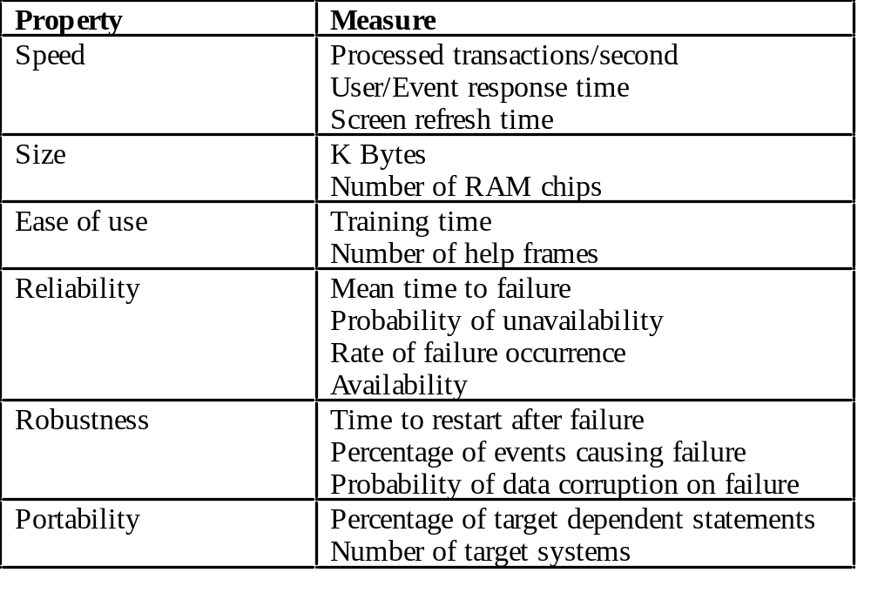
Requirements measures

Slide 25
Requirements separation
Functional and non-functional requirements should, in principle, be distinguished in a requirements specification
However, this is difficult as requirements may be expressed as whole system requirements rather than constraints on individual functions
It is sometimes difficult to decide if a requirement is functional or a non-functional
  For example, requirements for safety are concerned with non-functional properties but may require functions to be added to the system

Slide 26
System-level requirements
Some requirements place constraints on the system as a whole rather than specific system functions
Example
  The time required for training a system operator to be proficient in the use of the system must not exceed 2 working days.
These may be emergent requirements (see Chapter 2) which cannot be derived from any single sub-set of the system requirements

Slide 27
Requirements validation
Concerned with demonstrating that the requirements define the system that the customer really wants
Requirements error costs are high so validation is very important
  Fixing a requirements error after delivery may cost up to 100 times the cost of fixing an implementation error
Prototyping (discussed in Chapter 8) is an important technique of requirements validation

Slide 28
Requirements checking
Validity. Does the system provide the functions which best support the customer’s needs?
Consistency. Are there any requirements conflicts?
Completeness. Are all functions required by the customer included?
Realism. Can the requirements be implemented given available budget and technology

Slide 29
Requirements reviews
Regular reviews should be held while the requirements definition is being formulated
Both client and contractor staff should be involved in reviews
Reviews may be formal (with completed documents) or informal. Good communications between developers, customers and users can resolve problems at an early stage

Slide 30
Review checks
Verifiability. Is the requirement realistically testable?
Comprehensibility. Is the requirement properly understood?
Traceability. Is the origin of the requirement clearly stated?
Adaptability. Can the requirement be changed without a large impact on other requirements?

Slide 31
Requirements document changes
The requirements document should be organised so that requirements changes can be made without extensive rewriting
External references should be minimised and the document sections should be as modular as possible
Changes are easiest when the document is electronic. Lack of standards for electronic documents make this difficult

Slide 32
Key points
It is very difficult to formulate a complete and consistent requirements specification
A requirements definition, a requirements specification and a software specification are ways of specifying software for different types of reader
The requirements document is a description for customers and developers

