Slide 1

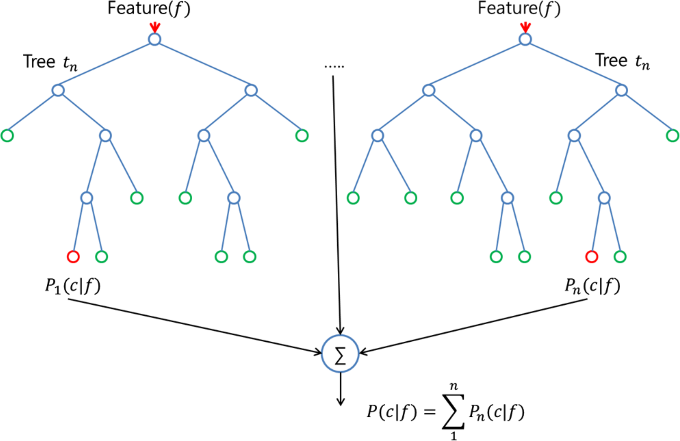
From: Fire detection system using random forest classification for image sequences of complex background
Opt. Eng. 2013;52(6):067202-067202. doi:10.1117/1.OE.52.6.067202
Figure Legend:
Random forest.
Date of download: 5/4/2015 Copyright © 2015 SPIE. All rights reserved.

