Slide 1
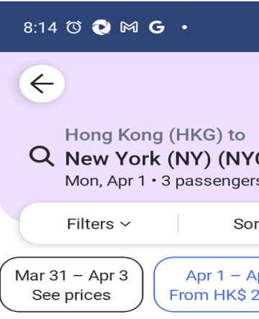
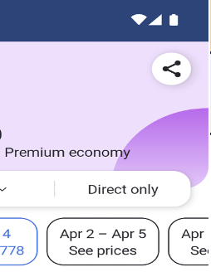
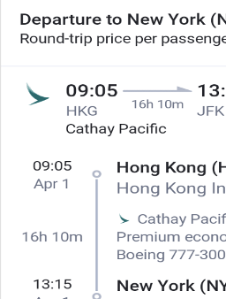
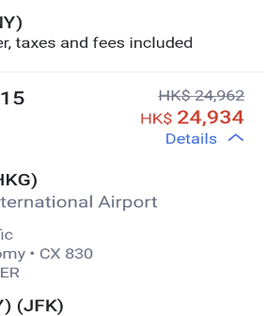
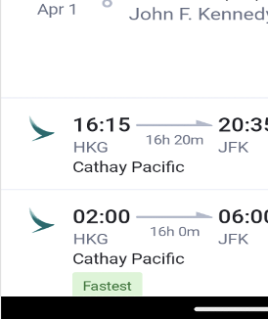
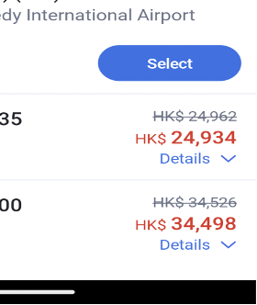
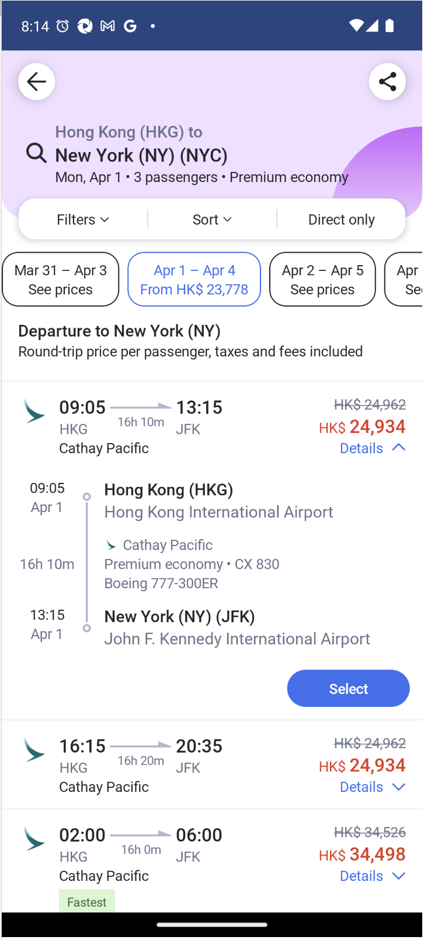
这种图片替换一下，要求凸显GUI screen中icon、text，这个图片文字太多了
图像参考地址：
AMEX：/mnt_code/user/262866/AMEX/screenshot
AITW：/mnt_code/user/262866/AITW
Rico：/mnt/user/hongchen/262866/457353/dataset/Rico
ScreenSpot:/mnt/user/hongchen/262866/457353/dataset/ScreenSpot/imgs
WebSRC:/mnt/user/hongchen/262866/457353/dataset/WebSRC
It is a search icon, you can click it to find flight information
Dense image representation
LLM
ViT
Alignment Projector
Input content to LLM
GUI Representation Enhancement Module
textual signal
Textual Expert
Dynamic High-Resolution
widget signal
Widget
Expert
GUI Experts
Router
spatial signal
GUI representation enhancement vectors
Spatial Expert
Query
Multi-Expert GUI Perception Module
Please describe the content of the coordinates [43,89,75,112].
Word Embedding
UI Screen Image
Semantic query signal
Query和output：
这个你可以替换，只要是和我们benchmark相关就行，也可以多个问题和回答。
图片你看看能不能优化美观一下

Slide 2


这些问题和回答你可以核对下或者优化美观(比如New York->The destination is New York)
涉及坐标的问答，坐标需要核实一下在图像中是否一样（可以在图像中画个bbox核对一下）
整个图片可以按照你的思路美化一下（颜色、布局等等）
GUI Understanding
Widget Caption
Screen2Words
What is the function of this widget [12,32,45,77] ?
Please describe this screenshot.
It is a return icon that can return to the previous page.
The current screenshot is a flight order page.
Referring Expressing
Select the search icon.
Questions and Answers
[12,367, 62, 419]
What is the destination of this trip?
New York
Taperception
Please determine whether the [299, 213,334,300] area is clickable.
How much discount can you get by choosing the flight from 16:15 to 20:35?
clickable
HK $28

Slide 3
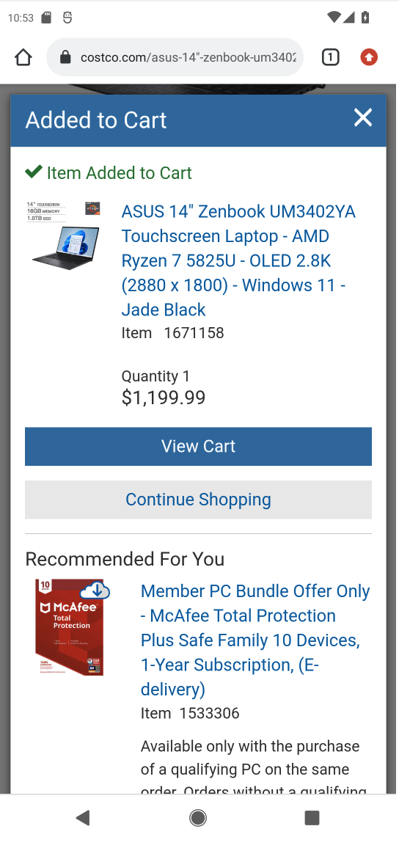
调色、修改布局….美化图像
检查是否存在语法或拼写错误
Question (text-style): There are two components at [ ] and [ ]. What is their relationship?
Question (xml-style): There are two components at [ ] and [ ]. What is their relationship? (with XML format)
Type 1: The two boxes have a containment relationship.
Samples: box1 and box3
Answer(text-style): The element at box1 is “button”, contained in box3.
Answer(xml-style): Related:
<container>
<box>box3</box>
<button><box>box1</box></button>
</container >
box3
Type 2: The two boxes are on the same layer and have a common parent area.
Samples: box1 and box2
Answer(text-style): “button” at box1 and “button” at box2 are sibling elements from box3.
Answer(xml-style): related:
box1
<container><box>box3</box>
<button><box>box1</box></button>
<button><box>box2</box></button>
</container>
box2
Type 3: The two boxes are contained but not related.
Samples: box4 and box5
Type 4: The two boxes are not contained and not related.
Samples: box4 and box2
Answer(text-style): “image” at box4 lacks a direct link with “button” at box2.
Answer(xml-style): Unrelated:
box4
box5
< image><box>box4</box></image>
<button><box>box2 </box></button>

Slide 4
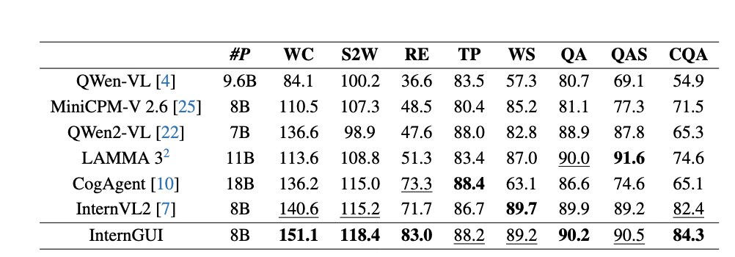
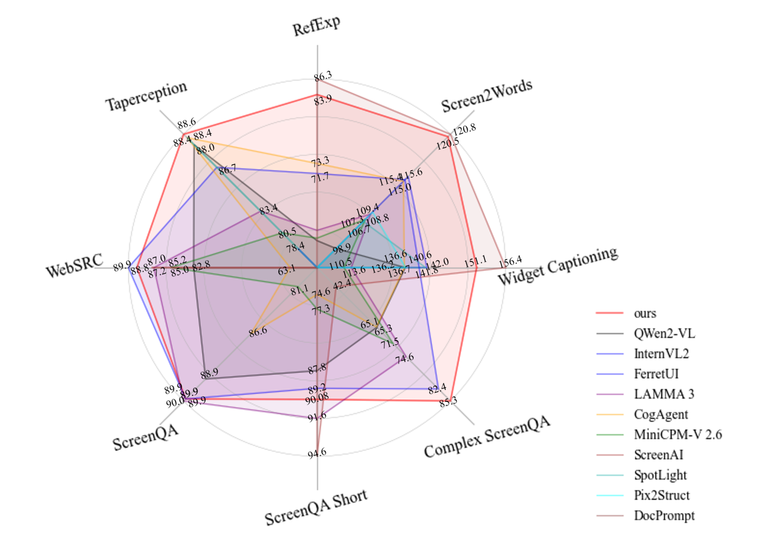
去掉专家模型，只保留大模型，结果用我们最新的表格（右边,加了个QWenVL）
调色优化，让图片清晰且明显一下

