Slide 1

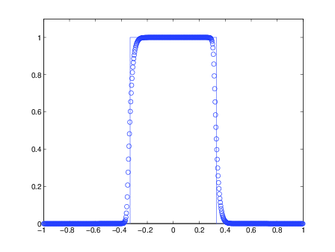

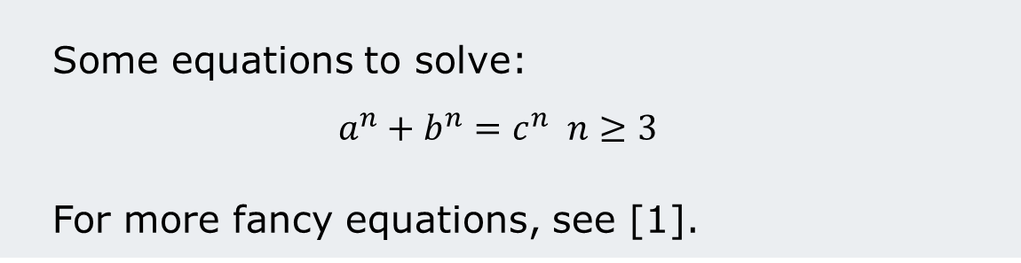
MPhil in Scientific Computing
My MPhil Project Title
Outline
My results
Here I describe an overview of what my project was about.
Here I describe an overview of what my project was about.
Background
Here I describe what problem I am trying to solve and why.
Formulation
Some equations to solve:
$$a^{n}+b^{n}=c^{n} n≥3$$
For more fancy equations, see [1].
Figure 1: x-axis is time in months, y-axis is espressos per hour
References and Acknowledgements
[1] D. Knuth. Addison-Wesley, 1984.
Thanks to my supervisor, and to other students for fruitful discussions and caffeine.
My Name
Supervisor: Dr A.N. Other

