Slide 1

SceneKit
Native 3D for iOS

Slide 2
Introduction
Who am I?
Vincil Bishop, iOS Developer with Jackrabbit Mobile
vincil@jackrabbitmobile.com
What will this presentation cover?
SceneKit General Concepts
SceneKit Major Types
SceneKit Examples
Where to learn more...

Slide 3
What is SceneKit
Apple’s description, see: https://developer.apple.com/scenekit/
SceneKit is a high-level 3D graphics framework that helps you create 3D animated scenes and effects in your apps.
It incorporates a physics engine, a particle generator, and easy ways to script the actions of 3D objects so you can describe your scene in terms of its content — geometry, materials, lights, and cameras — then animate it by describing changes to those objects.
A SceneKit scene is embedded in your app just like a UIView, expect it uses a SCNView.

Slide 4
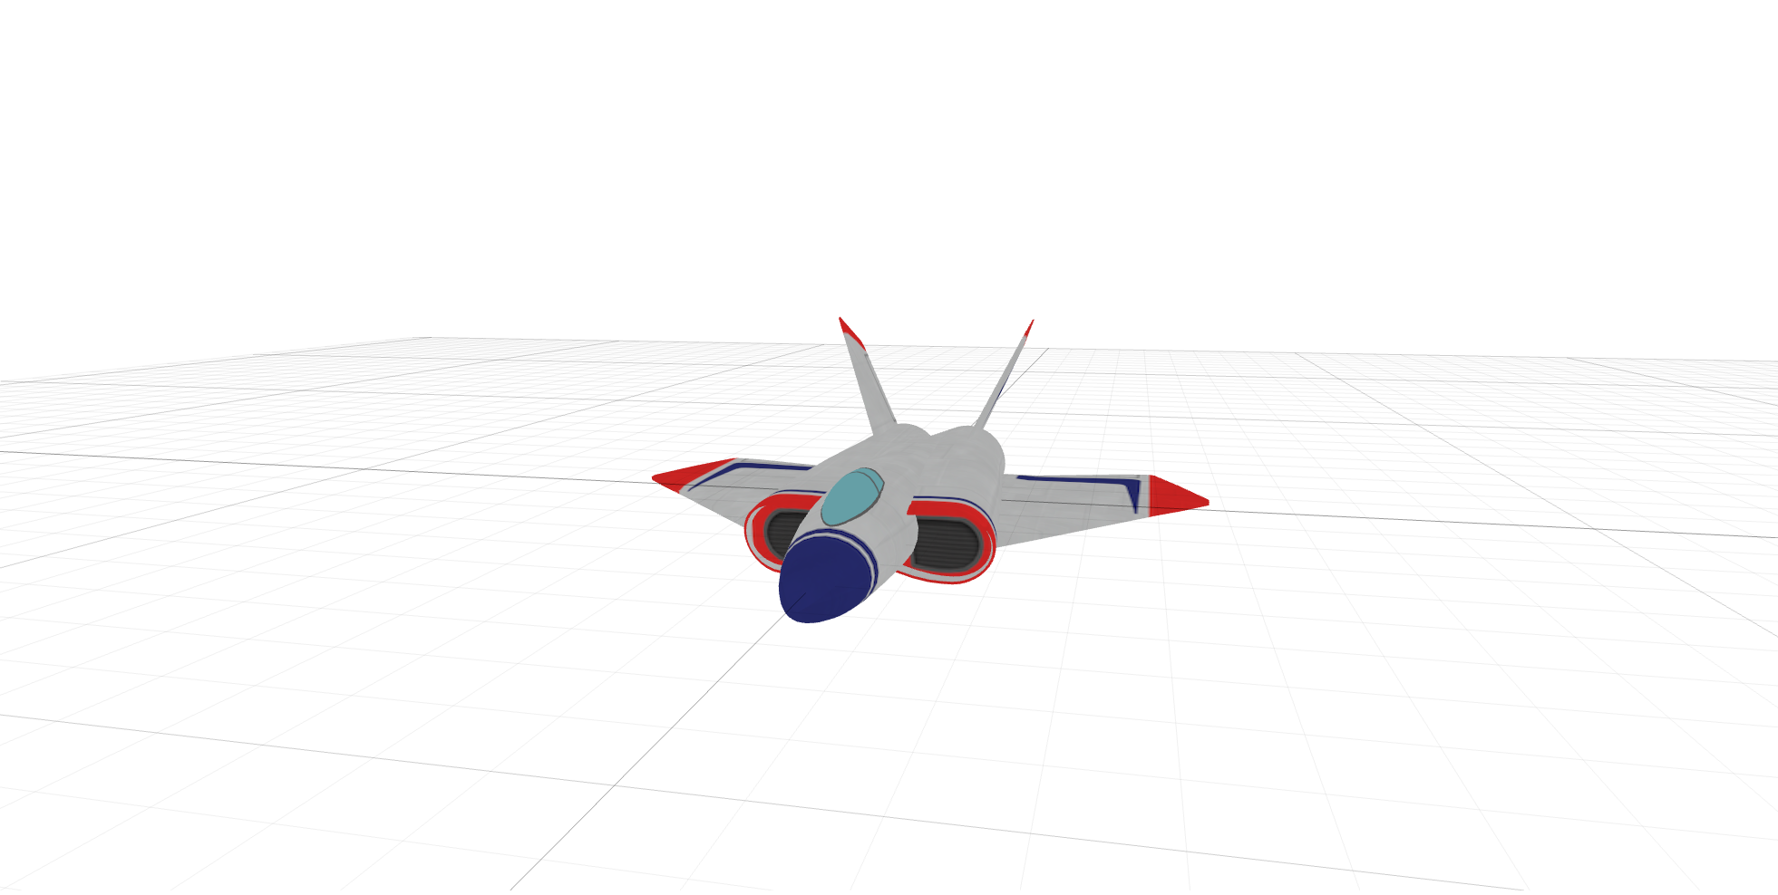
SceneKit Default Example

Slide 5
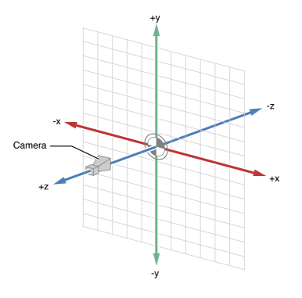
SceneKit General Concepts: The Plane
SceneKit “nodes” (type: SCNNode) are the major objects that interact with a scene.
These nodes are organized in a hierarchy and move along a 3 dimensional plane.

Slide 6
SceneKit General Concepts: Lights, Camera
A camera node (type: SCNCamera) determines the user’s POV.
One or more light nodes (type: SCNLight) illuminate the scene, and determine brightness, shadows, etc.

Slide 7
SceneKit Default Example A Closer Look

Slide 8
SceneKit vs. UIKit
X,Y, Z 3D Plane coordinates vs. CGRect / CGPoint 2D coordinates
node.position = SCNVector3Make(0, 10, 10);
A SceneKit scene is displayed in a SCNView instead of a UIView.
An SCNView can be used anywhere a UIView would be used.
Advanced Note: There are methods to translate between the UIKit and SceneKit coordinate planes...

Slide 9
SceneKit Major Types

Slide 10
SCNView
A view for displaying 3D SceneKit content.
Can be used anywhere a UIView would be used.
Behaves much like a “window” into the SceneKit 3D world.
Has a reference to a single SCNScene.
Reference: https://developer.apple.com/reference/scenekit/scnview

Slide 11
SCNScene
A scene graph—a hierarchy of nodes with attached geometries, lights, cameras and other attributes that together form a displayable 3D scene.
Contains a “root node” under which all other nodes in the scene are added, much like views in a UIView’s view hierarchy.
Reference: https://developer.apple.com/reference/scenekit/scnscene

Slide 12
SCNNode
A structural element of a scene graph, representing a position and transform in a 3D coordinate space, to which you can attach geometry, lights, cameras, or other displayable content.
Can be moved along the 3D plane by adjusting the .position property, using an SCNVector3 struct.
Reference: https://developer.apple.com/reference/scenekit/scnnode

Slide 13
SCNGeometry
A three-dimensional shape (also called a model or mesh) that can be displayed in a scene, with attached materials that define its appearance.
This is what gives an SCNNode its shape.
Built in primitive shapes (SCNGeometry subclasses)
SCNPlane, SCNBox, SCNSphere, SCNPyramid, SCNCode, etc.
Reference: https://developer.apple.com/reference/scenekit/scngeometry

Slide 14
SCNMaterial
A set of shading attributes that define the appearance of a geometry's surface when rendered.
UIImage, UIColor, SpriteKit scene, etc. can be applied to a SCNMaterial.
The SCNMaterial is then applied to an SCNGeometery for display on a node.
Reference: https://developer.apple.com/reference/scenekit/scnmaterial

Slide 15
SCNVector3 Struct
A representation of a three-component vector.
Comparable to a CGPoint in UIKit.
Created using SCNVector3Make(x, y, z);
There also exists a SCNVector4, and various utility methods for each.
Both structures are used for multiple purposes, not just representing a position on the 3D plane.
Reference: https://developer.apple.com/reference/scenekit/scnvector3

Slide 16
SCNAction
A simple, reusable animation that changes attributes of any node you attach it to.
SCNActions are high level, there are other ways to animate SceneKit content.
There are many default actions: rotate, move, scale, fade, hide, etc.
Can be grouped, chained, and even custom actions can be defined.
Reference: https://developer.apple.com/reference/scenekit/scnaction

Slide 17

A Simple Cube Example...

Slide 18
In Conclusion
Demo Project: https://github.com/BigWorkIndustries/SceneKitDemo
Apple Reference: https://developer.apple.com/reference/scenekit
Ray Wenderlich Tutorial: https://www.raywenderlich.com/83748/beginning-scene-kit-tutorial
My Information: vincil@jackrabbitmobile.com
Any Questions?

