Slide 1


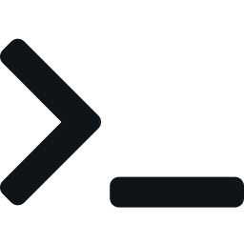
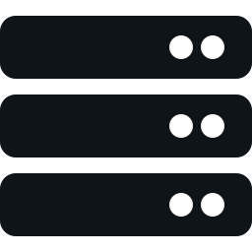
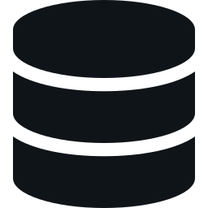


DevFeed: two clients, one API
Developer news from Hacker News and GitHub in one feed.
Save articles with notes, follow keywords, vote on stories.
Use it from the browser or the terminal: one API, one database.
Hacker News
Algolia API
DRF API
+ PostgreSQL
Web app
React + MUI
GitHub
Search API
CLI
devfeed
Steve Lopez · Code Platoon Cohort Juliett · Nov 14, 2026
Tech stack
Web client
CLI client
API
React 19, Material UI 9, Vite 8
Python 3.14, argparse, requests
Django 6.1, DRF, token auth
Database
Data sources
Deployment
PostgreSQL 18
HN Algolia and GitHub Search
Docker Compose, NGINX, EC2
Notes:
Hi, I'm Steve. DevFeed is a developer news digest: Hacker News stories and new GitHub repositories go into one PostgreSQL database through management commands, and a Django REST Framework API serves them. Two clients use that API: a React web app and a command-line client, devfeed. Neither client touches the database. The stack: React 19 with Material UI on Vite; Python with argparse and requests for the CLI; Django 6.1 and DRF with token auth; PostgreSQL 18; and three Docker Compose services on one EC2 instance, with NGINX serving the React build and proxying /api/ to Django.

Slide 2



Hardest problem: an unreachable site
Symptom
Cause
Fix
The stack ran on EC2, but the public address served nothing.
Compose published the frontend on 127.0.0.1:8080: right for my Mac, invisible to the internet.
One variable: local default unchanged, the server sets port 80 (PR #60).
docker-compose.yml — frontend ports
# before: loopback only
- "127.0.0.1:8080:80"
# after: the host side comes from .env (server: FRONTEND_HOST_BINDING=80)
- "${FRONTEND_HOST_BINDING:-127.0.0.1:8080}:80"
Lesson: a safe local default can be the production bug. I verified both cases with docker compose config before redeploying.
Notes:
After the first deploy, every container on the EC2 server was running, but the public IP showed nothing. The cause was in docker-compose.yml: the frontend was published as 127.0.0.1:8080, which I chose on purpose locally because port 80 on my Mac is taken and loopback keeps the site off my network. On a server, loopback means nobody outside can reach it. The fix made the host side a variable with the old value as the default, so local runs didn't change, and the server's .env sets 80. I checked both cases with docker compose config before redeploying.

Slide 3
Live demo, then what's next
Full CRUD on one bookmark, switching clients at every step
With another week
1
Help
CLI
devfeed --help
Finish my approved MVP
GitHub Trending banner
"My feed" from keywords
Voting UI (the CLI has it)
Article detail page
Tag filtering + autocomplete
2
Create
CLI
devfeed save <id> --note "..."
3
Read + update
WEB
devfeed web saved; edit + Read
4
Read
CLI
devfeed saved: new note, READ yes
Harden for real users
HTTPS with a domain
Scheduled ingestion
CI on every pull request
Real GitHub filtering
5
Delete
WEB
Remove, then confirm
6
Confirm
CLI
devfeed saved: the bookmark is gone
Notes:
Now the live demo, mostly in the terminal against the live site. One: devfeed --help shows every command, and devfeed save --help shows how each command documents itself. Two: devfeed feed, pick an article, devfeed save with a note, and devfeed keywords follow django. Three: devfeed web saved opens the browser on the Saved page, where the bookmark already is; I edit the note and tick Read, and Keywords shows django. Four: back in the terminal, devfeed saved shows the new note and Read yes. Five: in the browser, Remove the bookmark and confirm. Six: devfeed saved, and it's gone. Same API, same data, two clients. Optionally: devfeed vote, since voting isn't in the web app yet. With another week: finish the five features from my approved proposal that aren't in the web app yet, which I held back so the working app wasn't disturbed, then HTTPS, scheduled ingestion, CI, and real filtering for GitHub results.

