Slide 1

Calanus finmarchicus
Jan
Feb
Mar
Apr
May
Jun
Jul
Aug
Sep
v
Oct
Nov
Dec

Slide 2
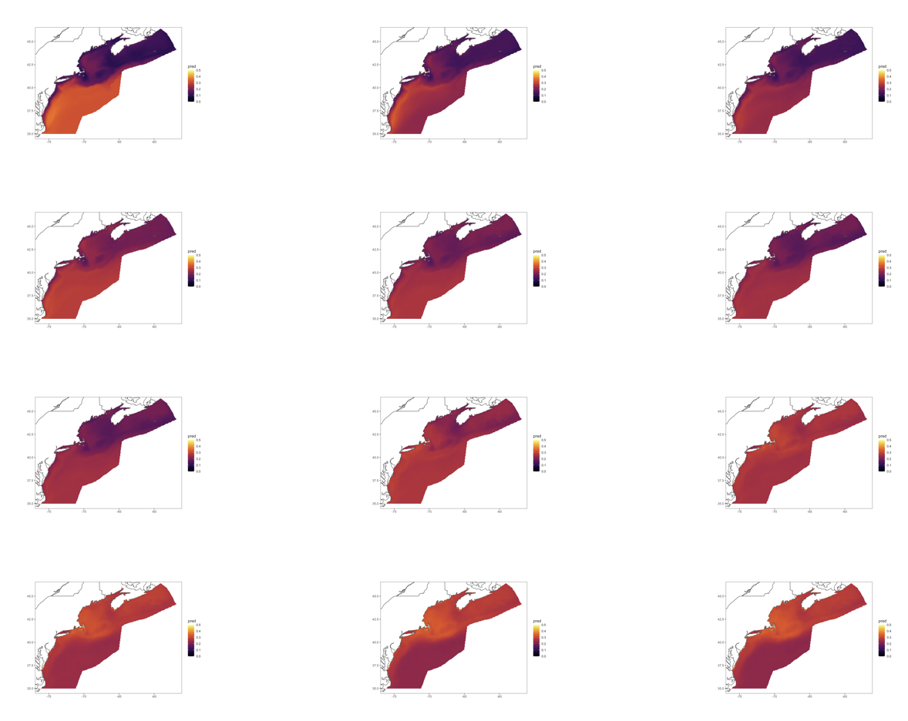
Centropages typicus
Jan
Feb
Mar
Apr
May
Jun
Jul
Aug
Sep
v
Oct
Nov
Dec

Slide 3

Pseudocalanus spp.
Jan
Feb
Mar
Apr
May
Jun
Jul
Aug
Sep
v
Oct
Nov
Dec

