Slide 1
Memory Networks for Language Understanding

Slide 2
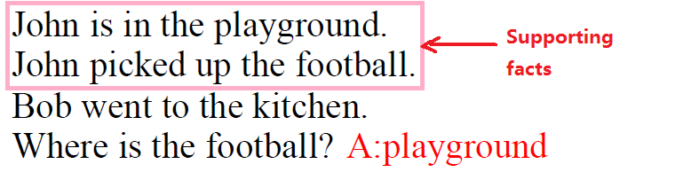
QA problem
Intuition
Large long term memory ➔read and written to
Attention over memory ➔ reasoning

Slide 3
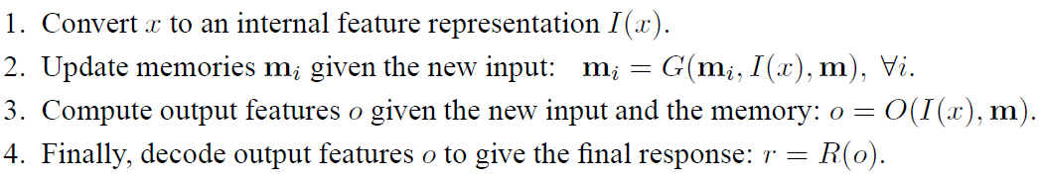
MemNet Framework

Slide 4
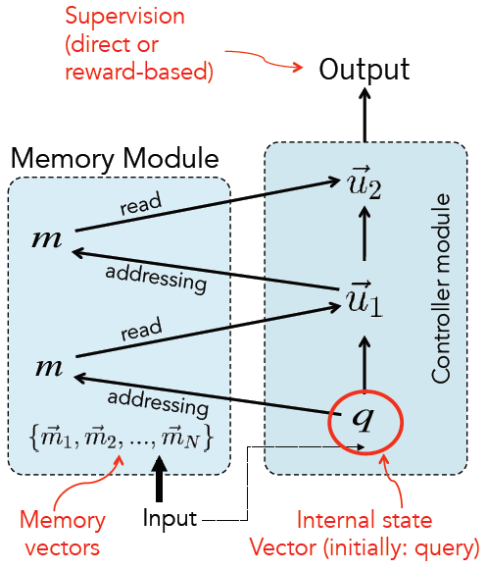


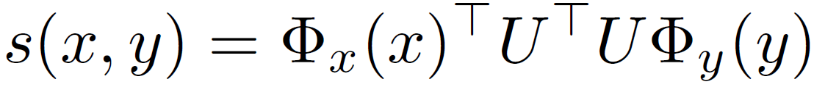
Basic Model
O (output) component: support facts
R (response) component:
Scoring function:

Slide 5
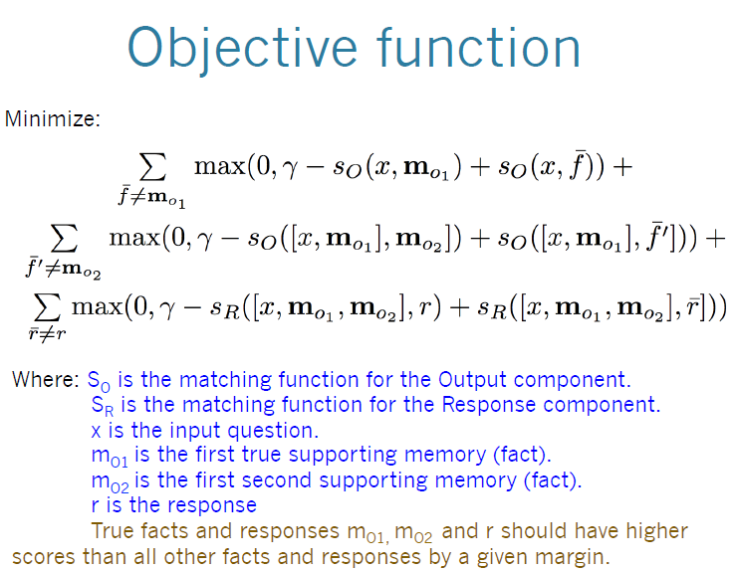

Slide 6
Variants of the class
Representation of inputs: bag of words, RNN style reading at word or character level, etc. DMN
Different possibilities for output module: e.g. multiclass classifier or uses an RNN to output sentences.
If the memory is huge (e.g. Wikipedia): hash the memories to store in buckets (topics). Then, memory addressing and reading doesn’t operate on all memories.
If the memory is full, there could be a way of removing one it thinks is most useless; i.e. it ``forgets’’ somehow. That would require a scoring function of the utility of each memory..

Slide 7
bAbI dataset
To measure understanding in several ways:
answer questions via chaining facts
simple induction
simple deduction
Working with larger amount of read data tends to lead researchers to simpler models
The dataset contains 20 nearly independent tasks, each checking one skill that the system must have (1k questions per task; About 15 sentences per story)

Slide 8
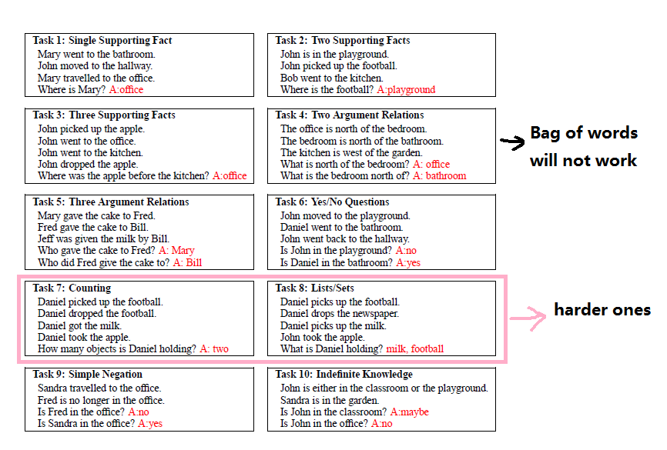
Simple Tasks

Slide 9
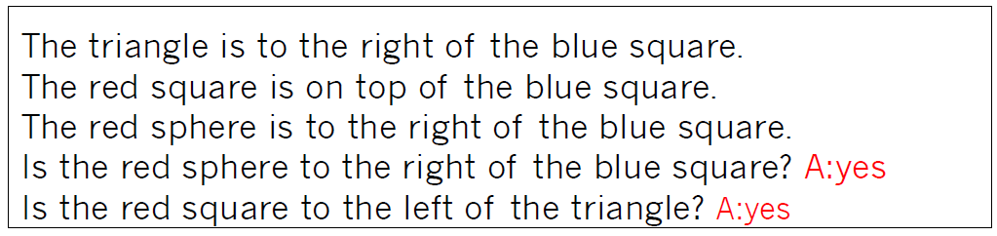
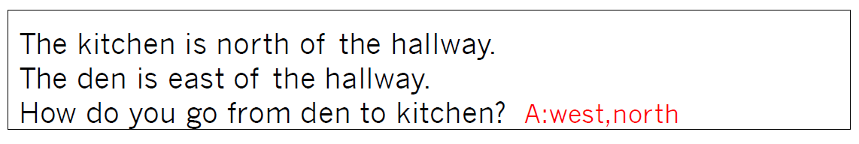
Harder ones
(17) Positional Reasoning
(19) Path Finding

Slide 10
Contributions of MemNet
Global long term memory
Attention mechanism for inference
Make use of strong supervision information (supporting facts)

Slide 11
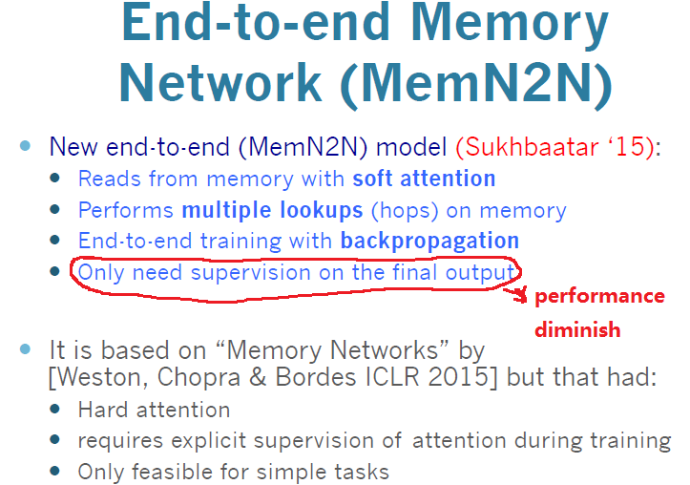

Slide 12



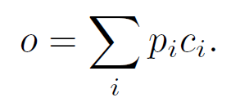
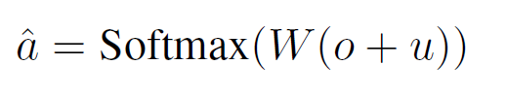
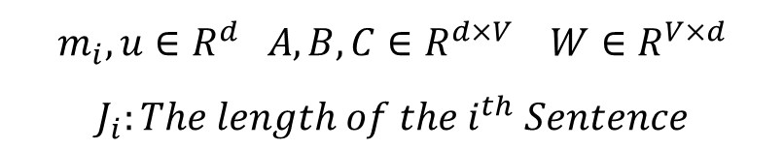
Model
Single Hop
$$m_{i},u∈R^{d} A,B,C∈R^{d×V} W∈R^{V×d}$$
$$J_{i}:The length of the i^{th} Sentence$$

Slide 13
Model
Multi Hops

Slide 14

Model details
Weight Sharing：
Adjacent：
$$B=A^{1}$$
$$A^{k+1}=C^{k},k=1,…,K −1$$
$$C^{K}=W$$
Layer-wise (RNN-like):
$$A^{1}=…=A^{K}$$
$$C^{1}=…=C^{K}$$
$$u^{k+1}=Hu^{k}+o^{k}$$

Slide 15
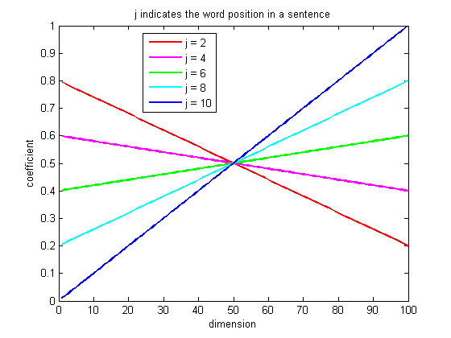


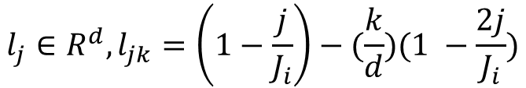
Model details
Position encoding other than BoW:
$x_{i}=\{x_{i1},…,x_{iJ_{i}}\}$
( )
$$l_{j}∈R^{d},l_{jk}=\left(1−\frac{j}{J_{i}}\right)−(\frac{k}{d})(1 −\frac{2j}{J_{i}})$$
$$d=100,J_{i}=10$$

Slide 16

Model details
Temporal Encoding:
Random Noise:
Randomly add 10% of empty memories to the stories when training
Linear Start:
At the beginning of training, remove the softmax layer when calculating p_i. When the validation loss stopped decreasing, the softmax layers were re-inserted.

Slide 17
Experiments

Slide 18
Experiments
The position encoding representation improves over bag-of-words on tasks where word ordering is particularly important.
The linear start to training seems to help avoid local minima.
Random empty memories gives a small but consistent boost in performance, especially for the smaller 1k training set.
Joint training on all tasks helps.
More computational hops give improved performance.

Slide 19
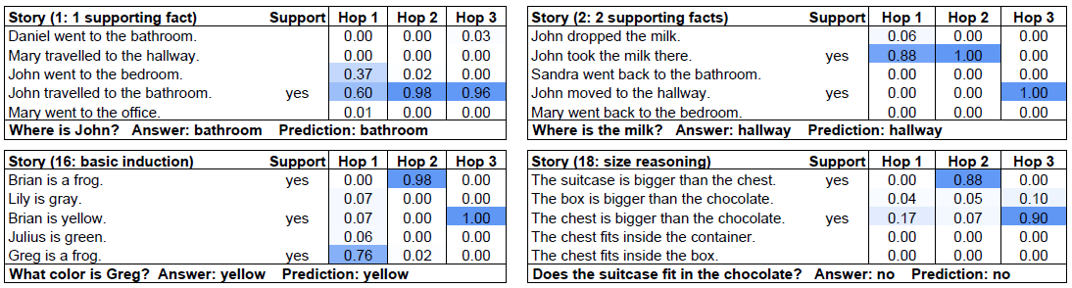
Attention during memory lookups

Slide 20
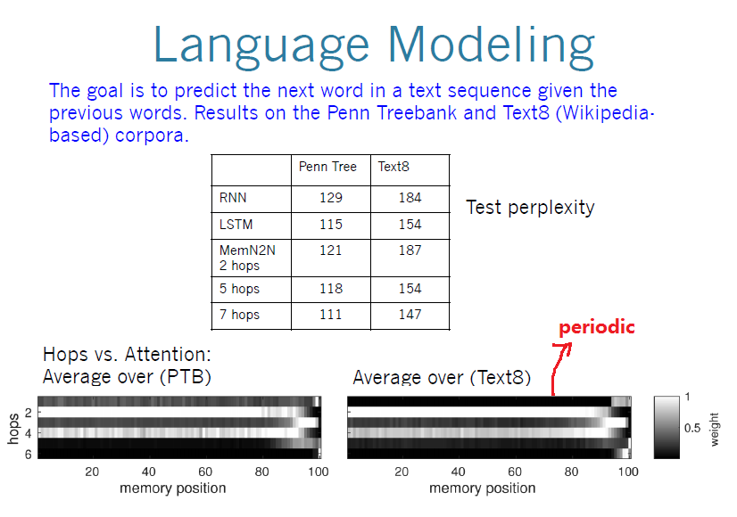

Slide 21
Q & A

Slide 22
