Slide 1
Project A4
Cross-modal joint sparse feature learning in robot tasks
Changshui Zhang
Dept. of Automation, Tsinghua University
Jianwei Zhang
Dept. of Informatics, Uni. of Hamburg

Slide 2
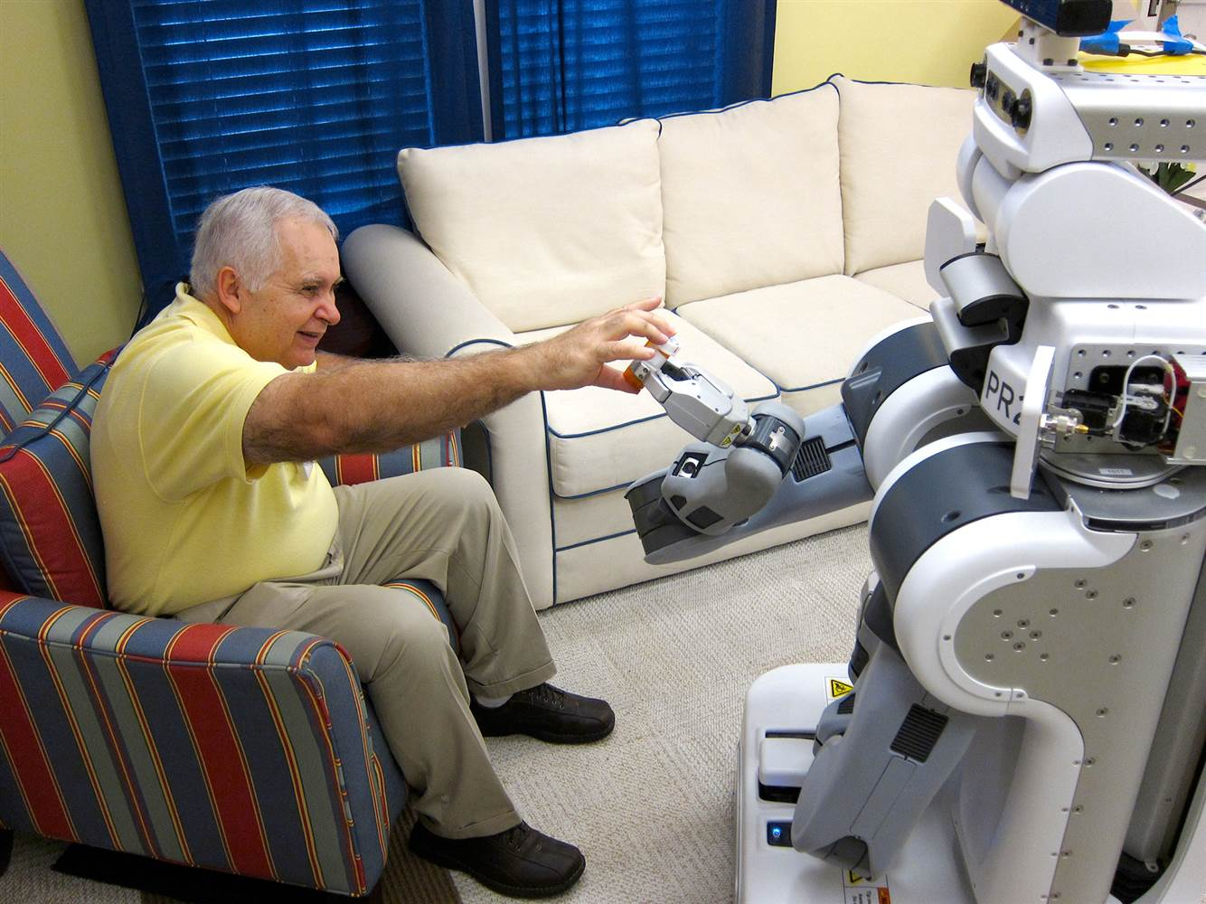
A4 – Aims and Strategies
Establishing a cross-modal feature learning method that is adaptive to the robot scenario using the modalities of image, sound and tactile signals as input
Designing classifiers that are adaptive to new unknown categories
Applying the trained model to the robot system and complete the task of assisting elderly people in taking medicine

Slide 3
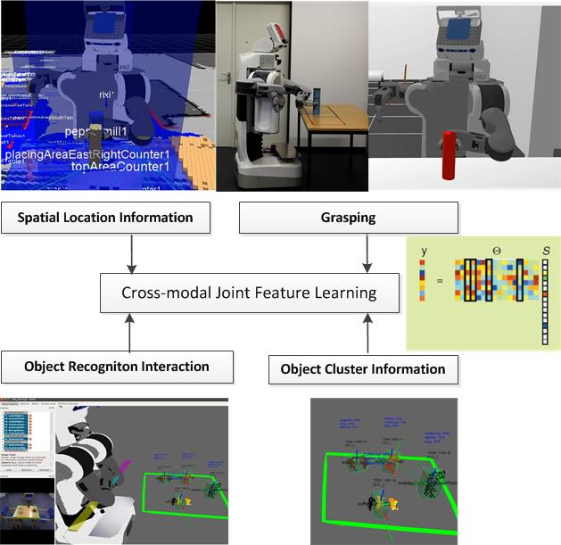
A4 – Hypotheses
The categories of medicines can be distinguished by different kinds of signals such as visual, audio or tactile information
The cross-modal features can perform better than mono-modal ones since different categories’ information are shared by the same kinds of features
The joint features of the samples are supposed to be sparse representations so that the learned joint features have the separability for different categories of samples

Slide 4
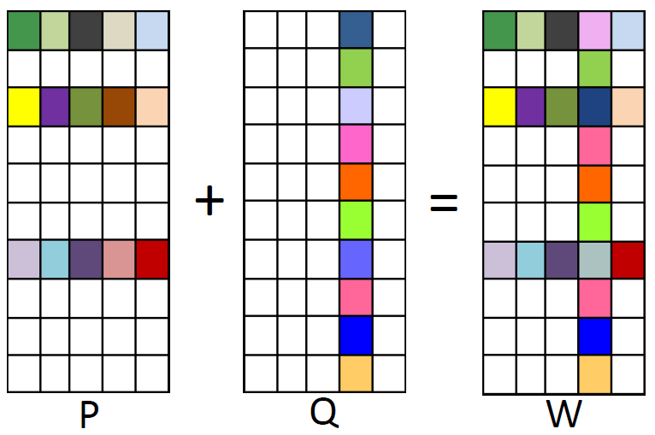
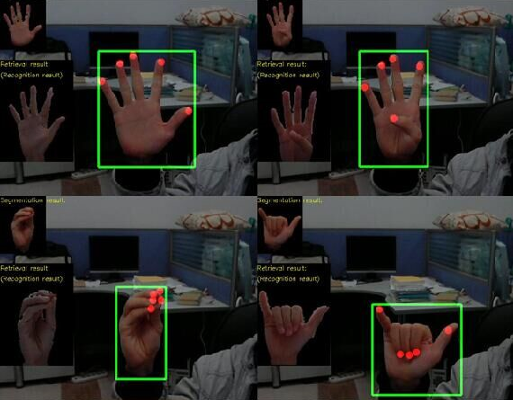
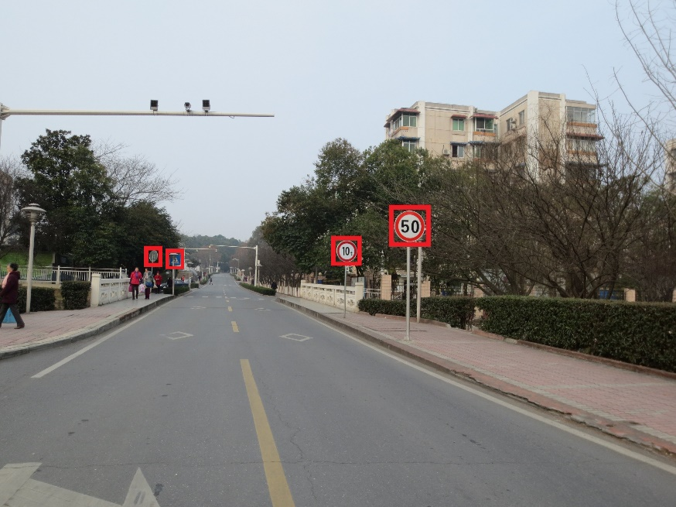
A4 – Own Previous Work
Robust multi-task feature learning: decomposes the weight matrix into two sparse matrices that denote the shared features among tasks and the outlier tasks.
Hand-pose recognition: Retrieval-based template matching algorithm that estimates the pose of a hand in the video.
Traffic sign recognition: Detection based on deep convolutional neural networks

Slide 5
A4 – Research Plan
Task 1: Acquisition and annotation of image, sound and tactile data
        We will exploit the robot platform set up by project Z3/II-R and develop general cross-modal learning methods.
        Task 2: Algorithms for multi-modal joint feature learning
        We will mainly focus on multi-task sparse learning algorithms that enable the robot to process different tasks using cross-modal features.
        Task 3: Classifiers suitable for new object categories
        In realistic circumstances, the robot may encounter unknown medicines, which requires the robot to recognize objects from new categories.
        Task 4: Application of the models and methods to a robot system
        Based on previous tasks, the models will be applied to the robot-assisted elderly medicine task in order to verify our approach.

Slide 6
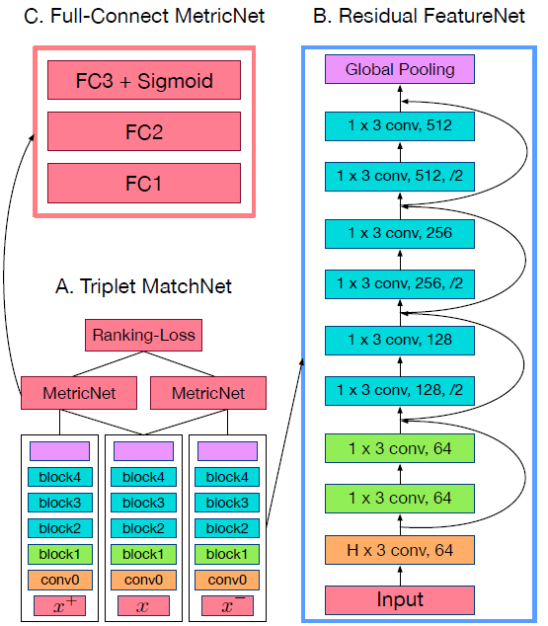
A4 – First Experiments
Deep model for content-based similarity learning: Triplet MatchNet.
Since we have lots of works in the field of CV, we explore audio feature extraction.
The model is made up of three main parts: feature extraction layers, metric calculation layers and a rank-based loss layer.

Slide 7
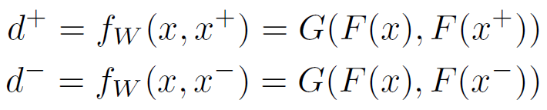
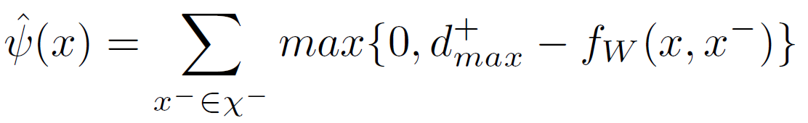
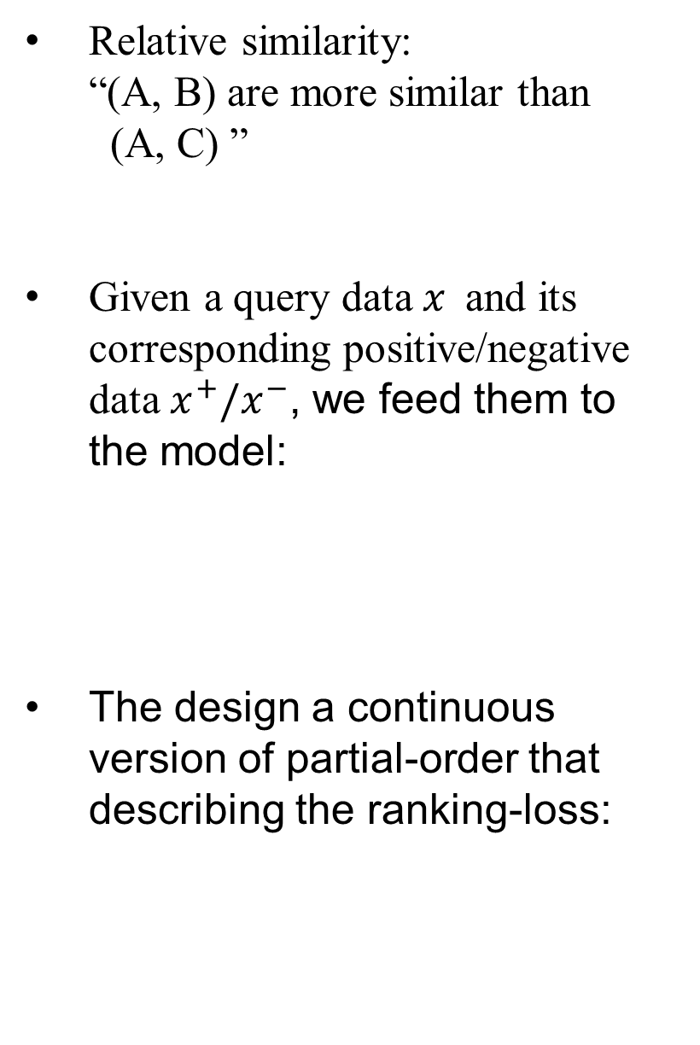
A4 – Computation paradigm
Relative similarity:
“(A, B) are more similar than
(A, C) ”
Given a query data $x$and its corresponding positive/negative data$x^{+}/x^{−}$, we feed them to the model:
The design a continuous version of partial-order that describing the ranking-loss:

Slide 8
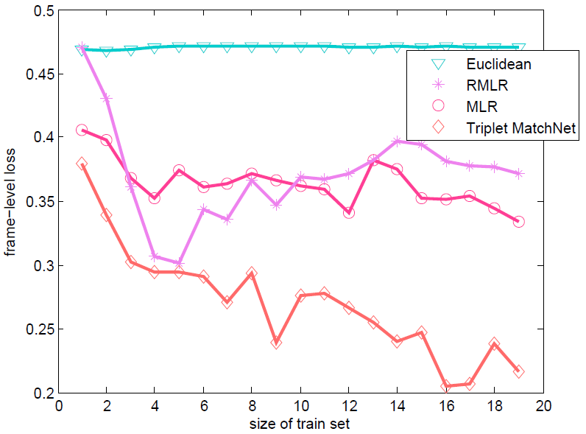
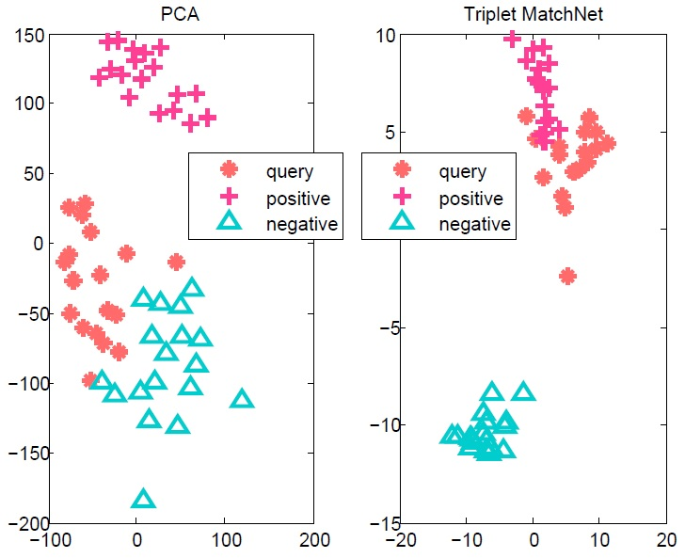
A4 – Experimental results
Training curve shows generalization ability of our model compared to traditional ones.
Features extracted by our trained model shows favourable separability.

Slide 9
A4 – Conclusions
Rank-based training strategy is effective in modeling content-based audio separation task.
Flexible end-to-end framework.
Sparse representation by residual network.

Slide 10
A4 – Outline of future work
Current progress
We show that deep sparse representation for audio data is feasible.
Multi-modal feature learning
Image features and tactile features
Classifiers adaptive to unknown categories
Dictionary-based searching algorithm
Learning the categories’ boundaries

