Slide 1

https://wenku.baidu.com
面向自解释的GNN
汇报人：李璐 刘佳乐
2024-04-20

Slide 2


研究背景
Towards Self-Explainable Graph Neural Network
ProtGNN: Towards Self-Explaining Graph Neural Networks
目录
SCIENCE AND TECHNOLOGY

Slide 3

01
研究背景

Slide 4
研究背景
Despite the success in modeling graph data, predictions of GNNs are not interpretable for human.
01
There are only very few work on the explainability of GNNs and
they focus on post-hoc explanations. Since post-hoc explanations
are not directly obtained from the GNNs, they can be biased and misrepresent the true explanations.
02
it is crucial to develop a self-explainable GNN, which can simultaneously give predictions and explanations
03

Slide 5
02
Towards Self-Explainable Graph Neural Network

Slide 6
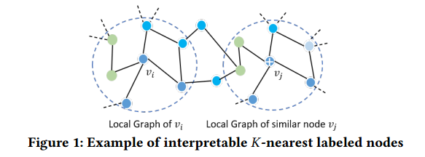
研究思路
One perspective to obtain the self-explanation for node classification is to identify interpretable 𝐾-nearest labeled nodes for each node and utilize the 𝐾-nearest labeled nodes to simultaneously give label prediction and explain why such prediction is given.
Explanation：
(i) node 𝑣𝑖 is classified as class 𝐵 because these 𝐾 nodes have the most similar node features and n-hop subgrph with that of 𝑣𝑖 and most of these 𝐾 nodes belong to class 𝐵
(ii) node 𝑣𝑖 is similar to node 𝑣𝑗 because the n-hop subgraphs centered at these two nodes are similar. For example, this part of the structure and attributes of 𝑣𝑖’s n-hop subgraph matches to that of 𝑣𝑗’s

Slide 7
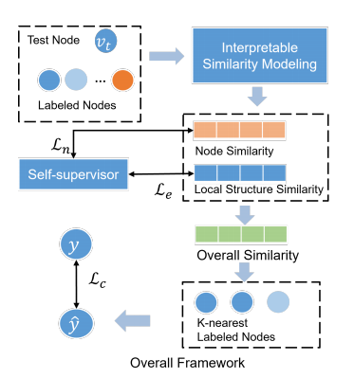
结构模块
SE-GNN explicitly models the node similarity and local structure similarity with explanations. An illustration of the proposed framework is shown in Figure 2. It is mainly composed of an interpretable similarity module and a self-supervisor to enhance the explanations. With the novel similarity modeling process, 𝐾-nearest labeled nodes of the target node and the similarity explanations can be obtained. Then, prediction of the target node can be given based on the identified 𝐾-nearest labeled nodes. And, a novel loss function is designed to ensure the accuracy of predictions and facilitate the similarity modeling. Furthermore, self-supervision for explanations is applied
to further benefit the accurate explanation generation.

Slide 8


可解释相似度建模
Node Similarity.
1.节点级别的相似度：The node similarity is to evaluate how similar the target node is with the labeled nodes in the node level.
2.对节点特征的处理：Since node features could be noisy and sparse, directly measuring the node similarity in the raw feature space will result in noisy similarity.
Therefore, we propose to firstly encode the node features with a MLP. Then, the node embeddings are further updated by aggregating the representations from their neighbors with one residual GCN layer.
3.节点相似度计算：

Slide 9




可解释相似度建模
Local Structure Similarity.
1.作用：(i) explicitly consider the local structure information to facilitate the identification of 𝐾-nearest labeled nodes and(ii) provide explanations about the similarity in a structure level.
2.边缘表示：Specifically, we propose to measure how well the edges between the local graphs of two nodes match to evaluate the similarity in structure level. The edge matching results can explain the similarity of two nodes in the aspect of local structure. The edge representation is
3.寻找匹配边：
4.局部结构相似度的解释：
5.局部结构相似度：

Slide 10

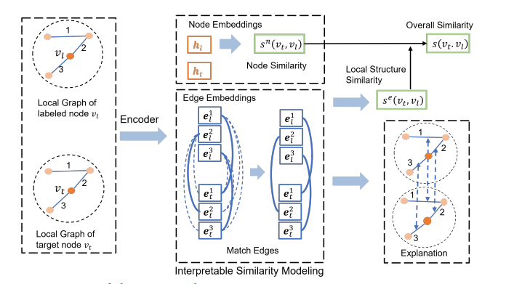
可解释相似度建模
Overall Similarity.

Slide 11



预测与解释
预测：
1.找到k个与目标节点结构最相似的标记节点，记为
2.预测节点𝑣𝑡的标签为𝐾-nearest节点标签的加权平均值：
权值：
预测结果：
解释：
1.识别的目标节点vt的k-nearest标记节点以及相似度得分可以清楚地解释预测的原因
2.总体相似度来源于节点相似度和局部结构相似度
3.寻找的匹配边对可以解释结构的局部相似度
4.也可以提取关键子图作为解释：
阐述本论文对于相关领域和实际应用的具体贡献，包括解决现有问题、推动领域发展、提供新的思路和方法等。同时，也可以指出本研究的不足之处和未来可能的研究方向。
论文贡献

Slide 12

分类损失
1.通过给定的标签监督确保准确性：we utilize the supervision from the given labels to ensure the accuracy of the self-explainable GNN
2.具体方法：采用负抽样并且近似选择𝐾-nearest标记节点作为正样本。
具体来说，对于一个标记节点vl，我们选取与他不同类的标记节点作为负样本，随机选择N个与他同类的标记节点作为支持集，从中获取近似选择𝐾-nearest标记节点，目标函数如下：
3.效果： the similarity scores of node pairs with different labels will be minimized, and the similarity scores between a node and its approximate k-nearest neighbor with the same labels will be maximized.
阐述本论文对于相关领域和实际应用的具体贡献，包括解决现有问题、推动领域发展、提供新的思路和方法等。同时，也可以指出本研究的不足之处和未来可能的研究方向。
论文贡献

Slide 13



自监督增强解释
1.自监督：通过对比学习为节点相似度以及局部结构相似度学习提供自监督
2.方法：Representations of the same node/edge from these two views will compose positive pairs for contrastive learning. And representations of different nodes in both views compose negative pairs.
3.节点表示对比学习的目标函数：
4.边缘表示对比学习的目标函数：
5.效果：With the self-supervision, the representations of similar edges and nodes will be similar, which can facilitate the similarity modeling for explanations
6.总体的目标函数：
阐述本论文对于相关领域和实际应用的具体贡献，包括解决现有问题、推动领域发展、提供新的思路和方法等。同时，也可以指出本研究的不足之处和未来可能的研究方向。
论文贡献

Slide 14
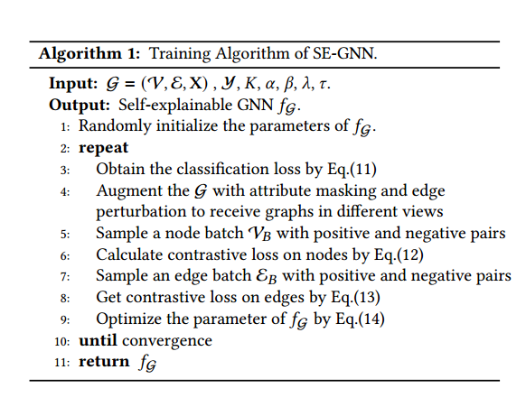
训练流程
阐述本论文对于相关领域和实际应用的具体贡献，包括解决现有问题、推动领域发展、提供新的思路和方法等。同时，也可以指出本研究的不足之处和未来可能的研究方向。
论文贡献

Slide 15
03
ProtGNN: Towards Self-Explaining Graph Neural Networks

Slide 16
研究思路
原型学习：Prototype learning is a form of case-based reasoning which makes the predictions for new instances by comparing them with several learned exemplar cases .
研究思路：
1.基于原型学习，根据新输入图与原型层中原型的相似度对其进行预测
2.使用蒙特卡罗树搜索算法来有效地探索不同的子图，用于原型投影和可视化。
3.此外，在ProtGNN+中，文章设计了一个条件子图采样模块来识别输入图的哪个部分与每个原型最相似，以获得更好的可解释性和效率。

Slide 17

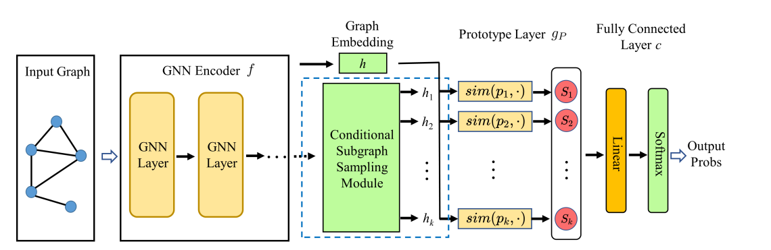
ProtGNN Architecture
The network consists of three key components:
a graph encoder f,
a prototype layer gP , （相似度计算： ）
a fully connected layer c appended by softmax to output the probabilities in multi-class classification tasks.

Slide 18

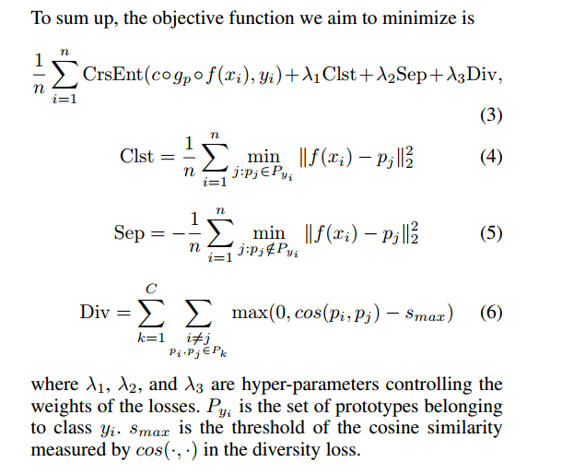
学习目标
确保准确度
最小化交叉熵函数：
提高可解释度，设置限制
the cluster cost (Clst) encourages that each graph embedding should at least be close to one prototype of its own class.
the separation cost (Sep) encourages that each graph embedding should stay far away from prototypes not of its class.
some learned prototypes are very close to each other in the latent space. We encourage the diversity of the learned prototypes by adding the diversity loss (Div) which penalizes prototypes too close to each other.

Slide 19
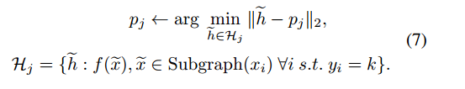
原型投影
学习到的原型嵌入是不能直接解释的向量。为了更好的解释和可视化，我们设计了一个在训练阶段执行的投影程序。具体来说，我们将每个原型pj (pj∈Pk)投影到最近的潜在训练子图上，这些子图来自与pj相同的类。通过这种方式，我们可以在概念上将每个原型等同于子图，这更直观，更容易理解。为了减少计算成本，投影步骤每隔几个训练周期才执行一次：

Slide 20
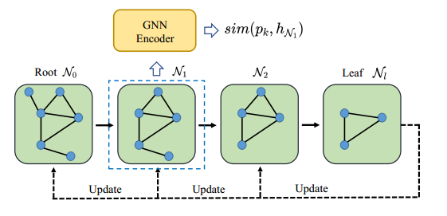
MCTS-子图探索
我们构建一个搜索树，其中根与输入图相关联，其他每个节点对应于一个探索的子图。
形式上，我们将搜索树T中的每个节点定义为Ni, N0表示根节点。搜索树中的边表示修剪动作。
为了限制搜索空间，我们添加了两个额外的约束:Ni必须是一个连通子图，并且投影子图的大小应该很小

Slide 21
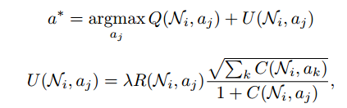
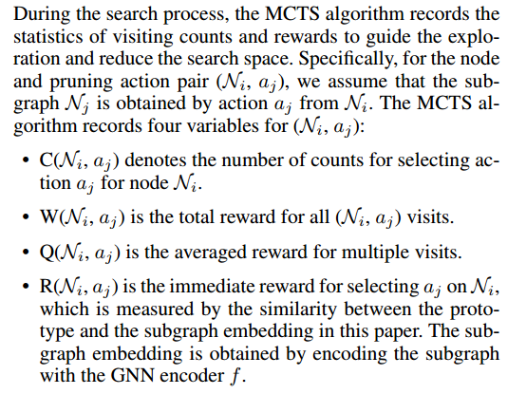

MCTS-子图探索
每次迭代有两个阶段：
1.向前传递：MCTS selects a path starting from the root N0 to a leaf node Nl .
2.反向传播：

Slide 22

条件子图采样模块
In ProtGNN+, we not only show the similarity scores to prototypes, but also identify which part of the input graph is most similar to each prototype as part of the reasoning process.
We adopt a parameterized method for efficient similar subgraph selection conditioned on given prototypes. The optimization objective of the conditional subgraph sampling module is:
where Gs is the selected subgraph whose adjacency matrix is ε. B is the maximum size of the subgraph.

Slide 23

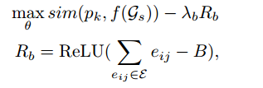
条件子图采样模块
图的组合性和离散性使得上述目标函数的直接优化难以实现，为了使用梯度下降等优化算法，问题被松弛到一个连续空间。在这个空间中，每个边 eij​ 的选择不再是一个二元决策，而是一个介于0到1之间的连续值，这允许使用基于梯度的优化方法。
使用 MLP 来学习一个函数，该函数根据节点的嵌入和原型向量，输出图中每条边被选中的概率。这样，模型就可以通过选择概率高的边来构建一个条件子图，这个子图在解释模型预测时更加相关和有用:
因此，目标函数更新为：
Rb为正则项，帮助控制选定的边的总数不超过B;
ReLU函数保证只有当选择的边大于B时才会贡献损失。

Slide 24
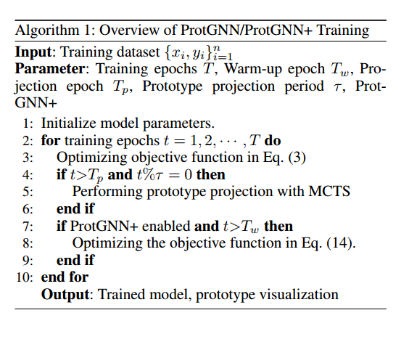
训练流程

Slide 25
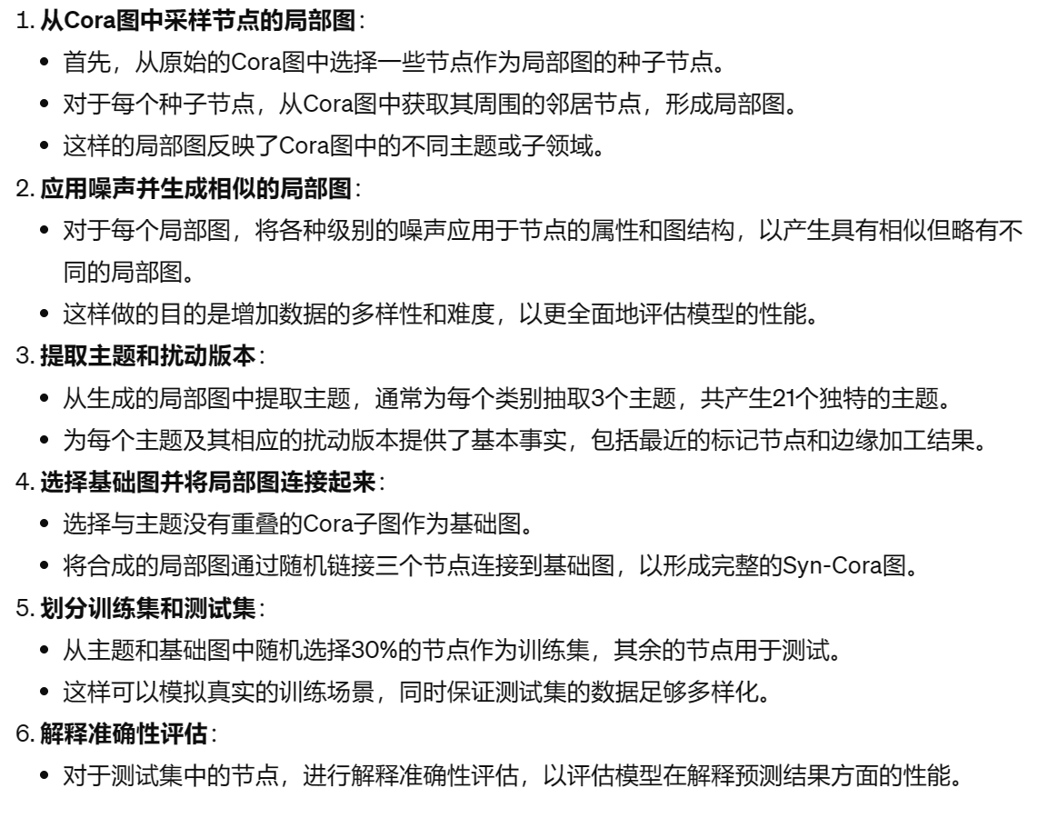
syn-cora数据集的构建

Slide 26
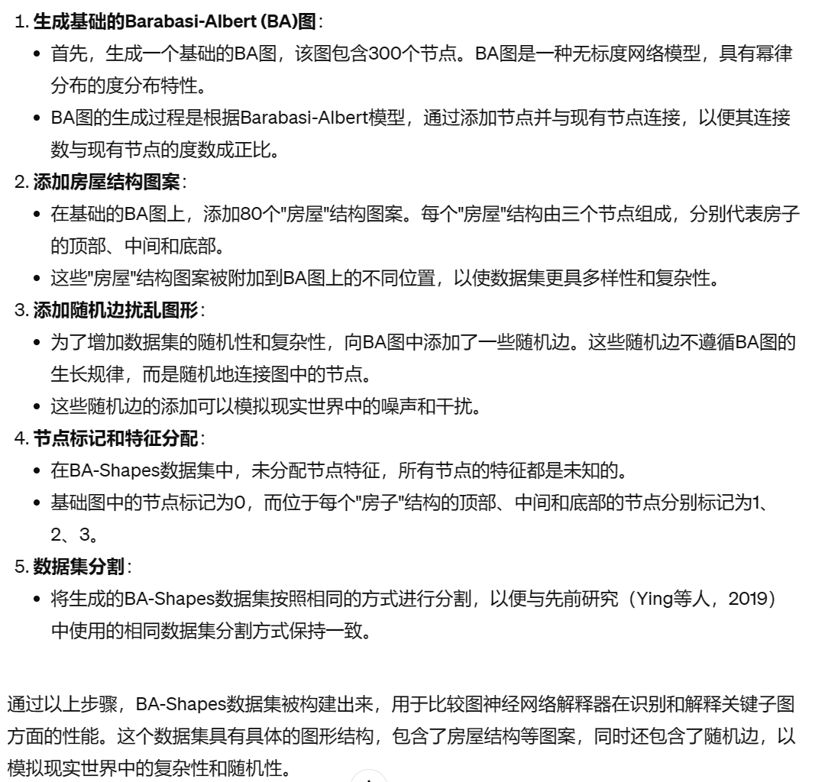
BA-Shapes数据集的构建

Slide 27
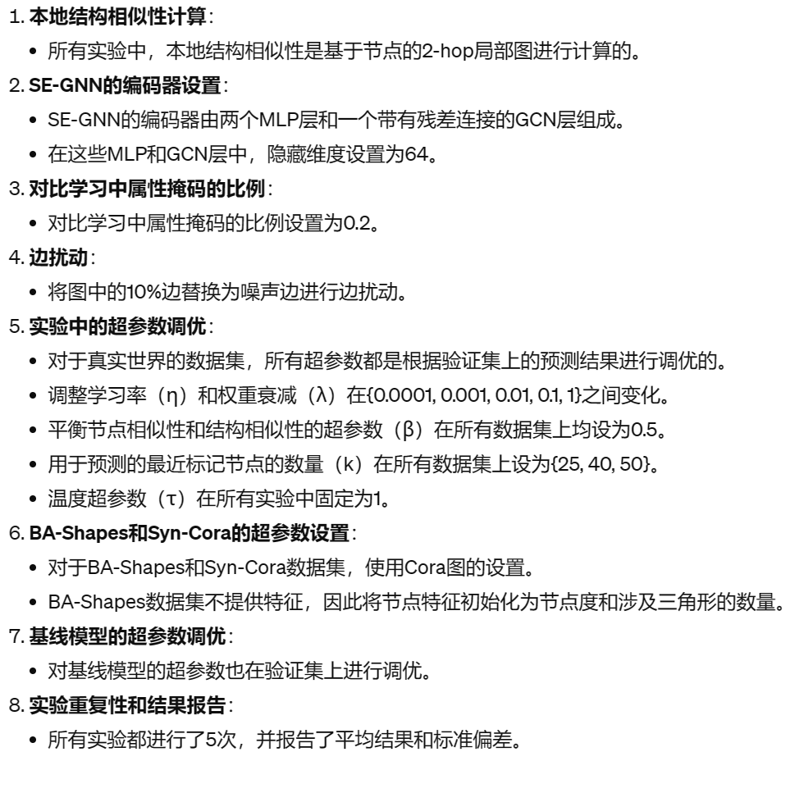
实现细节

Slide 28
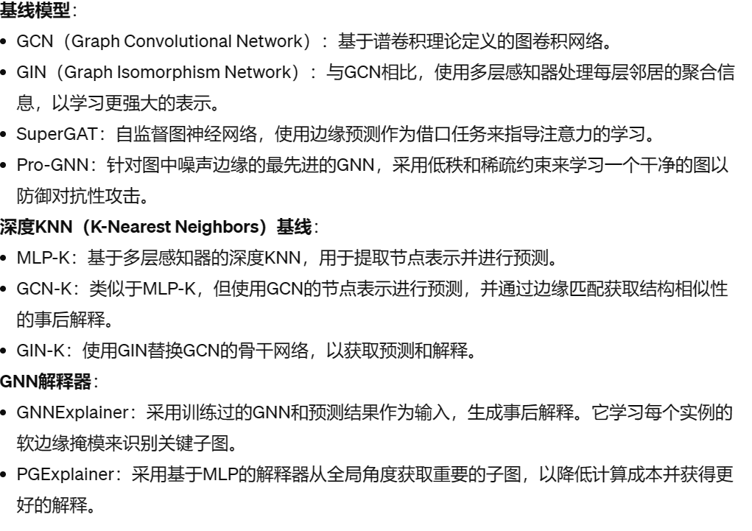
Baseline

Slide 29
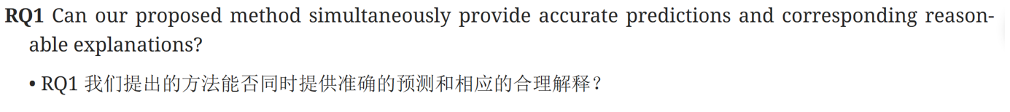
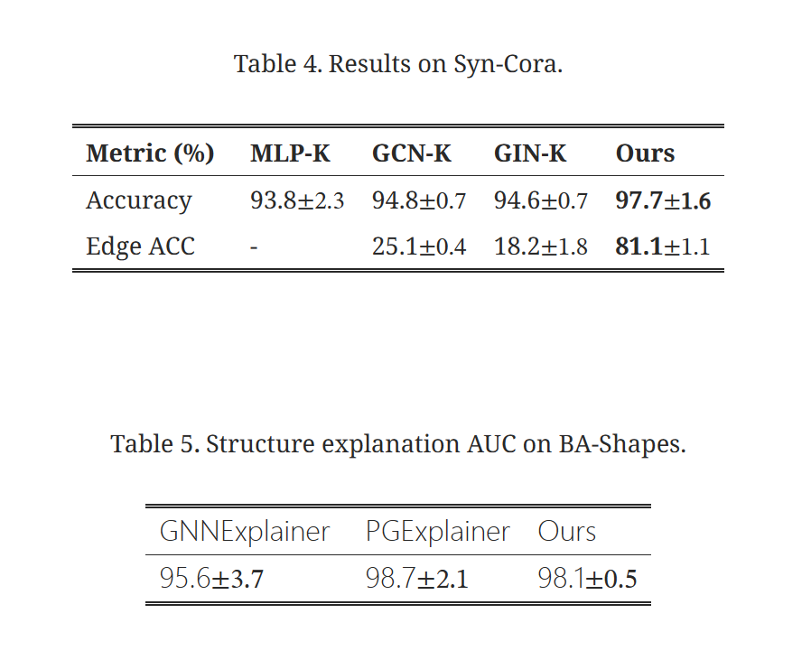
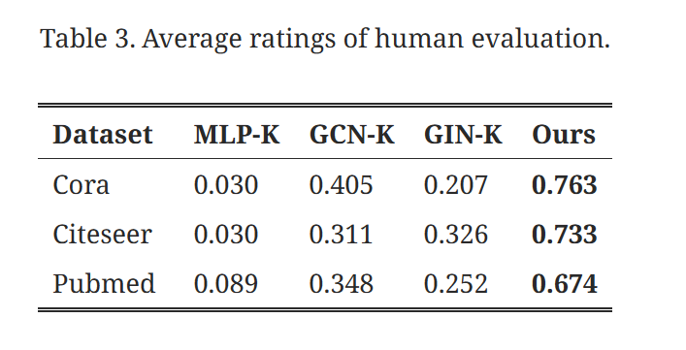

Slide 30
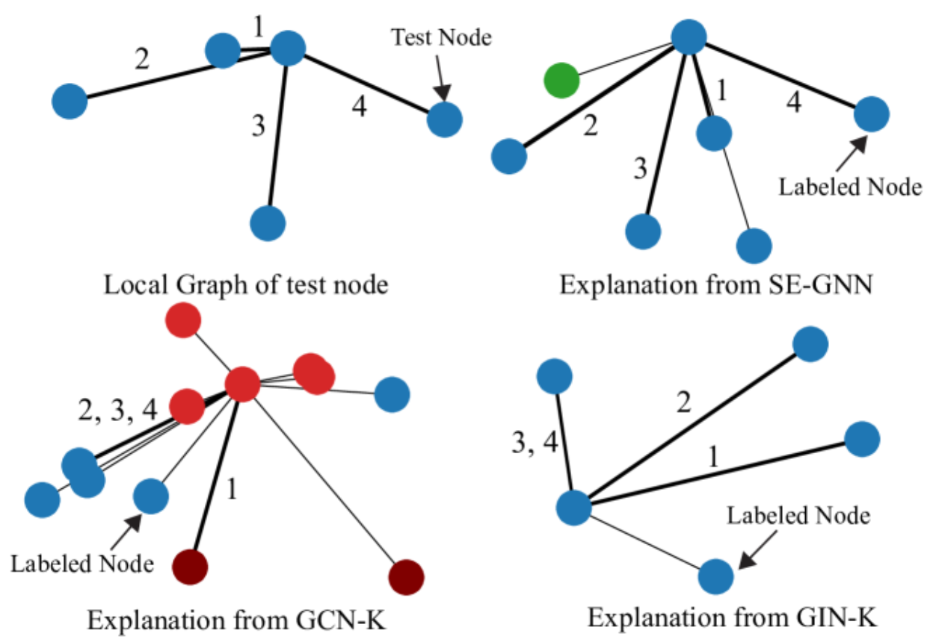

Slide 31
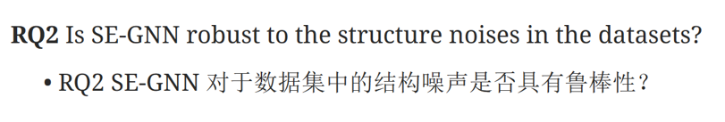
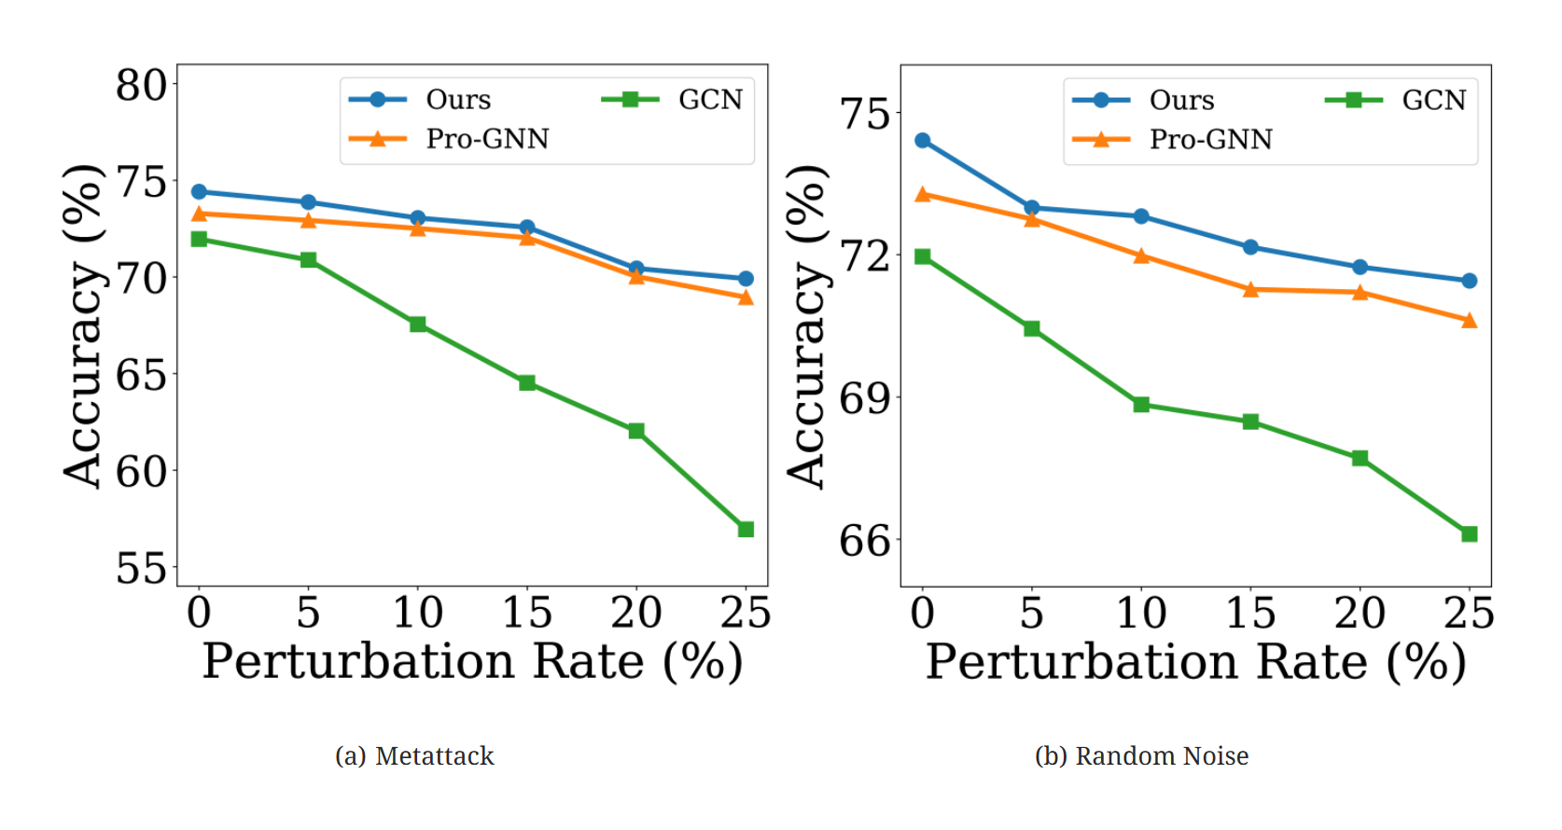

Slide 32
