Slide 1
HTML
Web Development

Slide 2



How the Web works
Client/server architecture
Page request
Data response
Client running Web Browser
Server running Web Server Software (Apache, IIS, etc)

Slide 3
What’s in an address?
Each Web page has an address, called a URL (Uniform Resource Locator)
http://www.knust.edu.gh/computersc/index.html
Directories can be nested, just like your Windows or Macintosh computer.
protocol
server
domain
Directory (folder)
Document (filename)

Slide 4
What is a Web Page?
A text file containing HTML
HTML - HyperText Markup Language
A system for describing document structure (semantic markup) and formatting (presentation markup).
The markup tags tell the Web browser how to display the page

Slide 5
The history of world wide web
First proposal by Tim Berne-lee
of the CERN-1989
First text-based prototype
Marc Andreessen created the first viable graphical web browser (mosaic) in 1993 as a student at the University of Illinois.-used by NCSA
CERN and MIT founded the worldwide web consortium -1994
Marc Andreessen –Nestcape corporation-1994

Slide 6
Creating HTML/XHTML
An HTML file must have an .htm or .html file extension
Text Editor: NotePad, SimpleText
WYSIWYG HTML Editors:
  Macromedia Dreamweaver
  Adobe GoLive
  Netobjects Fusion
  Netscape Composer
  MS Word
  MS FrontPage

Slide 7
<doctype>
For xhtml the beginning of document must have a document type declaration, which tells web browsers how to handle the version of HTML you are writing.
<!DOCTYPE html PUBLIC "-//W3C//DTD XHTML 1.0 Transitional//EN"
"http://www.w3.org/TR/xhtml1/DTD/xhtml1-transitional.dtd">
For html5 use:
<!DOCTYPE html>

Slide 8
HTML Basics
HTML is comprised of elements called “tags”: < >
  Begins with <html> and ends with </html>
  When writing XHTML, must define a namespace
  <html xmlns="http://www.w3.org/1999/xhtml">
Tags are written in lower case
Tags are nested:
  <html><head></head><body></body></html>
HTML describes structure using two main sections: <head> and <body>

Slide 9
<head> Section: Introduction
This section contains information that doesn’t show directly on the viewable page.
Starts after the <doctype> declaration.
Begins with <head> and ends with </head>
Can contain multiple nested tags:
  <title>
  <meta>
  <script>
  <style>
  <!– comments -->

Slide 10
<head> Section: <title> tag
Exists between <head> </head> tags.
<title>CSM : Web based concepts and Development</title>
Used to give the web page a title.
Search engines and people rely on titles.

Slide 11
<head> Section: <meta> tag
Meta tags describe the content contained within the page
<meta name="description" content="HTML tutorial">
<meta name="keywords" content="html, webdesign, styles">
<meta name="author" content=“CSS 3">
<meta http-equiv="refresh" content="5; url=http://www.css3.com">

Slide 12
<head> Section: <script> tag
The <script> </script> tag is used to embed scripts such as VBscript,Javascript or PHP into an HTML document.

Slide 13
<head> Section: <style> tag
The <style> </style> tag is recent addition to HTML used to embed further formatting information into a web page.

Slide 14
Comments: <!-- --> tag
Comments are a developer’s best friend (and other developers will either love you or hate you depending on whether you use them or not).
Comments can exist anywhere between the <html></html> tags
Comments start with <!-- and end with -->

Slide 15
Exercise 1
<!DOCTYPE html PUBLIC "-//W3C//DTD XHTML 1.0 Transitional//EN"
"http://www.w3.org/TR/xhtml1/DTD/xhtml1-transitional.dtd">
<html>
<head>
<!-- You should put your name between the title tags -->
<title>CSM 399</title>
</head>
</html>

Slide 16
<body> Section: Introduction
The <body> section describes the overall structure of the viewable portion of the page.
Starts after the <head> </head> section.
Begins with <body> and ends with </body>

Slide 17
<body> Section: Attributes
Some tags have attributes that further describe tag properties.
For example, <body>, while it describes the logical layout of the page, can be further modified with attributes:
  Ex. <body background="texture.gif" text="#238E23">
background | Background image file address | =“URL”
bgcolor | Background color | =“color”
text | Default text color | =“color”
link | Hyperlink color | =“color”
vlink | Visited hyperlink color | =“color”
For color codes, see www.webreference.com/html/tools/colorizer/

Slide 18
Exercise 2
<!DOCTYPE html PUBLIC "-//W3C//DTD XHTML 1.0 Transitional//EN"
"http://www.w3.org/TR/xhtml1/DTD/xhtml1-transitional.dtd">
<html>
<head>
<title>CSS 399</title>
</head>
<body bgcolor="black" text="#ffffff" link="red" vlink="blue">
WELCOME TO SCHOOL OF WEB TECHNOLOGIES
</body>
</html>

Slide 19
<body> Section: Text Styling
Text can be formatted as as headings or regular paragraph text. Use these consistently!
<p></p> automatically double spaces after each paragraph.
<br/> is weird: the trailing “/” makes it XHTML compliant
<h1></h1> | Heading 1
<h2></h2> | Heading 2
<h3></h3> | Heading 3
<h4></h4> | Heading 4
<h5></h5> | Heading 5
<h6></h6> | Heading 6
<p></p> | Paragraph
<br/> | Line break

Slide 20
<body> Section: Text Formatting
Tags modify the text between the opening tag and the closing tag.
  Ex. <b>Hello World</b> makes “Hello World” bold.
<b></b> | bold
<i></i> | italicized
<u></u> | underlined
<sup></sup> | superscript
<sub></sub> | subscript
<strong></strong> | strong
<em></em> | emphasized
<pre></pre> | Preformatted text
<blockquote> </blockquote> | Quoted text block
<del></del> | Deleted text (strike through)

Slide 21
Exercise 3
<!DOCTYPE html PUBLIC "-//W3C//DTD XHTML 1.0 Transitional//EN"
"http://www.w3.org/TR/xhtml1/DTD/xhtml1-transitional.dtd">
<html>
<head>
<title>Chris Brewer</title>
</head>
<body bgcolor="black" text="#ffffff" link="red" vlink="blue">
<h1>Notice</h1>
<p>This is a <em>bare-minimum</em> web page. It is created using web standards.</p>
<p>Next paragraph.</p>
<h2>More Info</h2>
<p>Specifically, we’re using XHMTL 1.0 transitional.<br>Next line.</p>
</body>
</html>

Slide 22
<body> Section: <a> tag
Link to a document called form.html on same server in same directory:
<a href="form.html">Form Example</a>
Link to a document called form.html on same server in a different directory:
<a href="../form.html">Example</a>
Link to a document called cat.html on same server in a subdirectory of the current directory:
<a href="stuff/cat.html">Catalog</a>

Slide 23
<body> Section: <a> tag
Link to an external web site:
<a href="http://www.knust.edu.gh" target="_new">KNUST</a>
  Note: Always use a full URL, including "http://". Using the target="_new" attribute opens the link in a new window.
Link to an E-mail address:
<a href="mailto:eoforioppong@yahoo.com">Email Me</a>
Link to a document called form.html on same server in same directory using an image as a button:
<a href="forms.html"><img src="eh_logo.jpg" /></a>

Slide 24
<body> Section: <img> tag
Add an image:
  <img src="http://cob.ccs.edu/icons/php.png">
There are a number of attributes:
  Ex. <img src=“../php.png" alt="PHP logo" border=0>
src | Location of image file
alt | Substitute text for display
align | Text alignment: bottom, middle, top
height | Number of pixels of the height
width | Number of pixels of the width
border | Size of border, 0 for no border

Slide 25
<body> Section: Misc. tags
<hr />: Draws a horizontal rule (line):
  <hr size="5" width="70%" />
<center></center>: Deprecated:
  <center>Hello World!</center>
<font>: Changes typestyle. With CSS, there is no reason to use this tag:
  <font size=1 color="blue">Woot!</font>

Slide 26
<body> Section: <ol> tag
Create an Ordered List using <ol></ol>
  Ex. <ol type="1"><li>Apple</li><li>Orange</li></ol>
Attribute values for type are 1, A, a, I, or i
Apple
Orange
Grapefruit
Apple
Orange
Grapefruit
Apple
Orange
Grapefruit
Apple
Orange
Grapefruit
Apple
Orange
Grapefruit

Slide 27
<body> Section: <ul> tag
Create an Unordered List using <ul></ul>
  Ex. <ul type="disc"><li>Apple</li><li>Orange</li></ul>
Attribute values for type are disc, square or circle
Apple
Orange
Pear
Apple
Orange
Pear
Apple
Orange
Pear

Slide 28
<body> Section: Special Chars
Symbol | Entity | Example
Copyright Sign | &copy; | ©
Registered Trademark Sign | &reg; | ®
Trademark Sign | &trade; | ™
Less Than | &lt; | <
Greater Than | &gt; | >
Ampersand | &amp; | &
Nonbreaking Space | &nbsp;
Em Dash | &mdash; | —
Quotation Mark | &quot; | “
Euro | &#8364; | €
British Pound | &pound; | £
Japanese Yen | &yen; | ¥

Slide 29
<body> Section: <table> tags
Tables are losing favor to <div> and <span>, with the CSS revolution
Tables comprised of several core tags: <table></table>: Begin and end the table
<tr></tr>: Create a table row
<td></td>: Create tabular data

Slide 30
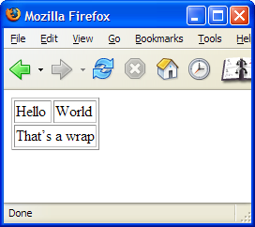
<body> Section: <table> tags
Example:
<table border=1>
<tr>
<td>Hello</td>
<td>World</td>
</tr>
<tr>
<td colspan=2>That’s a wrap</td>
</tr>
</table>
Creates a new row
Creates a
new row

Slide 31
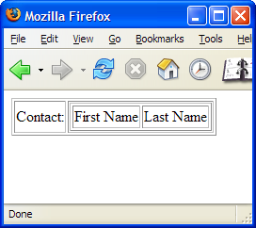
<body> Section: <table> tags
Table Data “cells” (<td>) can contain tables (tables within tables):
<table border=1>
<tr>
<td>Contact:</td>
<td>
<table border=1>
<tr>
<td>First Name</td>
<td>Last Name</td>
</tr>
</table>
</td>
</tr>
</table>

Slide 32
<body> Section: <form> tags
Forms are the primary method for gathering data from site visitors.
Create a form block with <form></form>
<form name=“myForm" method="post" action=“./path/to/script.php">

Slide 33
<body> Section: <form> tags
Hidden fields contain data that isn’t shown to user:
<input type="hidden" name=“Account#" value="This is a text field">
Text fields are single-line entry fields:
<input type="text" name="FirstName" value="This is a text field">
Text areas can contain multiple lines of text:
<textarea name=“Comments">This is a multi-line text area</textarea>

Slide 34
<body> Section: <form> tags
Create a checkbox:
<input type="checkbox" name=“fruit" value="apple">
Radio button sometimes called birdseye:
<input type="radio" name= “title" value=“Mr.">
Radio buttons can be grouped, allowing only one to be selected in the group:
<input type="radio" name=“snack" value=“chips">
<input type="radio" name=“snack" value="cookies">

Slide 35
<body> Section: <form> tags
Pull down menu:
<select name="gender">
<option value="Value 1">Male</option>
<option value="Value 2">Female</option>
<option value="Value 3">Other</option>
</select>
Submit button:
<input type="submit" name="Submit" value="Apply">

Slide 36
<body> Section: <form> Example
<form method="POST" action="http://cob.uccs.edu/courses/csm399/shared/email.php">
<input name="subject" type="hidden" value="Class Example" />
<p>Degree:
<select name="degree">
<option value="BA">Bachelor of Art</option>
<option value="BSc">Bachelor of Science</option>
<option value="MBA">Master of Business Administration</option>
<option selected="" value="PhD">Other Doctorate</option>
</select>
</p>
<p>
First Name: <input type="text" name="firstname" value="" />
</p>
<p>
Last Name: <input type="text" name="lastname" value="" />
</p>
<p>
Student ID: <input type="password" name="student#" value="" />
</p>
<p>
Gender: <input name="gender" type="radio" value="Male" /> Male&nbsp;|&nbsp;<input name="gender" type="radio" value="Female" /> Female
</p>
<p>
E-mail: <input type="text" name="email" value=“opp@knust.edu.gh" />
</p>
<p>
<textarea name="terms" cols="30" rows="4" readonly="readonly">TERMS AND CONDITIONS
By clicking the Send Form button you agree to submit this form.</textarea>
</p>
<p>
<input type="submit" name="button" value="Send Form" />
</p>
</form>

Slide 37
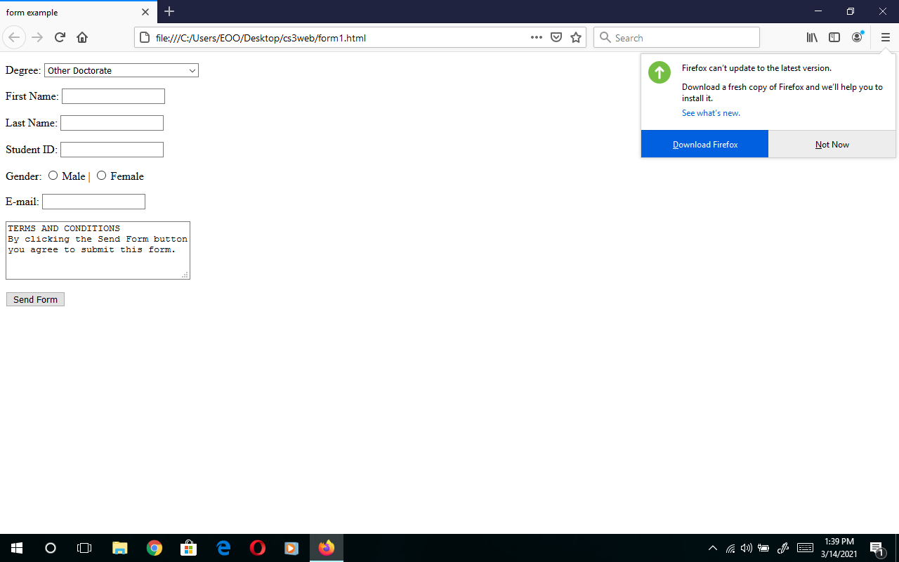
form

Slide 38
<body> Section: <div> tag
Creates logical divisions within a page
Acts as a <p>
Perfect for use with CSS

Slide 39
<body> Section: <span> tag
Span doesn’t act like a <p> tag
Useful for modifying a specific portion of text without creating a separate division in the document.
Very useful with CSS

Slide 40
HTML Resources
See www.htmlhelp.com/reference/html40/olist.html for a list of HTML tags and attributes.
Clean up HTML: http://infohound.net/tidy/

