Slide 1

Defining Visualizations’ Interaction’s Building Blocks
With the help of:
Hao Cheng
Dario Benvenuti

Slide 2
Outline
Problem statement.
Why do we need this theory?
How could we build it?
Models of Atomic Widgets.
Example of use.
Questions.

Slide 3
Problem Statement
We want to build a clear, and rigorous, definition for atomic widgets by modeling them with the simplest FSA possible.
Having that, we could enable the possibility to combine those FSA together, to model more complex widgets, and, in the end, every existing visualization.
BUILDING BLOCKS

Slide 4
Why?
Modeling every visualization from scratch can become costly and lead to ad-hoc models that work only for one particular visualization.
Well defined building Blocks could lead to a great decrease in the complexity of interaction’s modeling, leaving to the analyst/developer only to deal with the semantic.
With a really rigorous and event based definition, we could think of having, in the future, alghorithms for automated discovery of interaction’s models (e.g., by parsing the source code and looking for visual objects with event handlers).
The FSA for some widget is so simple to be just a transition.

Slide 5
How?
Top-down approach, starting from visualizations:
We can model the interaction with a FSA.
A widget could be a sub-graph of it, representing a particular sequence of steps in the interaction.
It is a graph made up by states and transitions.
Then an ATOMIC WIDGET could be just a widget containing AT MOST one state and two transitions*, representing an atomic action that the user can perform.
* We need two transitions to enter and leave the state that can potentially be in the atomic widget. If there is no state, we could still have 2 transitions to represent widgets that can be «navigated» both ways.

Slide 6
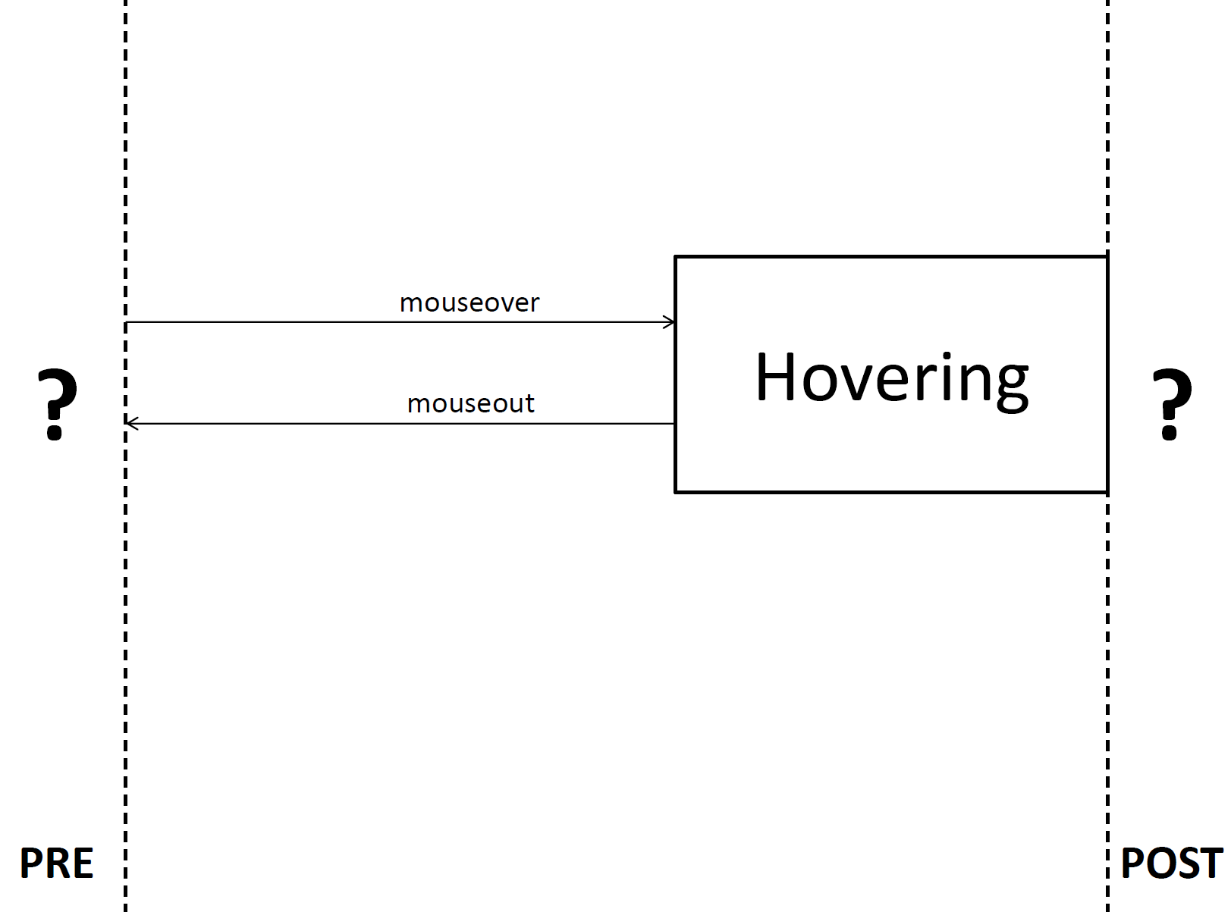
Atomic Widgets
Hovering
PRE and POST could be anything, as long as their model can be combined in a legal way with this one (e.g. we can’t have as POST for this widget something that begins with a state.

Slide 7
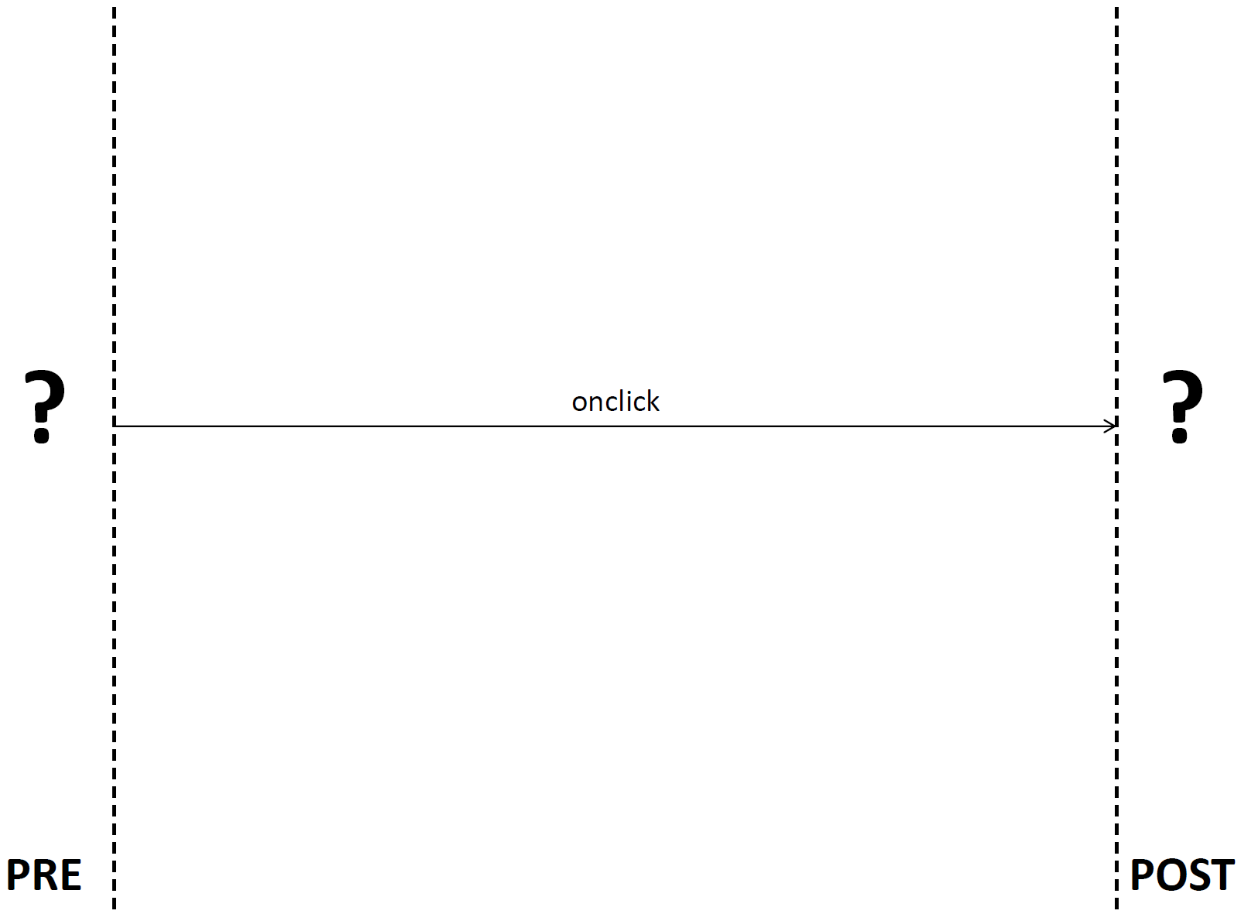
Atomic Widgets
Click
The cool thing is that PRE and POST can, of course, be other widgets, as we will see in few examples.

Slide 8
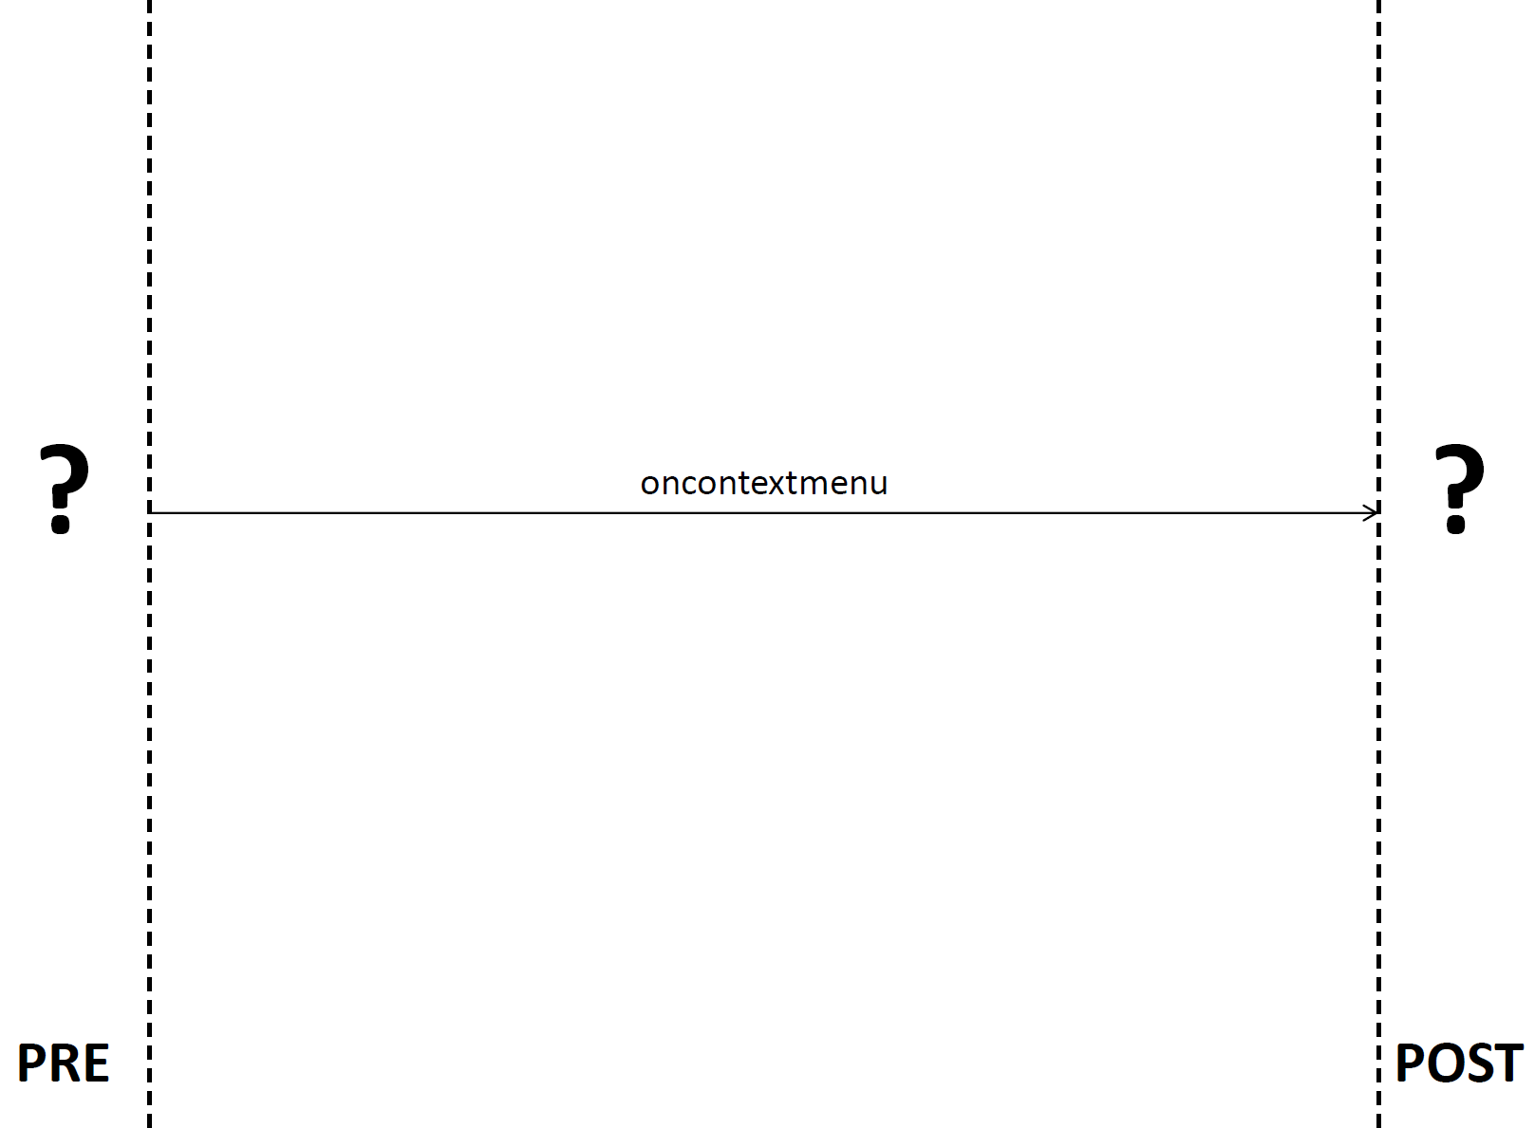
Atomic Widgets
RightClick

Slide 9
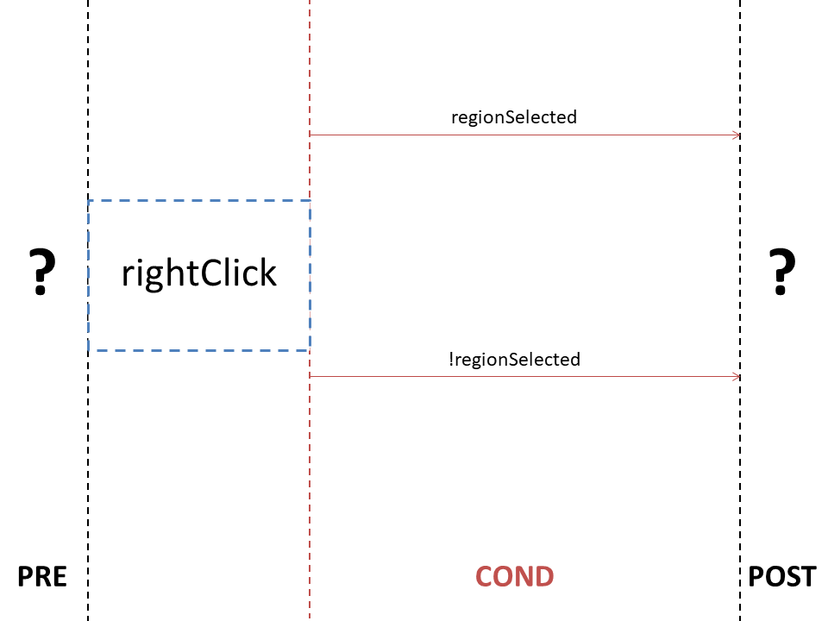
Atomic Widgets
RClick-Conditional
Here there is an example of conditions attached to the Rclick widget. By adding a COND between the widget and POST, it’s easy to model how the same transition can lead to different outcomes.

Slide 10
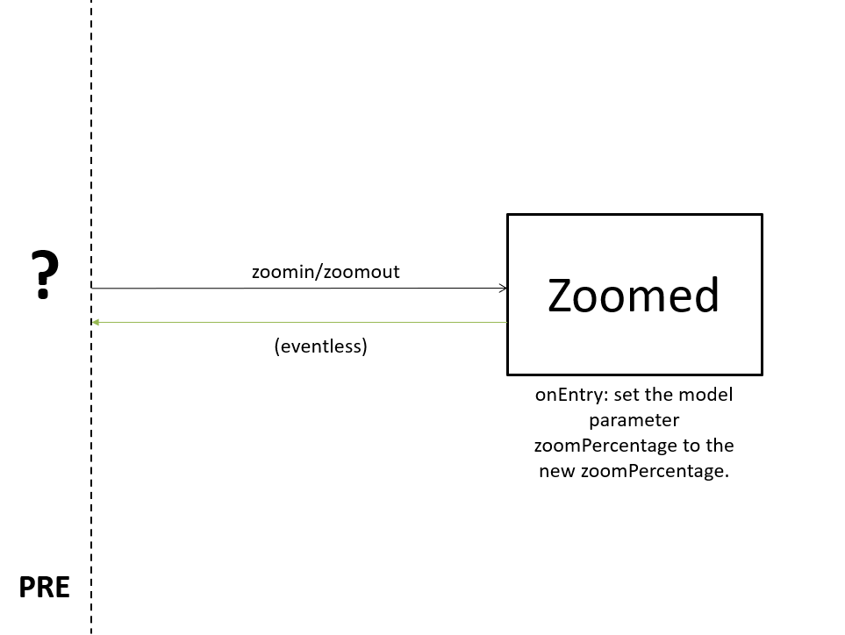
Atomic Widgets
Zoom

Slide 11
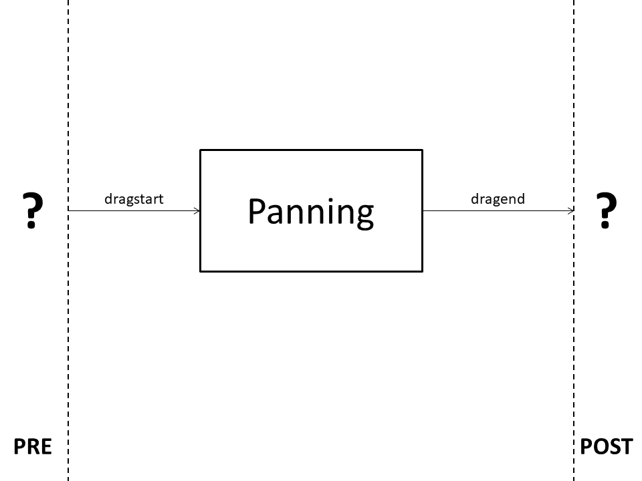
Atomic Widgets
Panning

Slide 12
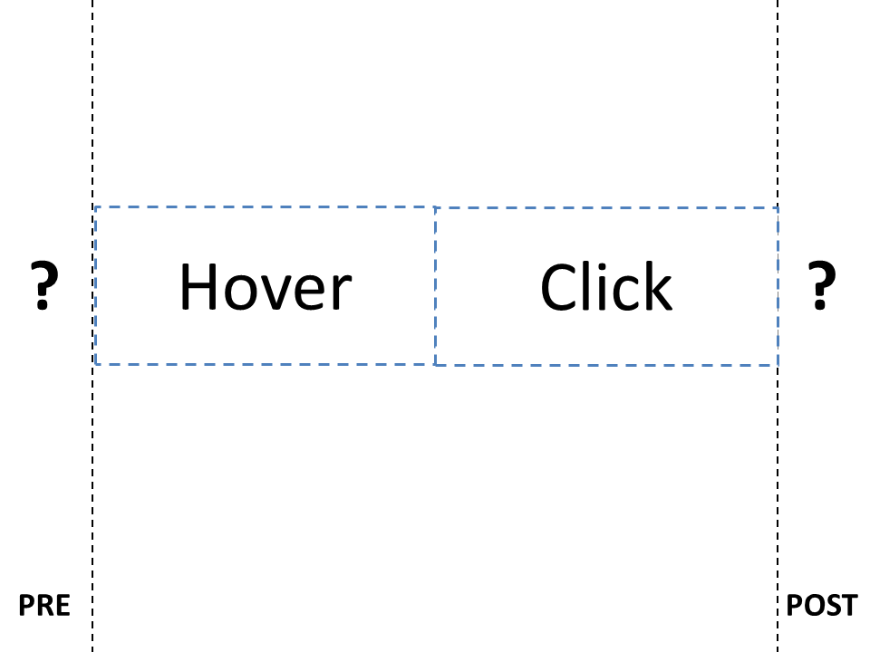
Example of Complex Widgets
Here we can see how easily atomic widgets can be combined. Of course we need to remember that «click» should be a legal POST for «hover», and that «hover» should be a legal PRE for «click».

Slide 13
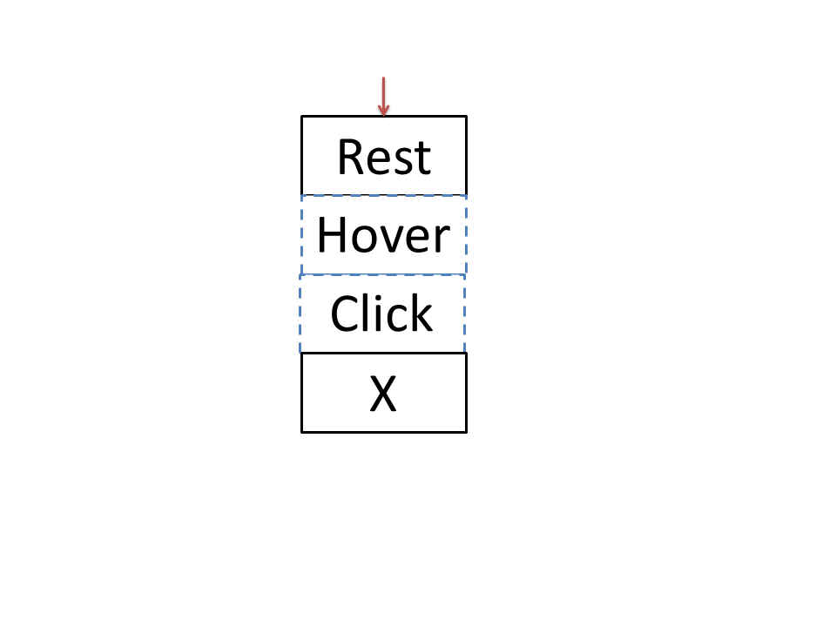
Example of use
Here there is a simple example of use, in which we are modeling something like a button. We are combining «hover» and «click» and adding at the and this X state, that represents the semantic behind the button itself.
Notice that the blue dotted boxes represent our building Blocks, while the other components of the FSA represent the semantic of the particular visualization that we are modeling.

Slide 14
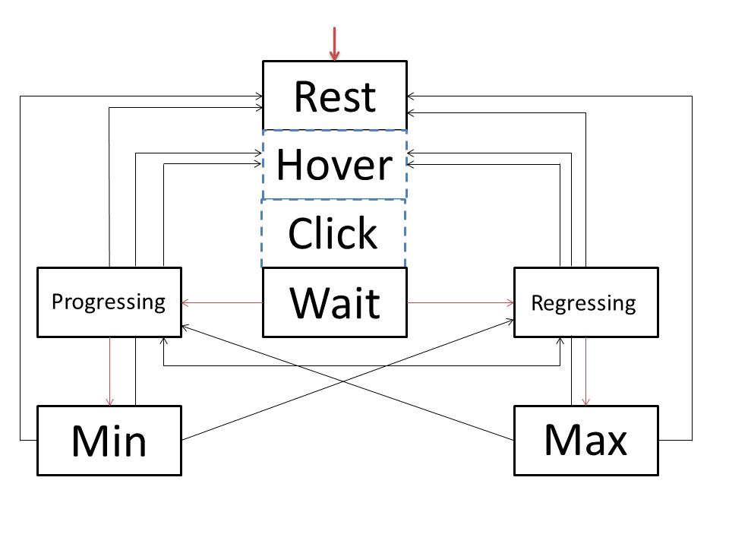
Example of use
Here we are modeling, always using a combination of «hover» and «click», one of the handles of a slider. This model could be applied to every handle of the slider, and the final state of the widget is the AND between the current state of each FSA.

Slide 15
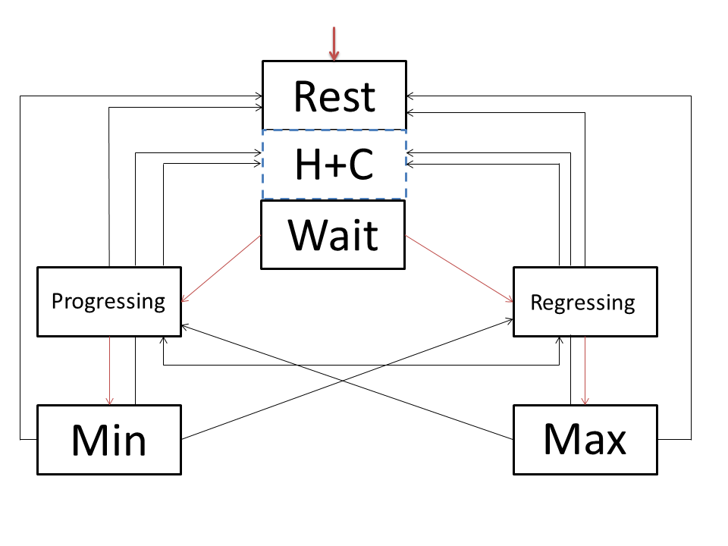
Example of use
This is the same model as the previous one, in which we exploit the building Blocks by placing both «hover» and «click» in one widget that contains both, to make the graph more readable.
Notice that transitions represented by red arrows are conditional transitions.

Slide 16
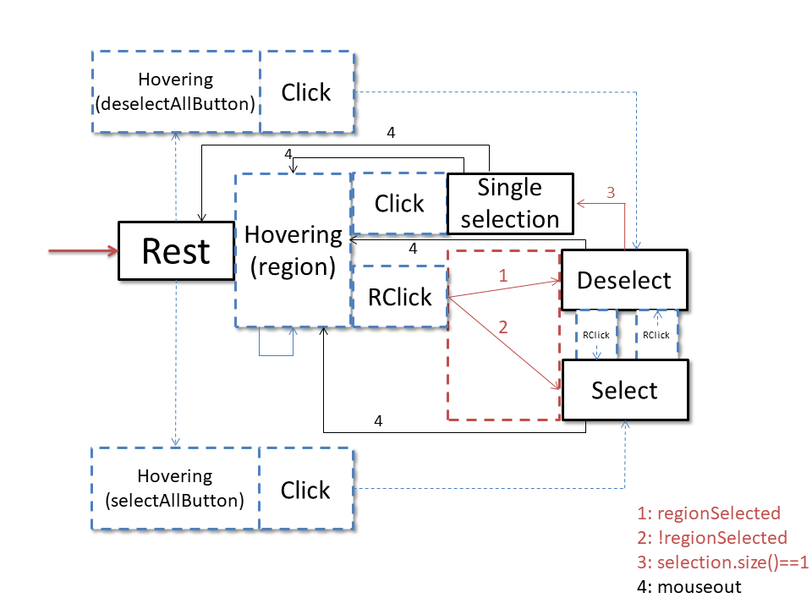
Example of use
Here, as a final test, we are modeling the brexitVisualization, using, whenever we can, our building Blocks.
Notice that blue dotted arrows are not transactions, but just a way to visualize where a brick is «attached».
The Rclick boxes between Deselect and Select have arrows inside to visualize the «direction» of the transition inside the brick.
The red dotted box represents the conditional portion of a brick.
The «hovering(region)» brick has a blue arrow going into itself because it can be POST of itself an infinite number of times.

Slide 17
Questions
Is this really what we want?
Can we really achieve the final goal?
Are there any flaws in the theory?
Is the notation (visual and not) bad?
Are there other atomic widgets?

Slide 18
Thanks for your attention!

