Slide 1
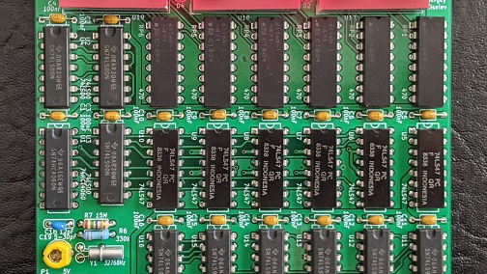

TTL CLOCK
Digital Clock Using TTL Logic
A digital clock built without hidden software
PITCH + DEMO
Name: Ensar Isci Date: 13/05/2026
Notes:
Slide 1 - Title and hook Imagine living in a world where every digital device depends on software and microcontrollers. Most modern clocks today use an Arduino or another programmable chip. They are easy to build, but you rarely see how the clock actually works internally. My project, the TTL Clock, is different.

Slide 2
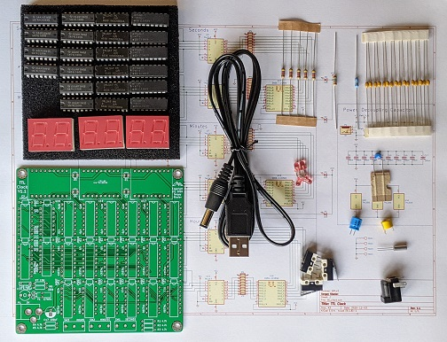
PITCH - NEED
0:30 - 1:05
The problem
Modern clocks work well, but their logic is hidden.
Software makes it easy.
Hardware shows how it really works.
Most clocks use Arduino or another programmable chip.
The result works, but the internal digital logic is almost invisible.
For a technical project, I wanted something that can be understood step by step.
Need: a project that makes digital electronics visible
TTL Clock Pitch & Demo | 2/8
Notes:
Slide 2 - The problem Most modern clocks today use an Arduino or another programmable chip. They are easy to build, but you rarely see how the clock actually works internally. That is the problem I wanted to focus on. The final product may work, but the real digital logic is hidden inside software. My project is different because it makes the hardware logic visible and understandable.

Slide 3
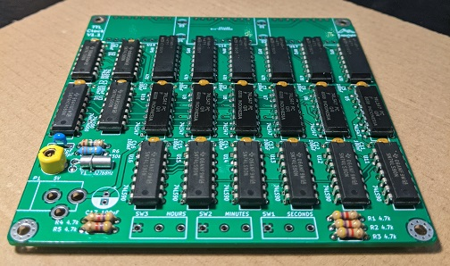
PITCH - APPROACH
1:05 - 1:45
My solution: pure TTL logic
The clock is built from real 74xx logic chips, not code.
74xx TTL ICs
Hardware logic
No microcontroller.
No firmware.
No hidden software.
Every second on the display is created by electronic circuits working together.
Based on the open-source TTL Clock by Sergey Kiselev
Open source base
TTL Clock Pitch & Demo | 3/8
Notes:
Slide 3 - The TTL Clock Instead of using software, this clock is built completely with TTL logic chips from the 74xx series. That means the clock works entirely through hardware logic. Every second that appears on the display is created by real electronic circuits working together. The project is based on the open-source TTL Clock by Sergey Kiselev. It includes PCB designs, assembly instructions, a bill of materials, and hardware files for building a complete digital clock.

Slide 4
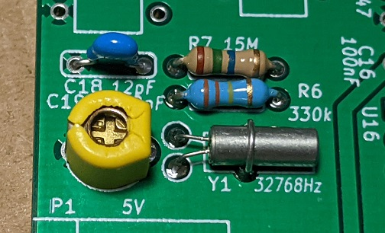
PITCH - TECHNICAL STORY
1:45 - 2:25
How the clock works
A timing signal becomes readable time.
The clock starts with a 32.768 kHz crystal oscillator. The signal is divided and processed by logic circuits and counters. Finally, decoder chips convert the values into numbers on the 7-segment displays.
32.768 kHz crystal
Oscillator
Logic
Counters
Decoders
Displays
precise timing
divide signal
sec / min / h
BCD to display
readable time
TTL Clock Pitch & Demo | 4/8
Notes:
Slide 4 - How it works What makes my project special is that it is not only functional, but also educational. It shows how digital electronics really work at a low level. Instead of programming a single chip, I use separate integrated circuits for counting, timing, decoding, and displaying numbers. The clock starts with a 32.768 kilohertz crystal oscillator, which creates a precise timing signal. That signal is divided and processed through several logic circuits and counters. Finally, the values are converted into numbers on the 7-segment displays.

Slide 5
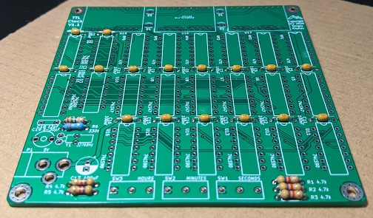
PITCH - ADVANTAGE AND COMPETITION
2:25 - 3:00
Why my project stands out
It is not just a clock - it is a visible digital system.
Main advantage: transparency
1
No microcontroller
You can physically follow how the signal moves through the system.
2
Real digital logic
3
Soldering + circuit understanding
More educational than a standard Arduino clock
4
Shows how early digital systems worked
TTL Clock Pitch & Demo | 5/8
Notes:
Slide 5 - Why it stands out The main advantage of this project is transparency. You can physically follow how the signal moves through the system. This makes the project much more interesting from an engineering perspective than a standard Arduino clock. Compared to other projects, my TTL Clock stands out because it uses no microcontroller, it demonstrates real digital logic, it combines soldering skills with circuit understanding, and it shows how computers and digital systems originally worked. So this project is not just about building a clock. It is about understanding the foundations of digital electronics.

Slide 6
DEMO - PART 1
3:00 - 4:00
Demo: power supply and oscillator
First, I show the heartbeat of the clock.
1
Stable 5 V power supply
2
32.768 kHz crystal oscillator
3
Divided into a one-second pulse
That pulse acts as the heartbeat of the clock.
TTL Clock Pitch & Demo | 6/8
Notes:
Slide 6 - Demo: power supply and oscillator First, I will show the power section of the clock. The TTL chips operate on a stable 5-volt power supply. Without stable voltage, the logic circuits and displays would not work correctly. This component is the crystal oscillator. It generates a frequency of 32.768 kilohertz, which is commonly used in digital clocks because it is very accurate. The circuit divides this frequency step by step until it creates a one-second pulse. That pulse acts as the heartbeat of the clock.

Slide 7
DEMO - PART 2
4:00 - 5:15
Demo: counters, display drivers and controls
The hardware counts time and turns it into readable numbers.
1
Counters track seconds, minutes and hours
2
Logic resets at 60 and increases the next counter
3
BCD-to-7-segment decoders drive the displays
4
Buttons adjust hours and minutes
TTL Clock Pitch & Demo | 7/8
Notes:
Slide 7 - Demo: counters, display drivers and setting the time Next, the pulse goes into the counter ICs. These counters keep track of seconds, minutes and hours. When the seconds reach 59, the logic resets them back to 00 and increases the minute counter automatically. The counter values are sent to BCD-to-7-segment decoder chips. These chips convert binary signals into readable numbers on the display. That is how the time becomes visible. Using the buttons, I can manually adjust the hours and minutes. This demonstrates that the clock is fully interactive without needing software. If the live demo does not work, I have a backup plan with screenshots, photos and a short demo video.

Slide 8
CONCLUSION
5:15 - 6:00
Conclusion
More than a digital clock.
Questions?
It is a practical demonstration of digital electronics at hardware level.
It uses pure logic circuits to generate, count and display time.
It proves that a complete digital system can be built using TTL electronics.
Source: skiselev/ttl-clock on GitHub
TTL Clock Pitch & Demo | 8/8
Notes:
Slide 8 - Conclusion What makes this project unique is that everything happens in hardware. There is no programming, no firmware and no hidden software. Every function is performed by real electronic logic circuits. That makes the project both technically challenging and educational. The TTL Clock is more than a digital clock. It is a practical demonstration of how digital electronics work at the hardware level. Instead of relying on software, this project uses pure logic circuits to generate, count and display time. My project proves that it is possible to build a fully functional digital system using only TTL electronics. And that is what makes it different from most modern clock projects. Thank you for listening. Are there any questions?

