Slide 1
Dependency Extraction
November 15, 2017

Slide 2
Ante Pimentel
Dusan Birtasevic
Francis Okoyo
Hashim Al-Helli
Richard Van
Team

Slide 3
Introduction
This presentation illustrates the effectiveness of different techniques of dependency extraction.
Dependency extraction is a step in the pipeline of Architecture recovery. It involves the extraction of file level dependencies from a source directory.
The dependency extraction techniques we’ll be contrasting are Include, srcML and Understand.
We'll explore how these techniques extract dependencies, as well as the benefits of choosing one over the other.
Notes:
Maybe take out last point

Slide 4
Derivation process
Dependency Extraction Techniques
Comparison Process
Quantitative Analysis
Qualitative Analysis
Limitations and Recommendations
Layout

Slide 5
Derivation Process
Generate dependencies using the selected tools (Include , srcML and Understand)
Develop scripts to clean up the dependency files to a more suitable format.
Analysed the volume of overlapping dependencies (occur in both) and distinct dependencies (occur in one but not the other)
Derive sample size and inspect code
Perform Quantitative and Qualitative analyses.

Slide 6
Dependency Extraction Techniques

Slide 7
Understand
Dependency Extraction Techniques
Understand is a professional tool used to extract dependencies between files in a large software system.
Designed to help maintain and understand large amount of code.
Supports many old and modern programming languages.
Understand uses Includes, Inheritance, Implementations, Function calls,Function Parameters, and many other techniques to extract dependencies.
Extracted the dependencies by exporting a CSV (Comma Separated File) ie F1,F2
It takes about ~15 - 20 mins to run depending on processor speed.

Slide 8
Include
Dependency Extraction Techniques
Script written in Java that iterates through the MySQL source code files.
Searches for #include statement only, looking for header files. If the header file exist in the mysql folder then a dependency exists (Meaning no standard library functions should be counted as a dependency).
I.e fileA contain #include <table.h> this will create a dependency between fileA and table.h if table.h exist in MySQL folder
Takes about ~5 min to run.

Slide 9
srcML
Dependency Extraction Techniques
XML representation of source code.
Gathers all C and Java files from a source directory ( in this case MySQL) and concatenates their XML representations into one file.
Keeps original information from the source code intact.
Use XML queries to manipulate data
Takes about ~3 min to run

Slide 10
Extraction Process Example (srcML)

Slide 11
srcML Method Steps
srcML Extraction Process
Convert MySQL into XML using srcML
Find MySQL dependencies using XML query
Convert XML file to CSV using Excel
Add path to dependency file
Convert CSV file to TA using perl script from lab

Slide 12
Converting MySQL to XML

Slide 13
srcML Script
Converting MySQL to XML

Slide 14
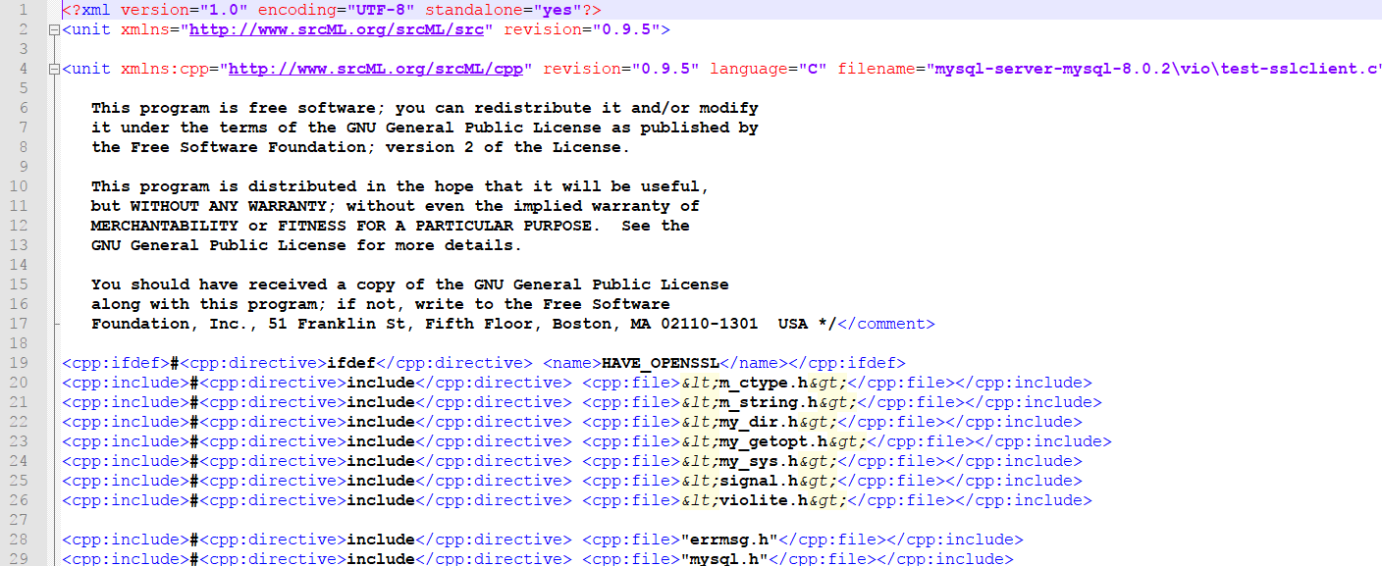
MySQL XML File
Converting MySQL to XML

Slide 15
Finding MySQL Dependencies

Slide 16
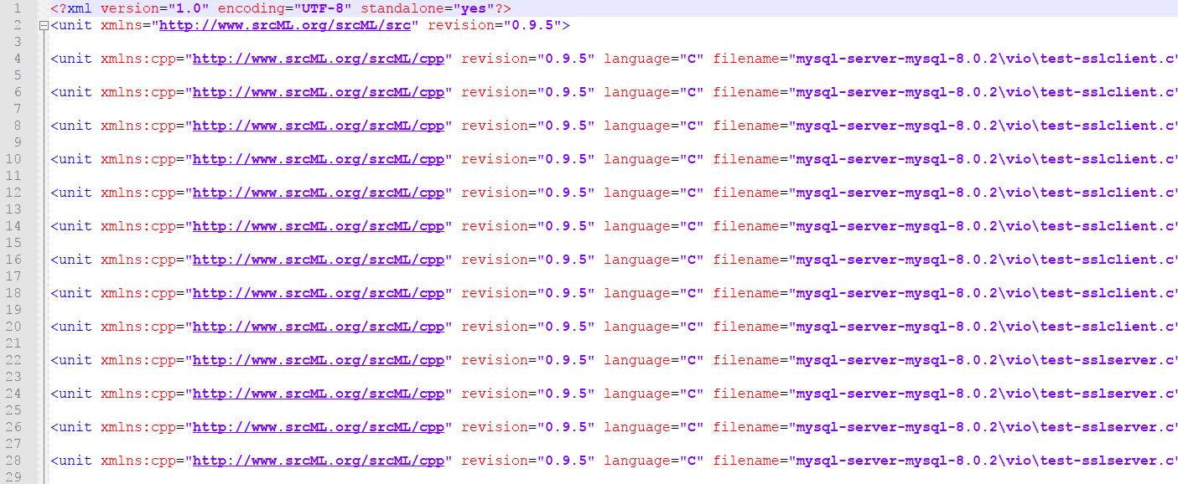
XML Query Dependencies File
Finding MySQL Dependencies

Slide 17
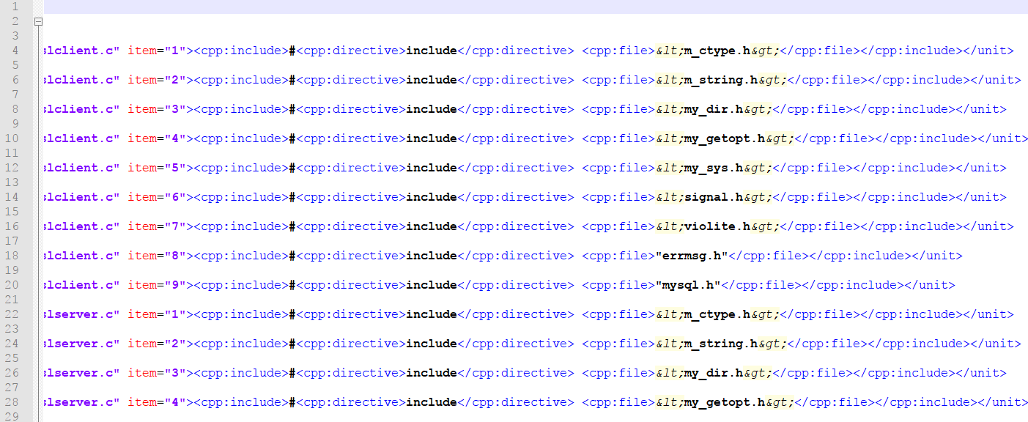
XML Query Dependencies File (2)
Finding MySQL Dependencies

Slide 18
Converting XML to CSV

Slide 19
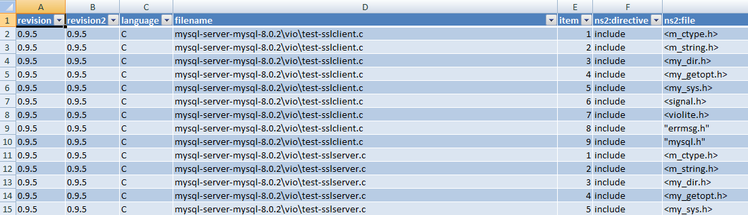
XML File in Excel
Converting XML to CSV

Slide 20
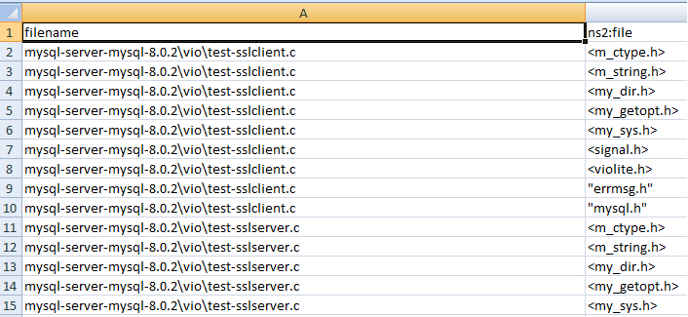
CSV File
Converting XML to CSV

Slide 21
Adding Path To Dependency

Slide 22
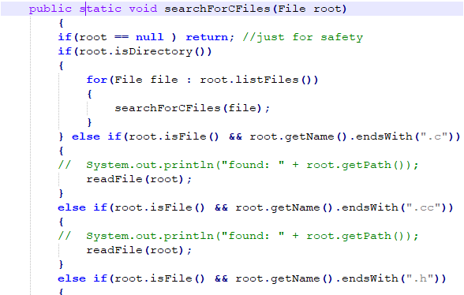
Java Find Paths File
Dependency Extraction Techniques

Slide 23
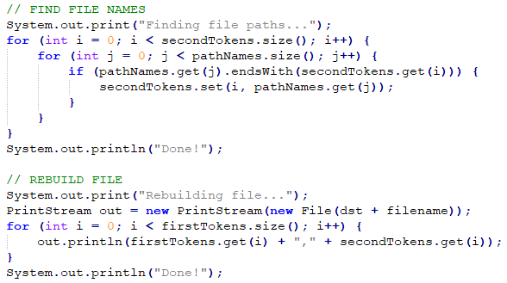
Java Add Paths File
Dependency Extraction Techniques

Slide 24
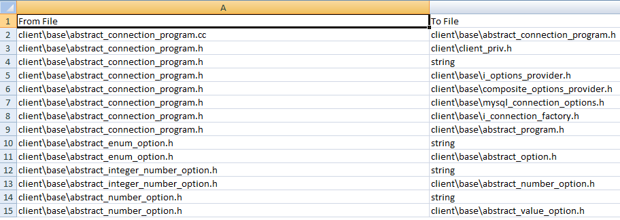
Final CSV File
Dependency Extraction Techniques

Slide 25
Converting CSV to TA

Slide 26
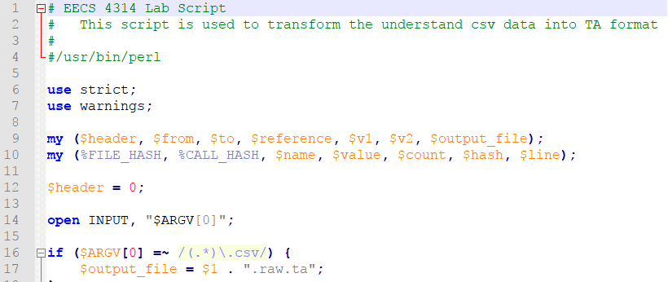
Perl Script
Dependency Extraction Techniques

Slide 27
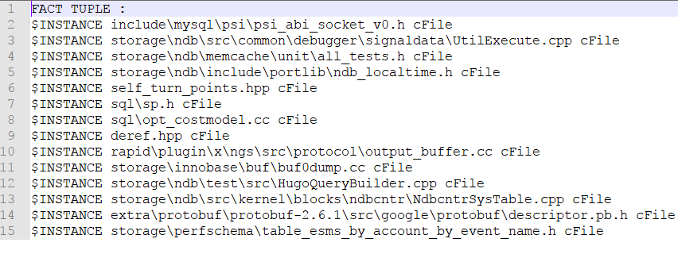
Dependency TA File
Dependency Extraction Techniques

Slide 28
srcML Method
Dependency Extraction Techniques
Produces XML representation of entire project
Provides library of XML queries
Difficult to read
Requires file clean up
Does not include dependency path

Slide 29
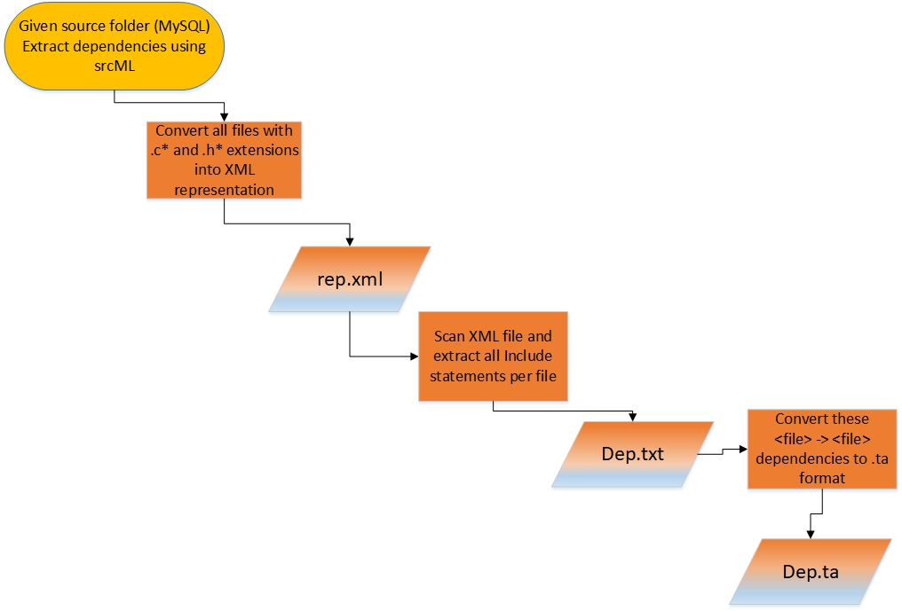
Dependency Extraction Techniques
srcML dependency extraction flow chart

Slide 30
Comparison Process

Slide 31
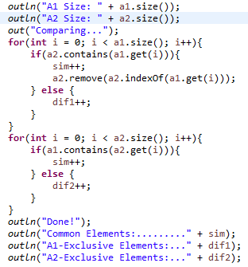
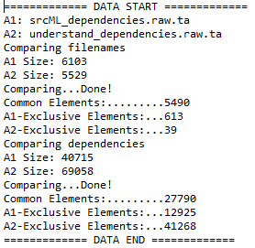
AnalyzeDependencies.java
Comparison Process

Slide 32
Quantitative Analysis

Slide 33
Understand Vs Include

Slide 34
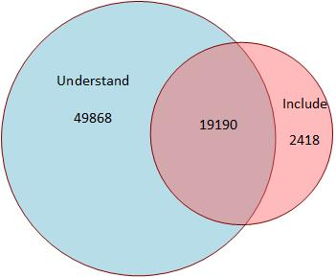
MySQL Dependencies
Quantitative Analysis
Notes:
71476 total dependencies

Slide 35
MySQL Dependencies (2)
Quantitative Analysis
Tool | Total Size | Common | Exclusion
Understand | 69058 | 19190 | 49868
Include | 21608 | 19190 | 2418
Notes:
71476 total dependencies

Slide 36
Additional Results
Quantitative Analysis
Include method finds dependencies by looking at “include” statements only.
Include method was able to get ~30% of dependencies while Understand was able to get ~97% of dependencies.
Understand method gets 67% more dependencies than include.

Slide 37
Understand Vs srcML

Slide 38
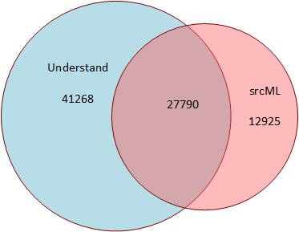
MySQL Dependencies
Quantitative Analysis

Slide 39
MySQL Dependencies (2)
Quantitative Analysis
Tool | Total Size | Common | Exclusion
Understand | 69058 | 27790 | 41268
SrcML | 40715 | 27790 | 12925
Notes:
81983 total dependencies

Slide 40
Additional Results
Quantitative Analysis
Understand method finds ~34% more dependencies than srcML
srcML method only considers “include” statements
Understand method includes dependencies at function call level
Notes:
71476 total dependencies

Slide 41
Include Vs srcML

Slide 42
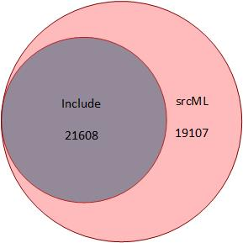
MySQL Dependencies
Quantitative Analysis

Slide 43
MySQL Dependencies (2)
Quantitative Analysis
Tool | Total Size | Common | Exclusion
Include | 21608 | 21608 | 0
SrcML | 40715 | 21608 | 19107
Notes:
71476 total dependencies

Slide 44
Additional Results
Quantitative Analysis
srcML method finds ~47% more dependencies than Include method
Due to bug in Include script that excludes some “include” statements wrapped around extra spaces or comments, ie:
#include <mysqld_error.h> /* to check server error codes */
Notes:
71476 total dependencies for understand and include

Slide 45
Qualitative Analysis

Slide 46
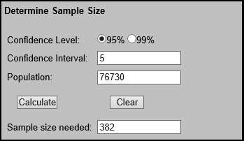
Determining Sample Size
Qualitative Analysis
Used online calculator from Creative Research Systems

Slide 47
Understand Vs srcML

Slide 48
Dependencies found by Understand
Qualitative Analysis
mysql-server-mysql-8.0.2\storage\ndb\src\mgmsrv\InitConfigFileParser.cpp → mysql-server-mysql-8.0.2\storage\ndb\src\common\util\require.c
Although require.c isn't directly imported by InitConfigFileParser.cpp , Understand wa still able to catch the indirect dependencies between these files.
InitConfigFileParser.cpp uses a “require” feature that is implemented in different ways in a file called ndb_global.h.
ndb_global uses a version of the “require” feature that is implemented in require.c
Understand
vs
srcML

Slide 49
Dependencies found by scrML
Qualitative Analysis
mysql-server-mysql-8.0.2\storage\innobase\row\row0upd.cc → mysql-server-mysql-8.0.2\extra\rapidjson\include\rapidjson\msinttypes\inttypes.h
This is an example of one of the many unneeded dependencies captured by the srcML method.
Because of the nature of the srcML extraction method, this dependency was picked up merely because the inttypes.h file was included in the header. Features from it werent actually used.
Understand was smart enough to see this and exclude it from its generated dependencies.
Understand
vs
srcML

Slide 50
Dependencies found by both
Qualitative Analysis
Storage\innobase\handler\i_s.cc → storage\innobase\include\btr0btr.h
Functionality from btr0btr.h is used in i_s.cc. Namely btr_page_get_index_id(page).
storage\ndb\src\kernel\blocks\trix\Trix.cpp → storage\ndb\include\kernel\signaldata\WaitGCP.hpp
WaitGCPReq and WaitGCPConf
Understand
vs
srcML

Slide 51
Understand Vs Include

Slide 52
Dependencies found by Understand Only
Qualitative Analysis
mysql-server-mysql-8.0.2\vio\vioshm.cc → mysql-server-mysql-8.0.2\include\ my_io.h
the reason is that vioshm.cc uses a macro named SOCKET_ETIMEDOUT that is defined inside the my_io.h file
Understand was able to get this dependency through macro usage even though the file vioshm.cc did not include the header my_io.h
Understand
vs
Include
Notes:
mysql-server-mysql-8.0.2\vio\vioshm.cc mysql_socket.h
mysql-server-mysql-8.0.2\vio\vioshm.cc violite.h
mysql-server-mysql-8.0.2\vio\vioshm.cc uca9-dump.cc
mysql-server-mysql-8.0.2\vio\vioshm.cc vio.cc
mysql-server-mysql-8.0.2\vio\viosocket.cc dbug.c
mysql-server-mysql-8.0.2\vio\viosocket.cc time.h
And Many more...

Slide 53
Dependencies found by Include Only
Qualitative Analysis
mysql-server-mysql-8.0.2\client\mysql.cc →mysql-server-mysql-8.0.2\extra\libedit\editline\ readline.h
It was found that mysql.cc doesn’t use any function from readline.h therefore its inclusion there is redundant.
Understand was smart enough not to depend only on includes but also searched if it was actually being used.
Understand
vs
Include
Notes:
mysql-server-mysql-8.0.2\components\mysql_server\dynamic_loader_scheme_file.cc dlfcn.h
mysql-server-mysql-8.0.2\extra\libevent\devpoll.c config.h
mysql-server-mysql-8.0.2\extra\libevent\epoll.c config.h
mysql-server-mysql-8.0.2\extra\libevent\evbuffer.c config.h
mysql-server-mysql-8.0.2\extra\libevent\evdns.c config.h
mysql-server-mysql-8.0.2\extra\libevent\evdns.c time.h

Slide 54
Dependencies found by both
Qualitative Analysis
msql-server-mysql-8.0.2\client\base\abstract_connection_program.cc→mysql-server-mysql-8.0.2\client\base\abstract_connection_program.h
It is found in both because of Include statement as well as function usage
Understand
vs
Include

Slide 55
Include Vs srcML

Slide 56
Dependencies found by Include
Qualitative Analysis
Everything found in Include is found in srcML since srcML extracted dependencies based on include directives as well.
Include
vs
srcML

Slide 57
Dependencies found by srcML
Qualitative Analysis
***** Dependencies.txt
client\base\simple_option.cc → mysql-server-mysql-8.0.2\client\base\simple_option.h
client\base\simple_option.h → mysql-server-mysql-8.0.2\include\my_getopt.h
***** SRCML_DEPENDENCIES.TXT
Client\base\simple_option.cc → mysql-server-mysql-8.0.2\client\base\simple_option.h
client\base\simple_option.cc → stddef.h - Standard System library Include script does not take Standard System library headers
client\base\simple_option.h → string - Include Script considered only headers with.h extensions
client\base\simple_option.h → mysql-server-mysql-8.0.2\include\my_getopt.h
Include
vs
srcML

Slide 58
Dependencies found by both
Qualitative Analysis
Comparing files Dependencies.txt and SRCML_DEPENDENCIES.TXT
***** Dependencies.txt
client\base\abstract_connection_program.h → mysql-server-mysql-8.0.2\client\ client_priv.h
client\base\abstract_connection_program.h→mysql-server-mysql-8.0.2\client\base\i_options_provider.h
***** SRCML_DEPENDENCIES.TXT
client\base\abstract_connection_program.h → mysql-server-mysql-8.0.2\client\ client_priv.h
client\base\abstract_connection_program.h→mysql-server-mysql-8.0.2\client\base\i_options_provider.h
*****
Include
vs
srcML

Slide 59


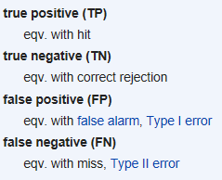
Precision and Recall
Qualitative Analysis
Precision: How many selected items are relevant
Recall: How many relevant items are selected

Slide 60
Include Vs srcML Example
Qualitative Analysis
TP = 381 (Common Dependencies)
FP = 195 (Exclusive Dependencies)
FN = 0 (Dependencies in sample size not present)
Precision = TP/(TP + FP) = 381/576 = 0.66 = 66%
Recall = TP/(TP + FN) = 381/381 = 1 = 100%

Slide 61
Risks and Implications

Slide 62
Potential Risks
Risks and Implications
Finding dependencies only based on import statements
Allows for unexpected/unnecessary dependencies.
Confidence Interval picked arbitrarily
May not suit observed data (dependencies)
Qualitative Analysis uses pseudo-random generated dependencies
rand() uses normal dist. Dependencies may be distributed differently
Script for Include method overlooks certain dependencies
Affects comparison results

Slide 63
Lessons Learned
There are various approaches to dependency extraction; such as function calls, include/import statements, inheritance (OOP only), etc.
Each approach may give different solution as a result of the variant extraction processes.
Understand provides more relations and is more inclusive.
Include provides a more compact list but it may skip important dependencies by not analyzing function calls.
Additional scripts required for formatting and output

Slide 64
Question Period

